Slide 1
Library Catalogues and Digital Repositories
Steve Cooney: April 2022

Slide 2
Libraries: Value in Baha’i terms
Libraries are part of the Institution of the Haziratu'l-Quds …whether local or national, will, as its component parts, such as the Secretariat, the Treasury, the Archives, the Library, the Publishing Office, the Assembly Hall, the Council Chamber, the Pilgrims' Hostel, are brought together and made jointly to operate in one spot, be increasingly regarded as the focus of all Bahá'í administrative activity, and symbolize, in a befitting manner, the ideal of service animating the Bahá'í community in its relation alike to the Faith and to mankind in genera – God Passes by 339-40

Slide 3
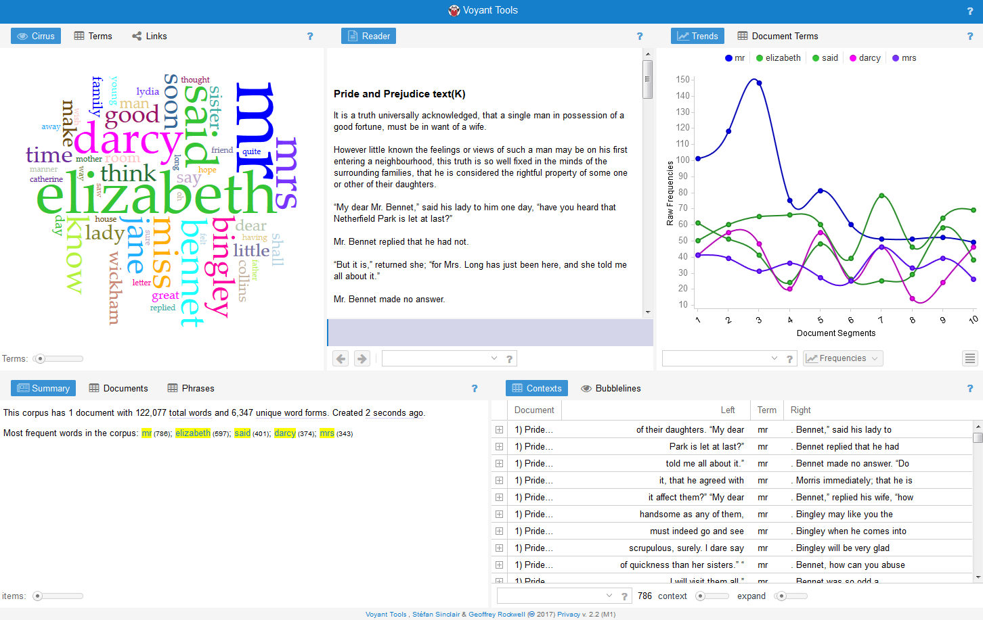
Note on Digital Humanities
Library catalogues represent one facet of an ever growing and ever expanding field of digital humanities.
This represents a computational turn in humanities.
More than digitisation can include textual analysis, hypertext, data mining, statistical analysis. Digital mappingvisualization and graph or networks tools

Slide 4
Searchable Cataloguing
The key thing is being able to find information
I am driven by improving the quality of research output by building on our existing body of published work so we are always advancing forward
So I am interested in a search engine rather than the minutiae of shelving systems and where to physically place materials.
The purpose is to reduce the unknowns

Slide 5
The Idea of a Union Catalogue: Cataloguing something you don’t possess.
There are several possibilities here. One is to have a catalogue that aggregates local libraries into a union catalogue. So you would record a bibliographic held in a local library but identify the holdings held in other places

Slide 6
Want Lists
Every library has gaps, specialised areas it wants to develop (say in my case New Zealand material.
Want lists are made much easier when you have a working catalogue. Potential contributors/donaters can see your gaps.
Crowd sourcing new material.

Slide 7
Evolving the National Baha’i Reference Library: Digital Repositories
Ingestion: Archivematica: CERN Open Source Project
Presentation: AtoM : Access to Memory (international Council on Archives)
More Standards to Comprehend:METS, PREMIS, Dublin Core, the Library of Congress BagIt

Slide 8
Standards: MARC (Machine Readable Cataloging)
Variants MARC21 (MARC for the 21st century) Esp US and Canada
UNIMARC (International Federation of Library Associations
MARCXML (Human readable, more or less)
Widespread so inertia for change is high
BIBFRAME is the successor

Slide 9
Collection Policy and Scope
Broad and catholic collection of materials
Primarily in English but also the languages of Polynesia and Melanesia because there are significant members of these communities in New Zealand.
Best efforts in terms of the languages of revelation. This is currently quite incomplete but expected to be filled out as the current generation of Iranians pass away. We will enrich these catalogues with digital material eventually
Other “foreign” languages where the material is significant, original, the only source for material: Persian, Arabic, Spanish, French, German, Portuguese, Russian. So this means we do not keep translations of Baha’u’llah and the New Era or other common materials but we do have, for example, a significant collection of Vahid Rafati’s works

Slide 10
Software Tools: Koha
Koha https://koha-community.org/ Horowhenua Library Trust 1999 Rural region of New Zealand
Koha in Te Reo Maori means gift Commercial Forks – LibLime known as Bibliovation Commercial Hosting of Koha: https://koha-community.org/support/paid-support/country/ https://bywatersolutions.com/ https://www.catalyst.net.nz/koha

Slide 11
Challenges: Cataloguing Edited Volumes
In some cases we have collected volumes of quite disparate material and then it becomes a cataloguing challenge of how to classify the material
Other cases are where we have an edited volume with a Bahaí chapter. First issue is whether to acquire the volume https://library.abs.org.nz/cgi-bin/koha/opac-detail.pl?biblionumber=30180

Slide 12
Challenges: Subject Authorities
Key aspect of Bibliographic Control: Categorization and Classification
Library of Congress Authorities
https://authorities.loc.gov/
Library of Congress Linked Data https://id.loc.gov/
See also Publications by William Collins in Cataloging and Classification Quarterly
Collins, W. P. (1987). "Classification of Materials on the Bahá'í Religion : Expansion of Library of Congress BP300-395." Cataloging & Classification Quarterly (Binghamton, N.Y.) 8: 99-133.
Collins, W. P. (1993). "Classification for Materials on the Bahá'í Religion : A "B200" Schedule Based on the Dewey Decimal Classification - Part 1." Cataloging & Classification Quarterly (Binghamton, N.Y.) 16(4): 103-121.
Collins, W. P. (1993). "Classification for Materials on the Bahá'í Religion : A "B200" Schedule Based on the Dewey Decimal Classification - Part 2." Cataloging & Classification Quarterly (Binghamton, N.Y.) 18(2): 71-86.

Slide 13
Challenges: Editions
Every book retained requires storage space and maintenance overheads. The question of which editions to keep needs to be considered.
Do you need to acquire every edition of say Lights of Guidance?
Do you need multiple editions of the Guardians writings which have different prefaces and forewords but the body of the text is unchanged.?

Slide 14
Challenges: Link Rot
It is impossible to guarantee that a digital artifact will be where you found it when you go back.
Manage your own reliable store of digital documents

Slide 15
Challenges: Print on Demand/Self Publishing
Missing metadata (Publisher, date of publication, ISBN, Place of publication)

Slide 16
Challenges: Kindle only Publications, Digital Rights Management, Licensing
Some Bahaí material is only available in Kindle format, licensed from Amazon to an individual person. This makes it difficult to have a holding of this title although it is always possible to have a bibliographic record.
Amazon Kindle titles are not generally available through libraries although there is software integration with Amazon

Slide 17
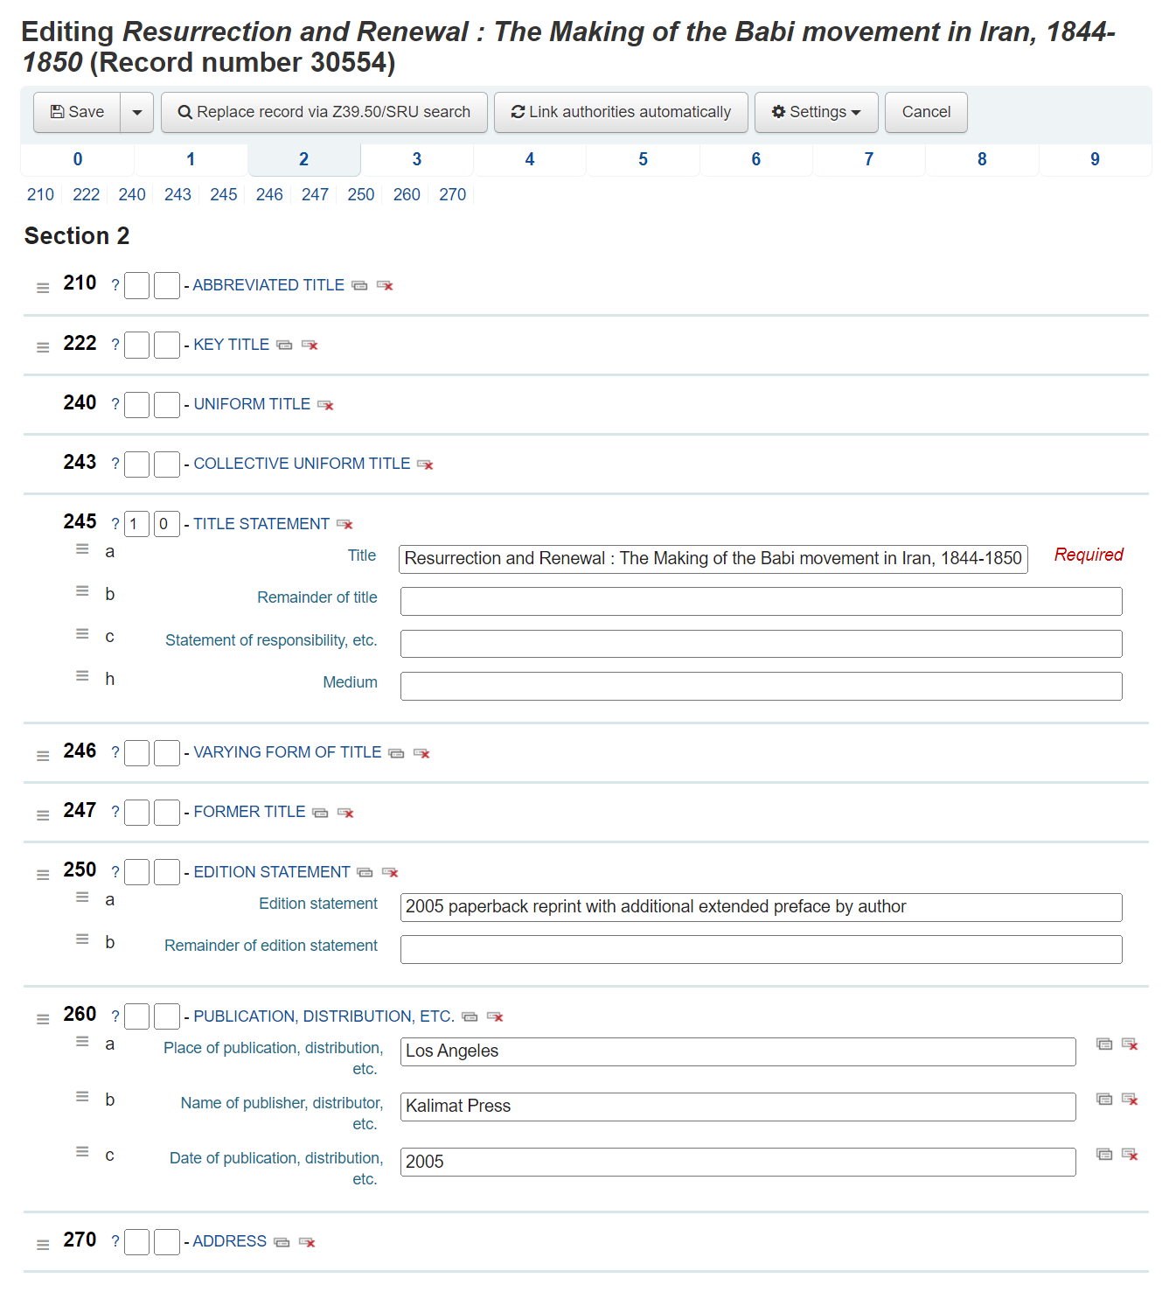
Cataloguing in Koha

Slide 18
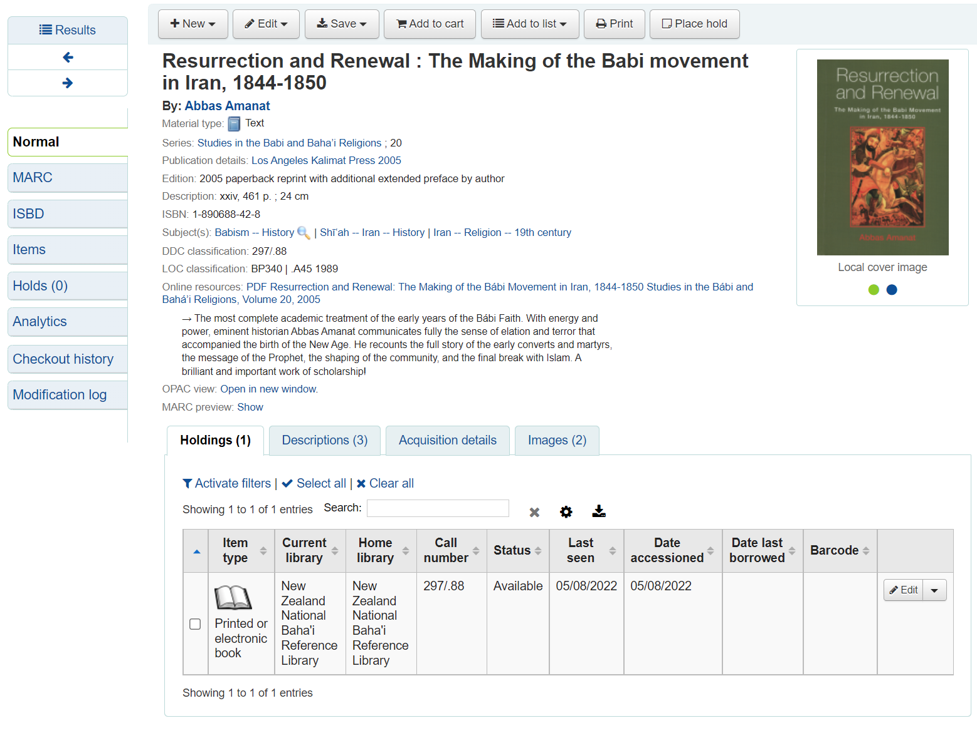
Cataloguing View

Slide 19
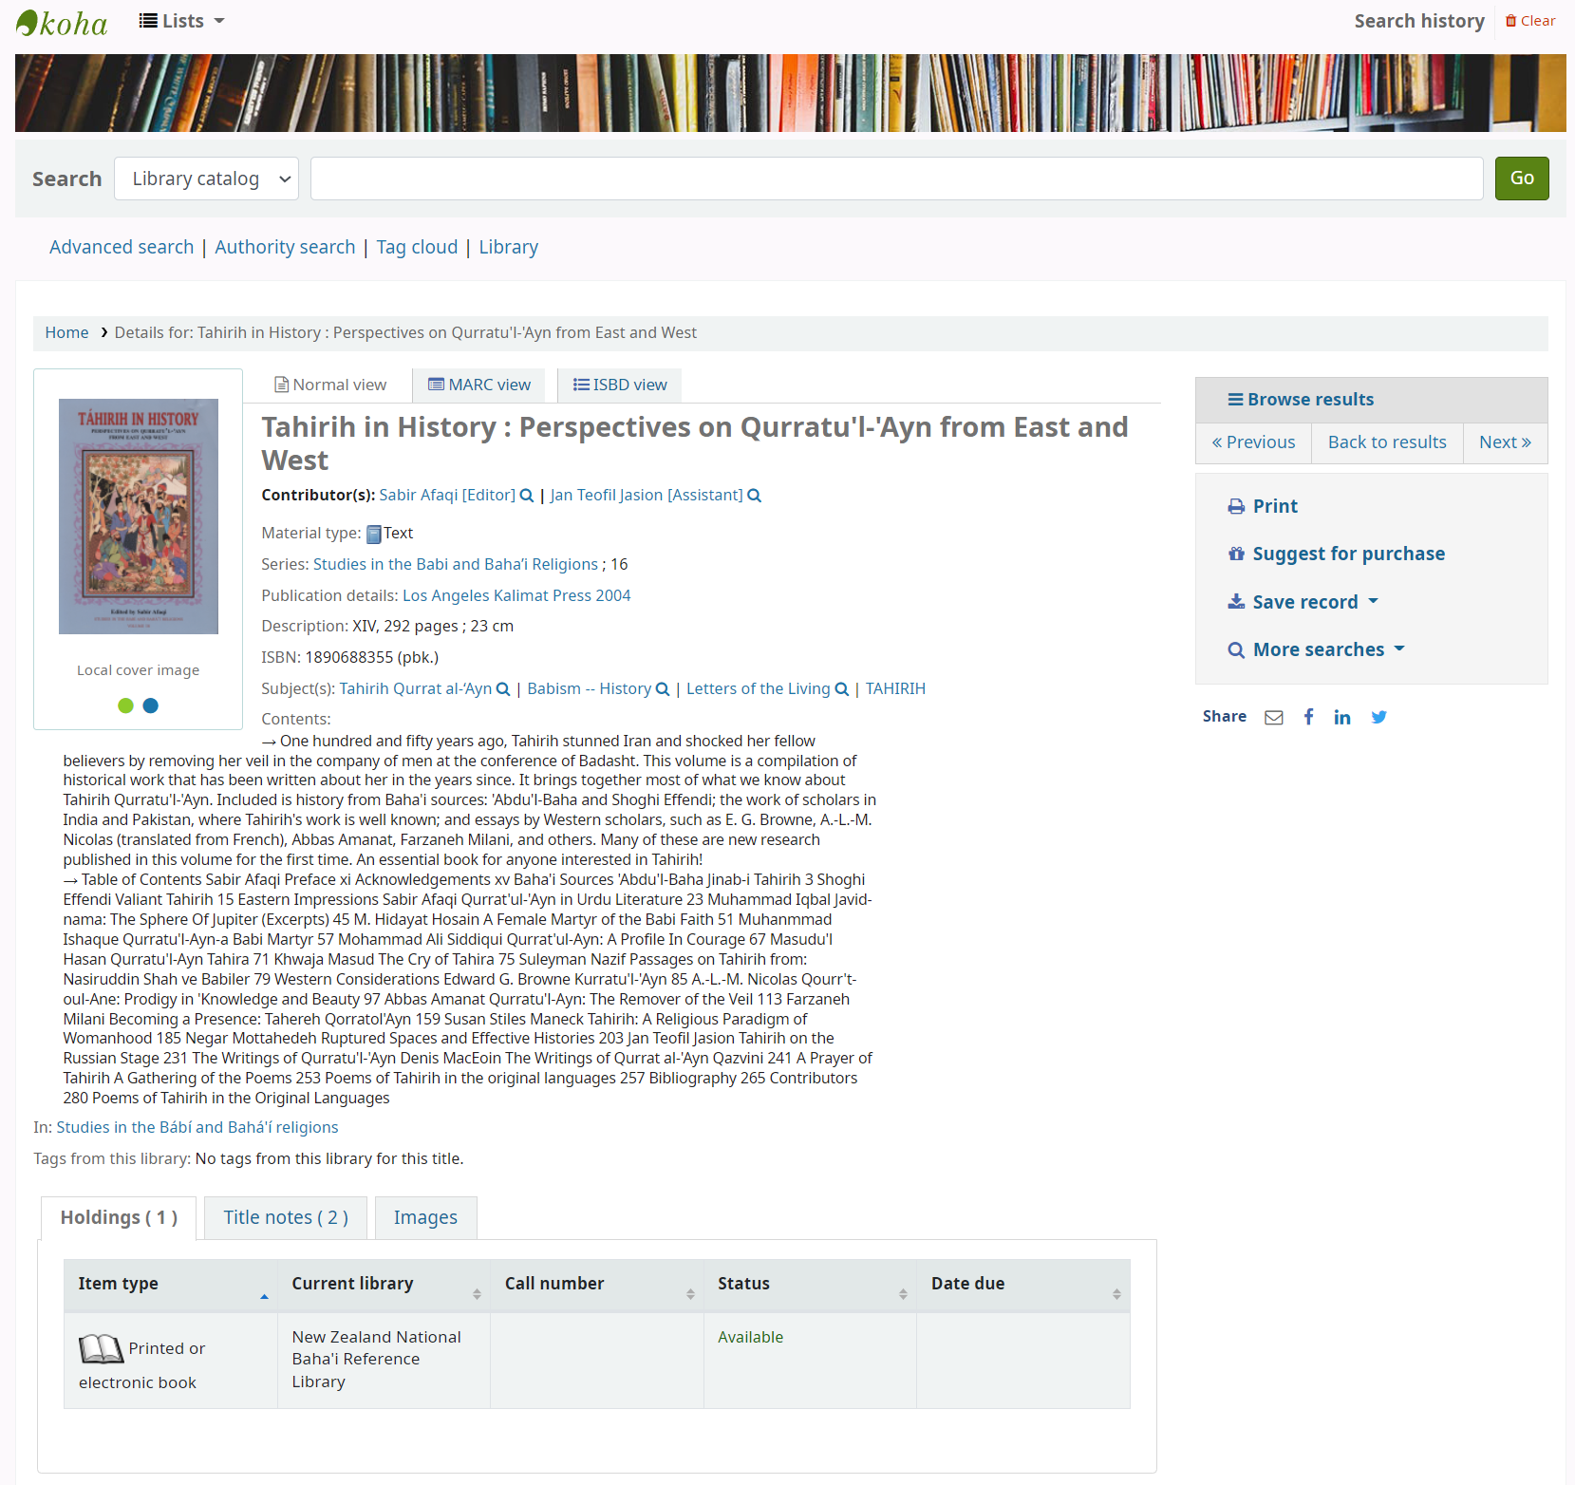
OPAC View
Development site: https://library.abs.org.nz/

Slide 20
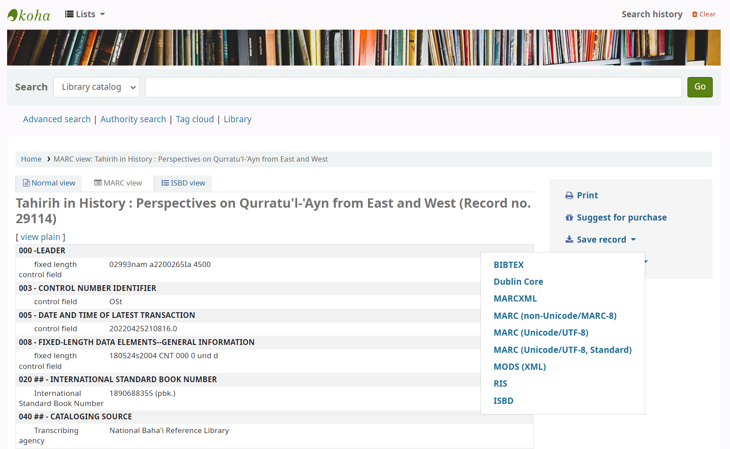
MARC View From OPAC This allows export of the bibliographic record to bibliograph collection tools (e.g. BibTex, RIS)

Slide 21
MARC21 and Classification Resources
MARC 21 Format for Bibliographic Data
https://www.loc.gov/marc/bibliographic/
RDA Steering Committee
http://www.rda-rsc.org/
C# MARC Editor
https://csharpmarc.net/
MarcEdit
https://marcedit.reeset.net/

