Slide 1

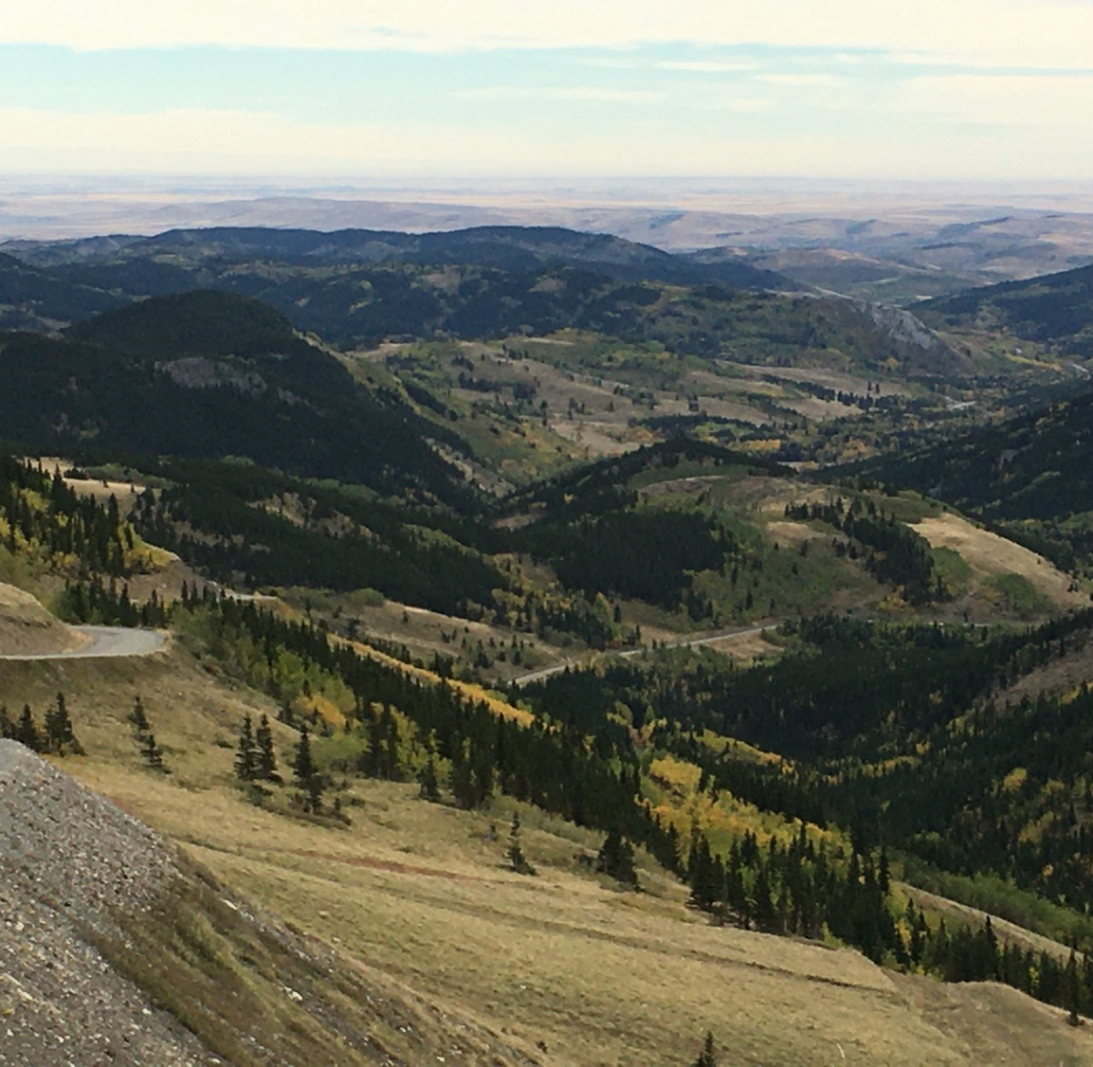
The Distance Traversed:
Looking back...

Slide 2
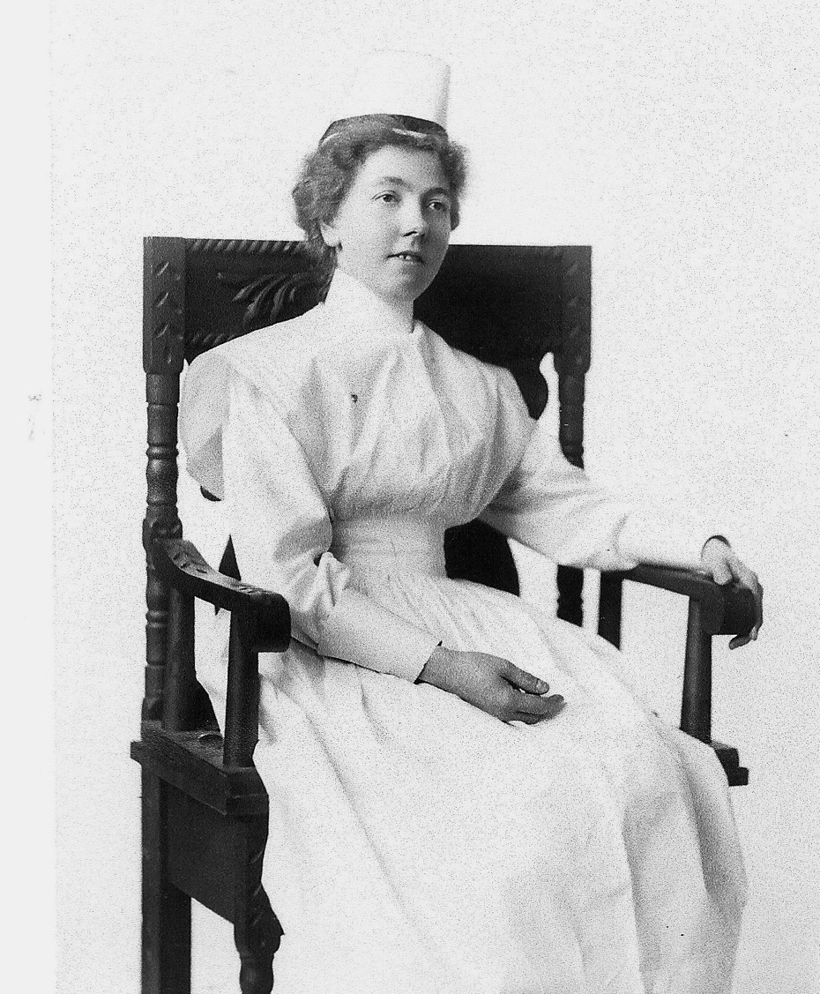
Esther Rennels hears of the Bahá’í Faith in Chicago, and lives in Edmonton from 1911 – 1917, then loses contact…
1912: Mabel Pine (photo at right) arrives in Edmonton and graduates from Nursing School in 1914.
In 1925, she hears of the Bahá’í Faith in BC and immediately accepts it.
She stays in Alberta, begins Bahá’í meetings and spends the rest of her life promoting the new Faith.

Slide 3
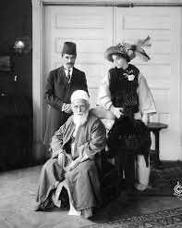
Famous early visitors
1912: Ali Kuli Khan, Persian Bahá’í diplomat in Washington DC, visits Lethbridge, attending an agricultural conference.
Here he is with his wife, entertaining Abdul-Baha in Washington in 1911.

Slide 4
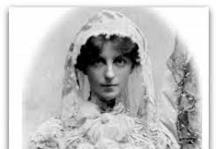
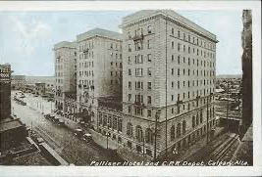
1934: First talk on the Bahá’í Faith given in Calgary
May Maxwell arrives by train at the Palliser Hotel (9Ave & 1 St. SW) Calgary. She speaks to a women’s Peace Club.
The hotel’s architect is her husband, William Sutherland Maxwell of Montreal.

Slide 5
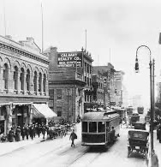
1939
Doris Skinner ‘pioneers’ to Calgary from Vancouver. She begins Bahá’í meetings in her home.
She meets Dorothy Sheets, who becomes the first Calgarian to enroll as a Bahá’í (in 1941)

Slide 6
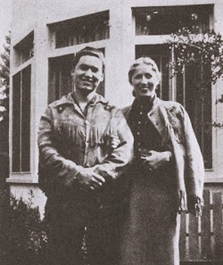
1947: Noel Wuttenee, a Cree artist living in Calgary, becomes the first Indigenous person to enroll as a Bahá’í in Canada.

Slide 7
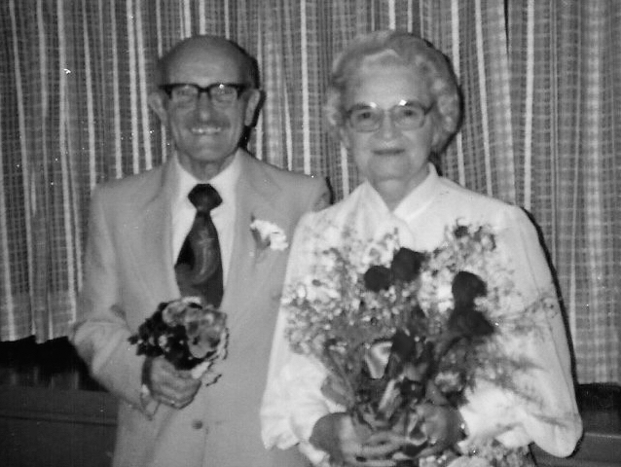
1956: Arthur & Lily Ann Irwin move to Calgary and begin visiting Piikani First Nation (then known as Peigan Reserve)

Slide 8
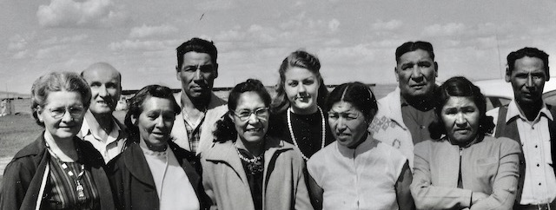
1961: An early group at Piikani investigating the Bahá’í Teachings

Slide 9
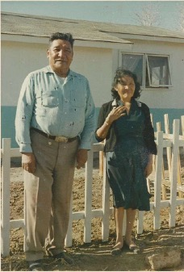
.
Samson & Rosie Knowlton are searching for a Faith that they can wholeheartedly believe in.

Slide 10
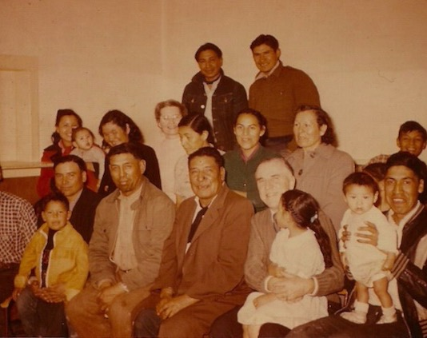
Hand of the Cause of God, John Robarts visits in 1959.
He is seated front row holding a little girl.

Slide 11
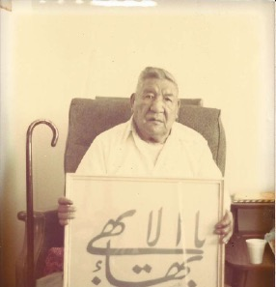
This is Samson’s story…

Slide 12
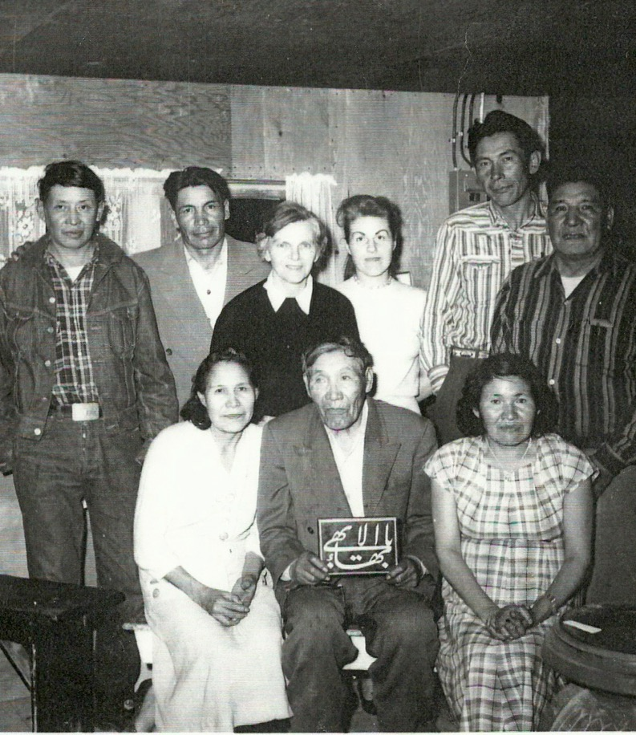
First Spiritual Assembly of the Bahá’ís of Piikani, formed in 1961

Slide 13
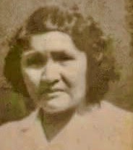
Rosie’s guestbook: entries from 1960 to 1965

Slide 14
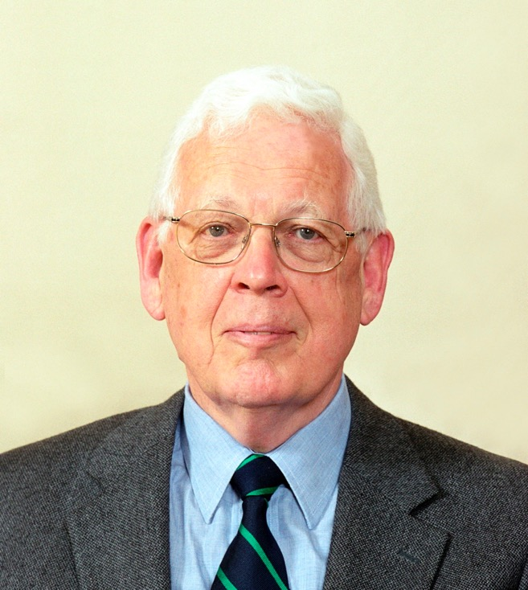
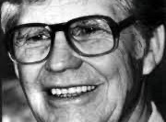
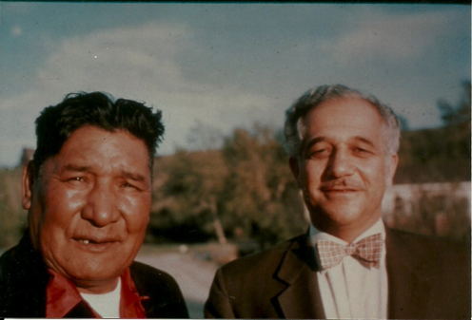
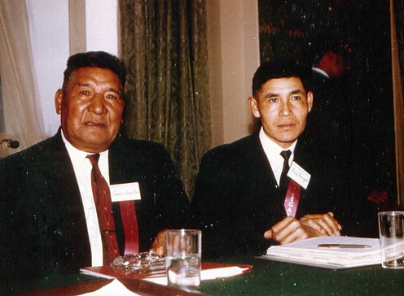
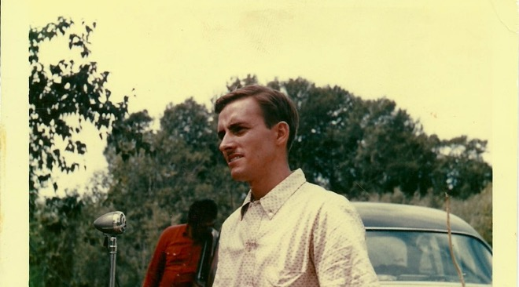
Distinguished visitors to Piikani whose names also appear in Rosie’s guestbook:
Hasan Balyuzi
Agnes Harrison
Doug Crawford
Angus Cowan
Reg Wilson
Dorothy Francis
Harvey Iron Eagle
Henry Keg
Douglas Martin
Peggy Ross & many more

Slide 15
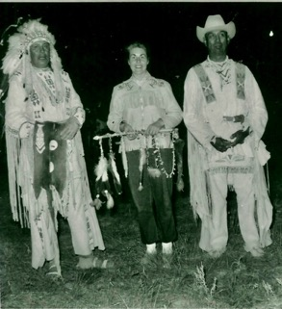
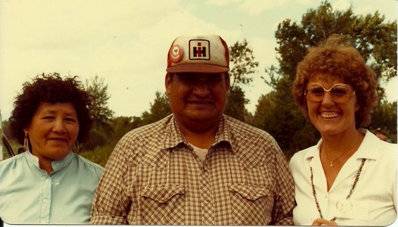
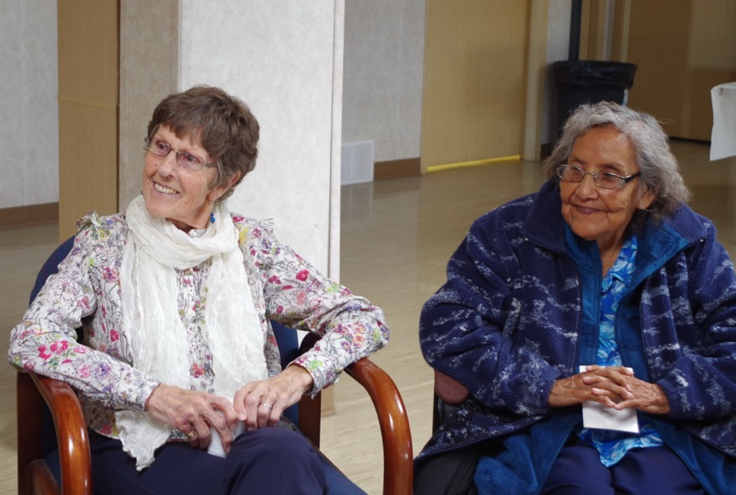
Dale Lillico arrives in 1959, marries a local rancher and spends the rest of her life, dear friends of the Piikani people

Slide 16
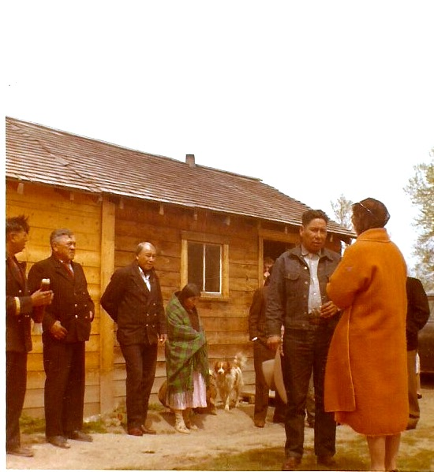
May 21, 1960 Ruhiyyih Khanums first visit to Piikani

Slide 17
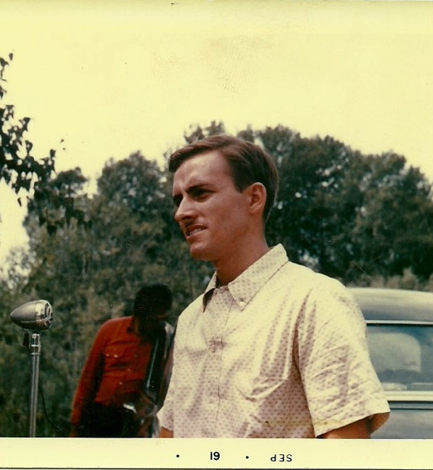
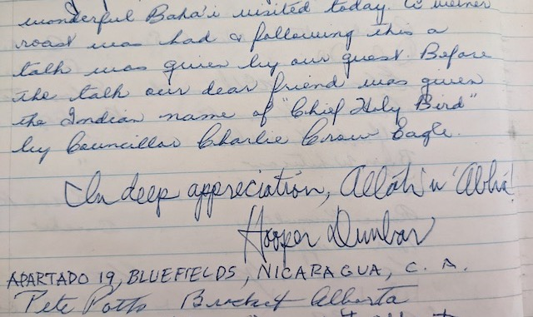
A young Hooper Dunbar visits
July 24, 1962

Slide 18
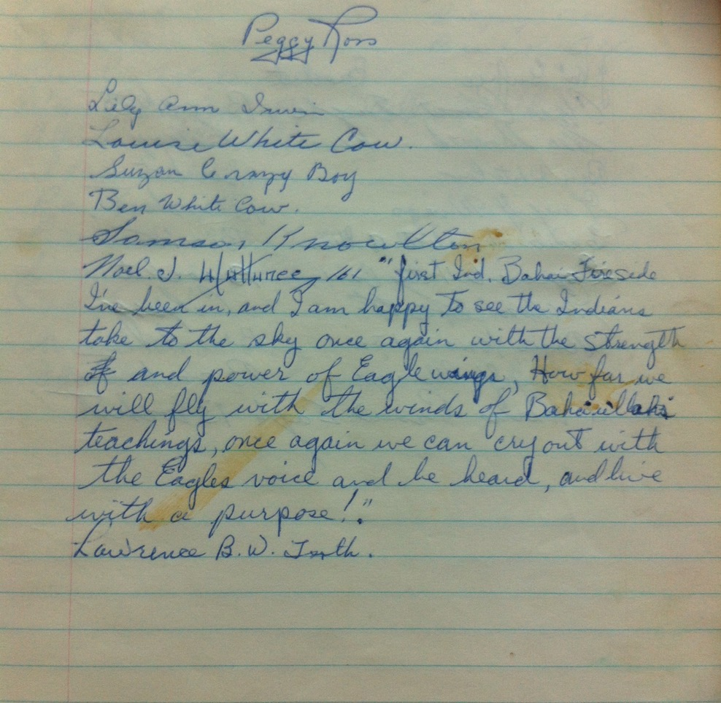
Noel Wuttenee visits January 23, 1961
First Indian Bahá’í fire side I have been to and I am happy to see the Indians take to the sky once again with the strength and power of eagle wings. How far we will fly with the winds of Baha’u’llah’s teachings, once again we can cry out with the Eagles voice and be heard and live with a purpose.

Slide 19
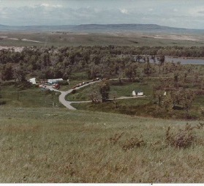
Highbush, my family’s home in the Oldman River Valley

Slide 20
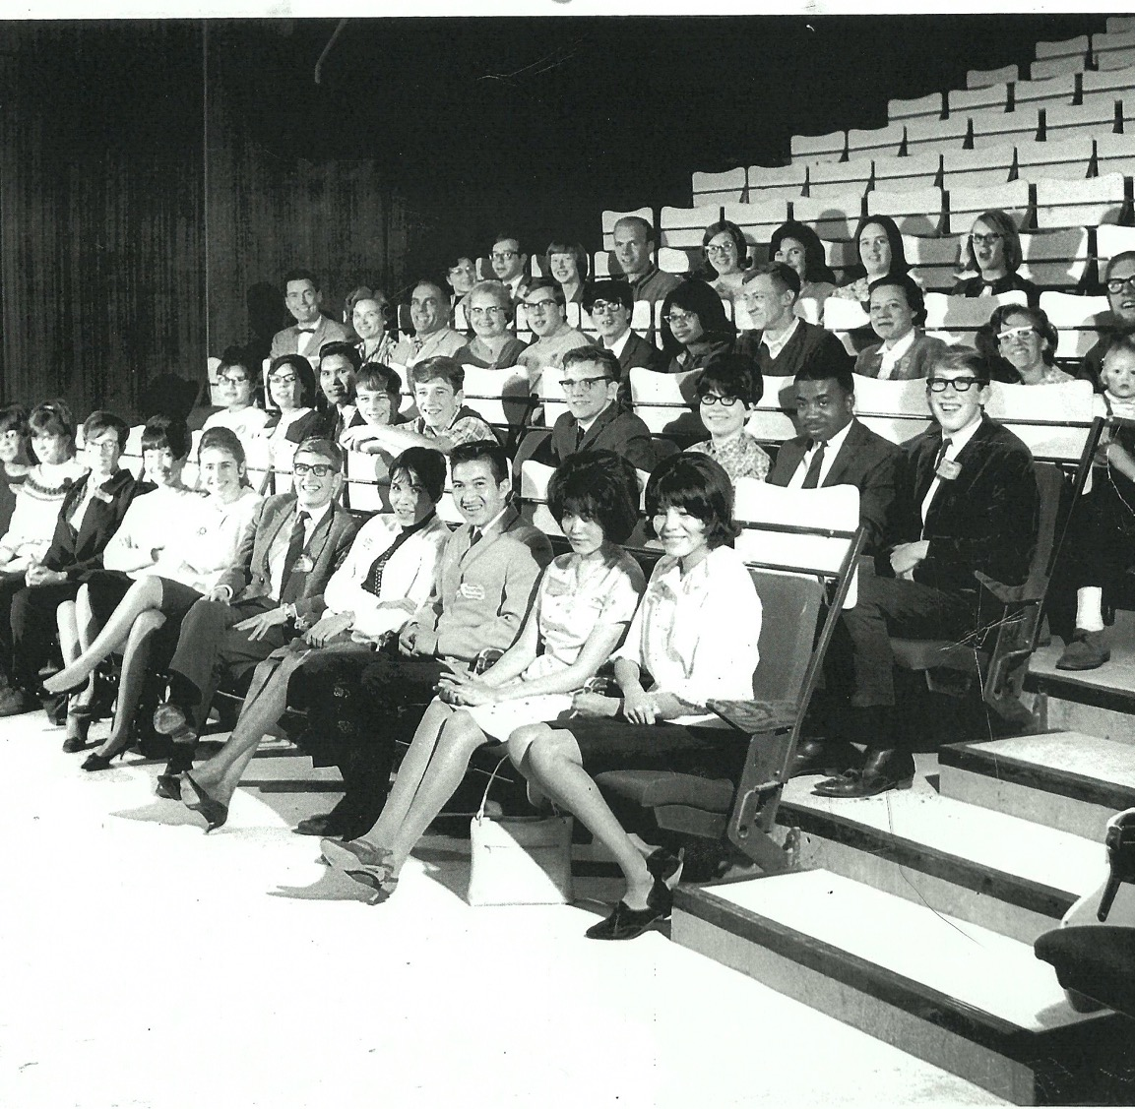
The Youth Movement begins: Young people from the western USA, Canadian prairies, and NWT come together at the U of C.

Slide 21
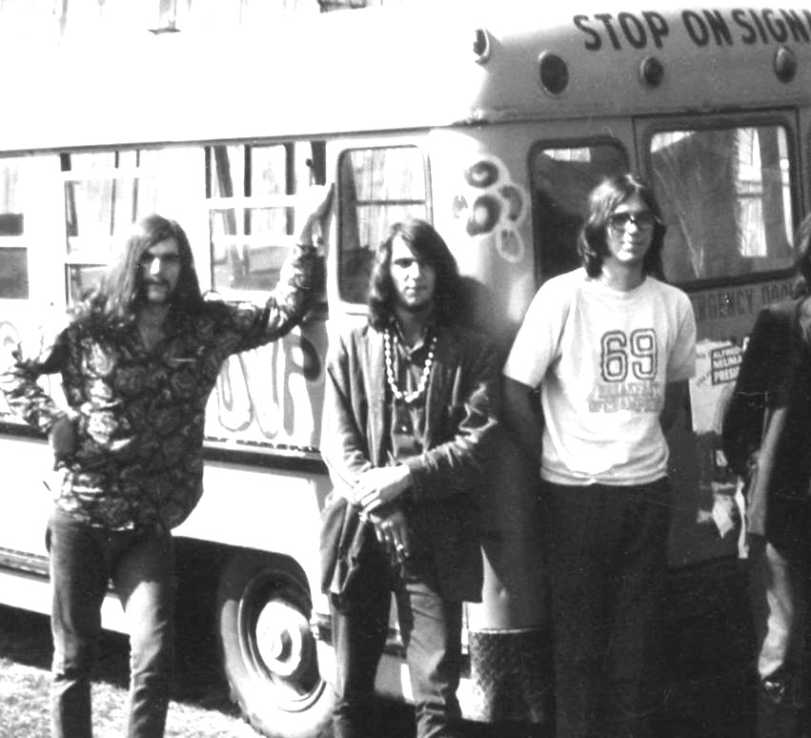
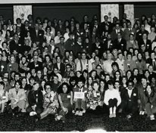
Early 1970s: A wave of youth are enrolling as Bahá’ís. The rock band, Jalal, travels the country attracting thousands.

Slide 22
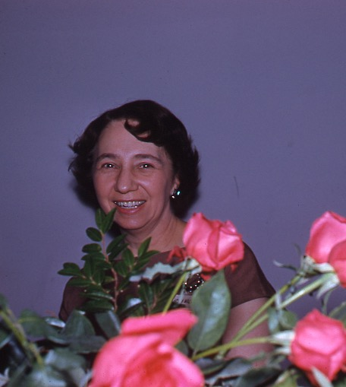
1970: Helen Marshall’s home at 921 – 18 Ave SW becomes the Bahá’í Centre in Calgary
Fireside information meetings are held almost nightly

Slide 23

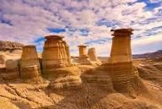

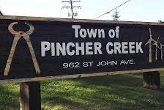
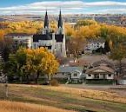
1980s: many new Spiritual Assemblies are formed in southern Alberta.
Persian refugees assist by settling in various towns.
Calgary Assembly has nine bi-elections in one year as its members also move out to the towns
High River, Drumheller, Carstairs, Pincher Creek, Olds, Medicine Hat, Banff, Airdrie, Okotoks

Slide 24
1996: The Universal House of Justice announces a 25-year series of Plans:
The Bahá’ís learn to be more systematic, using educational materials developed for all age groups. These are intended to endow it with a greater capacity to learn, grow, and serve humanity.
There are now well over 1000 Baha’is in southern Alberta and a vastly increased number of activities.
Children
Junior Youth
Adult Study Circles

Slide 25
2021: A new series of Plans is announced by the Universal House of Justice.
We began the current 25-year period of Plans
aimed at releasing the society-building power of the Faith.
transforming the very life of society.
to work with all who wish to see a better world.

