Slide 1
AI & the Human Spirit from Existential Risk to Essential Development
Roger Coe
Holistic Education Planner
Teacher Trainer
Research Scientist
Interdisciplinary Scholar

Slide 2
Why I’m here:
50 years ago in 1970 I discovered in the Chinese Book of Changes (Yijing) the key to the comprehending something of the oneness and wholeness of the realities of our Universe.
This soon branched out into the study of Cybernetics, the science of science, the basis of all AI and information processing and into Gregory Bateson, Norbert Wiener, Bucky Fuller, Carl Jung, and others.
Eight years later, in 1978, I discovered the work of my genius professor, Dr. Daniel C. Jordan, who founded a Science of Holistic education that’s based in a Wholistic philosophy of reality from A.N Whitehead that’s harmonious with Yijing.

Slide 3
Risks abound…. Positive Potentiality is Immense!
Risks include:
AI surpasses our human intelligence and becomes uncontrollable
Weapons systems of Mass Destruction are not controlled
Job Automation severely disrupts the socio-economic fabric

Slide 4
Managing Risks
Two things are absolutely required:
1. Moral education – for Chinese I suggest the Book of Rites
2. Global orientation – Ecological crises, Terrorism, War, lack of Global management of agriculture, water, food security, etc.
Recognition that our One Human Family has only One Home – the Planet Earth! To destroy our Earth is to commit suicide.

Slide 5
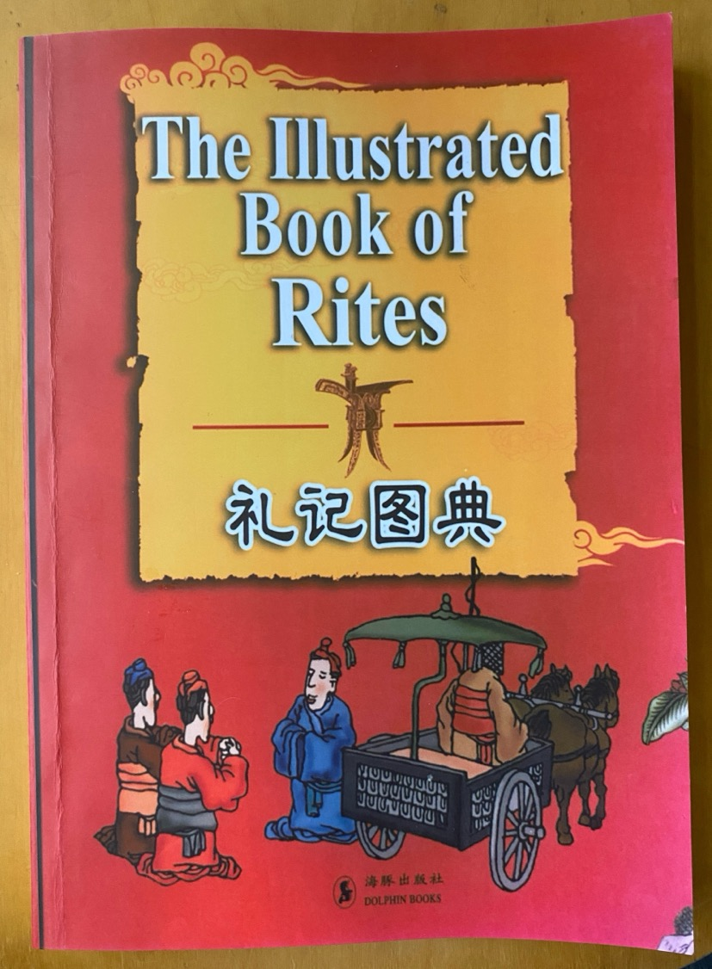

Slide 6
I Ching – or Book of Changes (Yijing)
Translated by Richard Wilhelm and cary f. baynes
From Princeton university press
Foreword by c.g. jung

Slide 7
AI’s Positive Potential
The intellect is Heaven’s greatest gift to humanity.
Artificial Intelligence with its learning capacity and speed can free human beings to be more fully human!
A Holistic approach is necessary!

Slide 8
Who is this?

Slide 9
Wholeness! …what does this mean?

Slide 10
My Discovery of Wholism
Vision Quest at 23
Use of Yijing daily for years
Encountered Cybernetics – the Science of Science
Carl Jung’s psychology of personal transformation
Meditation, Yoga and Awakening practices

Slide 11
The Astrology of Personality – a Reinterpretation of Contemporary Psychology and Philosophy (1936)

Slide 12
Man and His Symbols – C.G. Jung (also: Memories, Dreams, Reflections

Slide 13
Yijing - Fuxi, Nuwa, Zhou Wen Wang, Confucius

Slide 14
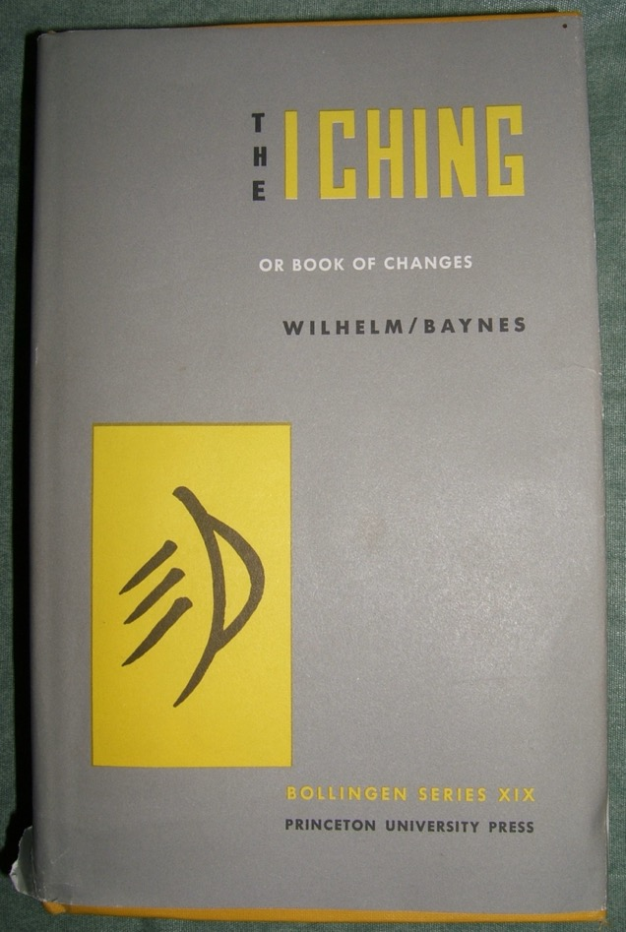
I Ching – trans. Richard Wilhelm
Princeton University Press
Qingdao 1912

Slide 15
I Ching (Yijing) Richard Wilhelm Available in China

Slide 16
EST: The Steersman Handbook

Slide 17
Tao Te Ching (Daodejing)

Slide 18
The Human Use of Human Beings – Norbert Wiener

Slide 19
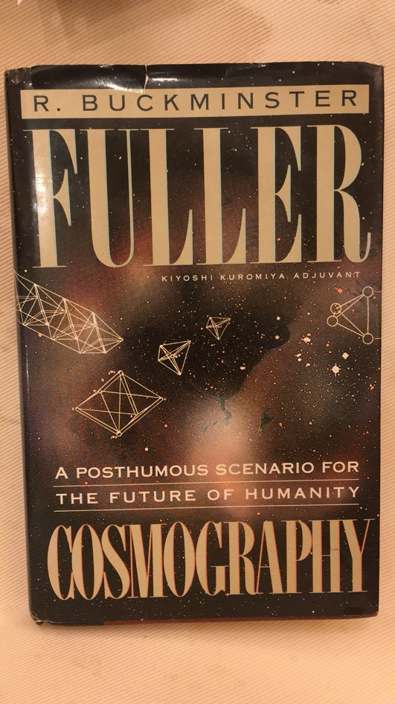
Bucky Fuller
Cosmography
Operating Manual for Spaceship Earth
Education Automation
Utopia or Oblivion

Slide 20
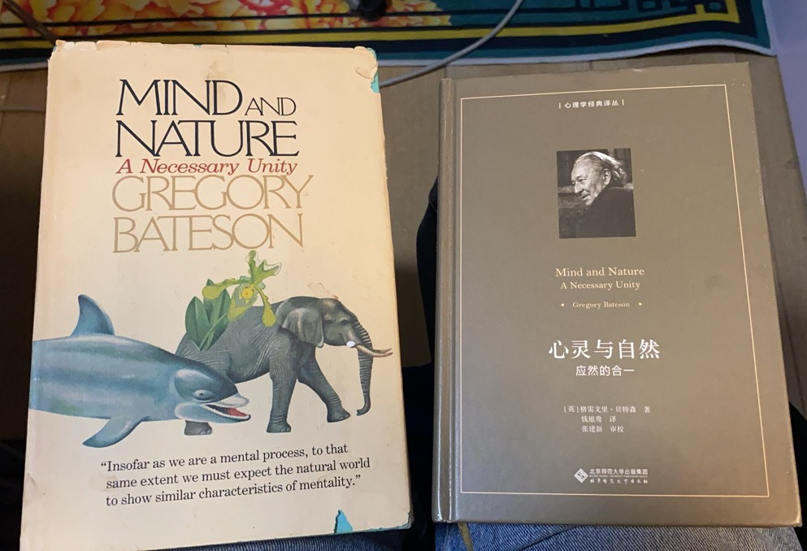
Gregory Bateson
One of the greatest scientists of the 20th Century

Slide 21
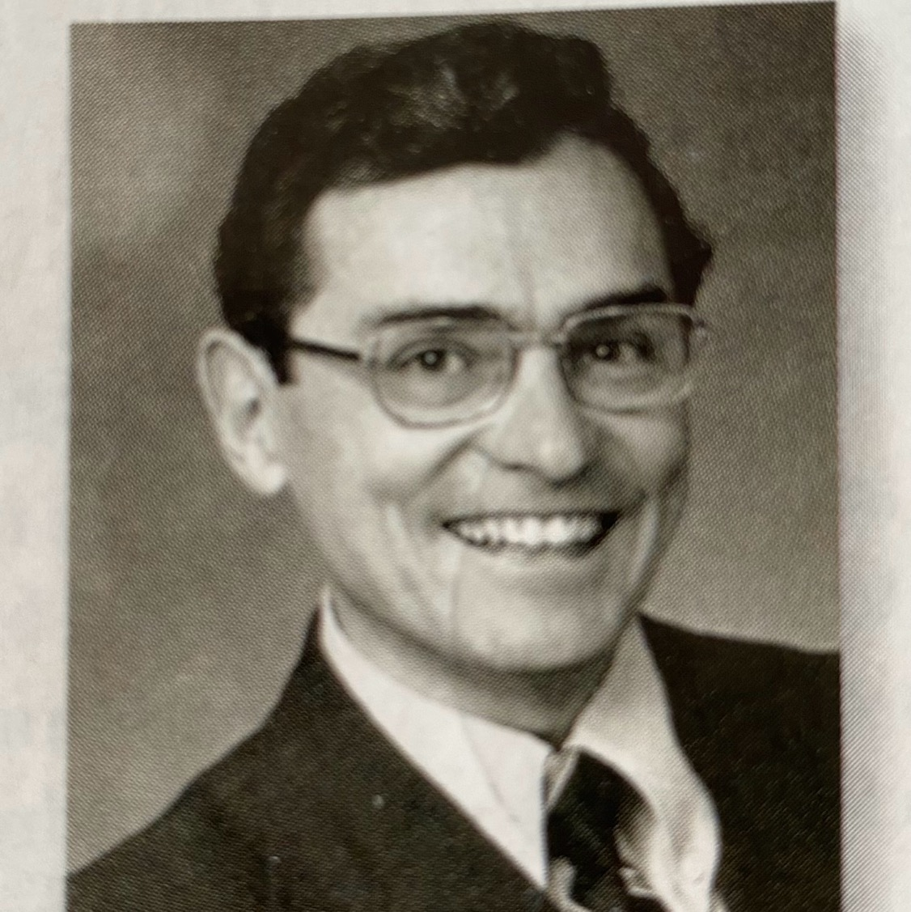
Daniel C. Jordan
Rx for Piaget’s Complaint – A Science of Education
The Process Approach
Being and Becoming
Guiding the Process of Becoming

Slide 22
The Process Approach Daniel C. Jordan

Slide 23
Process and Reality, et al. Alfred N. Whitehead

Slide 24
Process Studies Centers at Universities throughout China

Slide 25
World Class Learners - Zhao Yong

Slide 26
Gopnik, Kuhl, Lakoff & Dehaene

Slide 27
My Vision on Education Zhu Yongxin

Slide 28
Feeling & Knowing Antonio Damasio

Slide 29
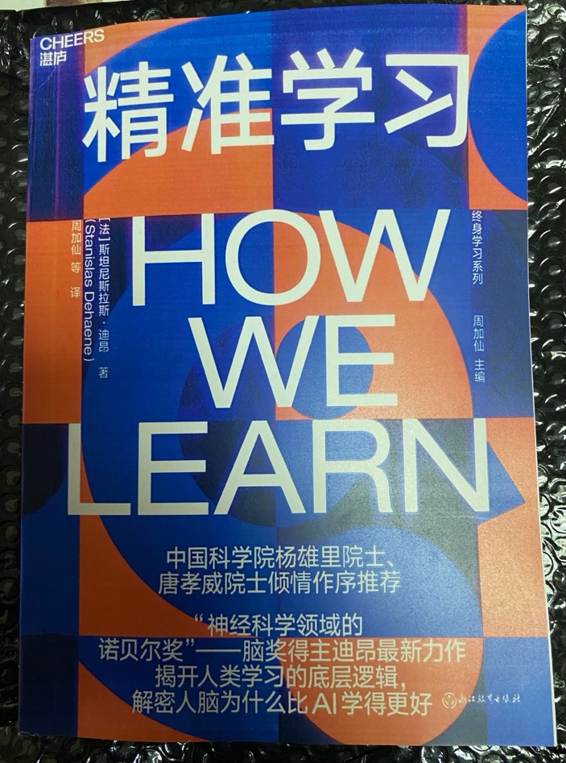
How We Learn - Stanislas Dehaene

Slide 30
Educators have 2 duties
1. Every teacher/administrator needs to Awaken to their own full human potentiality
2. An Awakened teacher/administrator can then learn how to awaken students

Slide 31
Deep Learning & Developmentally Appropriate Practice
Both DL and DAP resonate with Holistic education, and do so on a comprehensive and scientific basis.
What both could use is an Organizing Principle that comes from a Philosophy of Reality that is Coherent, Integrated, Logical, Open-Ended and applicable, stemming from the Science of Human Development.
Both Yijing and Whitehead’s Philosophy of Organism provide just such a Philosophy of Science, as both are grounded in Nature as a Whole.

Slide 32
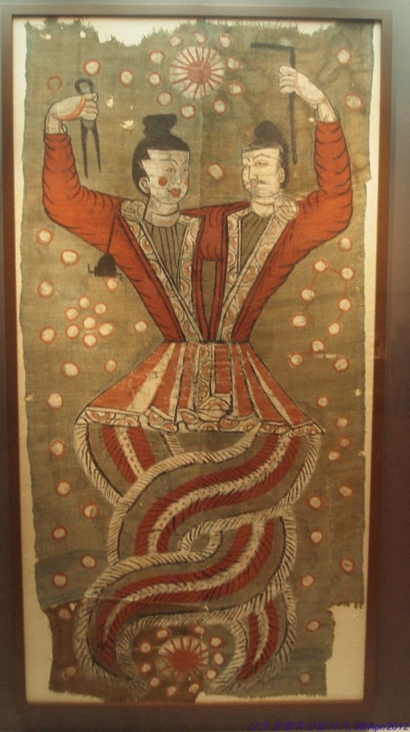
“Yi” – the Heart of China’s Civilization

Slide 33
The metaphysical principles of Yijing
The progressive Development of every entity – Yi, Change - is the most fundamental characteristic of Universe. Creativity in constant operation.
Things have a “mental” origin and are manifested in the physical world: Tian – Di - Ren
There is Heaven, the unknown and mysterious Dao – the originator of all things.
There is Earth, where the spiritual takes form.
There is Humanity, where the mind receives Heaven’s spiritual impulse and transforms it into physical reality.

Slide 34
In the past Schools served Business
Natural Creativity was “educated out” of the child
Conformity and dullness were taught.
AI has made all this obsolete.
The economy can work with much less human labor.
Schools must focus on educating children to be full, whole humans!

Slide 35
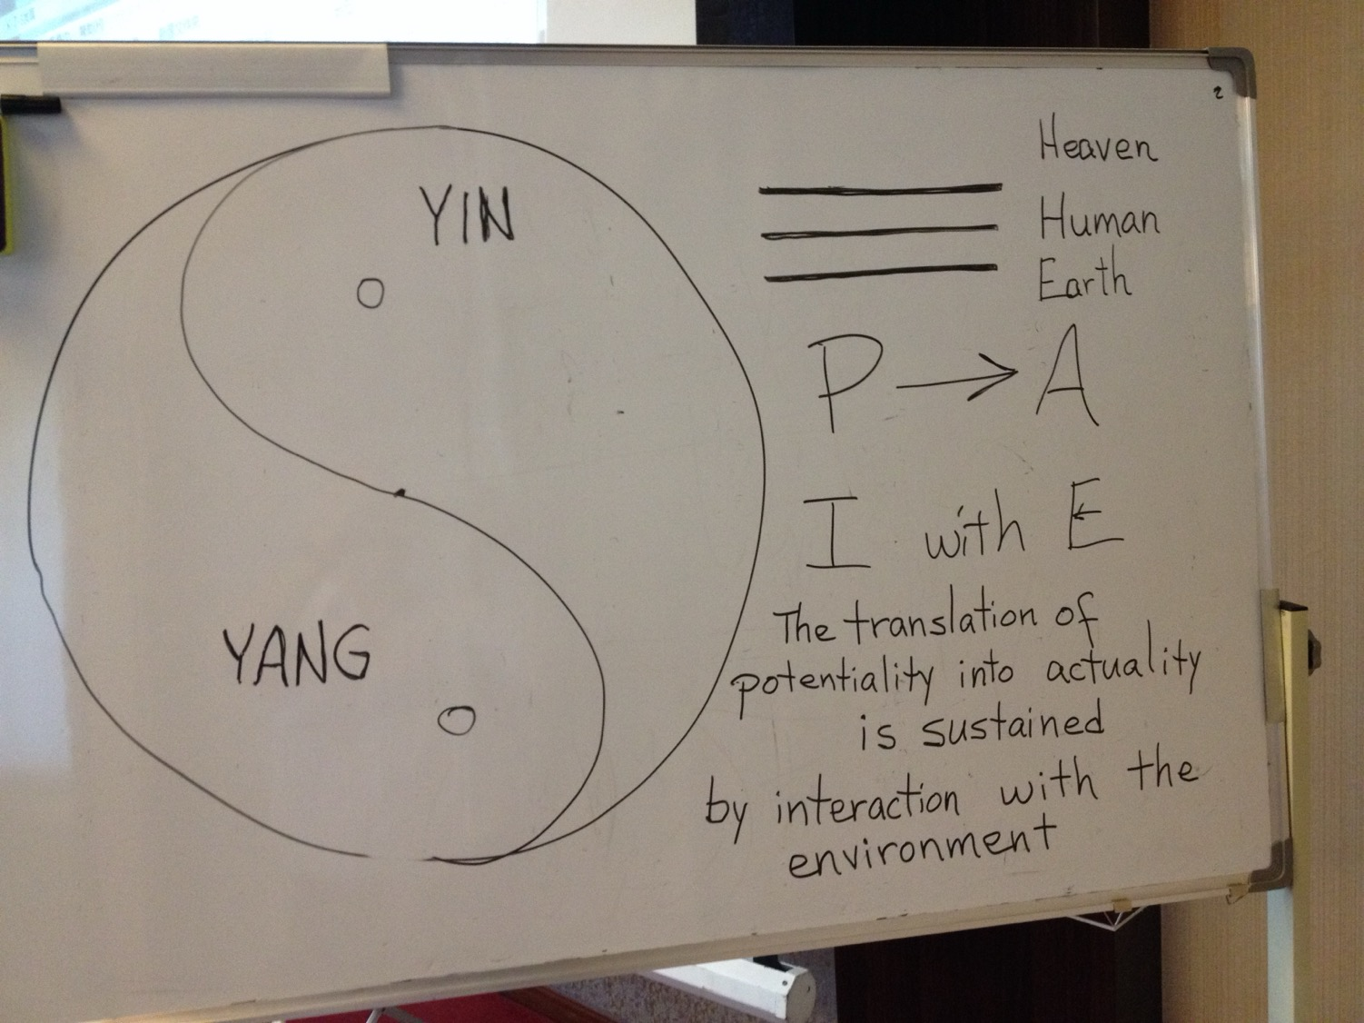

Slide 36
A Universal Theory of Development
From Dao comes One,
From One comes Two,
From Two comes Three, and
From Three all things arise.
Daodejing - Laozi, Ch. 42

Slide 37
Taijitu – Whole = Yin + Yang
An elegant symbol of Reality – the Whole of Reality is in Motion – the Active, Creative force of Yang is Interacting with the Receiving capacity of Yin, bringing about the Creative Advance of Life
Yin and Yang are the same, but different. Together they are the Whole, the Oneness of all Being
Each individual entity is both autonomous unto itself and One with all other entities in a coherent System

Slide 38
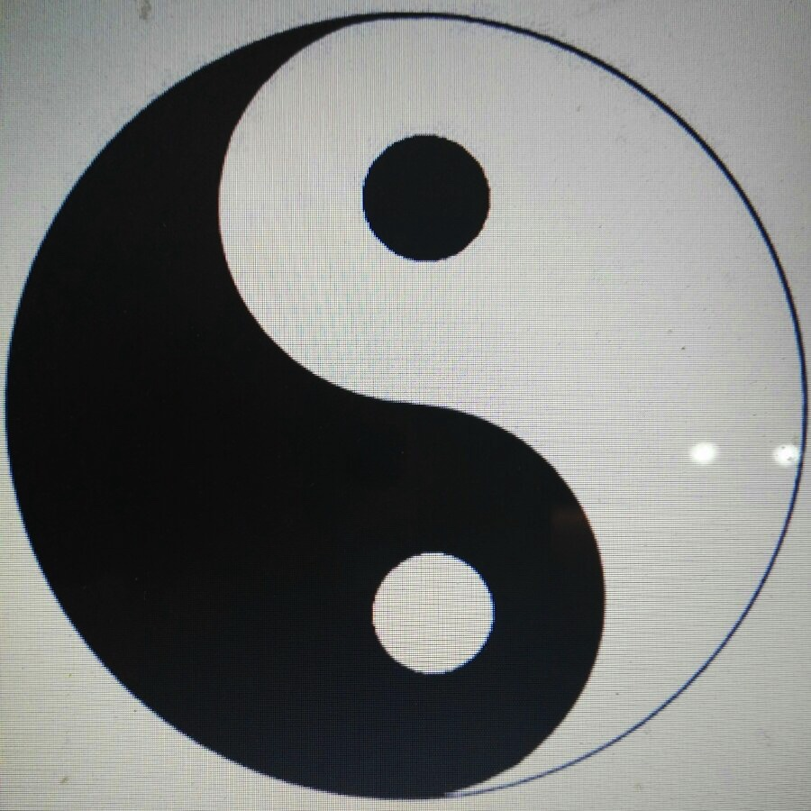

Slide 39
What are my Presumptions?
That we find ourselves within certain prepotent systems of relationships - the Natural Order.
That this Natural Order is One Coherent Whole that is comprised of several, interrelated Kingdoms: Mineral, Vegetable, Animal, Human & Unknown.
That there are stable Laws of Creative Development operating within these Kingdoms that Philosophy can help us to see, and Science can help us to know and understand.

Slide 40
Philosophy of Organism - Whitehead
Creativity / Development - the most pervasive characteristic of Universe. All entities are in the process of developing.
Development arises out of each entity’s potentiality as it interacts with its environment.
As an entity Actualizes its Potentiality it is Creating anew.
To understand this Process is to understand Reality.
All things are interrelated, Being in this Present Moment - this NOW - in an organic, coherent and comprehensive harmony.

Slide 41
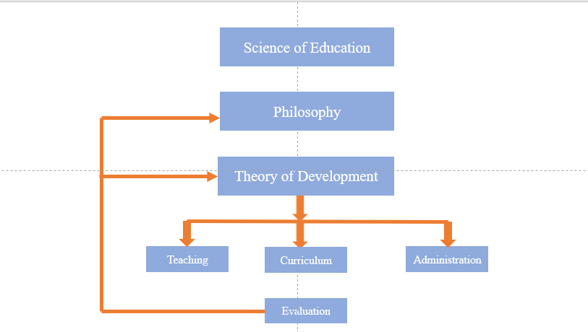

Slide 42
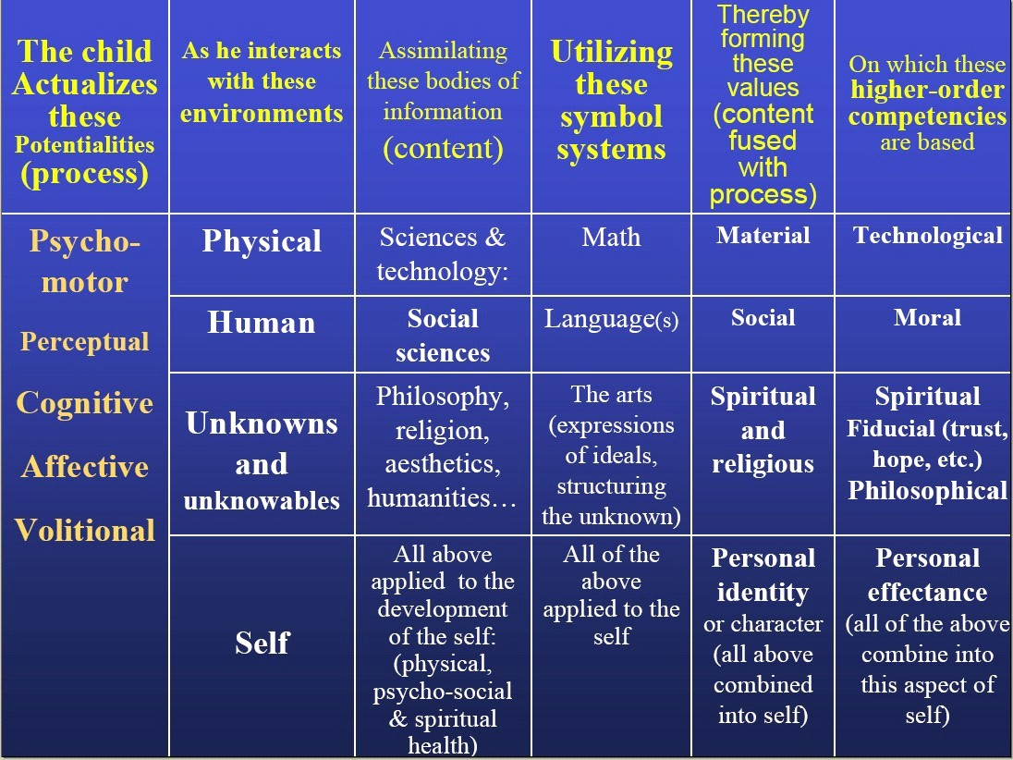
Process / Content
Chart of a
Holistic Education
System
Unique:
Master potential
Focus on SELF
Unknown as part
of Reality

Slide 43
Nature has evolved a BRAIN! Control center of every aspect of human life!

Slide 44
How the Brain Learns – 4 Pillars
Attention! (For teachers and parents it’s “Attention to the child’s attention.”)
Active Engagement! Potentiality is Actualized through Interaction with the Environment.
Immediate Error Correction so the child perceives the difference immediately.
Sleep (and meditation) consolidates the learning in the Brain, activating the same circuits as many as 100 times during the night.

Slide 47
The Brain’s Internal model of reality that is constructed through education and experience. Language acquisition The ratio of Unconscious processing to consciousness – 98:2 Reading as visual acquisition of language. The Global Neuronal Workspace theory of consciousness. Jiang Ping’s designs List of AI programs useful in Education List of areas where Brains are better than AI

Slide 48
Who is this?

Slide 49
Neil Bohr’s Coat of Arms

Slide 50
Gua in Binary Order (1032 CE)

Slide 51
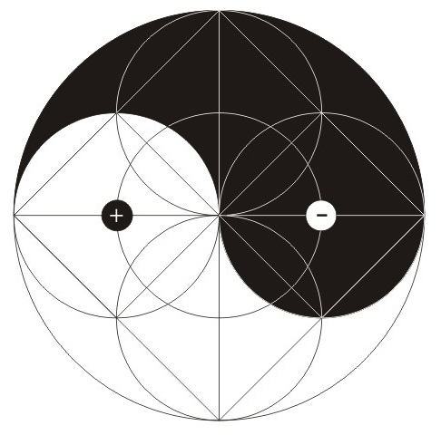
Taijitu Geometric Style

Slide 52
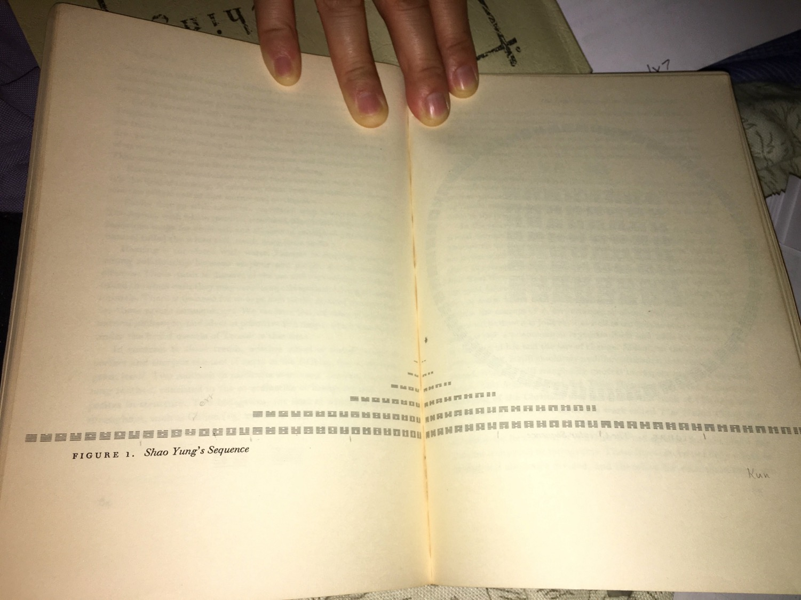

Slide 53
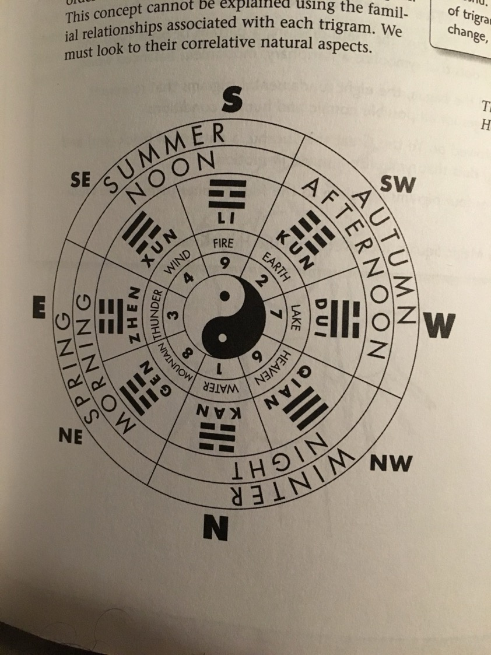

Slide 54
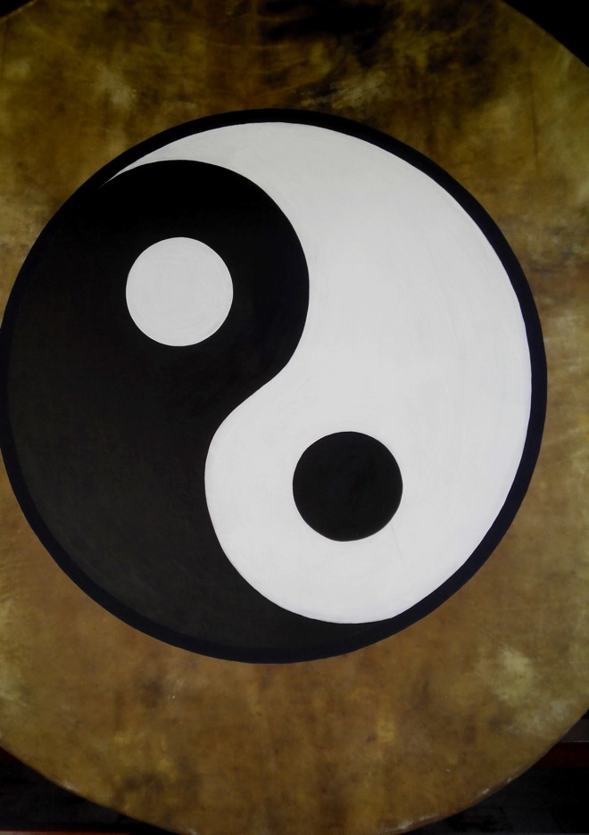
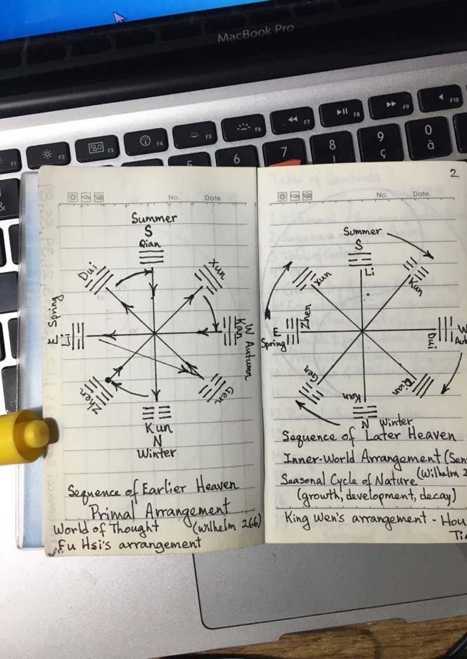
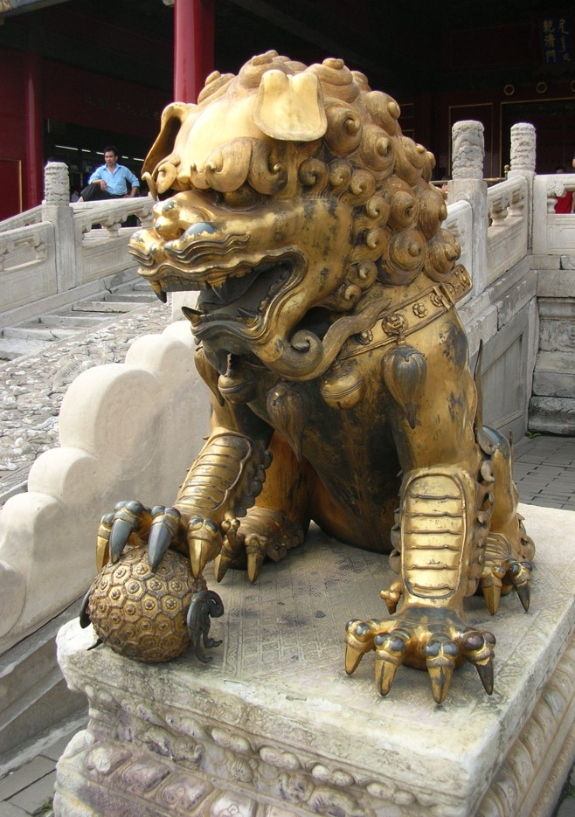

Slide 55
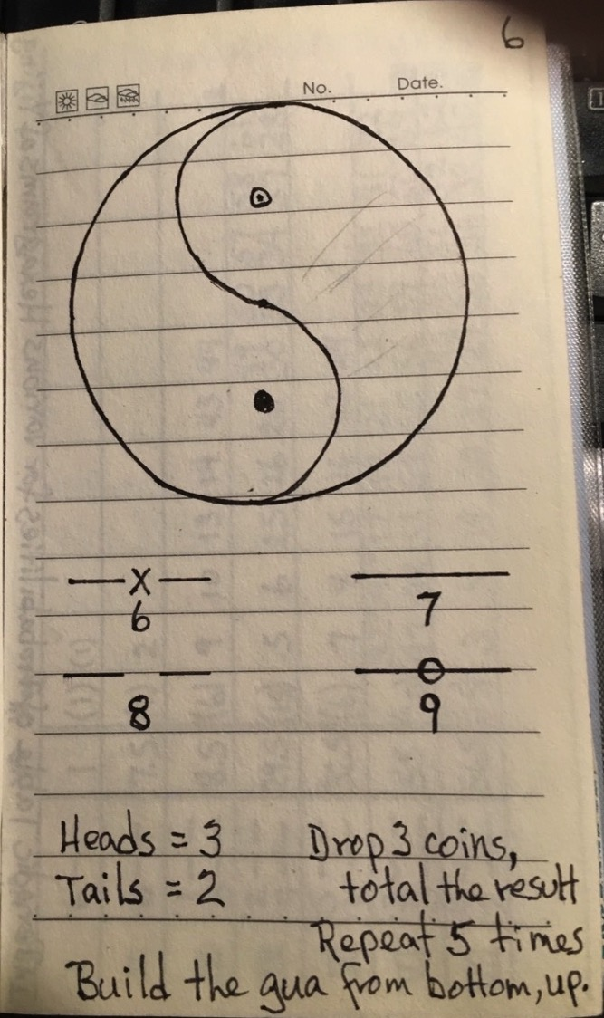

Slide 56
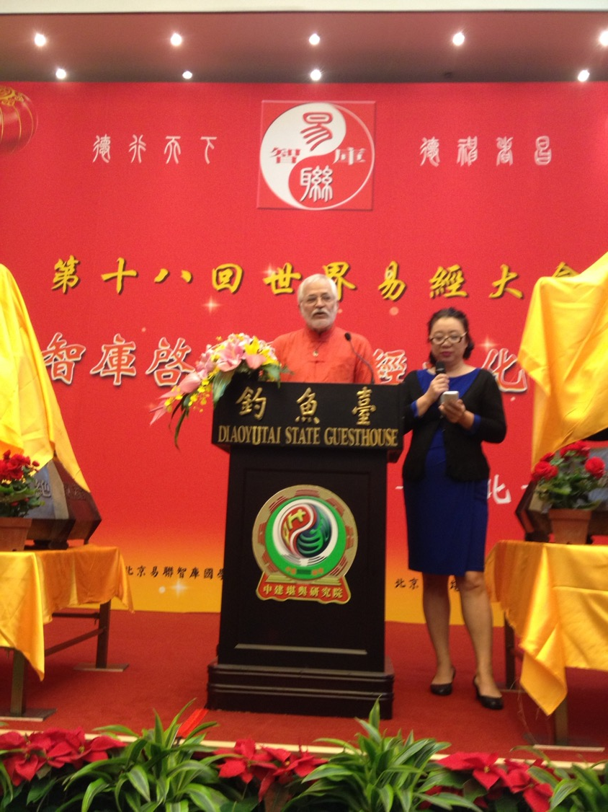

Slide 57
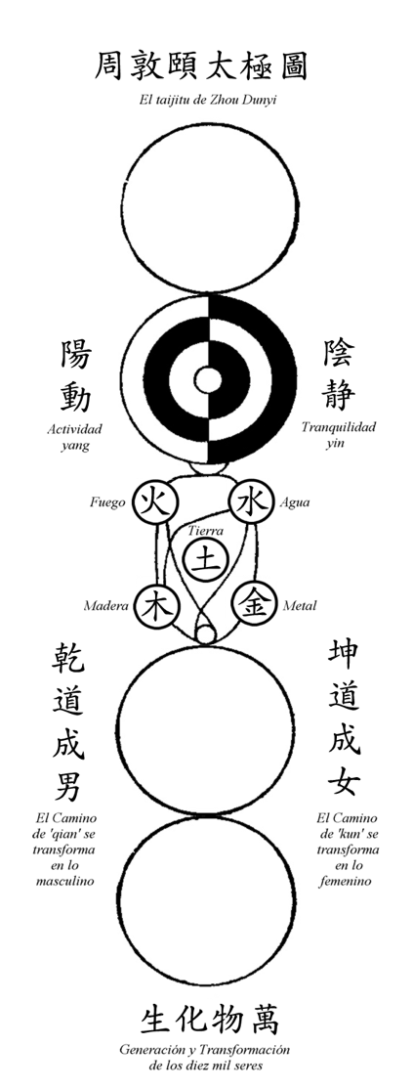
The Supreme Ultimate Metaphysical conception of the origin of the Universe – From Nothingness to One, - from One to Two, - from Two to Three, and - from Three to All Things!
by Zhou Dunyi (as Explained by Zhu Zi)

Slide 58
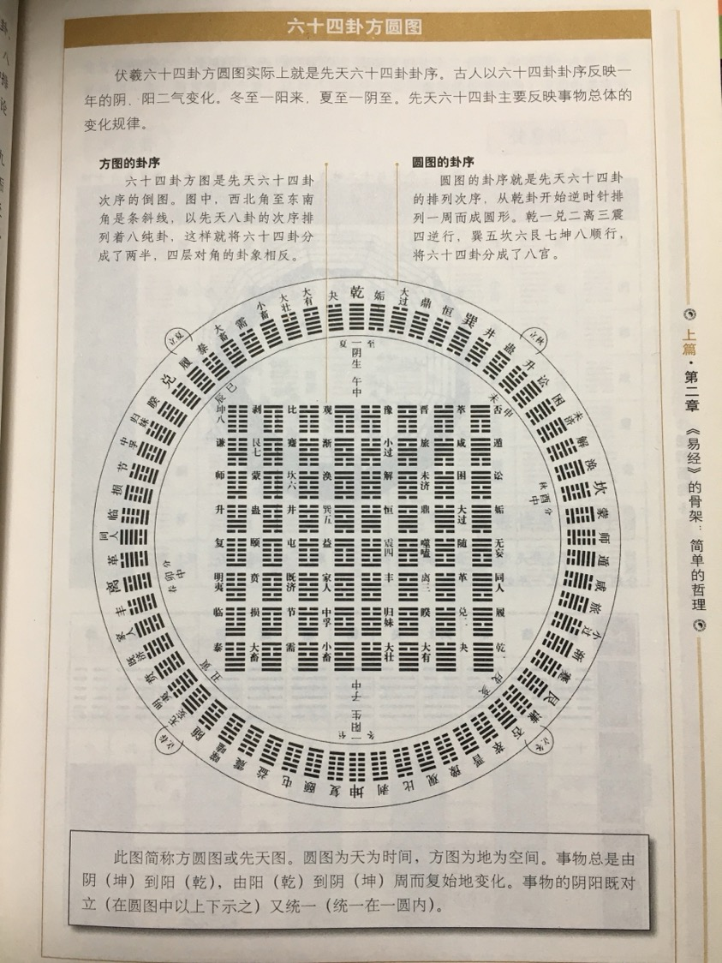

Slide 60
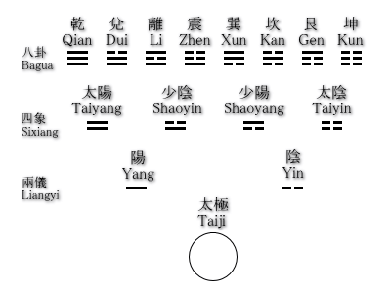

Slide 61
A Paradigm both Enables and Limits
T.S. Kuhn, The Structure of Scientific Revolutions
Normal science proceeds until it is overwhelmed with anomalies that it can’t resolve within its worldview.
Western educational science uses an Industrial paradigm, mechanistic, and sundering mind & body.
Organismic philosophy of Whitehead, which is in harmony with Laozi, brings a new adequate paradigm.

Slide 62
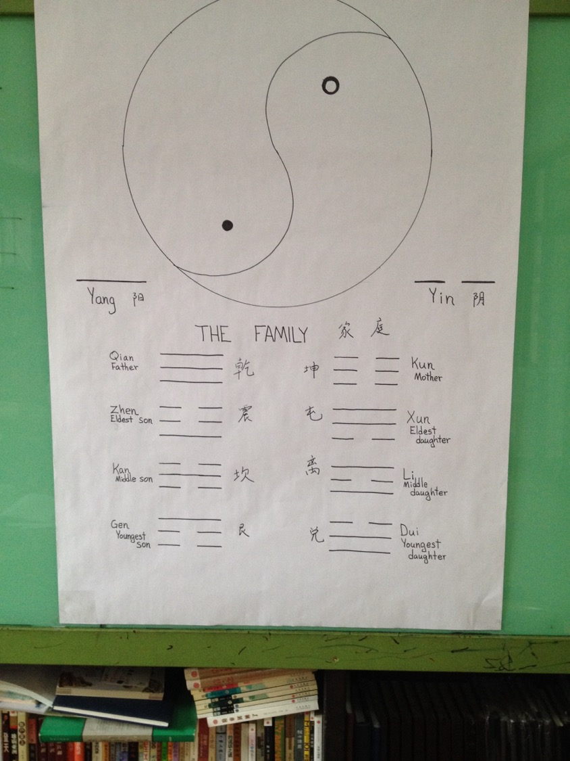

Slide 63
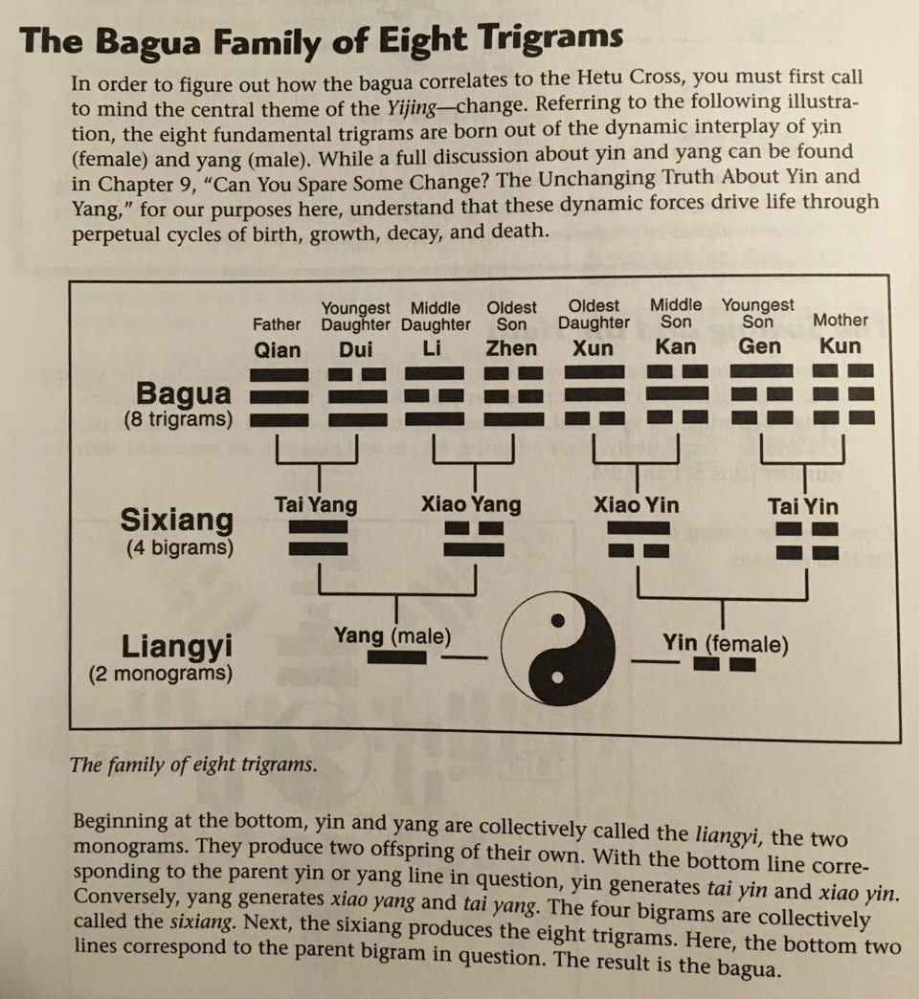

Slide 64
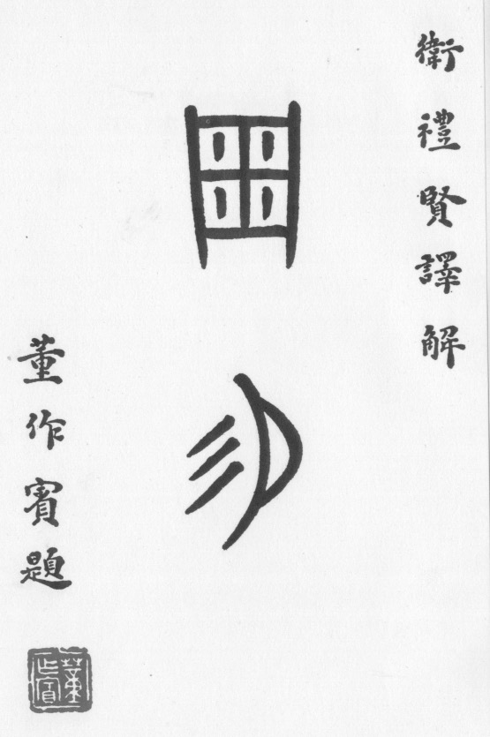

Slide 65
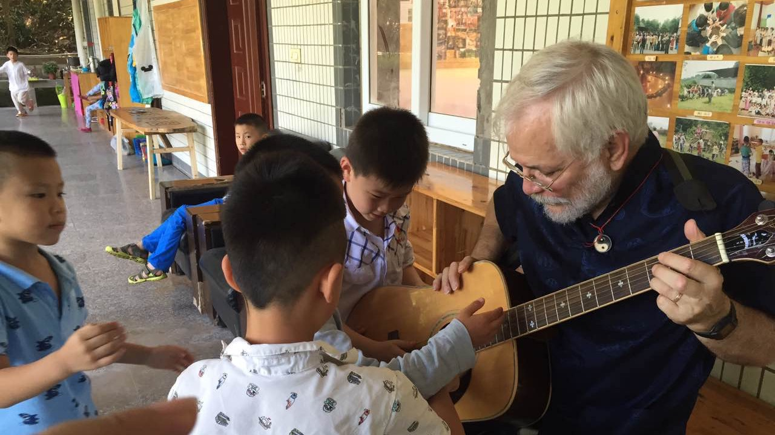

Slide 66
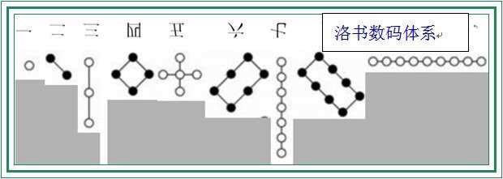

Slide 67
Culture is propagated out of a commonly-held “Worldview”. It is carried by language and education within the family and social relationships. We learn culture unconsciously. And it is dictatorial unless understood!

Slide 70
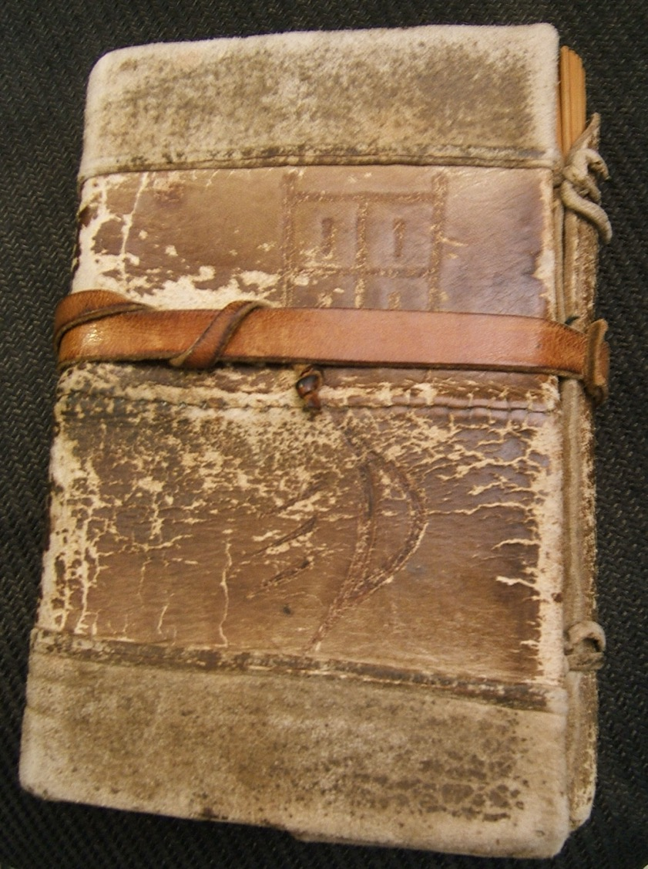

Slide 73
