Slide 1

Libraries and librarians
“Unveiled and unconcealed, this Wronged One hath, at all times, proclaimed before the face of all the peoples of the world that which will serve as the key for unlocking the doors of sciences, of arts, of knowledge, of well-being, of prosperity and wealth.” (Baha’u’llah. Lawh-i-Dunya)
“The Sea of Affirmation”

Slide 2
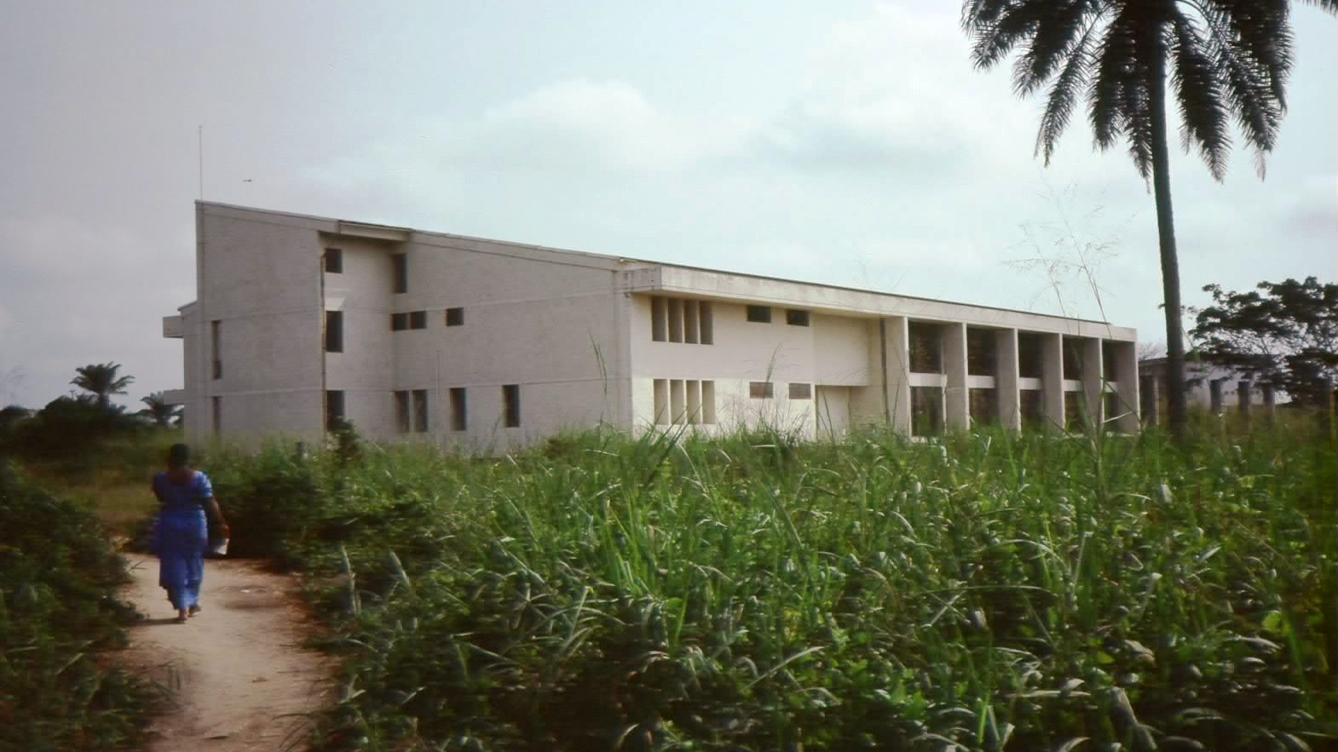
Cataloging librarian at the Université de Zaire à Kisangani (now DR Congo)
Louise Mould, c.v.
Librarian at the Université de Lubumbashi
Cataloging & Deputy librarian at the Bahá’í World Centre Library
Director of the Bahá’í World Centre Library
Cataloging and Metadata librarian at the University of Prince Edward Island, Canada
“New” Library building 1983 – Kisangani, Congo
Librarian at Holland College Library Services, Canada

Slide 3
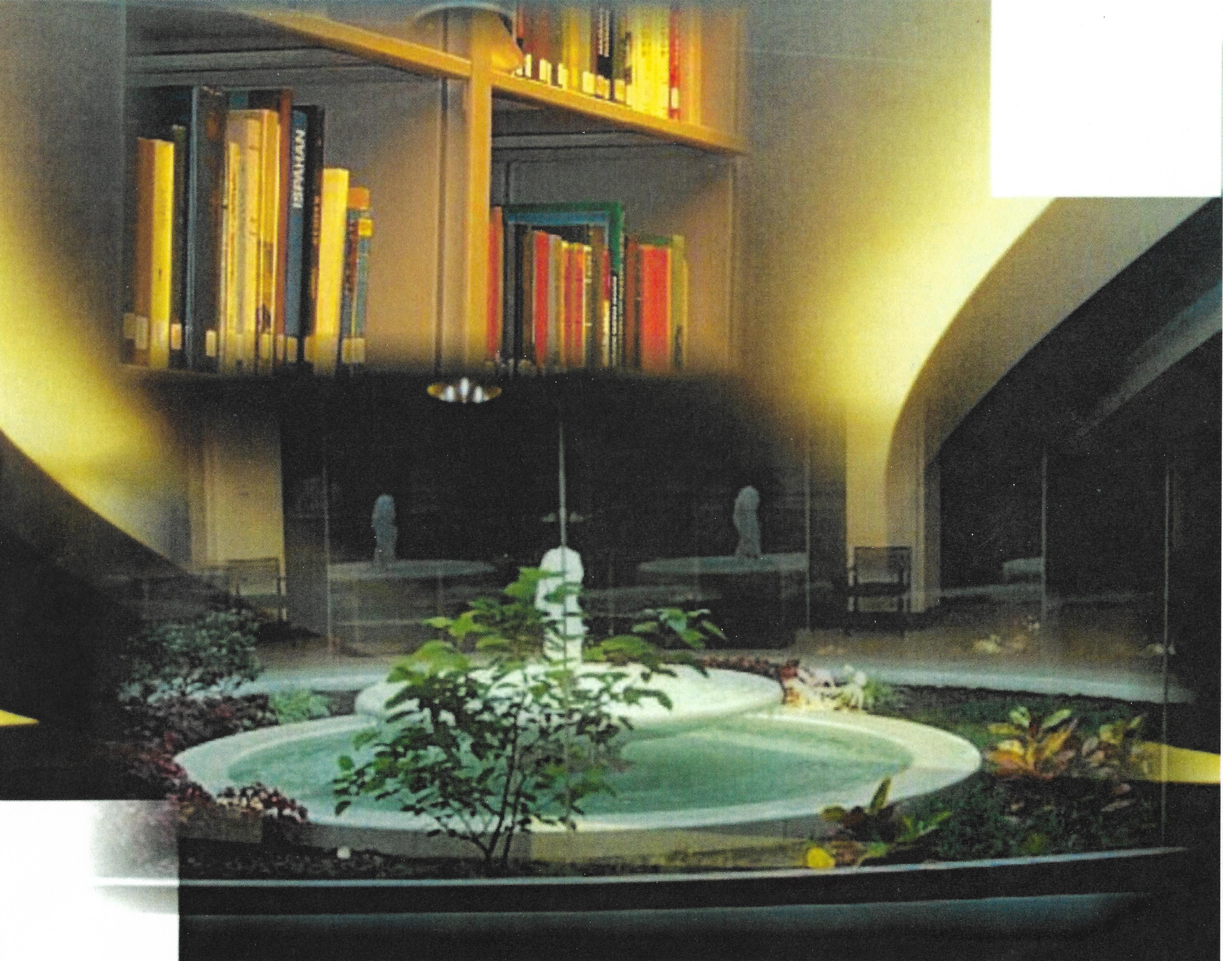
Introduction
World Assoc. of Baha’i Librarians and Archivists
Bahá’í libraries
Bahá’ís who are librarians
Highlighting certain issues (time constraints of presentation)
Digital photo collage of elements in a special library.

Slide 4
The Structures of Libraries: a shared mission
Organic by nature – they grow and develop
Providing Reference, Acquisitions (Collections), Cataloging (Metadata) -- print and/or digital
Part of a larger organization

Slide 5
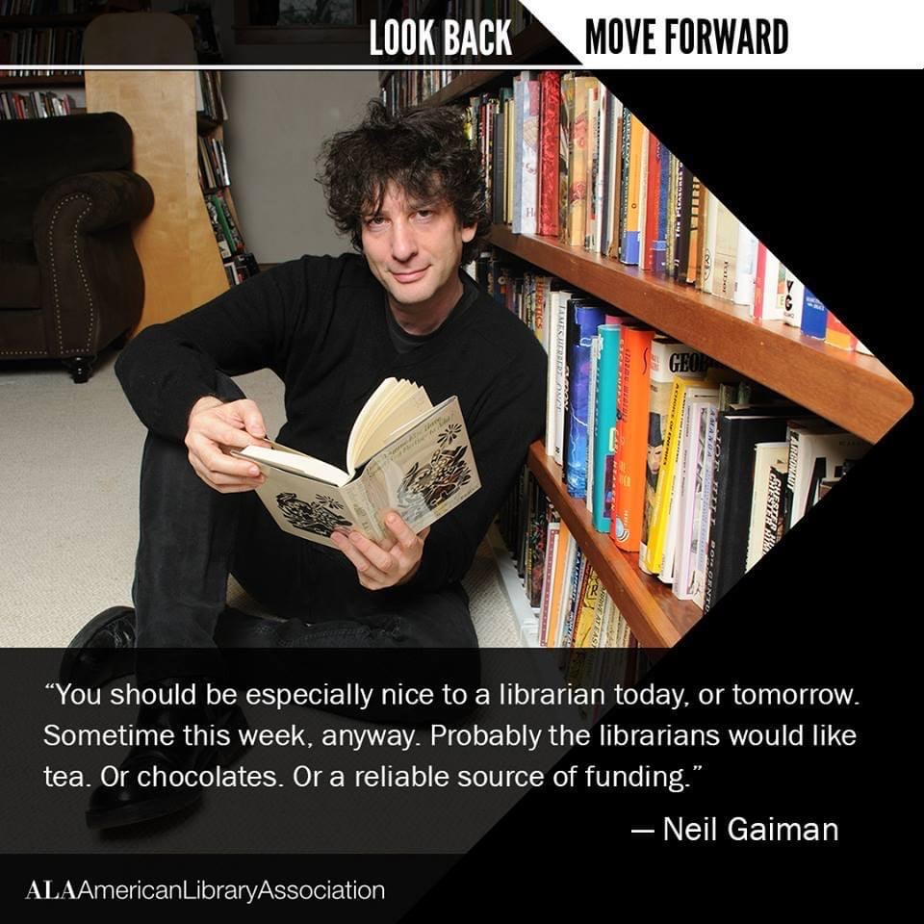
Serving the organization
All libraries are part of a larger organization.
The director(s) report to a governing body of some kind.
They derive their direction and their funding from that organization.

Slide 6

Librarians = Information professionals: what exactly do they do besides cataloging?
Administration: hire and supervise staff; monitor budgets, implement library policies and procedures.
Deliver instruction (both one-on-one and in classroom/lab environment) for students, faculty, others; give library orientation sessions.
Collection development includes library liaison for designated program/subject areas and evaluating resources such as databases and e-book delivery.

Slide 7
Special Libraries
A Bahá’í library would be a Special Library
Definition of a Special Library. A Special Library is a library that provides specialized information resources on a particular subject, serves a specialized and limited clientele, and delivers specialized services to that clientele.
Special Libraries include corporate libraries, government libraries, law libraries, medical libraries, museum libraries, news libraries. Special libraries also exist within academic institutions. These libraries are included as special libraries because they are often funded separately from the rest of the university and they serve a targeted group of users.

Slide 8
The librarians in Special Libraries
Specialist librarians, who have come to be called “information professionals”, have a unique relationship as collaborators with their users.” (Wikipedia)
“Special librarians are information resource experts who collect, analyze, evaluate, package, and disseminate information to facilitate accurate decision-making in corporate, academic, and government settings.” (2011 http://www.sla.org)

Slide 9
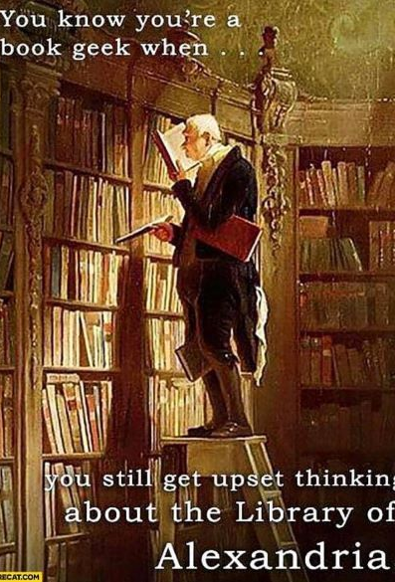
Collections = Acquisitions and Curation
Print, digital, digitized
Databases and e-books (rented)
  Full-text (pdf, text based)
Significant references – collection is curated.

Slide 10
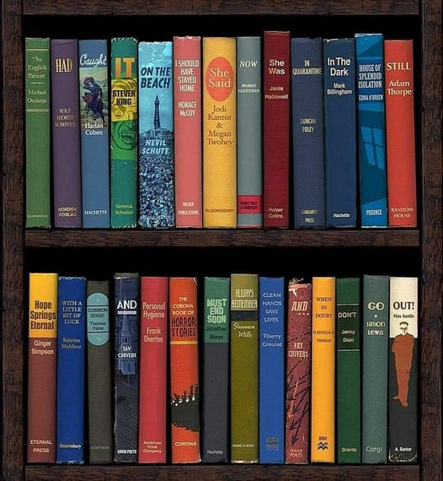
Disruption:
Libraries are not going away
All professions are changing, and it is not always about technology although much of it is driven by it.
Revolutions have beginnings and endings. Taking the long view there are those historians who say the French Revolution (1789-) has not yet finished it course. We may also be mid-revolution in this respect.

Slide 11

Searching: hidden resources
All collections must be accessible in a meaningful way.
Keyword searching and the importance of metadata
Search terms (vocabulary) are crucial.
The language of the Revelation is so elevated and often indirect. E.g in the text of the Kitab-i-Aqdas – searching for “holy days”. “All Feasts have attained their consummation in the two Most Great Festivals, and in the two other Festivals that fall on the twin days – the first of the Most Great Festivals being those days wereon the All-Merciful…”
In the three paragraphs (KA110, KA111, KA112) no direct ref to Ridvan, Naw-Ruz, etc.

Slide 12
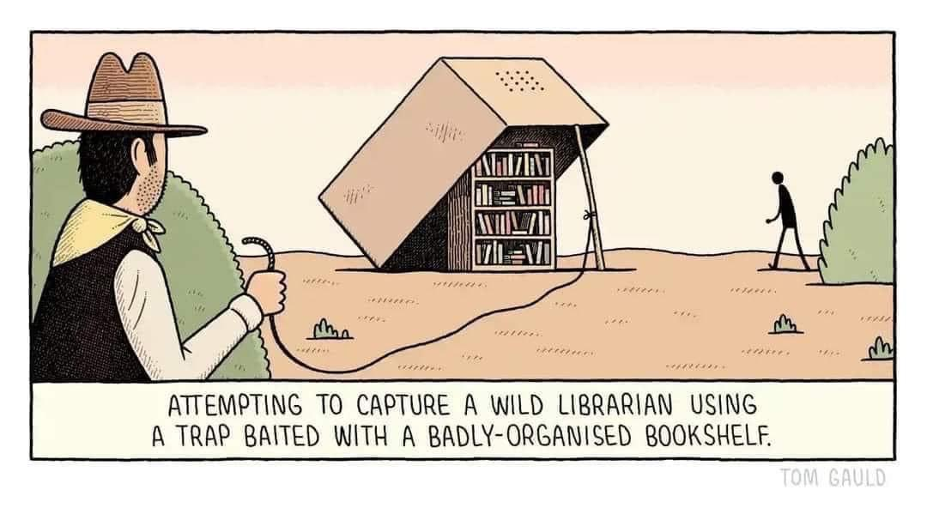
Instructional Services:
Information literacy and misinformation (identifying sources)
Bibliographic instruction
“Access is everything in libraries, and reference and circulation workers can’t do their job properly without a catalog. Cataloging may happen behind-the-scenes, but like other library jobs, its main purpose is always to increase access to information.” Szmodis, P. (2021)

Slide 13
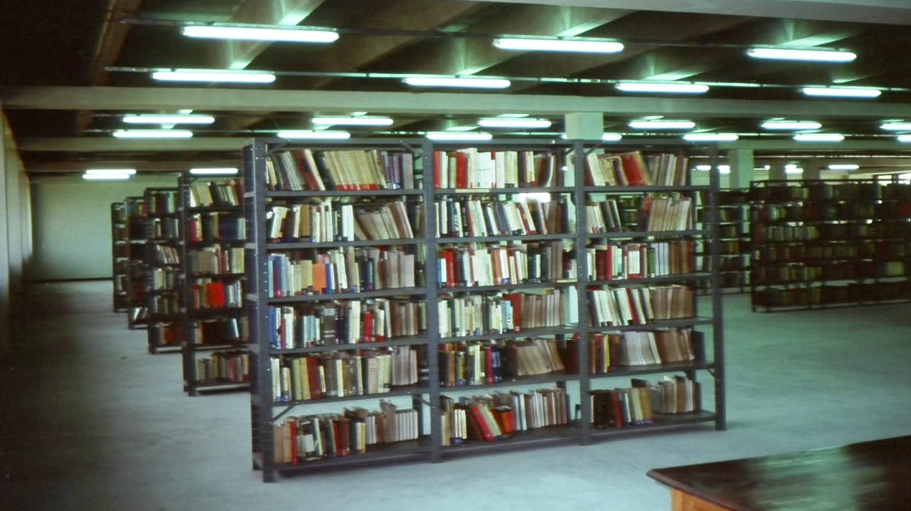
Supplemental reading
1. IFLA trend report update 2021 released.(2022 January 6). https://www.ifla.org/news/ifla-trend-report-2021-update-released/
“…the 2021 Update of its Trend Report, based on the ideas submitted by emerging library leaders ahead of our World Library and Information Congress. We invite you to look through, and think how these trends will interact and impact upon our institutions, our profession and our communities.”
2. Szmodis, P. (2021). Why every future librarian should take learning cataloging seriously. https://hacklibraryschool.com/2021/09/27/why-every-future-librarian-should-take-learning-cataloging-seriously/
“I also learned a lot about the value of a well-cataloged collection and the importance of understanding fundamentals about how library catalogs work.” “Cataloging improves your search skills” “Cataloging helps you understand the differences between works, expressions, manifestations, and items”
3. Tillman, RK. (2022). MARC Records vs. the Catalog. (presented at the ALA Core Catalog Management Interest Group on March 9) https://ruthtillman.com/talk/marc-records-vs-catalog/
4. Wardle, C. (September 1, 2019). Misinformation has created a new world disorder in Scientific American (Sept. 2019) https://www.scientificamerican.com/article/misinformation-has-created-a-new-world-disorder/

Slide 14

The House of Arts and Sciences
The End
Sailing Upon Two Seas

