Slide 1
The Reference Desk: Cataloging and Subject Indexing
Steven Phelps
9 APRIL 2022

Slide 2
Challenges for foundational work
Access
What is out there?
“Chart the coastline”
Content
What does it say?
“Plumb the depths”

Slide 3
The goals
Create two aids for foundational work
1. Facilitating access: catalog the accessible sources
Exhaustive list of what we presently have access to
Both original texts and translations
Include all three Central Figures
2. Exploring content: thematic reconstructions
Multiple approaches possible

Slide 4
Background
of 14
August 2019 Wilmette Institute Webinar: The Writings of the Báb
http://wilmetteinstitute.org/overview-of-the-writings-of-the-bab/
February 2020 Wilmette Institute Webinar: The Writings of Bahá’u’lláh (and Abdu’-Bahá)
https://wilmetteinstitute.org/overview-of-the-writings-of-bahaullah/

Slide 5
Challenges on the path of approach: The Writings of Bahá’u’lláh
Access
Both original texts and translations are scattered, uncoordinated (beyond the BWC)
Majority of texts (>90%) are untranslated
For those wanting an exhaustive and systematic study: where do they begin and where do they end? And where can I find them?
Content
Size: ~5 + 6 + 6 million words ~2,000 + 20,000 + 30,000 surviving works
Uncharted vastness discourages the approach

Slide 6
A “coordinate system” for the Bahá’í Writings
of 14
Longest Shortest Later additions
Writings
The Báb BB00001 … BB00635 BB00636+
Bahá’u’lláh BH00001 … BH11676 BH11677+
‘Abdu’l-Bahá AB00001 … AB11805 AB11806+
Utterances
The Báb BBU0001 … BBU0015 BBU0016+
Bahá’u’lláh BHU0001 … BHU0065 BHU0066+
‘Abdu’l-Bahá ABU0001 … ABU3664 ABU3665+

Slide 7
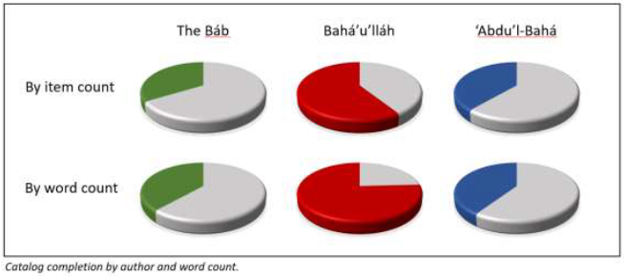
Results of the inventory
Availability:
The Báb: ~25-30% in public domain in original languages
Bahá’u’lláh: ~75%
‘Abdu’l-Bahá: ~40%
Reported utterances
A few thousand more (mostly ‘Abdu’l-Bahá)

Slide 8
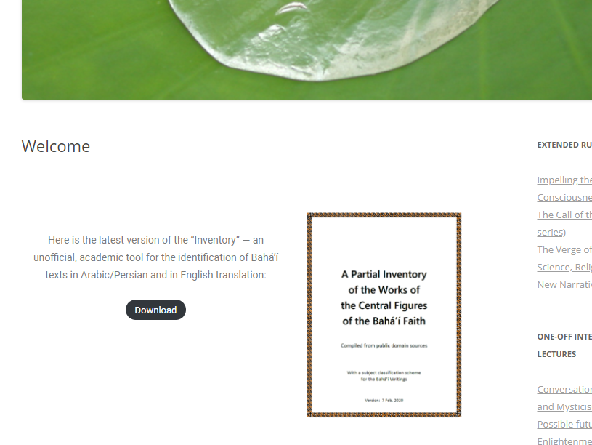
Accessing the inventory (~50MB pdf)
http://blog.loomofreality.org/

Slide 9
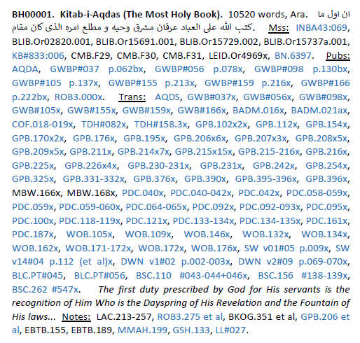
Parsing catalog entries
http://blog.loomofreality.org/
Catalog ID
Title
Word Count
Language
First line (Ara/Per)
Manuscripts (Ara/Per)
Publications (Ara/Per)
Translations (Eng only)
First line in translation
Musical interpretations
Notes
[Hyperlinks]

Slide 10
Some use cases
Lookup from source reference (e.g., “GWB#050”)
Refer to bibliography for source code abbreviations
Lookup from words/phrases in first line
Systematic readthrough
Longest-to-shortest, shortest-to-longest
Browse titles (from index)
Browse questions (from index)
Collation of original text from multiple manuscripts
May be useful when authorized text at Bahá’í Reference Library does not exist
http://blog.loomofreality.org/

Slide 11
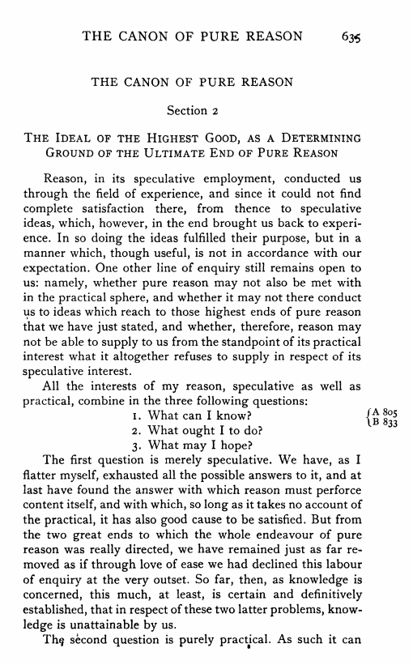
Next step: Content (appendix to the Inventory)
Kant’s Critique of Pure Reason
What can we know?
What should we do?
What may we hope?

Slide 12
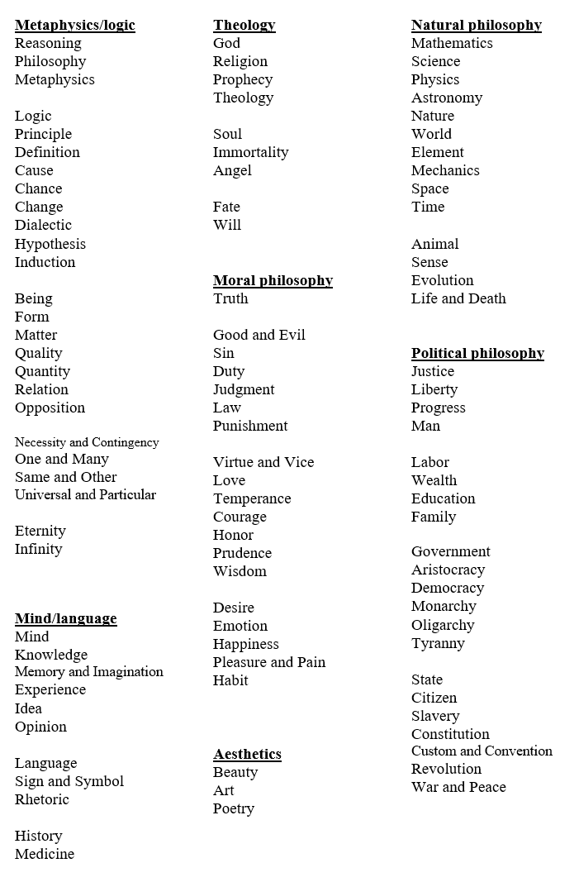
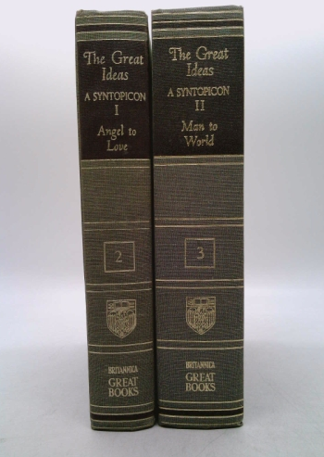
Previous systems? Adler’s “Syntopicon”

Slide 13
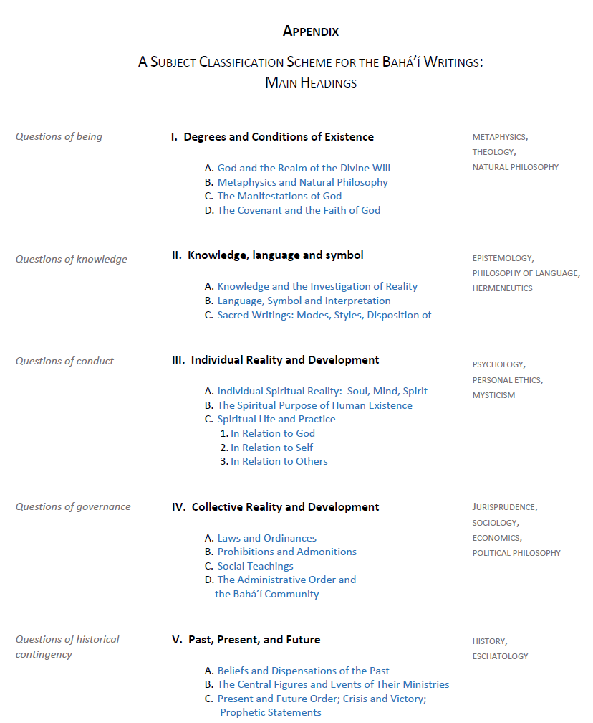
A classification scheme
What can we know?
What are the ultimate things to know about?
How do we know them? How does language function as a vehicle for the transmission of knowledge?
What should we do?
As individuals, in relation to ourselves, others, the Truth?
As groups of individuals that need to both cooperate and compete?
What shall we hope?
Where did we come from, and what kind of a world are we creating?

Slide 14
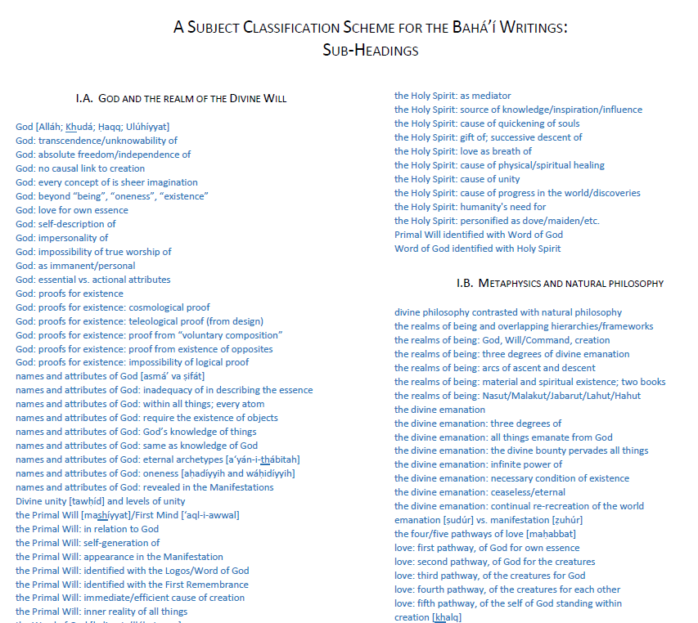
Classification: sub-categories
Links to thematic compilations of extracts
Shoghi Effendi, Universal House of Justice heavily referenced here

