Slide 1
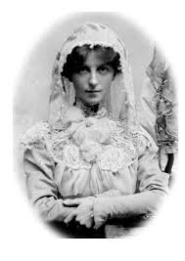
May Maxwell and the Maxwells of Montreal
An Overview of the Years 1870-1952

Slide 2
Notice to the Reader (1)
The following course notes, presented as slides, were prepared as lessons by the teacher, Jack McLean of Ottawa. They were not intended for publication. Consequently, they do not observe the formalities of the fully dressed academic paper. They do not contain footnotes, and while in some cases, page references to The Maxwells of Montreal are given, page references for quotations are not given in all cases. But anything in quotation marks is taken directly from The Maxwells of Montreal. The only other texts I have used are The Priceless Pearl, Earl Redman’s excellent 2 volume study, Shoghi Effendi Through the Pilgrim’s Eye, and Will C. van den Hoonaard’s The Origins of the Baha’i Community of Canada (1898-1948), as indicated. The abbreviations MM1 and MM2 refer to the volume number followed by the page number. I have stayed very close to Violette and Bahiyyih Nakhjavani’s original text, either word for word or by way of summary, except where I have used other sources.

Slide 3
Notice to the Reader (2)
It has been daunting to give a synopsis of some 800 pages of text within approximately 195 slides.I have undoubtedly neglected some matters at the expense of others, but the limitations of time did not allow for anything else. If possible, please bring any errors to my attention.
Jack McLean, Ottawa, Canada, October 19, 2019.

Slide 4
The Maxwell Literary Estate
Before she passed away, Ruhiyyih Khanum charged Violette Nakhjavani with the task of completing the book on her mother’s life. Violette Nakhjavani was assisted in writing the story of the Maxwells by her very accomplished daughter and award-winning writer, Bahiyyih. When Ruhiyyih Khanum passed away in the year 2000, she appointed her faithful secretary, Nell Golden, who is still serving in Haifa, and Violette Nakhjavani to be co-executrices of the Maxwell Literary Estate.
The Maxwell literary estate includes a vast correspondence written over a century, amounting to 3,000 items of correspondence among the 3 members of the Maxwell family, their relatives and friends. It includes 195 previously untranscribed tablets, letters and cables from ‘Abdu’l-Baha, Shoghi Effendi and the Greatest Holy Leaf.

Slide 5
The Early Years (1870-1922)
May was actually named Mary Bolles, but to distinguish her from her mother, Mary Ellis Bolles, she was called May. May’s mother and her grandmother were also called Mary. Mary Maxwell, aka Ruhiyyih Khanum, May’s daughter, was the 4th Mary in the family. May’s mother was nicknamed “Mamie” and her grandmother, nee Martin, nicknamed “Muddie.” She was born on January 14, 1870 in Englewood, N.J. May and her younger brother Randolph grew up there on the banks of the Hudson, next door to the Martins, her maternal grandmother’s family. They wore the “the-hand-me-down” clothing of their richer cousins in New York city. Her grandfather Martin had once owned the Ocean City Bank in New York, but they lost their money overnight in a successful bank robbery.

Slide 6
Her Parents’ Separation and the Paris Years
Although it was unusual for the time, May’s father, John Harris Bolles, separated from his wife, Mary Ellis Martin Bolles. Her parents married in 1868, but for reasons unknown, it was over by 1872, although the marriage was never annulled. Through May’s intervention, her parents reconciled much later in life after her mother had been diagnosed with terminal cancer .
In October 1875, Mamie Bolles took May and Randolph, ages 5 and 3 respectively, to Paris. It was customary, even for those of limited means, to live abroad. Paris was considerably cheaper for Americans than life in their homeland. In a letter to May, John Harris Bolles told his daughter that he knew the separation would be permanent. May and Randolph both received their very early schooling in Paris. Both brother and sister spoke French fluently throughout the rest of their lives.

Slide 7
May’s Love of the French Language
All in all, May spent 11 years in Paris growing up. She spoke French, a language she described as “a lyric, plastic tongue,” as well as English. She refused to be formally educated beyond the age of 14 years. When she arrived in Montreal as the bride of Sutherland Maxwell, after their marriage in London (1902), she asked Sutherland what language the dock-workers were speaking. She had trouble at first making out the French-Canadian accent, but her ear adjusted quickly.

Slide 8
Personality and Dynamic Influence (1)
May’s outstanding personality traits as manifested in her childhood and youth were her extreme emotional sensitivity, coupled with a delicate physical constitution, a love of nature, a loving, sympathetic and affectionate personality, and a profound spiritual capacity that inclined her to reverie, to idealism and to ponder the deeper questions of life. She had a great joie de vivre and expended her high spirits in social life, attending balls, plays and dances and playing tennis. In today’s terms, May Maxwell would be described as “a people person.” After her life-changing meeting with the Master in Akka in 1898, the love she transmitted to others, was the love of ‘Abdu’l-Baha, He said. She was a pure instrument transmitting the love of the Master to others. She had a magnetic, enchanting personality. She lived only to do the bidding of ‘Abdu’l-Baha whom she worshipped.

Slide 9
Personality and Dynamic Influence (2)
Mrs. Maxwell possessed a fine, sympathetic, intuitive understanding. She knew how “to reach” people with her open-hearted, loving-kindness. Like a benevolent mother, if she intervened in one’s personal affairs, it was only for the purpose of solving their problems and relieving their suffering. She cared deeply for the poor. Beggars never went away empty handed from her door. She defended the weak and downtrodden. Both tough and tender, and no mincer of words, she once intervened when a mother was shaking her crying baby and reprimanded her with the remark: “Maybe she inherited it from you!” When not confined to bed because of frequent spells of extreme weakness, she was friendly and outgoing. May would feely engage strangers in conversation. Her profound emotional sensitivity made her vulnerable to the pain of others; she bore their sufferings as if they were her own. In the Paris of 1900, “star violet” was the ethereal beauty, the magnetic teacher-guide to whom seekers were irresistibly drawn to discover her secret.

Slide 10
Two Visions in Childhood
As a child, May used to pray in the woods. She believed she was living in the time of the return of Christ. The first vision she experienced at eleven years of age. She saw in her sleep a sunlight so brilliant that for a whole day her eyes went blind. The second vision happened when she dreamt that angels carried her up through space. Through the light, she saw the earth below. It was marked with seals. Only one word was written on the earth. Of this word, she could read only the B and the H, but she knew then that these letters would transform her life. Then the Master Himself came to her, a majestic figure clothed in Eastern garb, beckoning her with a gesture from across the Mediterranean. She thought He was Jesus, but two years later when Lua proclaimed the Faith to her in Paris and heard May tell of the vision during their conversation, Lua said: "This is 'Abdu'l-Baha!"

Slide 11
May’s Spiritual Search (continued)
May believed that she lived in the time of the return of Christ. She was an intrinsically religious soul from childhood. She read the Quran, a very unusual practice for a young woman in the late 19th century, when Europeans and Americans knew very little about Islam and had inherited deep prejudices against the religion. She studied esoteric movements such as the Rosicrucians (the Rose Cross), a group that believes that ancient occult wisdom was handed down to them from ancient times. It’s a syncretistic system that includes a combination of Hermeticism (Hermes), Jewish mysticism, and Christian gnosticism. (Gk. gnosis=knowledge). She had a religious vocation that could not be satisfied until she met Lua in Paris on that fateful day.

Slide 12
May’s Description and Fragile State of Health
May was a beautiful girl, with long, abundant auburn hair. Her eyes were large and blue. She had soft, milk-white skin. Compared to other girls of her generation, she was tiny with a natural wasp waist. She wore a size 2 shoe. (Description of the artist Juliet Thompson). Her mother’s cousin, Frank Irwin, wrote that she had a few “fascinating freckles” and “fine blond hair, slight,” while Ruhiyyih Khanum described her mother’s hair as “auburn”.‘Abdul-Baha said that May had been born with an unknown ailment that doctors could never diagnose. Although in her youth, she once had much vitality, according to Frank Irwin (p.51), May told him much about a broken wedding engagement, after which she became very depressed and reclusive, and prone to emotional extremes. Ruhiyyih Khanum, however, wrote she didn’t know the cause of her mother’s sudden loss of vitality. May took to her bed from age 21 and was slowly wasting away until she met Lua.

Slide 13
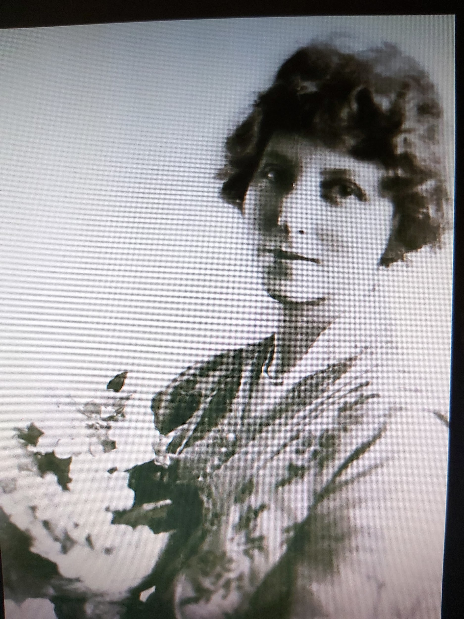
The Lady with Auburn Hair, Pale Skin, Freckles and Blue Eyes

Slide 14
Declining Health and Spiritual Crisis (Age 27)
May’s journal indicates that she prayed and had a deep faith in God, but she had lost all hope in life for personal happiness. She had had several suitors but was not pleased with any of them. She became deeply disillusioned with the shallowness of the world. Her mother returned to Paris in 1894 when May was 24, where her brother Randolph was going to study at the Ecole des Beaux-Arts. Friends and family were hoping that May’s failing health would soon begin to recover. She had been an invalid from the age of 21 years. By the age of 27, her physical and emotional health were ruined. She was subject to depression, anxiety, insomnia and general weakness. It was a desperate situation. ‘Abdu’l-Baha reportedly said that if she had not found the Faith, she would have died. (See MM1, pp. 52-54).

Slide 15
The Hearst Connection in Paris (1898)
The heiress, Mrs. Phoebe Hearst, “the mother of the faithful,” (‘Abdu’l-Baha) one of the most wealthy widows in California, was a friend of May’s grandmother. Mrs. Hearst was so taken with May that at one time she wanted to bring up May as her own daughter. Mamie Bolles said it was out of the question. Mrs. Hearst launched May’s expensive coming out as a debutante in Washington. The Bolles’ had been invited to “house sit” at Mrs. Hearst’s luxury apartment at 13 Quai d’Orsay in Paris. While Mrs. Hearst was leading the first group of American believers to visit ‘Abdu’l-Baha in Akka/Acco, she stopped in Paris to visit her nieces, Anne Apperson and Agnes Lane. May and her mother learned that Mrs. Hearst was going to stop in a few days at her Paris apartment along the way. Mrs. Hearst was shocked at May’s appearance. She called on Dr. Getsinger to treat May, but he decided that what May needed was to talk to his actress wife, Louisa.

Slide 16
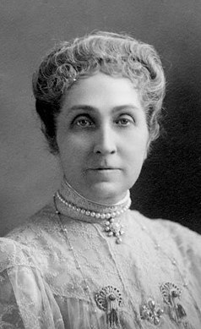
Phoebe Apperson Hearst “Mother of the Faithful”

Slide 17
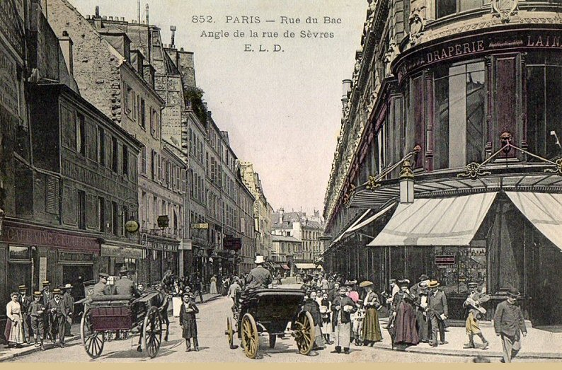
Rue du Bac in 1900

Slide 18
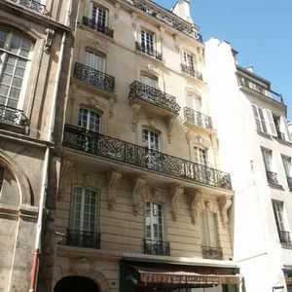
100 rue du Bac: The Bolles’ Home in Paris
May, her mother, her brother Randolph and her grandmother were living here when May heard about the Baha’i Faith from Lua Getsinger in 1898.

Slide 19
The Immortal Lua: “Herald of the Covenant”
Mrs. Hearsts’ friends thought the wealthy lady was just taking a tour down the Nile in Egypt, but Lua knew the true purpose--pilgrimage. It was at 100 rue du Bac where Lua uttered the name of ‘Abdu’l-Baha to the languishing patient like a prayer. When May heard the words, “There is a prisoner in Akka who holds the key to peace,” May became electrified. It was the cup of salvation that May’s parched lips had been thirsting for. She half-rose from her pillows and exclaimed: “I believe. I believe!” and then instantly fainted. Although May was one year older, Lua became May’s spiritual mother until the time of Lua’s early death at 43 of age in Cairo (1916) from heart failure. Lua could not have known that her little pupil would teach a number of illustrious western Baha’is, who would in their turn make their own indelible mark on Baha’i history. Baha’i history in Europe began at that very moment. In just a few years, it would begin in Montreal.

Slide 20
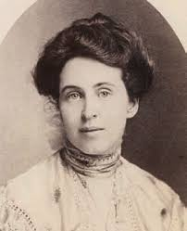
May’s Teacher: Louisa “Lua” Moore Getsinger
‘Abdu’l-Baha placed bread dipped in honey in her mouth and told her that He had given her “the gift of eloquence.” “Let all of your words be sweetly flavored by kindness to all people as this bread is flavored by honey.” He was reported as saying in another account that He handed her the bread.
May simply adored her teacher, and her teacher adored her. It was a unique, loving relationship. May said simply in a letter praising Lua to the Master: “There is no one like her.” Read her eulogy to Lua on Lua’s lonely death in Cairo. (MM1, pp.330-331)

Slide 21
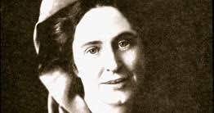
Lua “Liva” (Banner): “Mother Teacher of the West”
Lua was an actress and singer by training. She had a beautiful singing voice. ‘Abdu’l-Baha used to love to hear her sing. When she was with Him in Akka, He would ask her to stand on the terrace of His house, the House of Abdullah Pasha and sing “Nearer my God to Thee,” while He listened from His own special apartment on the roof. Her singing moved Him to tears.

Slide 22
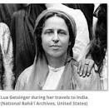
Lua in India
Lua was sent by the Master to India with her husband Edward to teach the Maharajah of Jalowar the Baha’i Faith. She met personally with Muzaffaridin Shah, son of Nasiridin, when he came to Paris (1902) to persuade him to alleviate the persecution of the Baha’is in Iran and release the prisoner of Akka. He did little for the first request and nothing for the second. Accompanied by other believers the same year, she headed for Constantinople to persuade the Sultan to release ‘Abdu’l-Baha, but the Master called them back from their mission.

Slide 23
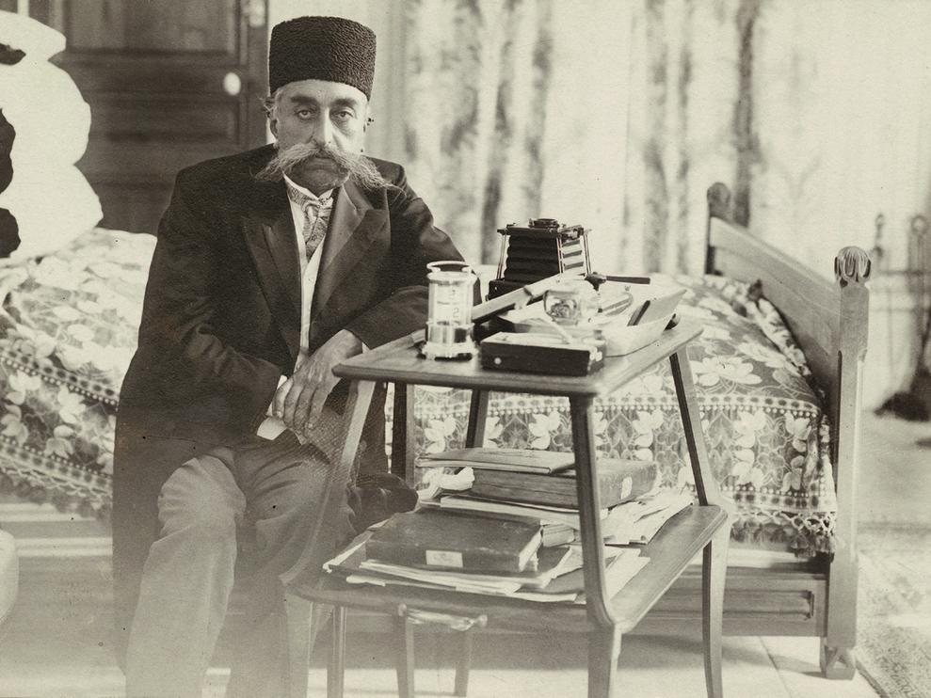
Muzaffaridin Shah Received Lua in Paris (1902)

Slide 24
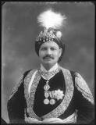
Prince of Jalowar
This man (1874-1929) was the ruler (Maharaja) of the princely state of Jalowar in India. ‘Abdu’l-Baha sent Lua Getsinger to India to teach this prince the Baha’i Faith. The state and the city of Jalowar are in north-west India.

Slide 25
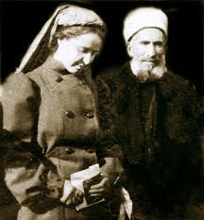
Lua with “the great apologist” Mirza Abu’l Fazel
‘Abdu’l-Baha told Lua
that Mirza Abu’l-Fazel
was her “spiritual father.”
Here Lua shows her
reverence and humility
before her great teacher. Sent by ‘Abdu’l-Baha, he also taught May Maxwell in Paris and the friends in America. His translator was Ali Kuli Khan who was my Aunt Ruth Halsted Kern’s teacher in Washington.

Slide 26
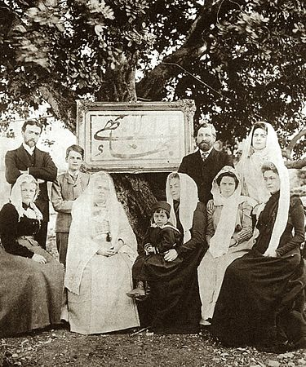
Some Early Western Baha’is
From left to right standing: Charles Mason
Remey, young Sigurd Russell, Dr. Edward
Gestinger, Laura Barney, later Dreyfus-Barney.
Seated left to right: Ethel Rosenberg, the first
English Baha’i, Madame Jackson, the foster
mother of Sigurd Russell (15,) Helen Ellis Cole,
a cousin of May Maxwell, holding Shoghi
Effendi on her lap, Lua Getsinger and Emogene
Hoagg.

Slide 27
Those Luminaries who Believed in Paris
“The first to believe was Edith MacKaye [later de Bons], and by the New Year of 1900, Charles Mason Remey and Herbert Hopper were next to follow. Then came Marie Squires (Hopper), Helen Ellis Cole, Laura Barney, Mme. Jackson, Agnes Alexander, Thomas Breakwell, Edith Sanderson, and Hippolyte Dreyfus, the first French Baha'i. Emogene Hoagg and Mrs. Conner had come to Paris in 1900 from America. Sigurd Russell at fifteen returned from 'Akka a believer, and in 1901, the group was further reinforced by Juliet Thompson, Lillian James, and ‘the frequent passing through Paris of pilgrims from America going to the Master... and then again returning from the Holy Land.’ These are but a few [add Marion Jack] for in 1901 and 1902 the Paris group of Baha'is numbered between twenty-five and thirty people with May Bolles as spiritual guide and teacher.." Baha’i Heroes and Heroines

Slide 28
The First Believers in Paris
Although the blog “Baha’i Heroes and Heroines” says that the opera singer Edith (Theodora) MacKay (later de Bons) was the first to believe in Paris, The Maxwells of Montreal records that after May Maxwell’s declaration of faith, it was a friend of May’s, Brenetta Hermann, who had vision of May standing at the foot of her bed, when she heard the words: “This is your teacher!” (1899). Edith MacKay was actually the second believer to follow Brenetta. Edith’s singing moved May to tears. It was after hearing Edith sing and following the guidance of “the breeze of the Holy Spirit” that May went again to hear her friend. After the song was over, Edith approached May, took May’s hands in hers and whispered in an agitated way: “Speak to me.” It was then that May announced to Edith the Kingdom of God on earth.

Slide 29
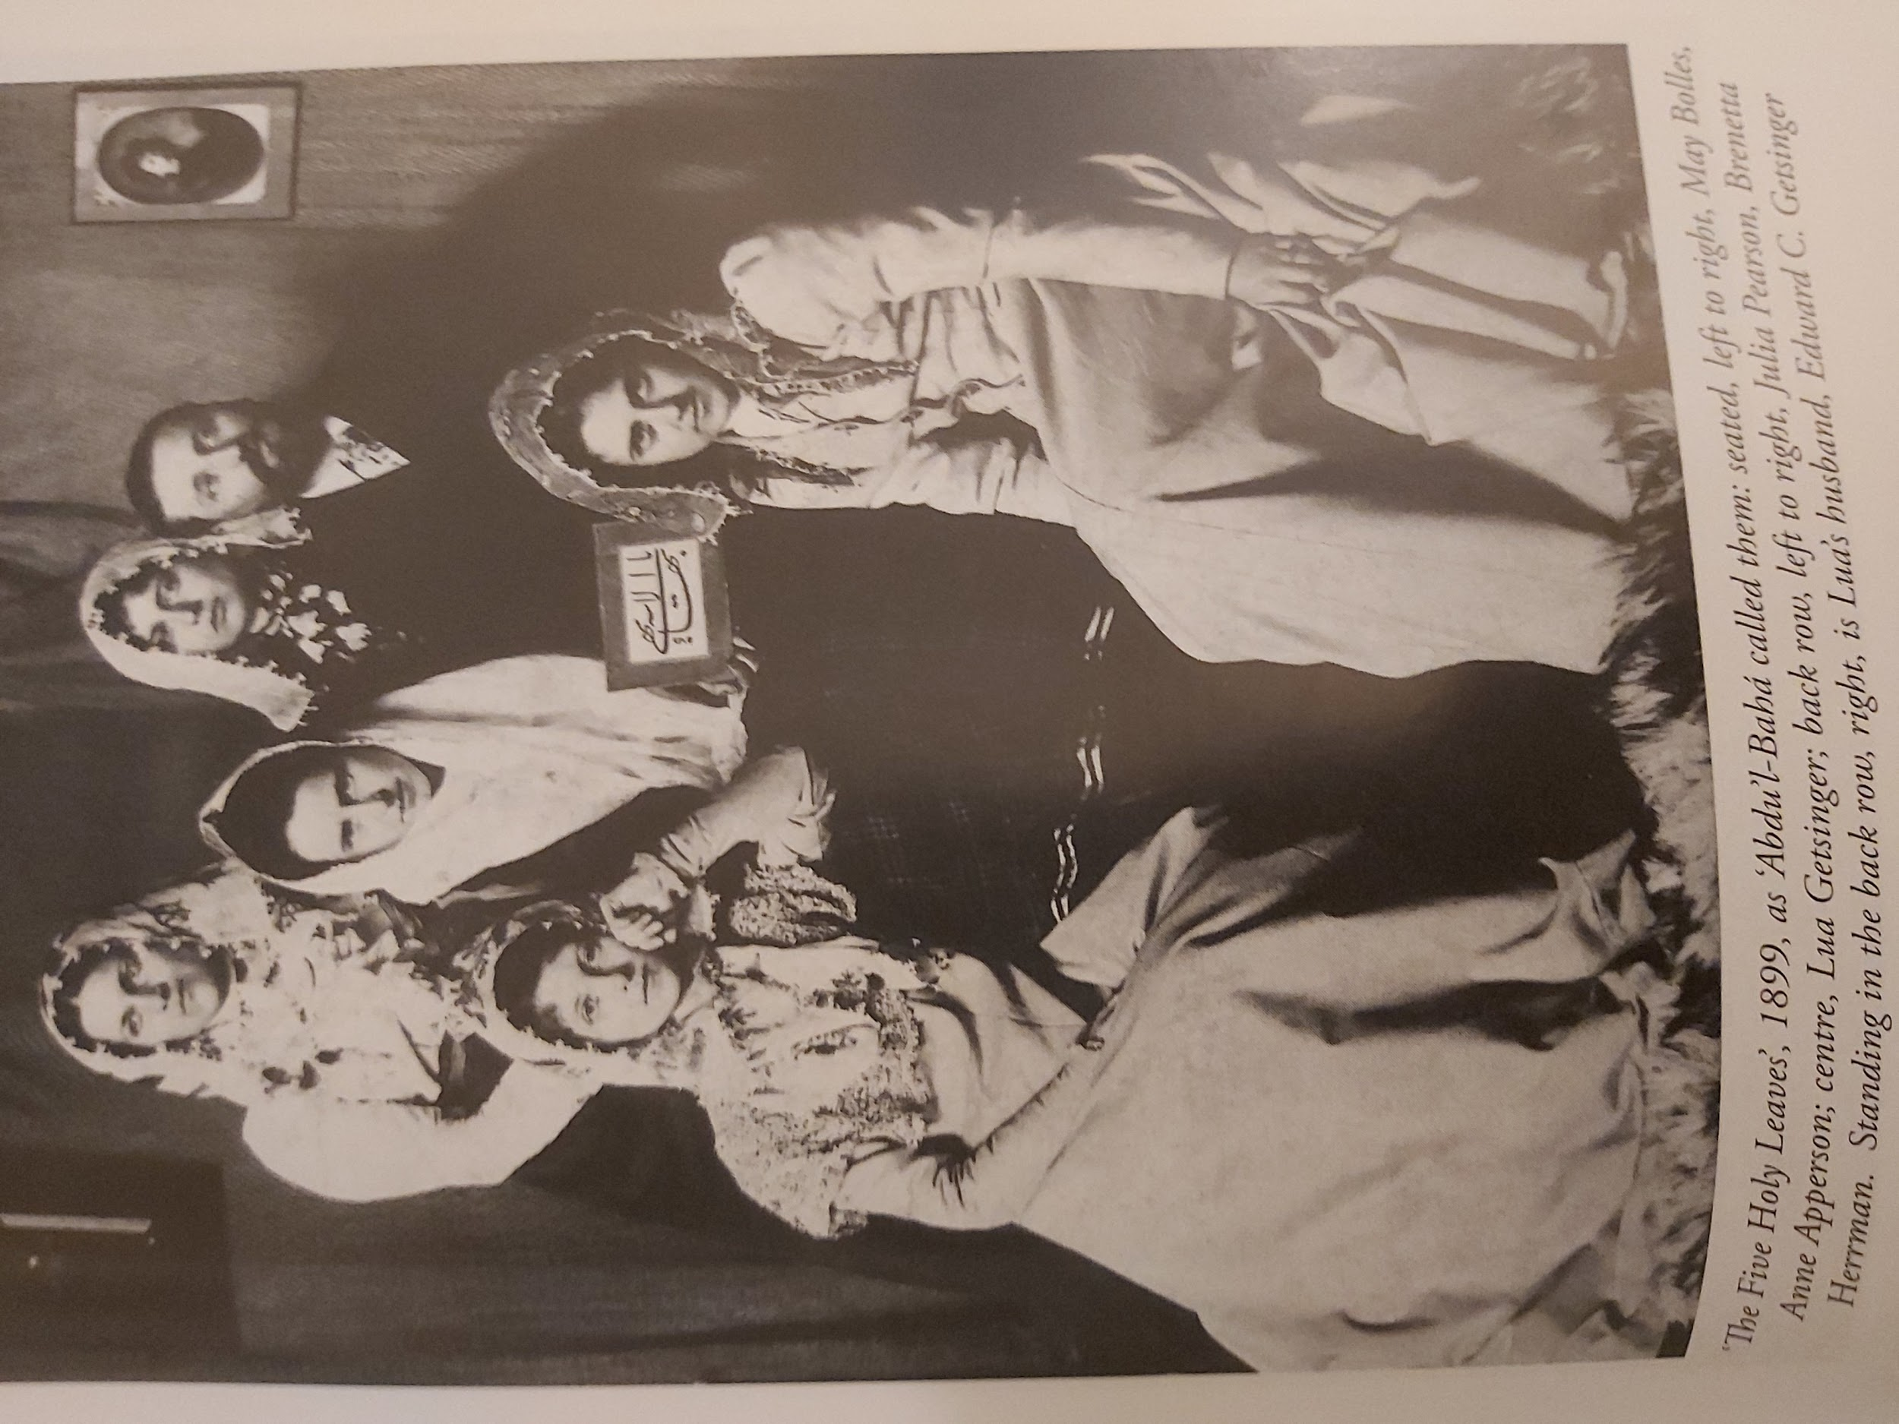
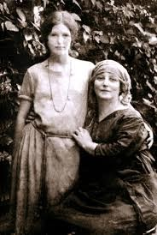
“The Five Holy Leaves” Paris 1899
Seated left to right: May Bolles, Anne Apperson, the niece of Mrs. Hearst.
Centre: Lua Getsginger
Back row, left to right: Julia Pearson, Brenetta Herrman, the first believer to accept the Faith after May Bolles, Dr. Edward Getsinger, Lua’s husband.

Slide 30
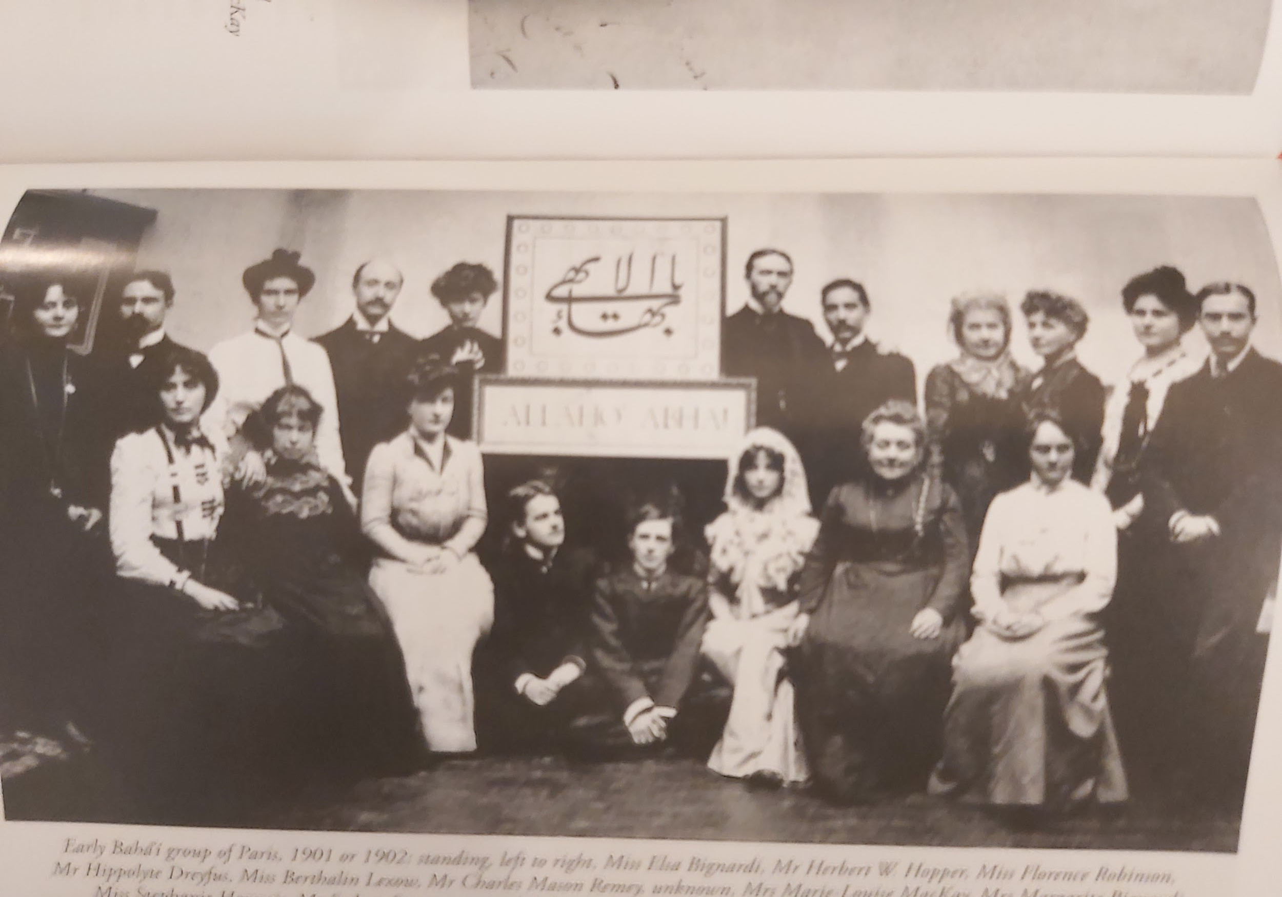
The Paris Baha’i Group Founded by Max Maxwell c. 1900
Facing the photograph, May is seated in white with a veil in the front row to the right of Thomas Breakwell. Tall Charles Mason Remey is standing to the right of the Greatest Name. Hippolyte Dreyfus, the first French Baha’i is the 2nd person to left of the Greatest Name. Edith MacKaye wearing a white blouse is seated to the extreme left.

Slide 31
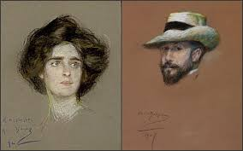
Laura Barney and Hippolyte Dreyfus Paris c. 1900
I have not been able to decipher the name of the artist. Later they became husband and wife, known as the Dreyfus-Barneys. Both Hippolyte Dreyfus, the first French Baha’i, and Laura were taught the Faith by May Maxwell in Paris, along with several other Baha’i historical figures mentioned below.

Slide 32
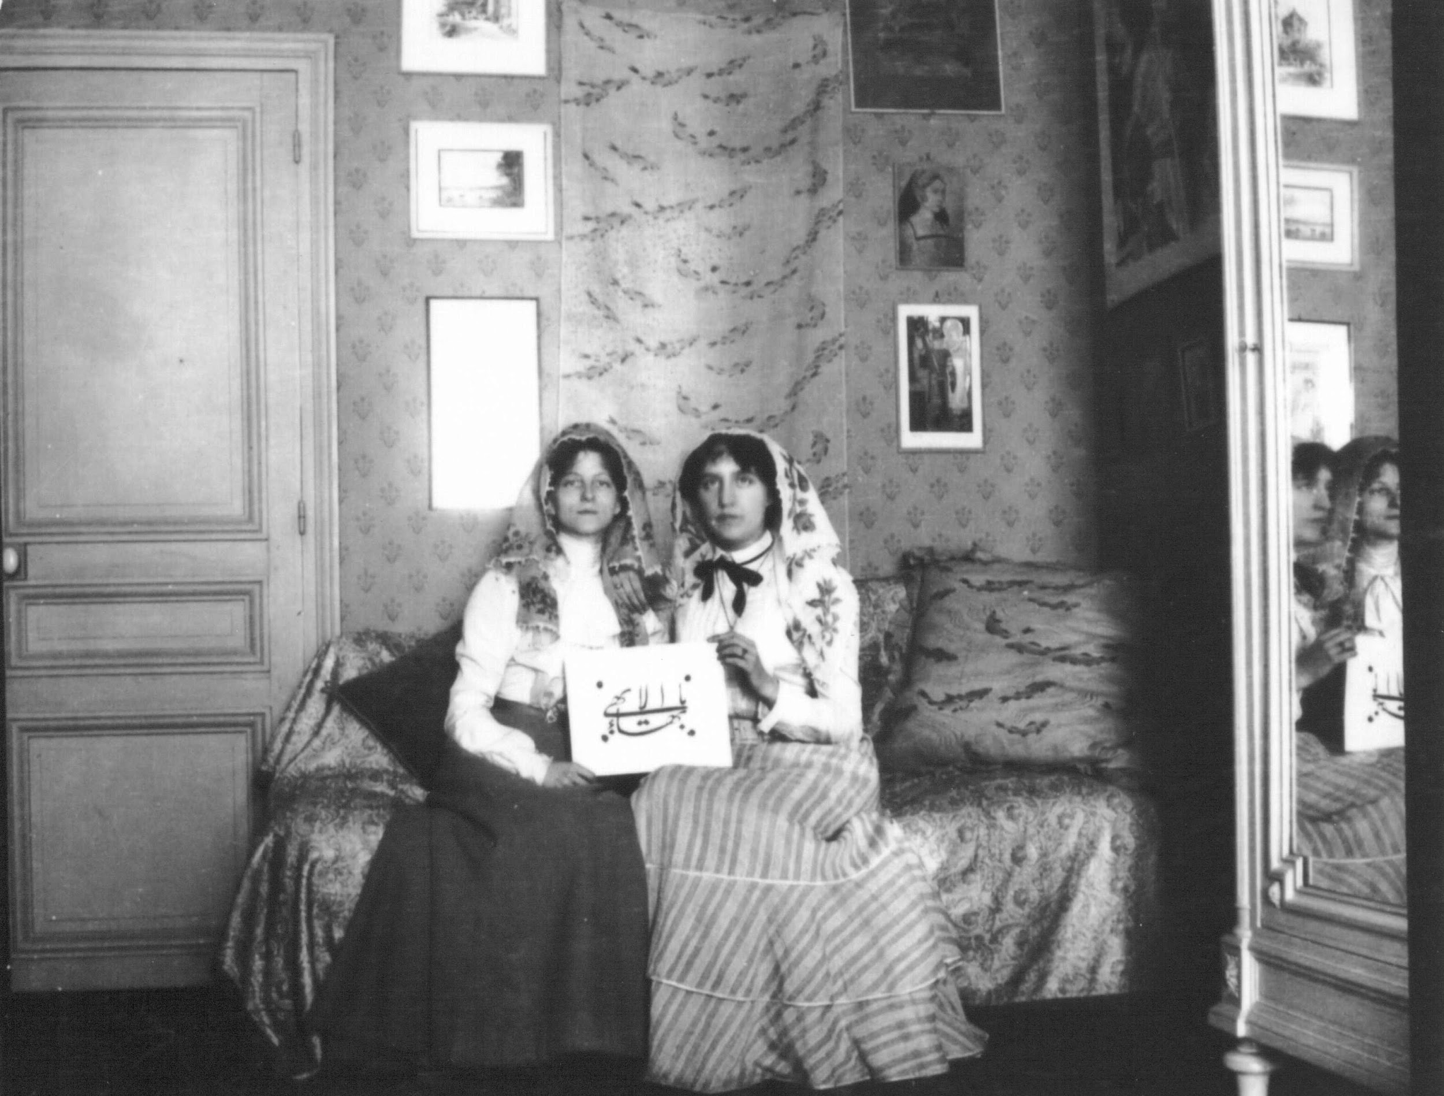
May Maxwell and Edith MacKay, later Madame de Bons. She married a Swiss dentist, M. Joseph de Bons. They became the first Swiss Baha’is. I had the good fortune of meeting her daughter Mme Haenni de Bons when I was a student at the Sorbonne (1965-1968). In her talk she called May Maxwell “l’ange de l’annonciation”. (the angel of annunciation).

Slide 33
Meeting Sutherland Maxwell in Paris
May’s brother Randolph who finally formally accepted the Faith very late in life--it was Randolph who provided the English translation of the French footnotes in Shoghi Effendi’s The Dawnbreakers--had gone to Paris to study architecture at the École des Beaux-Arts (School of Fine Arts) where he met Sutherland. In October 1899, Randolph first invited Sutherland to dinner at 100 rue du Bac--the building no longer exists--where he would dine with Mrs. Bolles and May. May was 29 years old and unmarried. Mamie Bolles, May’s practical, down-to-earth, fun-loving mother, liked Sutherland, but as a young architecture student, he was as yet without prospects. Still, Mrs. Bolles was impressed with the character of the Scots Canadian and thought he had potential.

Slide 34
May’s First Reaction to “Max”
Being a lifelong lover of beauty, a love that began in his earliest years, William Sutherland Maxwell soon became entranced with May’s delicate beauty. At dinner, he could not help staring at her. Sutherland’s attentions made May feel uncomfortable. When Mrs. Bolles made a favourable comment about Sutherland one night after dinner when the young Canadian had already left, May turned suddenly to her brother Randolph and said:
“Don’t ever bring that big Canadian here again!”

Slide 35
Marriage of Sutherland Maxwell to May Bolles
When May first told Sutherland Maxwell about the religion she belonged to, Sutherland was not at first very interested in the Baha’i Faith. He was interested only because he realized it was such an intrinsic part of May’s life. Since their first meeting at dinner at 100 rue du Bac in October 1899, their friendship and later their courtship, stretched out over a two-year period. Both May’s mother’s and brother Randolph’s fondness for “Max” gradually influenced May’s increasing favourable feelings for William. They married in London on May 8, 1902. They were married for 38 years until May’s death in 1940. It was the happiest of domestic relationships. “Happiness was ours with never a cloud on the horizon.” (WSM) There was one, however, one brief cloud on the horizon, but it was quickly dissipated. (MM1. p. 228).

Slide 36
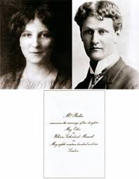
Marriage of May Bolles and William S. Maxwell
May 8, 1902
Christ Church
4:00 p.m.
Woburn Square
London
After the two year courtship, when it came time to propose to the woman with whom he had fallen in love at first sight, “Max” as May’s brother Randolph called him, could not get the words out. (May was the only person to call him Sutherland. Everyone else called him William, except Randolph). May helped him by saying: “Sutherland, are you proposing to me?” He said, “Yes,” and May said, “I accept.”

Slide 37
The Canadian Chapter Begins in Montreal (1902)
May’s very fruitful historic period of teaching in Paris, during which several western luminaries became believers, and who established the Faith around the world, was very short, lasting from 1900-1902. It was very difficult for May to leave Paris. She had grown up there, became a believer there, met her husband in Paris and returned to Paris after the great Hearst pilgrimage to Akka of 1898. Leaving Paris for Montreal weighed heavily on her sensitive heart. As the mother of the community, she felt as if she were abandoning her children, although she left Paris to marry Sutherland with the permission of ‘Abdu’l-Baha. Lua followed up on May’s work in Paris later that year (1902). It was a great sacrifice for May to leave Paris. She fell ill on her arrival.

Slide 38
The Early Years: Joy and Sorrow (1902-1910)
The Maxwells moved 3-4 times, living with Sutherland’s parents and later in a house provided by his brother Edward. May’s adjustment to life in Montreal was very difficult. May was sickly; the Maxwells were hearty. She fled the harsh winters on the advice of the Master. Sutherland was not close to his father. May belonged to a peculiar religion for which they showed no interest. She was open, friendly and affectionate; they were reserved. Sutherland was not yet a confirmed believer, something for which May prayed constantly and begged ‘Abdu’l-Baha to hasten. May often absented herself from Montreal to seek the company of the friends in the United States. May’s mother needed care and passed away during this time. After a period of eight years of adjustment, they moved into their own home at 716 Pine Avenue West that Sutherland had designed and built himself. (1910)

Slide 39
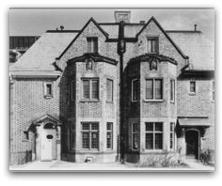
716 Pine Avenue West: Now 1548 Pine Ave. West

Slide 40
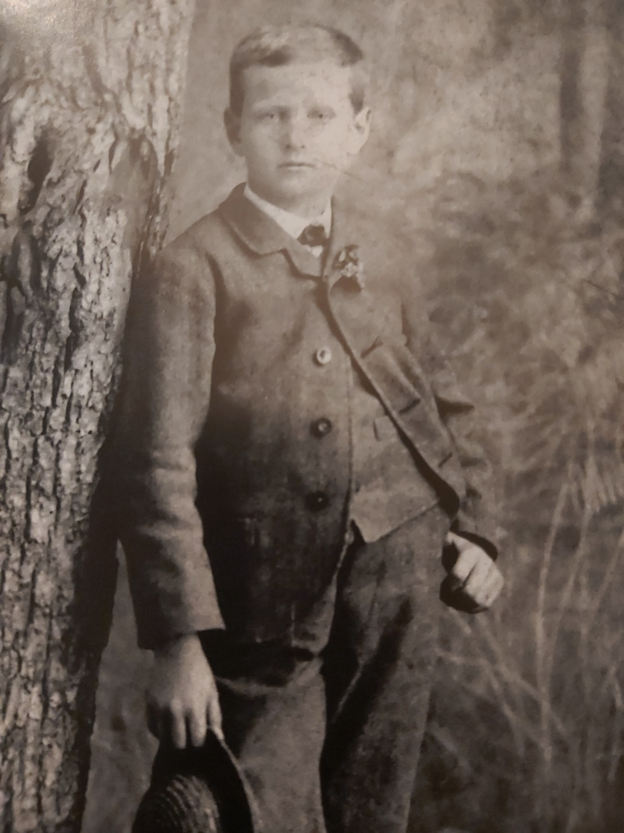
Sutherland as a Boy Age 10 in 1884
His daughter wrote that this photo was like his own life and nature: kind, strong, deeply rooted in his traditions, good and peaceful.

Slide 41
The Early Years: Sutherland’s Declaration (1904)
Despite the radical culture shock May experienced in moving from Paris to Montreal, it wasn’t all doom and gloom. Sutherland joined the Faith in 1904, although his understanding of the Faith was restricted until he met ‘Abdu’l-Baha on the pilgrimage of 1909. In her frequent absences, through her letters and in all her conversations, May always attempted to deepen William’s understanding of the Faith. In one of His tablets, the Master assured May that William would eventually join the Faith. She had led him to the “threshold’, as ‘Abdu’l-Baha wrote. May’s priority was of course the Baha’i Faith. From 1901 when he joined the firm of Edward and W.S. Maxwell Architects, William’s priority was in establishing the firm. It is only my impression that William liked to keep his faith activities somewhat separate from his professional activities. Although Sutherland was somewhat reclusive, he was very active in a good number of art and architecture clubs.

Slide 42
The Montreal “Local Spiritual Assembly” (1906)
Despite the health and climatic challenges that she faced in Montreal, May wasted no time in discharging the mission given to her by ‘Abdu’l-Baha to establish the Faith in the Dominion of Canada. By 1906, only 4 years after she left Paris, and just 2 years after her marriage to Sutherland, the Baha’i “Local Spiritual Assembly” was established in Montreal, with a membership of “12 or 15 members” who were in various degrees of association with the Faith, some more formal than others. In His reply to the letter from Montreal artist Percy Woodcock that the Spiritual Assembly had been formed, ‘Abdu’l-Baha wrote: “Such confirmation deserveth thanks and praise, and such
Guidance is the the most great bounty from of His Highness the Desired One.” May was one of the first Baha’is in the Dominion of Canada, but it wasn’t long before the wife of Sutherland’s cousin, Martha MacBean, became a Baha’i circa 1903. Others soon followed. In these days, Baha’is often retained their membership in the churches to which they belonged, until the Guardian ruled that it was inconsistent to be a Baha’i and to belong to a church at the same time. N.B. The LSA above means the community not the institution that is formed or elected.

Slide 43
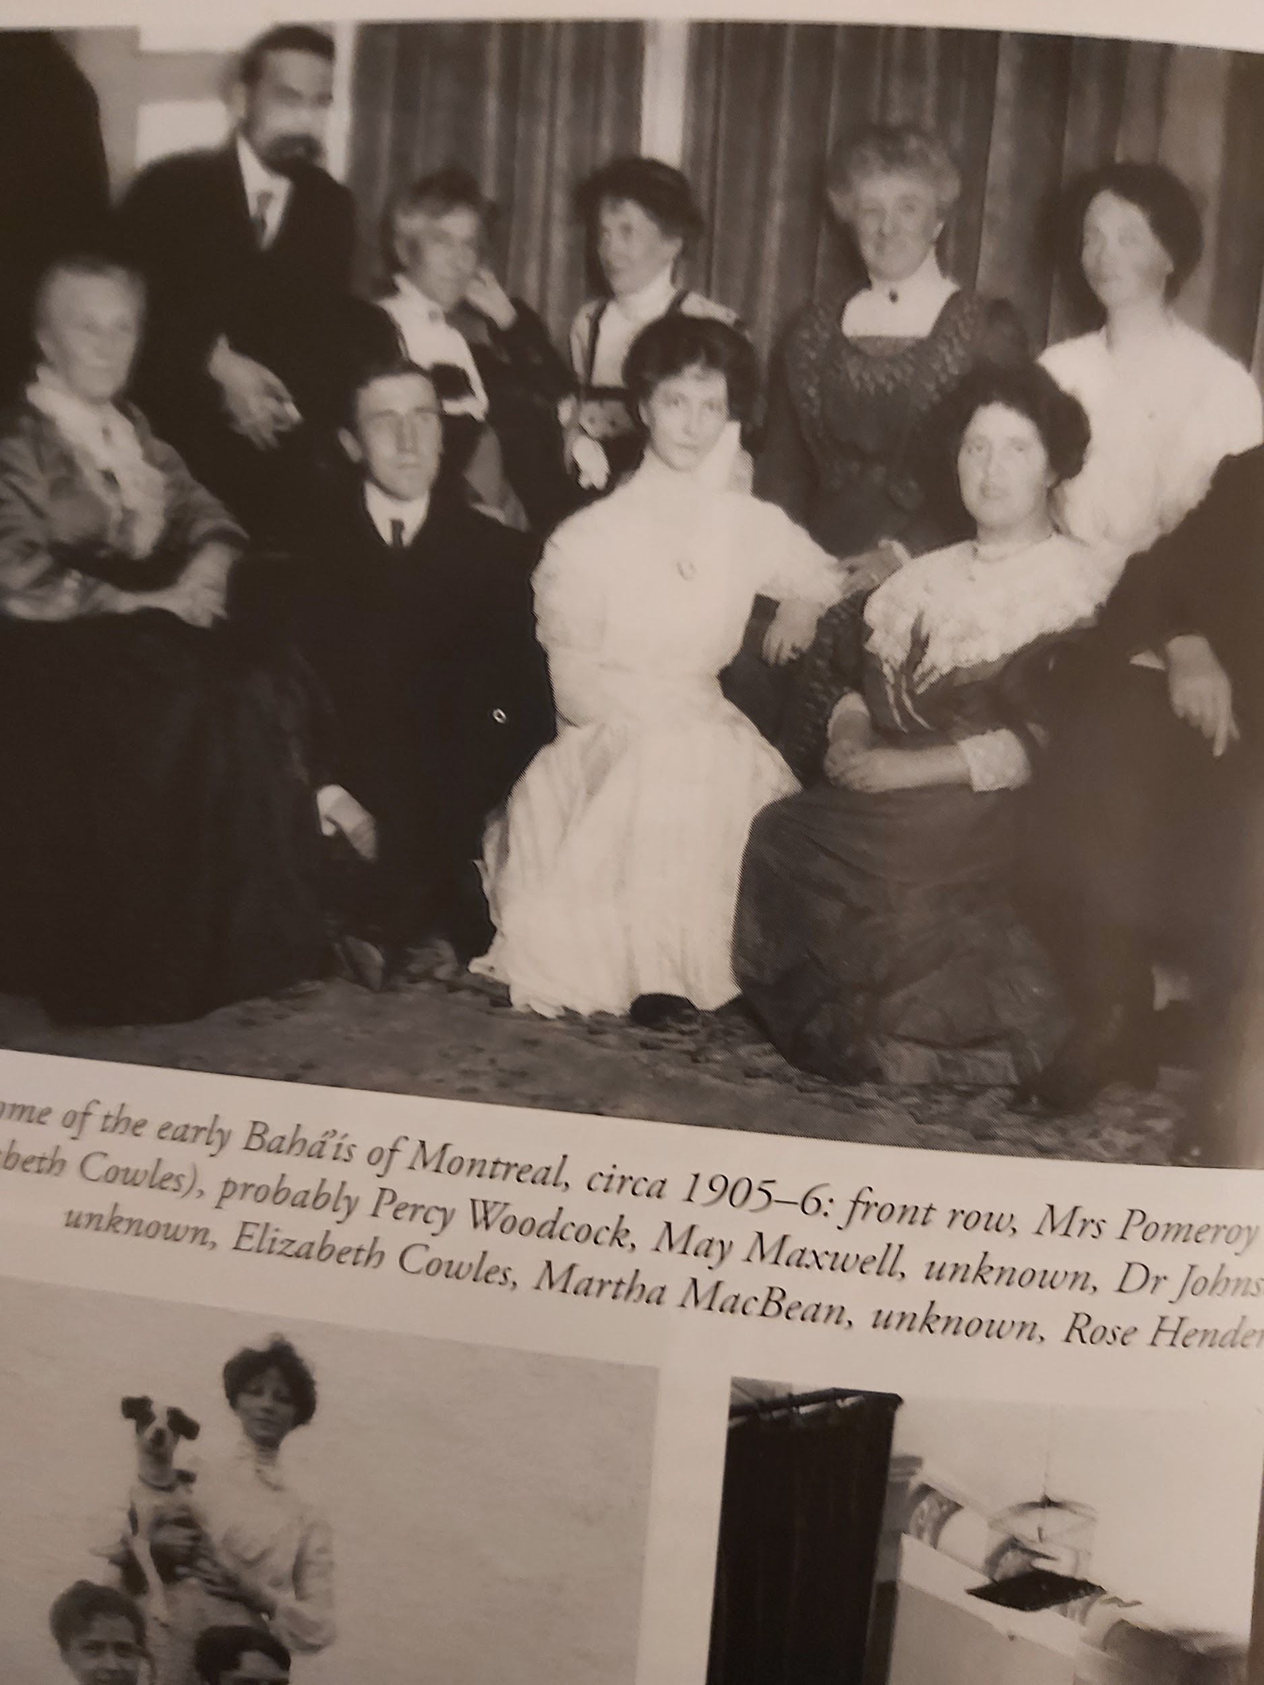
The LSA of Montreal 1906: LSA =Community
Front Row, left to Right: Mrs.
Pomeroy, Percy Woodcock,
May Maxwell, unknown, Dr.
Johnson. Back Row: Unknown,
Elizabeth Cowles, Martha
MacBean the wife of Sutherland’s
Cousin, Unknown, Rose
Henderson .

Slide 44
A Moment of Crisis and Turning Point (1)
Early on in their marriage (circa 1902), May was often absent from the home, either on family matters in the US, teaching the Faith, or escaping the Canadian winters, as ‘Abdu’l-Baha advised her to do. William was preoccupied in establishing his business in Montreal. The married couple was growing apart. One night they had a conversation. Sutherland said words along these lines: “You are involved more and more in your Baha’i work and I in my professional work; we are drifting apart.” May was tempted to respond as the obedient wife, a role that was expected of her in those days. She was terrified by the implication of his words, but she reminded him that when they married, she told him that her allegiance to the Faith would always come first in her life. She steeled herself and said: “If I must, then I will go alone on this chosen path in my life.”

Slide 45
Domestic Crisis and Sudden Resolution (2)
Sutherland was silent for a few moments, then he reached out and took her hands in his and said: “I will go with you all the way.” The crisis was thankfully quickly resolved. Ruhiyyih Khanum said that this moment was a turning point in her father’s recognition of the Faith. If May had wavered in her commitment to the Faith, and relegated it to a second order in her life, as many women in those days felt they must, Sutherland would never have continued to be exposed to May’s efforts to bring him fully into the Faith. Her steadfastness had made all the difference. “By taking this stand, she brought him, as it were, to a critical crossroads. He had to chose.” (MM1, p. 228)

Slide 46
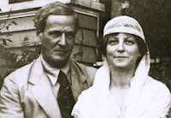
Mr. and Mrs. May and Sutherland Maxwell

Slide 47
The Birth of Mary Maxwell, Ruhiyyih Khanum
During May’s second pilgrimage in 1909, this time with Sutherland, they had been married for seven years, but they were childless. She had assumed that she could not have a baby. In a very touching scene, while she was holding Ruha Khanum’s newborn baby in her arms, the Master told her that she could have a baby and that He would pray for her. It was on this pilgrimage that Sutherland became confirmed in the Faith when the Master helped him to understand the necessity of knowing God through the Divine Manifestation. Previously Sutherland thought he could worship God directly. In His famous reply to Mr. Maxwell, when the Master asked Sutherland where God was, and he replied, “God is everywhere, ‘Abdu’l-Baha pointed to the necessity of a Mediator when He said: “Everywhere is nowhere.” Sutherland bowed his head and accepted His explanation . (MM1, pp.250-251).

Slide 48
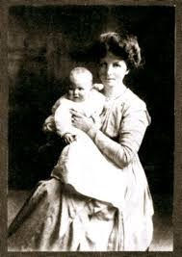
The Birth of Mary Maxwell
during the last few months of pregnancy. To avoid travelling, May remained in New York at least from May to August. Little Mary Maxwell was born in the Hahnemann Hospital at 657 Park Avenue on August 8, 1910. Their joy was great but especially because they received a tablet from ‘Abdu’l-Baha for the occasion. (MM1,p.268). May had to get “a good wet-nurse” because Mary was “weak and frail from improper nourishment.” May stayed 3 months post natal in the hospital.
Mary Maxwell was born when May was 40 years old. Because of her weak constitution and because her grandfather had been one of the earliest homeopathic doctors, she wanted to be under the care of a homeopathic physician.(In those days homeopathic doctors also practiced allopathic medicine-- until the drug companies and allopathic doctors began to restrict their activities). She decided to remain in the United States

Slide 49
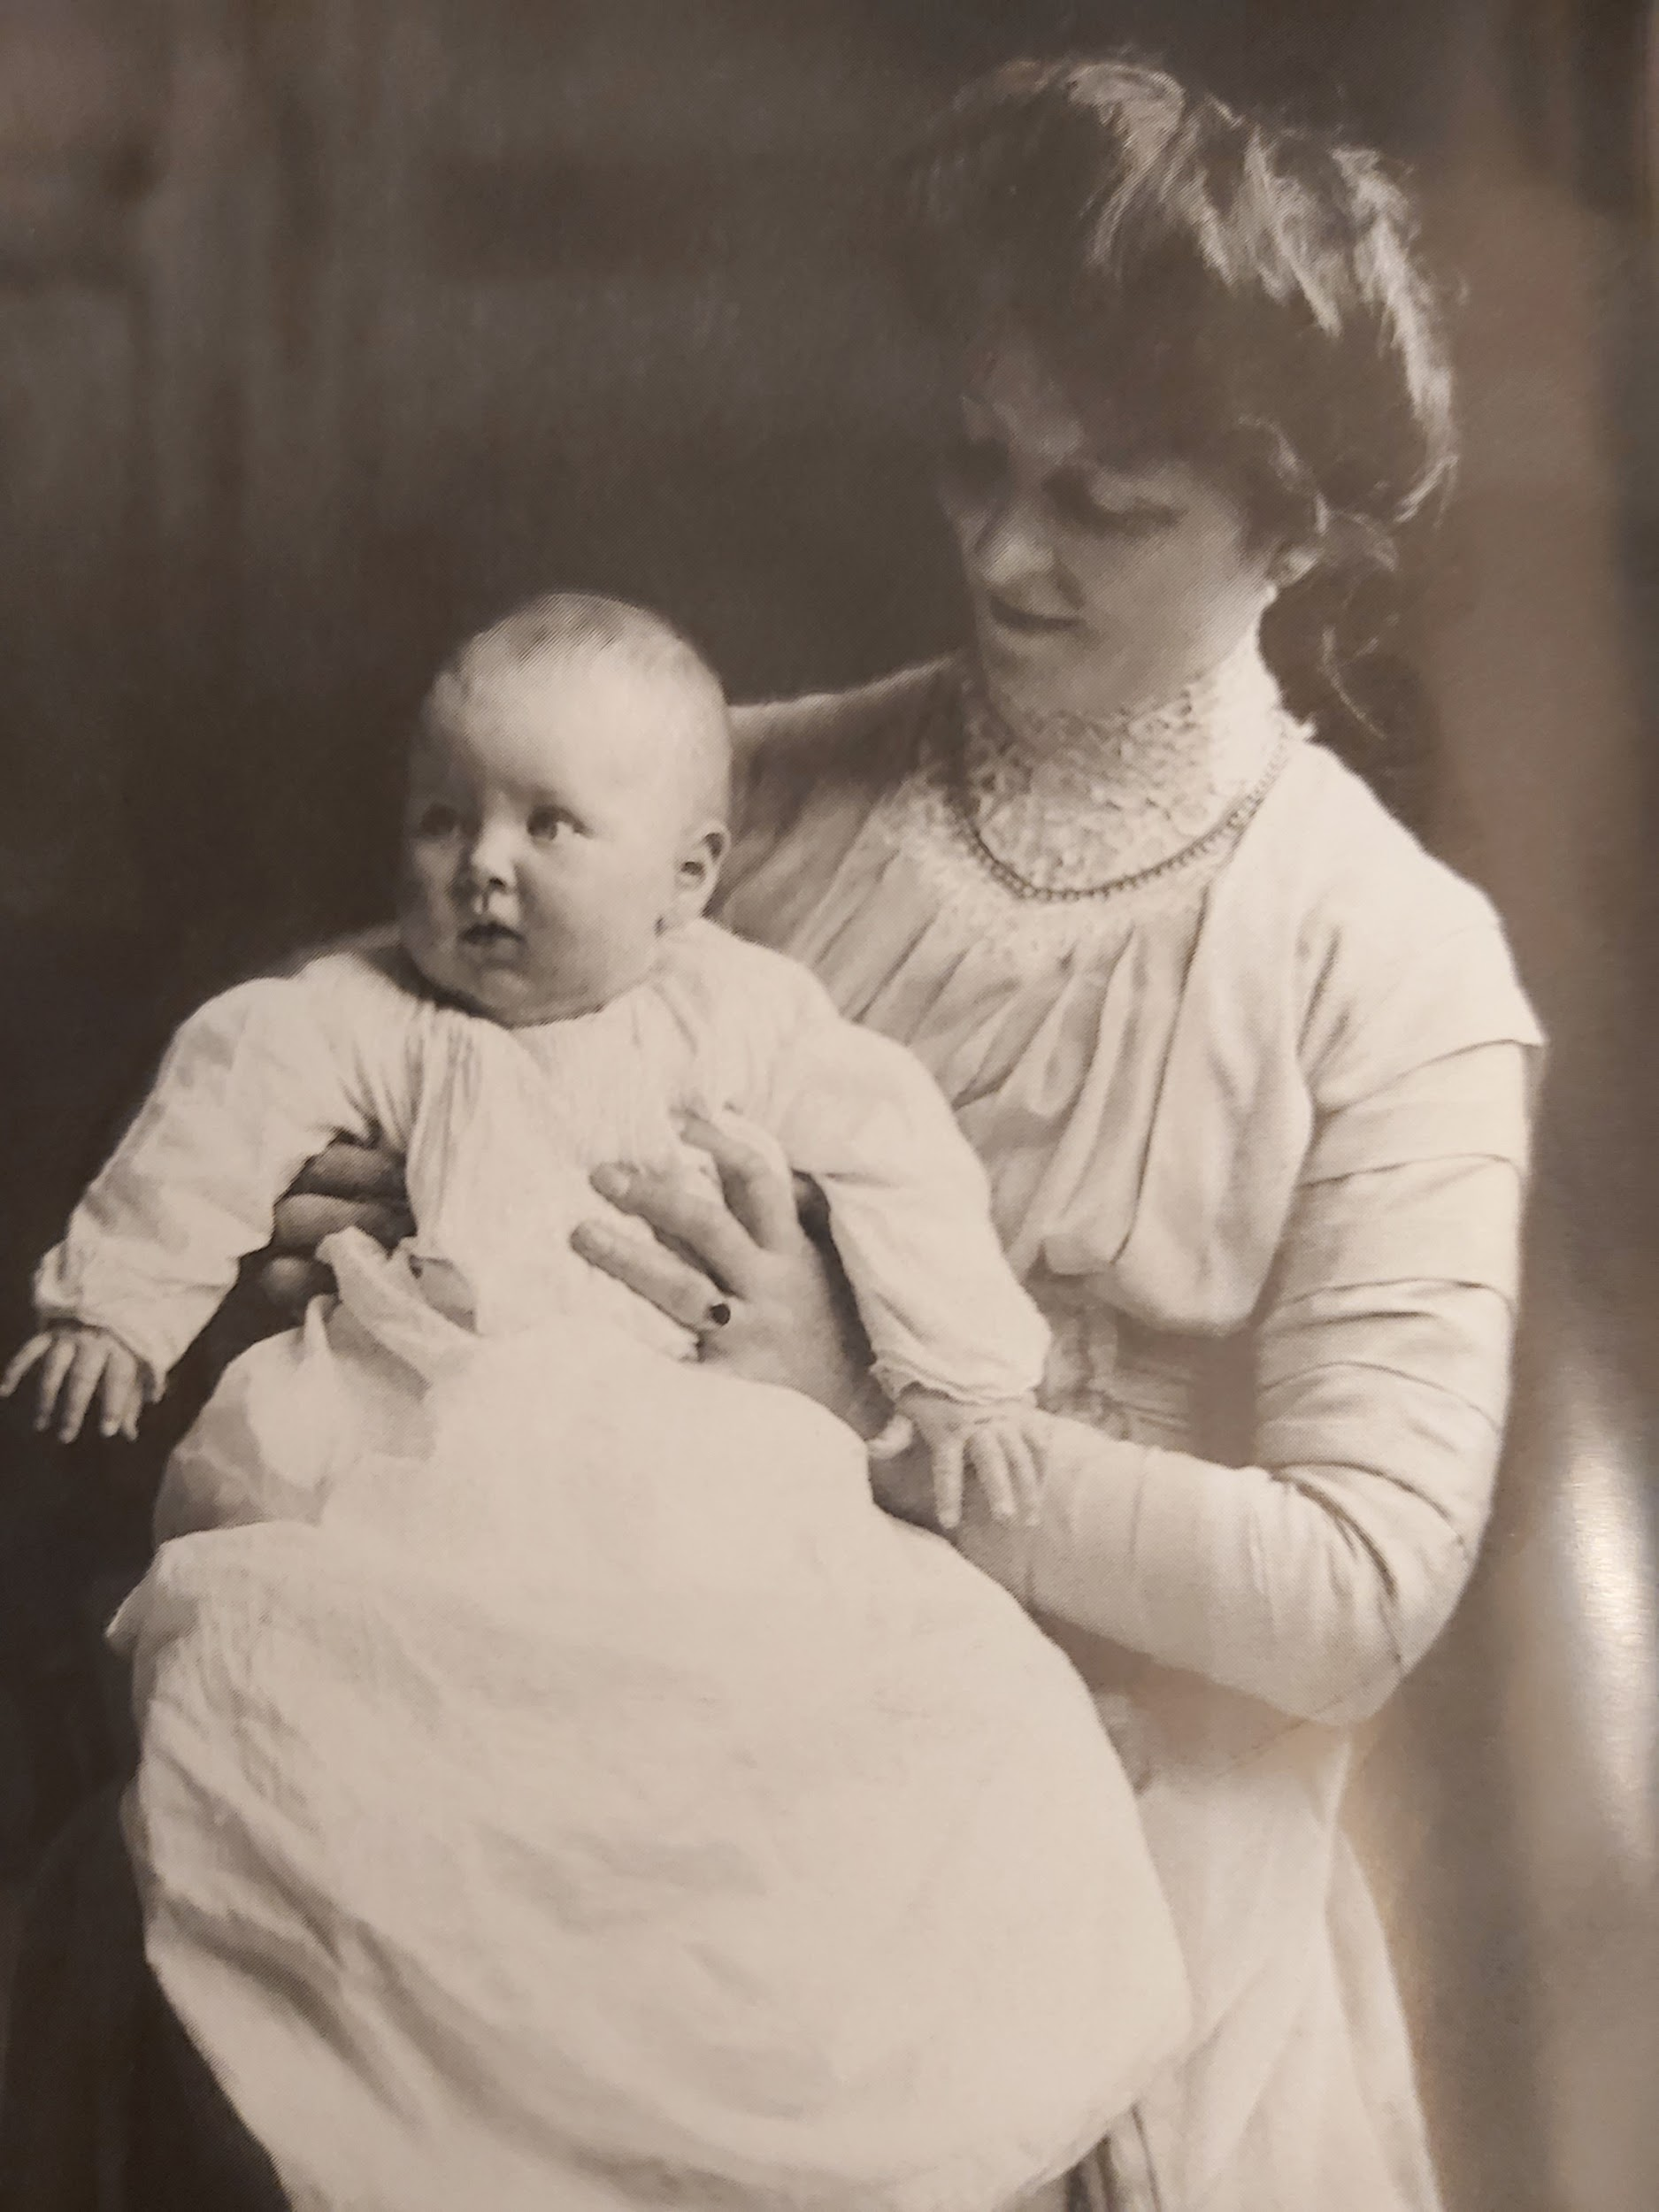
Mary Maxwell: Born August 8, 1910
“In the garden of
existence a rose has
blossomed with the
utmost freshness,
fragrance and beauty.”
‘Abdu’l-Baha

Slide 50
Her Relationship with Sutherland Maxwell
May was a prolific correspondent throughout her life. Close relations based on warm and effective communication were essential. During her travels for the Faith, she would often employ a stenographer to dictate letters. Her letters to Sutherland are warmly affectionate and full of terms of endearment, not only to Sutherland and Mary, but to all her friends. His to her were equally affectionate. Unlike his parents, Mr. Maxwell does not give the impression of being the reticent Scottish Canadian in expressing his emotions. In the early days of her marriage especially, May was an insistent teacher, reminding Sutherland of the great station of the Faith that he had joined and that their real union was based on a spiritual union of souls. She frequently reminded him of how blessed he was to have made the pilgrimage in the days of the Master and to have had the inestimable bounty of knowing this Most Great Revelation. (MM1, pp. 231-232, 234)

Slide 51
Review and Addenda
(1) Despite the fact that May was one year older, Lua always addressed May as “my dear little pupil” and “Oh my own dear little violet,” and “a star in my crown,” and “my May violet.” May considered Lua to be her older and wiser spiritual mother to whom she owed a priceless debt of gratitude.(2) When a group of early western believers, headed by Lua, were on their way to visit the Sultan to petition him to release Abdu’l-Baha, the Master wrote and ordered them to abort their plan. (3) Madame Jackson, the foster mother of young Sigurd Russell, is pictured in the photo of early western pilgrims. Both are pictured in slide 29. (4) The painter Edwin Scott met both ‘Abdu’l-Baha and later Shoghi Effendi, who visited his artist’s studio while Shoghi Effendi was recovering from exhaustion, taking water therapy in Neuilly, just outside of Paris, on the orders of the Master. Abstract impressionist Edwin Scott’s paintings are still available for purchase on the Internet.

Slide 52
Review and Addenda (continued)
(5) Although Sutherland decided at the first dinner that he was going to marry May, it took about 6 months to establish cordial relations with her. May was in love with the Cause; Sutherland was in love with her. May wanted to awaken Sutherland's heart to the Faith to ensure their mutual spiritual bond. Sutherland's “religion” was art. May prayed that he recognize Baha’u’llah’s revelation and the station of ‘Abdul-Baha. Although Sutherland believed in God and had a strong sense of morality and decency, his soul was not initially moved by the Faith in the same way May’s was. She copied prayers for him and asked him to say them often every day. When he lost them, she sent them again. She used her letters as a teaching medium, always reminding him that marriage was a partnership of souls, that the Faith was sublime and ‘Abdu’l-Baha’s station was unique.

Slide 53
Review and Addenda (continued)
(6) The reason for the two year engagement had very much to do with the wishes of Abdul Baha. He had instructed her in a tablet “Do not make haste in the matter.”(MM1, pp. 173-4).The Master was waiting for Sutherland to progress spiritually. He also wanted her to stay in Paris until the requisite number of believers had been established. It was in this context that the shocking refusal of May to leave for vacation in Brittany with her mother, brother Randolph and Frank Irwin, her mother’s cousin, on the orders of Abdul-Baha is relevant. The Master instructed her that in no wise was she to leave Paris.(MM1, pp. 131-132). But as soon as May mailed off Thomas Breakwell’s declaration of faith, May received a blue cablegram from the Master telling her: “You may leave Paris any time.” When May explained this sudden turn of events to her mother in Brittany, her mother burst into tears and exclaimed that May did indeed have “a wonderful Master!”

Slide 54
Miss Mary Maxwell’s Childhood Personality
Mary was an independent little girl with an indomitable will. She was very articulate from a young age and spoke at the more mature level of an adolescent or adult. She was encouraged by May from an early age to speak her mind, perhaps because ‘Abdul-Baha encouraged her parents to give her more freedom than most children. May noted that she was “Never afraid of anything--interested in everything.” (MM1 pp. 316-17). She was not always an easy child to discipline. Sometimes there were tearful scenes when Mary could not have her own way. When she fell into a creek, Mary told her mother: “It was an accident, on purpose to see if I could swim.” When she behaved improperly towards her father, Sutherland said to his young child: “Do you understand, you have got to show more respect to me because I am your Father.” The precocious child famously retorted: “Why should I respect you when you are not respectable?” (MM1, p. 317). ‘Abdu’l-Baha had prayed that Mary would become a child of the Kingdom. May raised her diligently to ensure that His prayers would be answered.

Slide 55
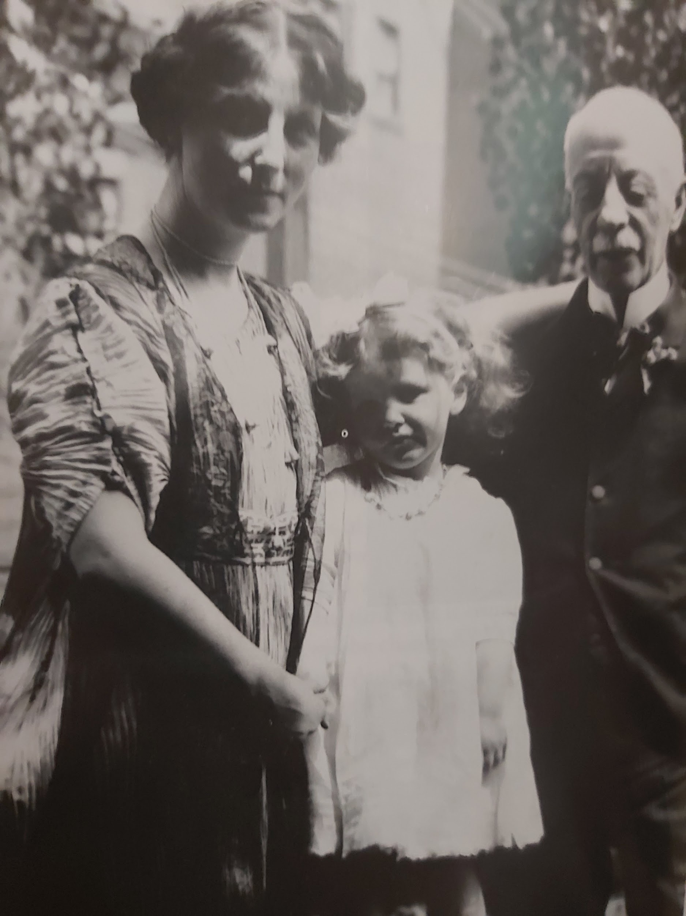
The Three Generations
Although it is difficult to
see it in this photo, May is
wearing a string of beads
given to her by ‘Abdul-Baha.
Little Mary is pictured here
with May and her grandfather
John Harris Bolles.

Slide 56
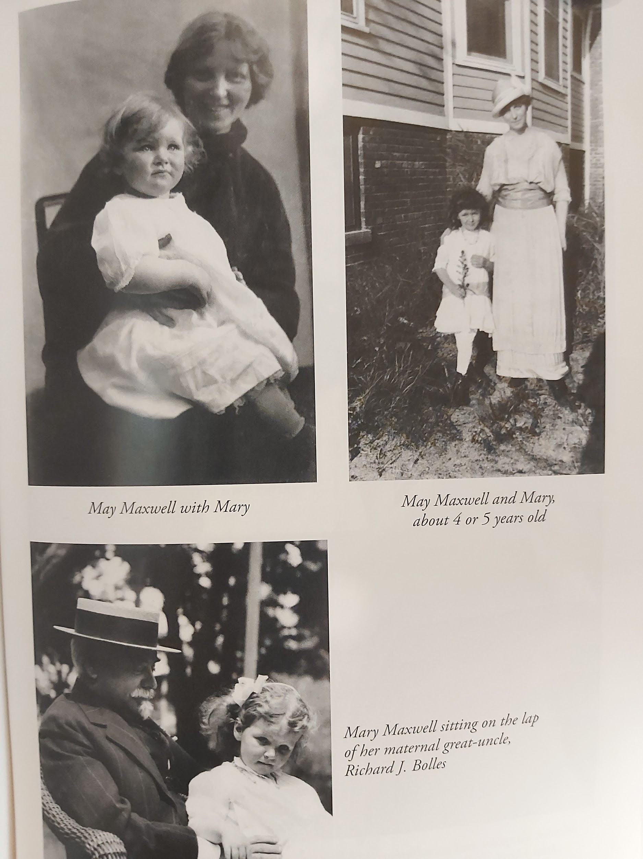
Mary’s Childhood
In the photo to the right
Mary is 4 or 5 years old.
Her mother is about 45
years old in the same
photo.
With Richard J. Bolles,
her maternal great uncle.
.

Slide 57
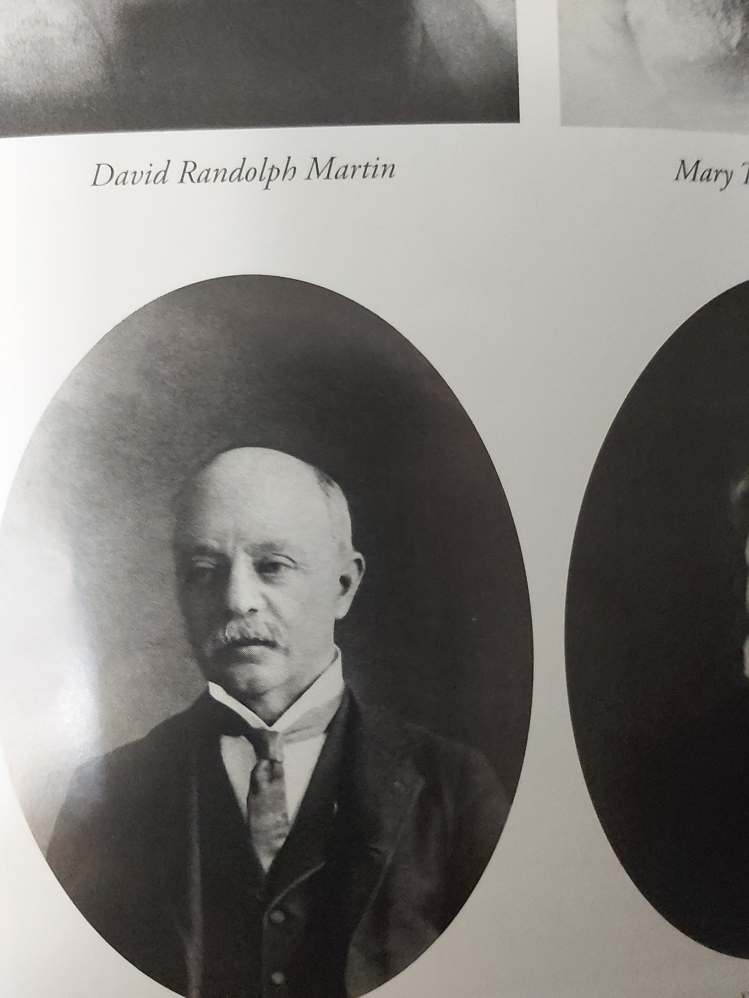
May’s Father John Harris Bolles
John Harris Bolles was a very kind and loving father. His letters to May were unusually affectionate for a man of his time. He was mostly silent, except when he was writing.Then he expressed himself fully. A mining engineer, like his millionaire brother Richard, he did not fit at all the mould of a practical man. He was an idealist, inclined to contemplation and melancholy, who enjoyed literature and admitted that he was not interested in making money.
JHB had a dry wit and subtle sense of humour, that he best expressed in writing. Here is his amusing description of an attack of kidney stones. (MM1, pp. 300-301).

Slide 58
John Harris Bolles and the Baha’i Faith
May Maxwell begged ‘Abdu’l-Baha to grant to her father forgiveness and recognition of the Faith. May claimed that her father accepted the Baha’i Faith before he died of cancer. May ensured that JHB met ‘Abdu’l-Baha before the Master began His tour of the western states. The Centre of the Covenant affectionately embraced him and spoke with him. When he died, ‘Abdu’l-Baha wrote to May: “Regarding thy dear father, rest assured that in the Kingdom of God the brightness of his countenance is great indeed.”

Slide 59
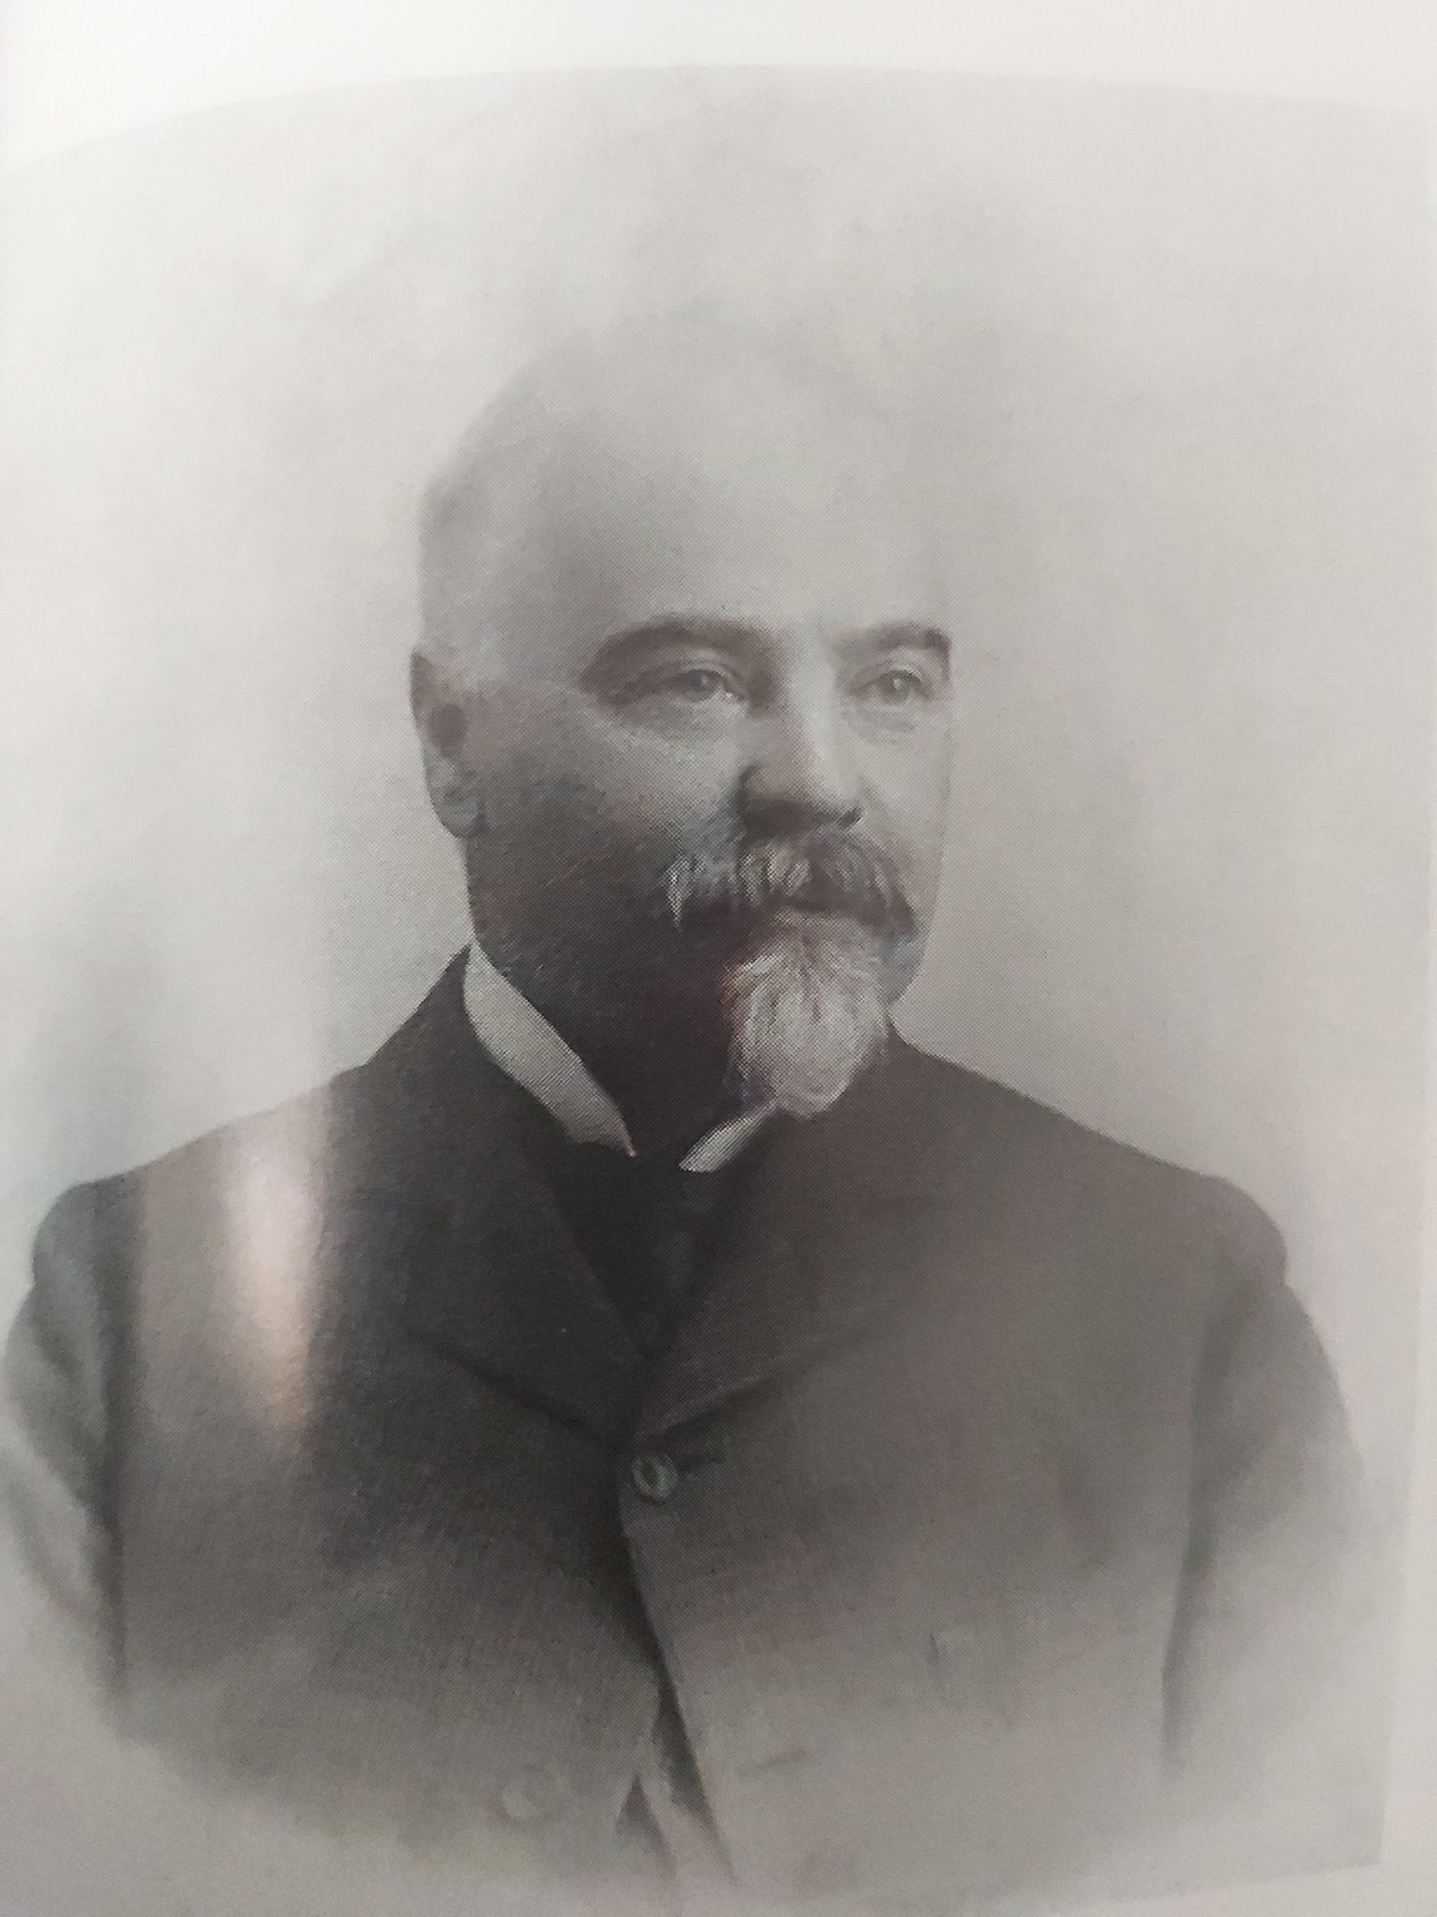
May’s Multi-Millionaire Uncle: Richard J. Bolles
‘Abdu’l-Baha told May that she would never have to worry about money. It was RJB’s generous inheritance that allowed May to live without financial worries. He left almost half his estate to Randolph and May. A mining engineer who made his fortune in silver mining and in Florida Everglades real estate, he died in 1917.

Slide 60
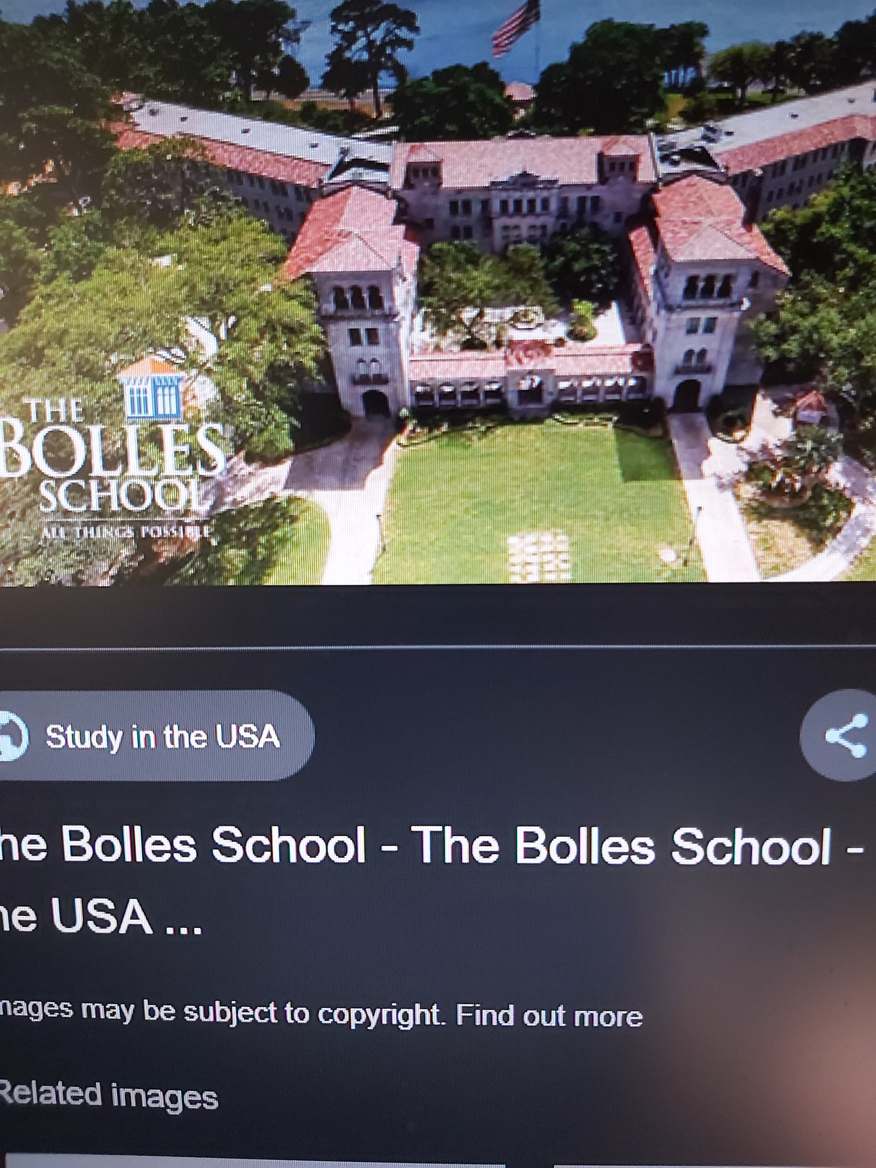
The Bolles School
It was founded as a military academy in Jacksonville, Florida in 1933 with funds from the Richard J. Bolles estate.Today it is a college preparatory “prep” school that includes elementary and middle school grades.

Slide 61
Mary’s Childhood Education:Montessori School
In 1914 when Mary was four years old, May turned The Studio, the top floor of her home, into a kindergarten and engaged a Montessori teacher from New York to teach there.She enrolled about 8 children consisting of the children of the Maxwell and MacBean families and some less advantaged neighbourhood children. The Montessori school in the Maxwell home was one of the first, if not the first of its kind in Montreal. During the years she travelled for the Faith or when she had to go south during the harsh Montreal winters, May engaged a series of governesses who ran the school and tutored Mary. Having a governess/private tutor was normal practice in middle-class families up to the time of WWI, after which public education became more widespread. Little Mary did not always get along very well with her governesses. They were changed frequently enough. Little Mary was also accustomed to having a one maid and a cook at 716 Pine Avenue West.

Slide 62
Mary’s Childhood Education (2)
Because May was so often absent from the home doing Baha’i work, escaping the winter and visiting her family, she kept up at all times a prolific correspondence with Sutherland and with Mary. This correspondence continued with her husband and daughter right up until the time of May’s death in 1940.May began to write letters to Mary when Mary was still a child. She would send them in care of the governess who would read the letters to Mary. This letter writing may have served as an incentive to Mary to learn how to read and write because she missed her mother and was anxious to know what she was doing. Any child needs to know that she/he is loved and cherished. May did not neglect reminding her treasured child how much she loved and missed her. The letters were also used for Baha’i spiritual instruction as soon as Mary was old enough to grasp the concepts.

Slide 63
Mary’s Childhood Education (3)
Stanwood Cobb, who met ‘Abdu’l-Baha on 5 different occasions, both in Palestine and in the United States, was an author and educator who earned an M.A. in philosophy and comparative religion from Harvard Divinity School. He founded his own school based on Baha’i principles, the Chevy Chase Country Day School in MD(1919). Mary lasted only one term there when she was about 10 years old. May did not believe that children should be exposed to day long education. Mary also agonized over the possibility of her mother dying while she was away at school.Her schooling and study habits were irregular as was her spelling. It did not help matters that governesses were changed so often, depending on whether or not they could get along with Mary. By the age of 12, Mary was taller than her mother and more or less in charge of the house. May used animal metaphors in her letters to inculcate in Mary moral and spiritual principles. (MM1, pp.357-359)

Slide 64
Mary’s Higher Education (4)
During home-schooling, Mary was given freedom to draw, to paint, to play outdoors, and to raise her beloved animals. Although Mary enjoyed much personal freedom, May was a strict governess of her daughter’s morals; she sometimes reduced Mary to tears. (MM1, 361-362). This calling to account continued right up until Mary’s twenties. Mary feared losing her mother’s good-pleasure. Sutherland was also called to account on occasion. When she was 20 years old (1930), Mary wanted to attend Sarah Lawrence College in Yonkers, New York, but she did not have the necessary prerequisites to pass the entrance examinations. Instead she attended McGill part-time, studying Economics and History. One of her Economics professors was the famous humourist Stephen Leacock for whom she wrote a Baha’i essay on how to relieve unemployment in Montreal. Leacock passed on her suggestions to Mayor Houde of Montreal (MM2, 106-7). While at McGill she wrote an excellent paper, The Reflorescence of Historical Romance in Nabil. (See online and The Baha’i World, 1932-1934).

Slide 65
Her Love of Animals (1)
Mary’s love of insects, reptiles and animals dated from her earliest childhood. It may have been inherited from her parents who kept dogs and cats. Mary was an only child; animals kept her company. She began to draw them as soon as she was able. She told her mother from the time that she could talk that a strange creature called Laudrios lived on the stairs on a red carpet. In a letter to Santa Claus, she requested a pet monkey, a tame kitten, a little puppy dog, a goldfish, a chicken and a parrot. When she was not more than 5 years old, she brushed aside a parental summons to come indoors with the impatient response: “Shut! Stop your nonsense! Don’t you see I am watching that grasshopper!” She carried a toad in from the garden exclaiming: “Oh! God! She is so good to me! She showed me where to find the toad in the dark and help me to catch it!” In the rain she would cover herself with worms and at other times with green caterpillars.

Slide 66
Her Love of Animals (2)
Mary’s passion for animals never ceased. Even when she was married to Shoghi Effendi. (Bobbi Leedham McLaren told me that Ruhiyyih Khanum had pet rabbits when Bobbi was on pilgrimage). When age 12 on her first pilgrimage (1923), she was photographed riding “Petty” in front of the western pilgrim house. When she was 9 years old, her mother consoled her in a letter because her pet mouse had died. Her favourite dog was the neighbour’s dog Kaiser that she played with during WWI. She also had another dog named Gyp. Her father once read her a sad account of a man, woman and child killed when crossing a track in a carriage. Mary cried for the horse, not for the human beings. She used to swear her friends to secrecy later in life that they would not divulge all the animals in her childhood menagerie. It included: parrots,snakes, rabbits, guinea pigs, monkeys, chinchillas,chipmunks, turtles and even a bear! (List incomplete). As an adult, animal rights and preserving the environment were important causes for her.

Slide 67
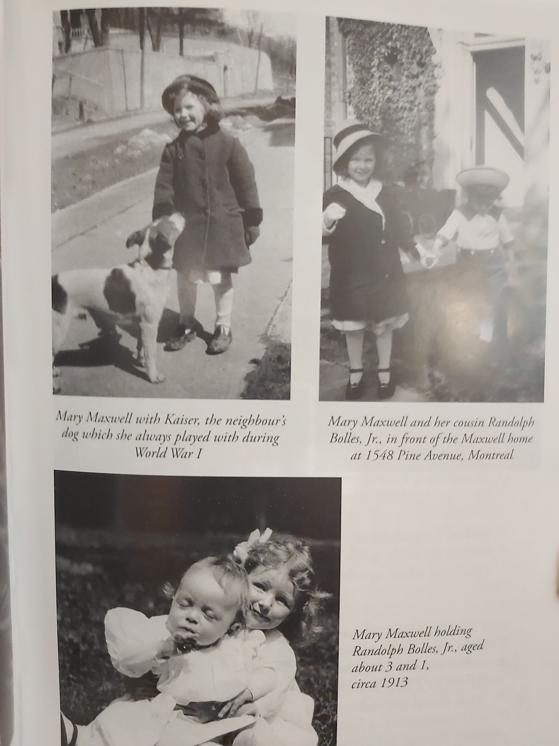
Mary Maxwell’s Childhood in Montreal
Photo upper left: With
Kaiser, the neighbour’s dog
during World War I.
Photo lower left: With
cousin Randolph Bolles, Jr.
Photo upper right: With
cousin Randolph Bolles.

Slide 68
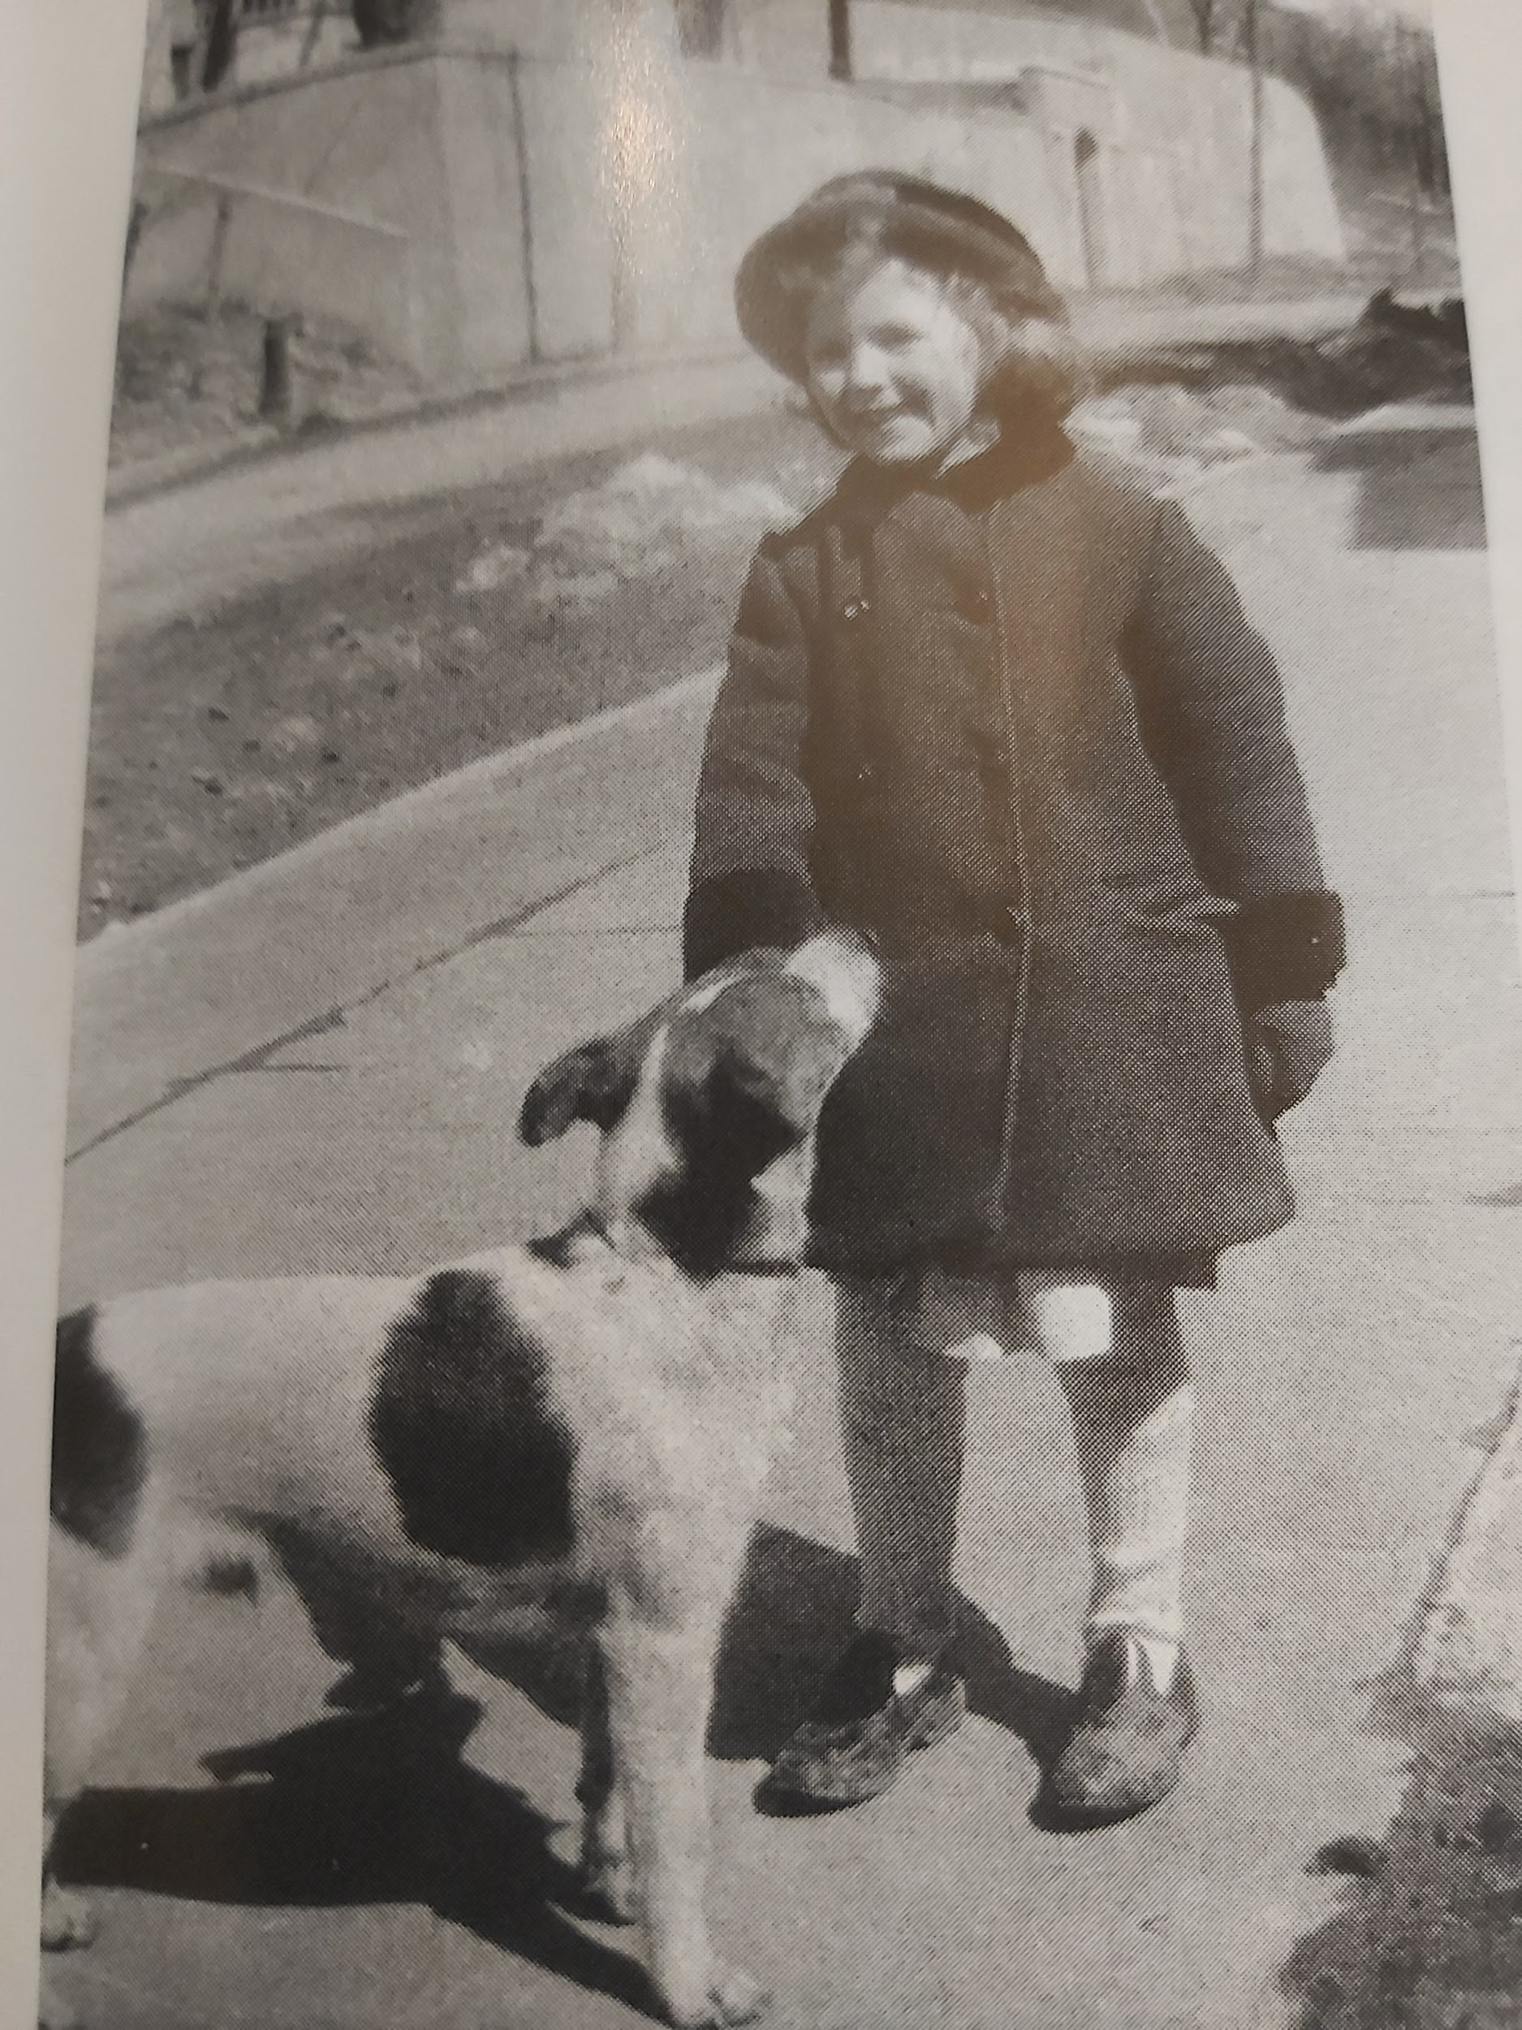

Slide 69
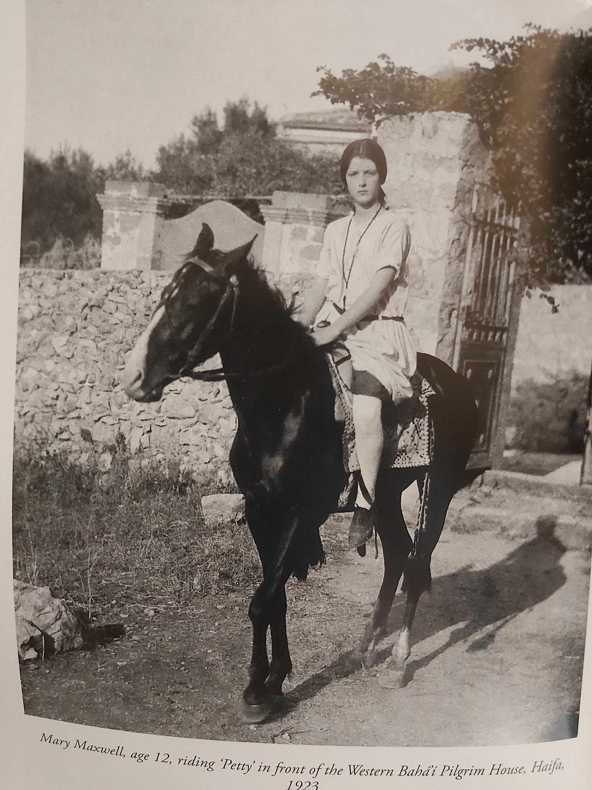
Mary Maxwell Age 12 Riding “Petty” in Haifa

Slide 70
Visit of ‘Abdu’l-Baha: Aug. 30-Sept. 9, 1912 (1)
Along with the birth of Mary Maxwell, the greatest event in the life of May and Sutherland was the visit of ‘Abdu’l-Baha to their home. The Master’s visit occurred when little Mary was only two years old. Since it has been well covered elsewhere, I will mention here only a few personal points of interest.Sutherland did not at first offer their home to the Master, but he must have sensed May’s disappointment. Two days before ‘Abdu’l-Baha arrived,he rushed down to Morgan’s to purchase the white-painted Louis XV style bed, dressing table and chairs that are still in the Shrine. Sutherland met the Master at the train station and begged Him to accept his hospitality. (Initially his Scottish reticence did not want the publicity of having “the Persian Prophet” under his roof).When ‘Abdu’l-Baha walked into the Maxwell house He said: “This is my home. All that is in it is mine. You are mine [to May], your husband and child. This is my home.” May was in a state of ecstasy, worshipping the Master as if He were Christ, something He repeatedly denied.

Slide 71
Visit of ‘Abdu’l-Baha: Anecdotes (2)
One day ‘Abdu’l-Baha caught up little Mary in His arms and tried to kiss her. With her strong, chubby little hands, she slapped him so hard across the face that His turban fell off! May was mortified and suggested that He prescribe a punishment. He replied: “Leave her alone. She is the essence of sweetness.” (MM1,282). On the couch at the foot of His bed, the Master was resting after lunch when Mary rushed into His room, pried His eyelids open and said: “Wake up ‘Abdu’l-Baha!” He took Mary in His arms and she slept on His breast. He visited Sutherland’s office. AMP (A.M. Parent) Sutherland’s secretary and a personal friend said: “I could not keep my eyes away from him. It is a face you cannot forget!” Turning to Sutherland, He said: “You can trust her!” The irascible Irish cook exclaimed: “Ah, Mrs. Maxwell, why is He going away! Tell him I will work my fingers to the bone if He will only stay!” (MM1, 284).

Slide 72
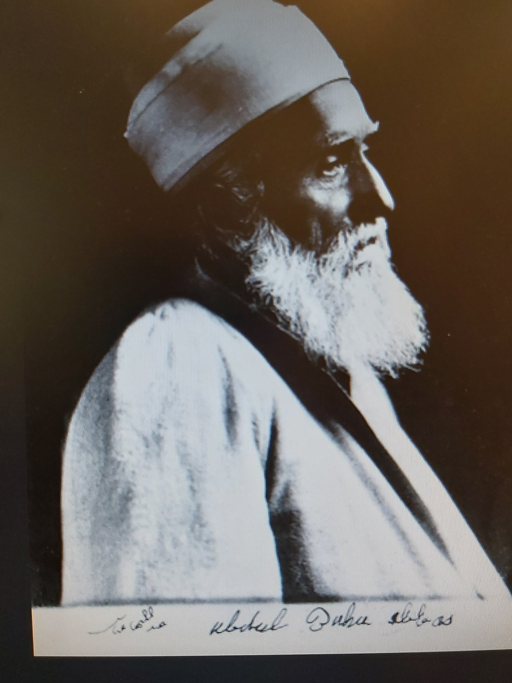
‘Abdu’l-Baha Abbas
‘Abdul-Baha was named Abbas
after the great-grandfather of
Baha’u’llah. While Baha’u’llah
was on the earth, He called His
Son “His Excellency the
Master” or “the Master.” After
His father’s death, He took the
name ‘Abdu’l-Baha. He signed His writings “Abdu’l-Baha Abbas” shorted to “Aiyn Aiyn” in His prayers.

Slide 73
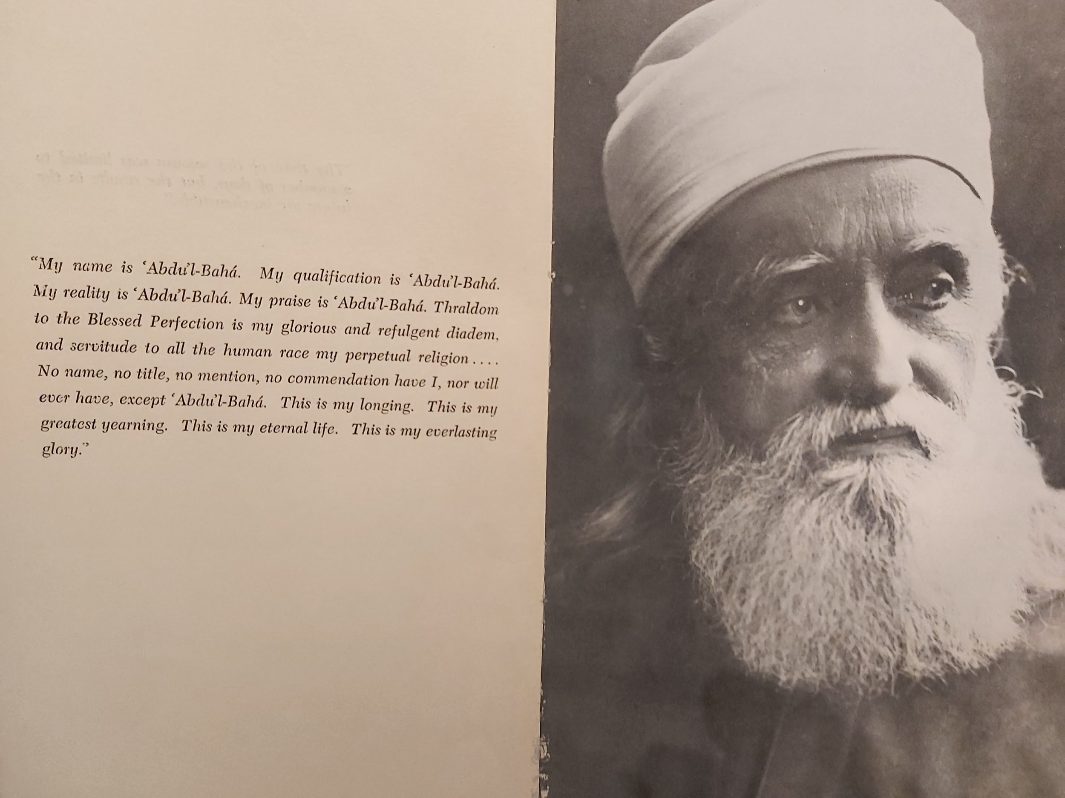
His Famous Statement About Himself

Slide 74
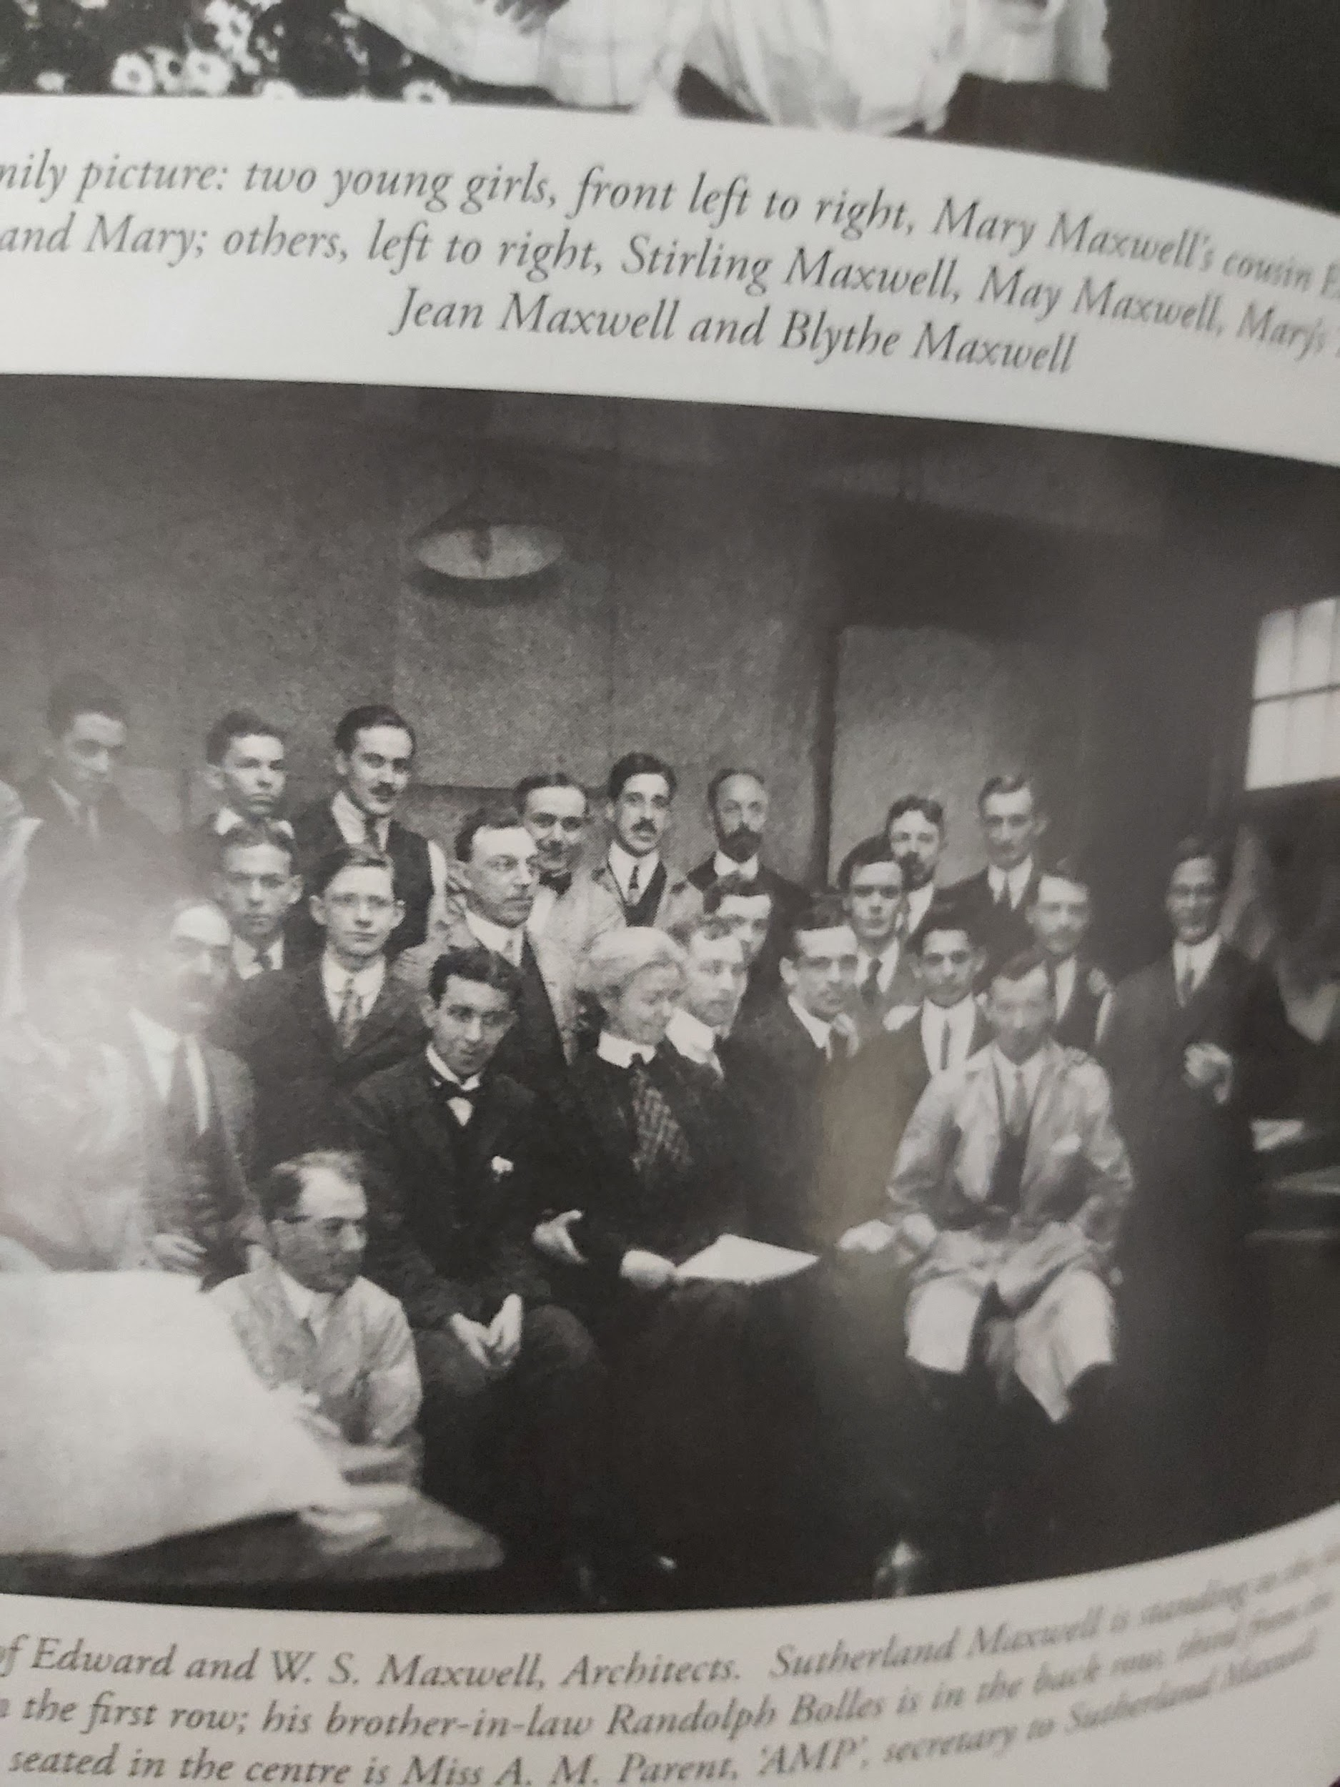
Maxwell Brothers Architects with AMP (Centre)

Slide 75
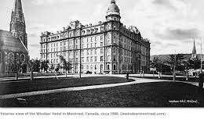
Windsor Hotel (1912)
‘Abdu’l-Baha decided to move to the Windsor Hotel after three days to give greater accessibility to the public of His presence. But He may have done so also because of May’s fragile physical constitution. The room where He stayed has since been destroyed because of renovations.

Slide 76
The Tablets of the Divine Plan are Unveiled in New York City (1919)
The two tablets to Canada were sent to the Maxwell home, arriving in 1916. The revelation of the these 14 tablets was clearly the biggest event for the worldwide systematic expansion of the Faith since its inception. May was surely conscious of the significance of receiving one of the 4 Charter documents of the Faith. (+ the Aqdas, the Will and Testament, Tablet of Carmel). May’s travels were inspired by these tablets which aroused faithful friends to take immediate action to scatter far and wide to spread the Glad Tidings of the new Revelation throughout the length and breadth of North America and the world. (The Iranian friends were not able to fulfill this mandate because of the severe restrictions and persecutions that afflicted them). Mary’s formal debut in the Faith began with the launching of the Tablets when she was just 9 years old. They were unveiled at the “Convention of the Covenant” at the Hotel McAlpin in New York City on April 26-30, 1919.

Slide 77
Mary Maxwell Unveils the Tablets to Canada
According to a letter of Ahmad Sohrab that records the plans for the occasion, 9 year old Mary Maxwell would present the tablets to Canada, just as the other tablets were presented, with a dramatic flair and elegant ceremony, “dressed in a beautiful, soft pink silk dress for the occasion and as she advances toward the platform to unveil the Tablet a strain of soft music will be played.” (MM1, 347).Thus it will be seen that little Mary, whose mother gave lectures and spoke in Baha’i meetings, must have learned how to behave in the limelight from an early age. May Maxwell was training her daughter, whether consciously or not, to become a Baha’i public figure. Such training helped Mary to prepare for a life of service, especially when she became the Guardian’s wife in 1937, the hostess of many a Baha’i pilgrim, and facilitator of conversations at the pilgrim’s table, later a Hand of the Cause (1952), and world ambassadress for the Baha’i Faith.

Slide 78
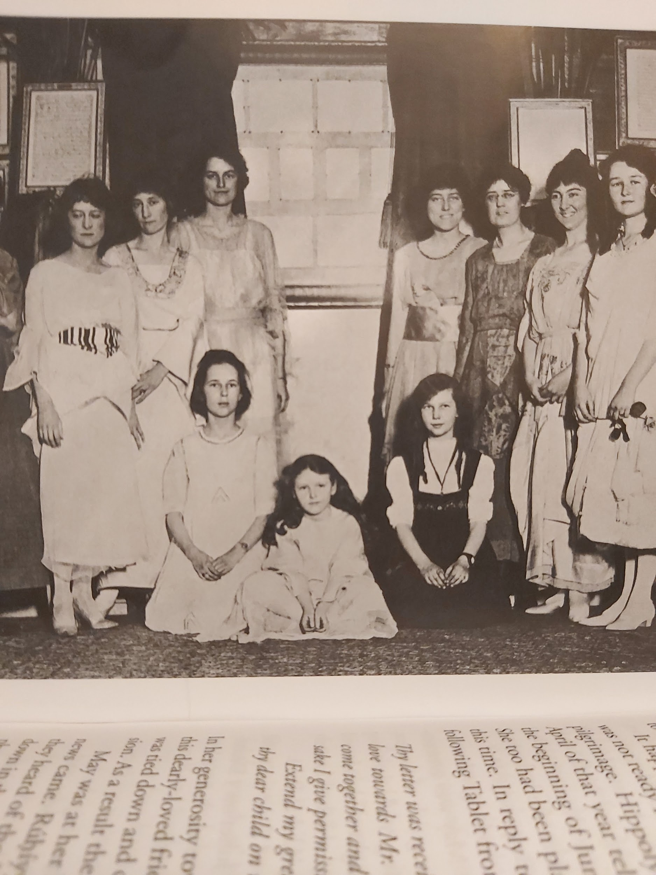
Tablets of the Divine Plan Unveiled: 29 April 1919

Slide 79
The Decade of the 1920’s: Years of the Greatest Trial, Recovery and Years of Service

Slide 80
The Ascension of ‘Abdu’l-Baha and Its Effects (1)
When the Master died suddenly, just when He appeared to be in the best of health, May was devastated by the news. She had been looking forward to her third pilgrimage for which ‘Abdu’l-Baha had already given His permission. It was to be a family affair. But the pilgrimage had to be delayed because Juliet Thompson was tied down. (May had offered to pay her expenses).The person who announced the catastrophic news did so in an insensitive manner by telephone. Without preamble the person suddenly announced: “‘Abdu’l-Baha has died!” Sutherland and Mary were downstairs while May was resting upstairs. They heard the telephone ring, followed by silence--then a heavy thump on the floor. May had fainted at the news! When they revived her, she fainted again. When He died May lost her will to live.She sank into a severe second depression, similar to the one that had afflicted her in Paris before Lua announced to her the Glad Tidings.

Slide 81
The Ascension of ‘Abdu’l-Baha and Its Effects (2)
It was ‘Abdu’l-Baha’s love and good-pleasure that had motivated May’s will to live. Being the loving, all-knowing, all-powerful Father figure that He was, after His ascension May was left with no one to protect her from her worst fears. Shoghi Effendi later explained to May that her physical affliction was in large part responsible for the dark thoughts she sometimes harboured and which drained her of her life force. Just like Lua before her, May began to question and doubt herself. She had missed her chance to go on pilgrimage. Was it because she had failed to serve her Beloved adequately? As often happens with the human psyche--one trauma stirs up again all the negative unresolved issues of the past. By not taking her chance to go on pilgrimage, she felt she had deprived Mary of His presence. Like an avalanche, May’s dark, negative thoughts cascaded down and buried her. She thought she was unworthy to be in ‘Abdu’l-Baha’s presence again. She even despaired of ever seeing Him again in the next life.

Slide 82
The Ascension of ‘Abdu’l-Baha and Its Effects (3)
This was also a hard time for Sutherland Maxwell. He felt entirely powerless to bring his wife out of the deep morass into which she had sunk. In the middle of one of the biggest projects the Maxwell brothers had ever won, building the west wing of the Chateau Frontenac, Edward, his older brother, mentor and guide, was diagnosed with terminal cancer. Sutherland was forced to look on, not only as his wife seemed to have entirely succumbed to a debilitating depression, but to watch his beloved Edward waste away over the next year until he died.The years 1921-1922 were a dark time at 716 Pine Avenue West. Despite her own grief, May was able to pull herself together enough to serve the Cause. She travelled to Chicago, New York, Boston, and Washington, but over a period of 7 months, Sutherland had been called to different cities because May was believed to be on her death-bed. Both Dr. Zia Bagdadi and Sutherland encouraged her to make another pilgrimage. They thought it was the only hope to restore her to health.

Slide 83
Helpful Counsel from Dr. Zia Bagdadi
It is not clear whether or not Shoghi Effendi was in Haifa at the time that Dr. Badgadi enouraged May to write to Haifa to obtain permission for pilgrimage. We know that Shoghi Effendi was dealing with his own monumental challenges in accepting the Guardianship. He retreated to Switzerland several times during the early years of his ministry. (During the hot summers pilgrimages were suspended in Haifa). Dr. Bagdadi encouraged May to write the pro tem Head of the Faith, the Greatest Holy Leaf. By October of 1922, May wrote to Sutherland telling him that she was feeling a little better, even homesick. During this time, May’s letters to Mary were full of the same spiritual counsel she had always offered her daughter. Her sagging spirits never prevented her from being the teaching-mother and the mother-teacher that she had always been.May did receive an encouraging answer from Bahiyyih Khanum dated December 12, 1922, but there was no specific mention of pilgrimage. It is more likely that May had written to express her grief and ask for prayers. (MM1, p. 371).

Slide 84
On the Way to Haifa: 1923
By the end of 1922, May had recovered enough of her health to write Shoghi Effendi to ask permission for another pilgrimage. On January 29, 1923, May received a brief cablegram from Shoghi Effendi: “MOST WELCOME TO HOLY LAND.” In retrospect, this cable signified a new beginning for May and a fuller return to active service in the Faith. Shoghi Effendi was to play a key role in May’s recovery of better health and increased service to the Faith she loved so much. When May left New York for Haifa on March 7, 1923, accompanied by 12 year old Mary and their maid Athala Burke on the S.S. Paris, she was still ill and in mourning. She had to travel very slowly; it was questionable whether or not she could make the journey to Haifa. In arriving in her beloved Paris she quite ill. The Dreyfus-Barneys had cabled Shoghi Effendi for prayers. He replied: “PRAYING MAXWELLS RECOVERY ENABLE VISIT HOLY LAND NAWRUZ GREETING.”

Slide 85
On the Way and Arriving in Haifa: 1923
The years 1921-1922 had not been easy for young Mary Maxwell either. After having been separated from her mother for long periods during her childhood, on the verge of her teens years, she must have agonized over her mother’s health. May’s departure from the world seemed imminent on more than one occasion. When May was home and during the pilgrimage of 1923, young Mary found herself responsible for her mother’s care. Although they had the help of Athala the maid, Mary was to all intents and purposes in charge of all practical matters. (MM2, p.4). The guest book of the Pilgrim House in Haifa records the date of their arrival: April 29, 1923. On their arrival, May received a wonderful, unexpected gift from Shoghi Effendi:the last tablet written by ‘Abdu’l-Baha to May. It was found in His papers after His passing. There had not even been time enough to mail it. (MM2, p.5)

Slide 86
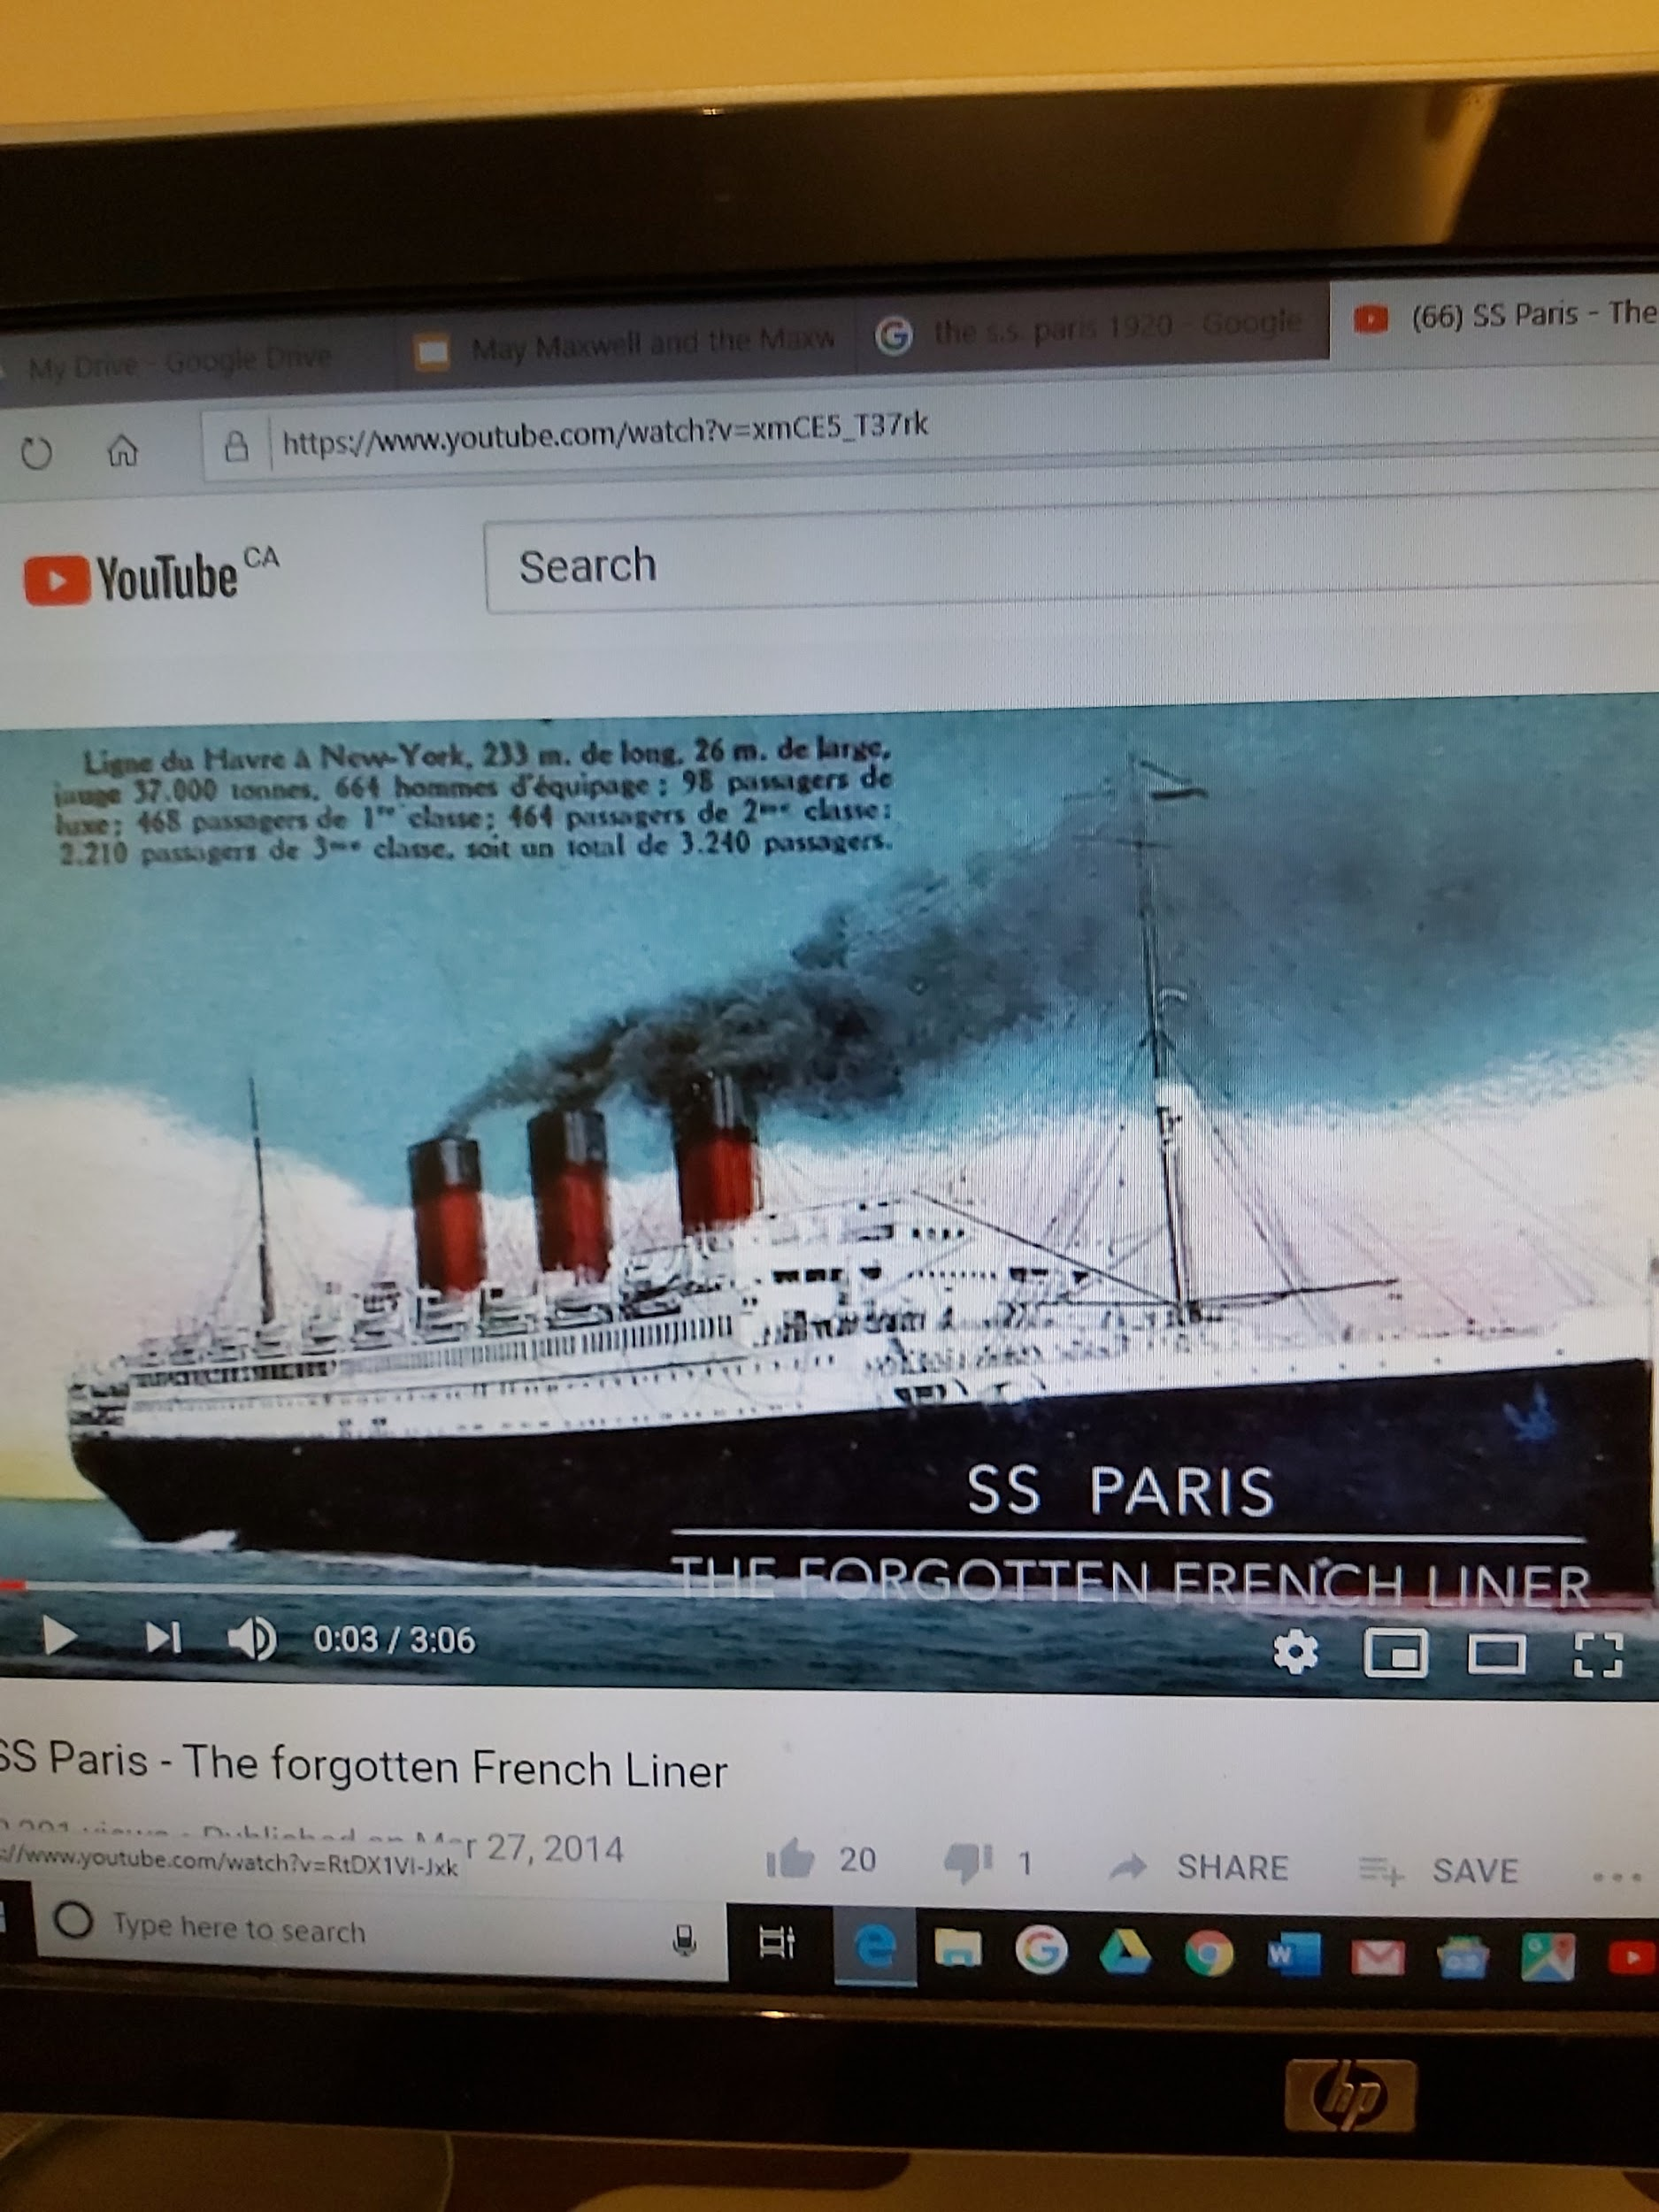
The S.S. Paris French Line Launched in 1921
In her day, the S.S.
Paris, taken by May,
Mary and Athala was
the luxury flagship
of France. They
boarded her only two
years after her
maiden voyage. She
was destroyed by fire while docked in Le Havre (1939). She could carry 2,500 passengers in all comfort.

Slide 87
Meeting the Guardian
Excerpt to be read from The Maxwells of Montreal (vol. 2), pp. 5-6.
Note: We should not forget that where ever Mary went her menagerie of animals went with her. It must have made for some interesting travel adventures!

Slide 88
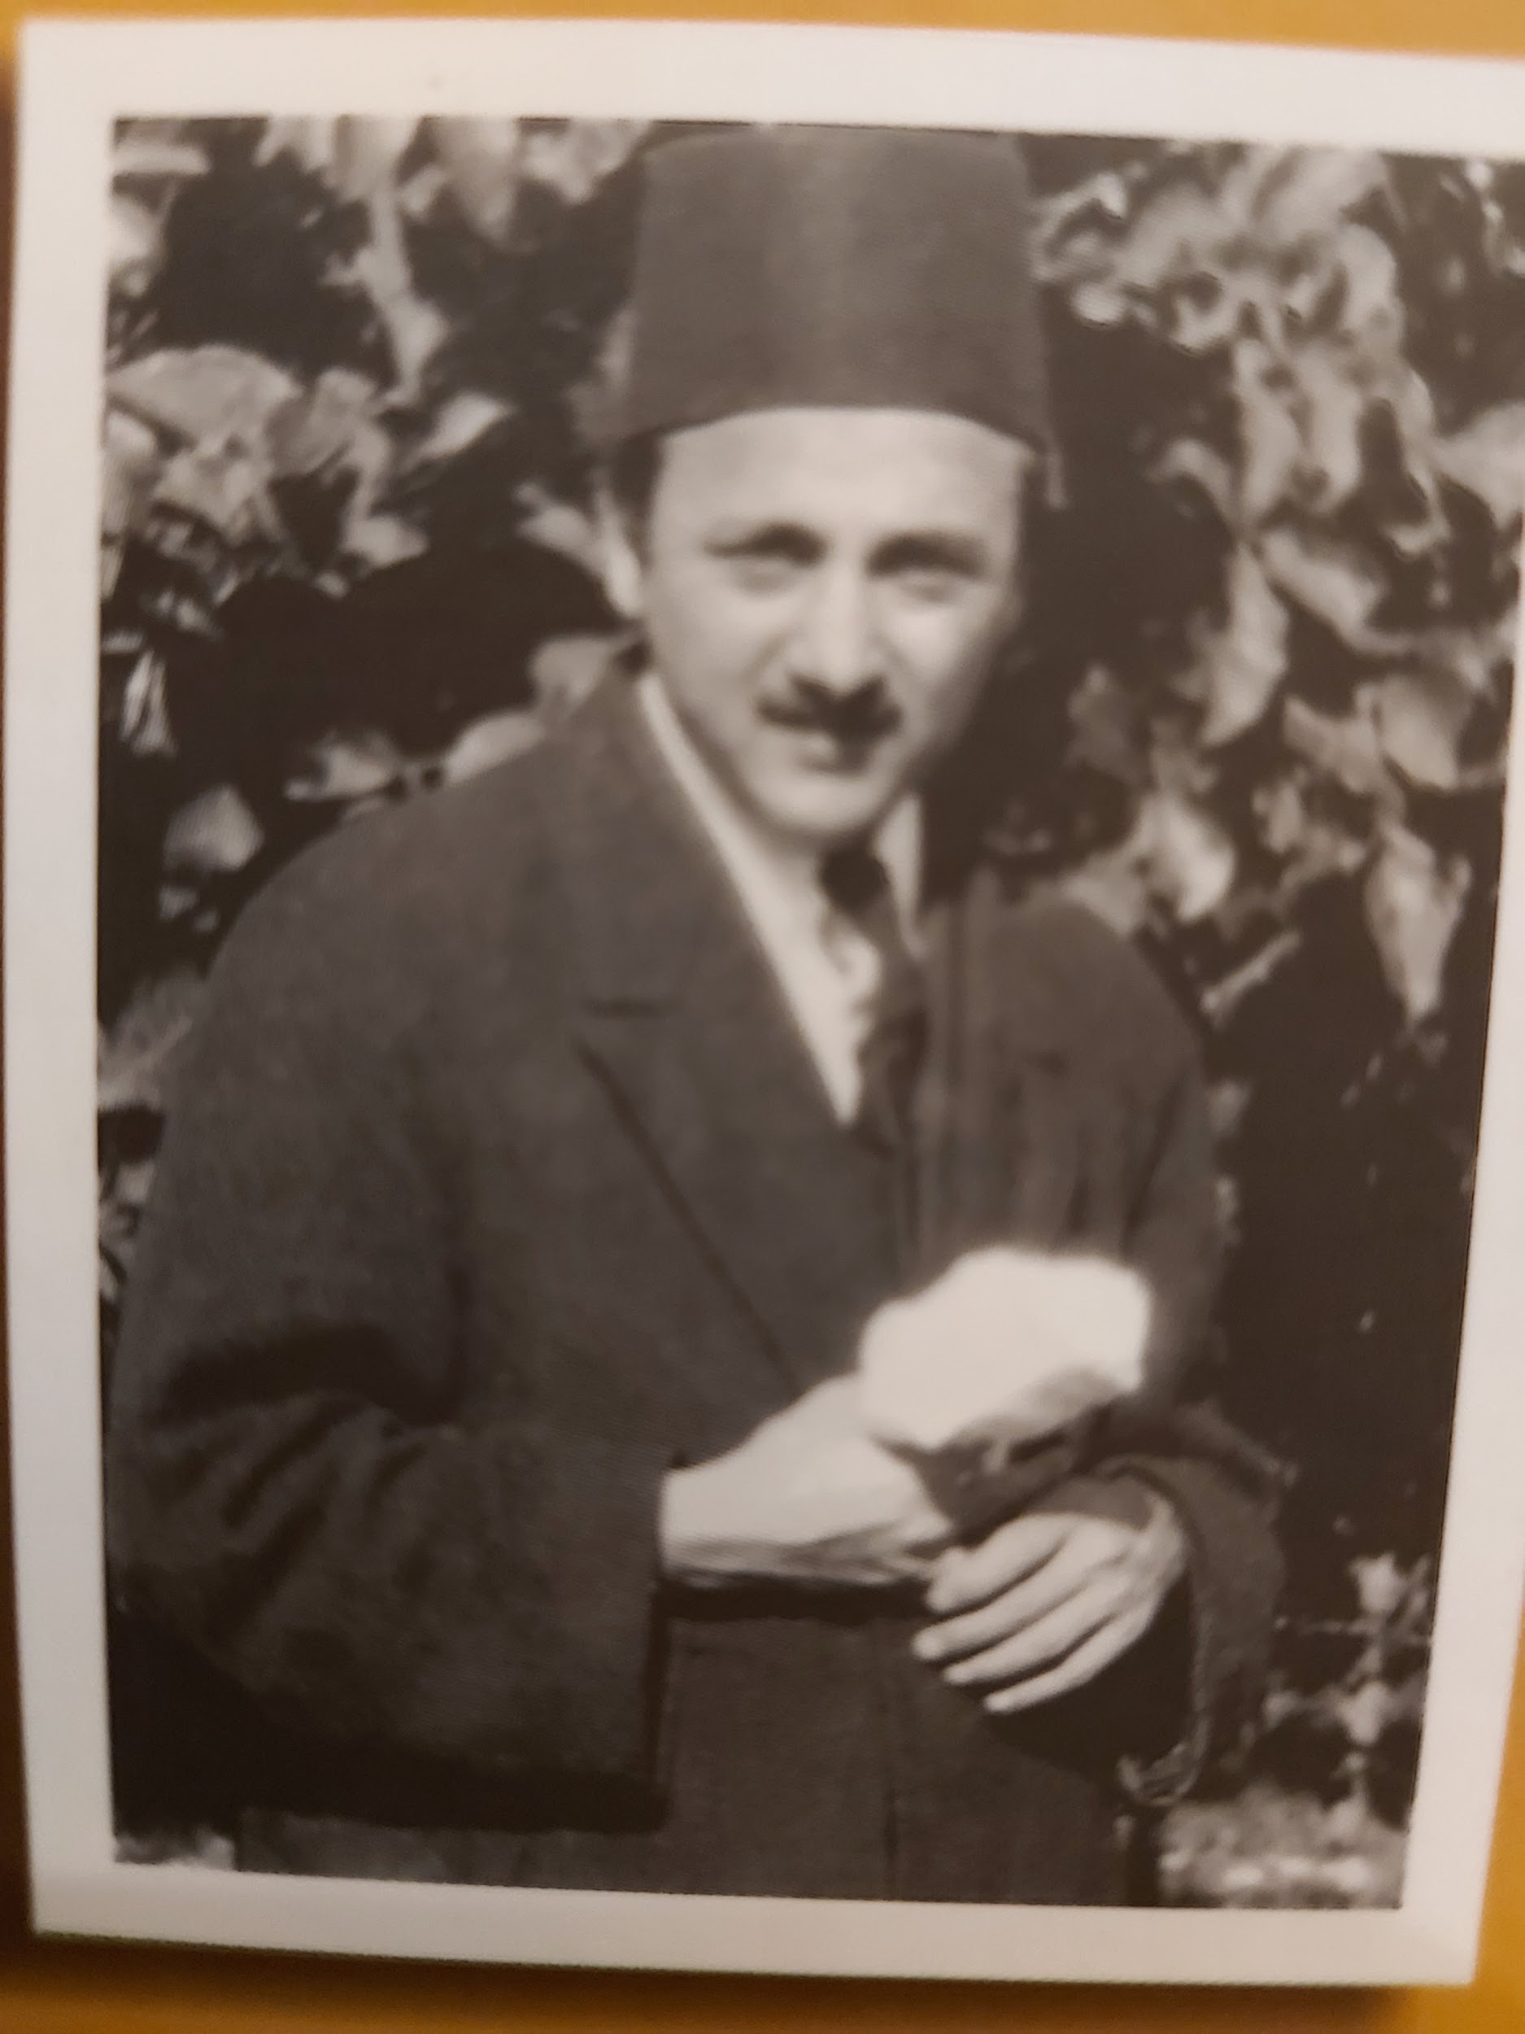
The Young Guardian in the Garden of the Master
This photo was taken shortly after
Shoghi Effendi was appointed
the first and only “Guardian of the
Cause of God.” The Iranian friends
refer to him as Hazrat-i-Valiyih-
Amrullah, “His Holiness the
Guardian of the Cause of God.”This
photo is one of only a few that the
Guardian consented to have taken.

Slide 89
The Guardian to Leroy Ioas on Becoming Guardian
Shoghi Effendi had no advance knowledge that he would be appointed Guardian. He thought perhaps he might have the honor of calling the great conclave that would elect the Universal House of Justice. Instead he found that he had been appointed Guardian of the Cause of God. He said to Hand Leroy Ioas, his executive assistant: “I didn’t want to be the Guardian of the Cause. In the first place, I didn’t think I was worthy. Next place, I didn’t want to face these responsibilities. I didn’t want to be the Guardian. I knew what it meant. I knew that my life as a human being was over. I didn’t want it and I didn’t want to face it.So remember, I left the Holy Land, and I went up into the mountains of Switzerland, and I fought with myself until I conquered myself. Then I came back and I turned myself over to God and I was the Guardian.” Shoghi Effendi said it was the duty of every Baha’i to do exactly the same thing: “Every Baha’i must fight with himself and conquer himself...And he won’t achieve his greatest success until he has done it.” (Earl Redman, Shoghi Effendi Through the Pilgirm’s Eye, vol. 1, pp. 49-50).

Slide 90
The Pilgrimage that Lasted a Year (1923-1924)
Although May’s health was never completely restored, it was during this third pilgrimage that Shoghi Effendi got her out of her wheelchair and back into active Baha’i service. When Shoghi Effendi left Haifa for Switzerland that summer (1923), he advised May to go to Egypt for a period of recuperation. In this photo, they were in Ramleh. Here Mary had a great time collecting animals. They did not return to Montreal until the Spring of 1924! Mainly because of May’s poor health the pilgrimage lasted a whole year. May stayed also in Bahji while Mary was in Haifa. May wrote letters to the Guardian even when she was staying across the road in Haifa.
The Maxwells witnessed the Guardian’s complete nervous prostration. While the Master’s family had stayed loyal when He was alive, after He ascended, they were gradually infected by the older Covenant-Breakers led by Muhammad Ali. Except for Bahiyyih and Munirih Khanum, his relatives--to put it mildly-- did not give him the respect that he deserved. As members of the Master’s family, they thought they were special and didn’t have to obey the Guardian. They confused his human personality with his station as Guardian. One of the Master’s daughters said to one of the pilgrims that she didn’t know why pilgrims were still coming to Haifa after the Master’s death. The Guardian retreated to Switzerland in June of 1923 and did not return until November.

Slide 91
The Guardian’s Role in Restoring May Maxwell’s Health (1923-1924) (1)
During the year that she was in Haifa, Bahji and Ramleh, it was Shoghi Effendi who brought May back into fuller life. Day after day at the pilgrim’s table, the Guardian tired to lift her depression, to fill her mind and heart with optimism. Ruhiyyih Khanum said that the Guardian treated her spiritual ailments like a doctor. He instructed her to abandon thoughts of nihilism and fear which only led to a weakening of her spiritual powers. As mentioned above, Shoghi Effendi tried to allay her fear and guilt by reminding her that the dark thoughts that obsessed her were in large part the result of her “severe illness,” an illness for which she was not responsible. He would turn to her repeatedly at the dinner table and say: “Mrs. Maxwell, the thoughts you are thinking are not true!” During his summer absence, Mary and May stayed at Ramleh, Egypt, first in the home of a believer and later in a summer resort. She wrote to Sutherland that she would not be home for Christmas. She pitied his loneliness, but was cheered by his letters.

Slide 92
The Guardian’s Role in Restoring May Maxwell’s Health (1923-1924) (2)
On November 20, 1923, May sent a letter to Sutherland saying that she was feeling much stronger. This change for the better came simultaneously with the Guardian’s return to Haifa. Shoghi Effendi had cabled May in Ramleh on November 19: ‘MOST WELCOME. On November 30 he cabled again: “DESIRE TO SEE YOU WISER TO BRING WITH YOU MARY AND ATHALA.” En route to Haifa she received another cable on December 28: ‘MOST WELCOME EAGER TO MEET YOU.” Settling affairs in Ramleh and travel arrangements May placed on young Mary’s shoulders with instructions for Athala and Mary sent by letter to her daughter. They settled in the Pilgrim House across the street from the Master’s house during January and February,1924. In a letter to her father from Bahji, Mary reported that May was able to walk 200 yards to the Shrine of the Bab.The Guardian also fired May’s vision by instructing her in the basics of Baha’i Administration, unfolding to her mind Baha’u’llah’s vision of a new world order,whose establishment was the next dynamic stage in the Faith’s expansion..

Slide 93
Sutherland’s Life in the Absence of May and Mary
Although Sutherland was very alarmed at his wife’s prolonged illness and absence, his letters to Mary betrayed no hint that he was lonely or worried. His professional and Baha’i activities continued apace.The positive side of May’s absence was that W.S. Maxwell filled the void in the Baha’i community. In addition to his several professional clubs and associations, he was a member of the League of Nations Society in Canada (1923),Chairman of the Teaching Committee, Temple Committee, Music Arts Exhibitions Committee, and Ways and Means (Finance) Committee. Between 1922-1923 he served occasionally as a speaker for the Montreal Baha’i Community, usually on an artistic subjects. “Japanese Art”, was the title of one talk on on March 4, 1923. On Sutherland’s birthday, November 14, 1923, after more than 30 years of partnership, his brother Edward died. The new firm became Maxwell and Pitts. May felt guilty about leaving Sutherland alone during this difficult time, but she was still not fit to travel.

Slide 94
May’s Letter of Gratitude to Shoghi Effendi
As mentioned above, Sutherland and Dr. Bagdadi had urged May to make another pilgrimage not long after the young Guardian had become the Head of the Faith. In her grief, May had received the prayers and counsel of the Greatest Holy Leaf and the Master’s family. The Guardian welcomed her to Haifa. When she arrived in Haifa, she was a broken vessel, confined mostly to a wheelchair, suffering from insomnia, extreme anxiety and depression. She had despaired of ever seeing the Master in the world-to-come. Despite his youth, “the priceless pearl” was alert and wise. He had a strong, intuitive inner sense of divine guidance that enabled him to diagnose the root cause of May Maxwell’s breakdown and to apply the remedy. (More than one pilgrim over the years has attested to the fact that Shoghi Effendi was able to read their thoughts). May’s letter of gratitude to the Guardian to be read. (MM2, pp. 18-19)

Slide 95
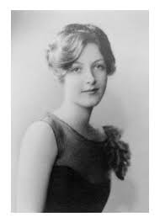
Mary Maxwell (16) Second Pilgrimage (1926)
On the pilgrimage of 1926, Mary went without her parents on board the R.M.S.Maurentania accompanied by Juliet Thompson and Marguerite “Daisy” Smythe. May provided the funds for Juliet’s passage. During this pilgrimage, Mary’s spiritual understanding of the Faith increased considerably thanks to Shoghi Effendi. At the same time, Mary grew to appreciate the great station of the Greatest Holy Leaf. While she had been in Ramleh with her mother on the previous pilgrimage (1923), Mary had learned the Egyptian “shimmy”. In costume, her eyes darkened with kohl, Mary danced it for Bahiyyih Khanum and made her laugh heartily.

Slide 96
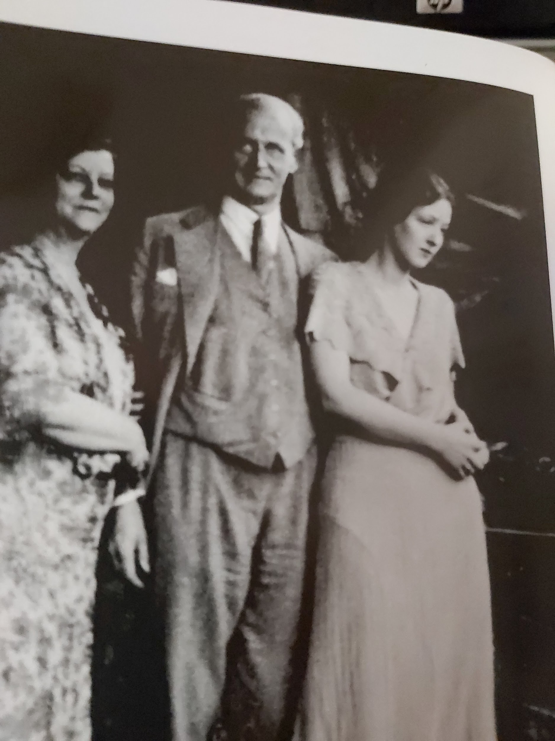
The Maxwells of Montreal (1927) Mary 17, May 57, WSM 53

Slide 97
The Guardian Directs Mary’s Education (1926)
During Mary’s 1926 pilgrimage chaperoned by Juliet Thompson and Marguerite “Daisy” Smythe, who was like Juliet a painter, Mary at first expressed her disappointment to her mother that the Guardian seemed to ignore her. (Shoghi Effendi was at this time 29 years old).At the Shrine of Baha’u’llah, Mary wept bitterly. She thought she had done something to displease the Guardian. But then something shifted.The Guardian called her to dinner and advised Mary to get a good general education and to take lectures in Economics, Sociology and Literature. The Guardian also tried to make arrangements for Mary to learn Persian as well. Mary was over the moon. She wrote in a letter to her mother dated May 24, 1926: “O dearest! It’s perfectly awful to be as happy and in love with everyone as I am. If I could be an insect and crawl around after Shoghi Effendi I would be a very happy being! And I love you and Daddy and Robin so much!” (MM2, p. 68) May noticed a new deeper dimension in Mary’s personality.

Slide 98
May’s Contribution to the Teaching Activities (1)
Over the year that May was in Egypt and the Holy Land, the Guardian both healed her malady and prepared her to serve the new institutional development of the Cause, as he laid the early foundation of “the embryonic World Order of Baha’u’llah.” On her return, May spoke at the 16th National Convention at Worcester, Massachusetts (Ridvan 1924). She seized the occasion to instruct the friends on the new direction that the Faith was destined to follow under the Guardian’s unerring guidance. She told the delegates how she had witnessed his suffering because of the disobedience of the friends, some of which had to do with the resistance and criticism that some were showing to the institutional development of the Faith which he later so brilliantly expounded in his world order letters. It caused the Guardian the greatest suffering when he realized that systematic opposition to his guidance came gradually from his own parents, brothers, sisters, cousins, and later from the Master’s daughters and their husbands. At the Guardian’s request, May anointed the delegates with Attar of Roses.

Slide 99
The Guardian Leaves Again for Switzerland (1924)
It is a sad commentary on the faith of the believers that Shoghi Effendi had repeatedly requested competent secretarial help to relieve him of the tremendous burden of his work in Haifa. The only one to respond was Dr. J.E. Esslemont who was fighting a ravaging tuberculosis. At age 51 years, Dr. Esslemont died of three strokes in November, 1925, leaving the Guardian bereft. Shoghi Effendi vigiled at his beside throughout the night before he died and placed his own ring on Esslemont’s finger when he was buried. The temporary assistants that he had included his own brothers Husayn and Riaz, who eventually broke the Covenant. They were either unable or unwilling to meet his high standards. Again the Guardian had to leave Haifa in a state of nervous prostration and grief. He returned to the mountains of Interlaken at Bern, the gateway to the Alps, where he could find peace, rest, refreshment and renewal. May wrote to Dr. Esslemont on July 3, 1924: “Our prayers and longing and unceasing effort in servitude is to bring him back to that sacred home where he belongs.” (MM2, p. 28)

Slide 100
May’s Contribution to the Teaching Activities (2)
As soon as May’s health permitted, she arose to spread the teachings and establish the Faith following the revelation of the 14 Tablets of the Divine Plan (1916-1917). From the moment that they were revealed, she arose to travel back and forth across North America to fulfill the wishes of the Master. Despite her debilitating grief following ‘Abdu’l-Baha’s sudden passing, she arose to travel and teach in Chicago, New York, Boston and Washington. She taught in Edgartown, Massachusetts, and with Grace Ober (John Robarts’ aunt) in St. John, New Brunswick (1916), and at Green Acre. (MM1, p.334). In Canada she did early teaching work not only in St. John but also in Brockville, Ottawa, Toronto, Calgary, and Vancouver.

Slide 101
May’s Contribution to the Teaching Activities (3)
During the year 1925, May travelled widely both in Canada and the USA, crossing the border several times. Her services were highly praised by Shoghi Effendi. In these early years of his administration, the Guardian sometimes personally corresponded in his own hand with the friends, particularly those who showed great capacity for teaching. May Maxwell was one of the favoured recipients of his letters and praise. Her commitment to Baha’i activities can gauged from her service as: an alternate member of the NSA, the Green Acre Program Committee, the History of the Cause in America Committee, the National Teaching Committee (both in Canada and the USA),the Green Acre Publicity Committee, and the Resolution and By-Laws Committee. As well as teaching the great principles of the Baha’i Faith, May was also creating an awareness of the necessity of establishing the Baha’i Administrative Order, just as Shoghi Effendi had instructed her. (The Guardian’s letter of thanks and praise to May, MM2, p. 25)

Slide 102
May’s Contribution to the Teaching Activities (4)
The post 1922 years were a busy time in May’s life. She wrote to one of the Guardian’s assistants: “I have never been so overwhelmed with work in my life.” (MM2, p.27). In the summer of 1925, she organized a “community kitchen” at Green Acre, a communal meal for Baha’is of limited means and their friends. May did nothing on a small scale. She invited 200 people! She felt that she owed her services to the Guardian “for the renewing of my health and strength...in association with the Holy Family and repeated visits to those sacred Shrines which impart Eternal life.” During the second half of the decade of the 1920’s, as secretary of the National Teaching Committee, May assumed the lion’s share of administrative responsibilities, writing reports, keeping minutes, organizing meetings and guiding the fledgling LSA’s in their tasks. These administrative tasks were always accompanied by May’s characteristic loving guidance and encouragement.

Slide 103
May’s Intensive Teaching Activities (1925-6) (5)
Between the years 1925-1926, May was continually on the road. She organized “World Unity” and “Amity” conferences. She conceived of these activities within the framework of the “Plan of Unified Action,” with its focus on building the Wilmette Temple. After attending the 18th Annual Convention in San Francisco, she went to Seattle on her way to Vancouver, May and Elizabeth Greenleaf taught intensively in Vancouver to individuals, groups, and public meetings “from 9 in the morning till 12 or 1 at night, scarcely time to eat and very little to sleep”....(MM2, p. 51).The LSA of Vancouver was formed during this trip.She listed the associations she contacted: the New Thought Society, the Soroptimist Club, an association that encourages women’s empowerment, British Women’s League, and Absolute Scientists. After 2 years of intense teaching, she suffered another breakdown in health and wrote Bahiyyih Khanum asking for prayers to remedy her “nervous disorder.”The Guardian wrote her a very affectionate thank you letter. (MM2,p.54)

Slide 104
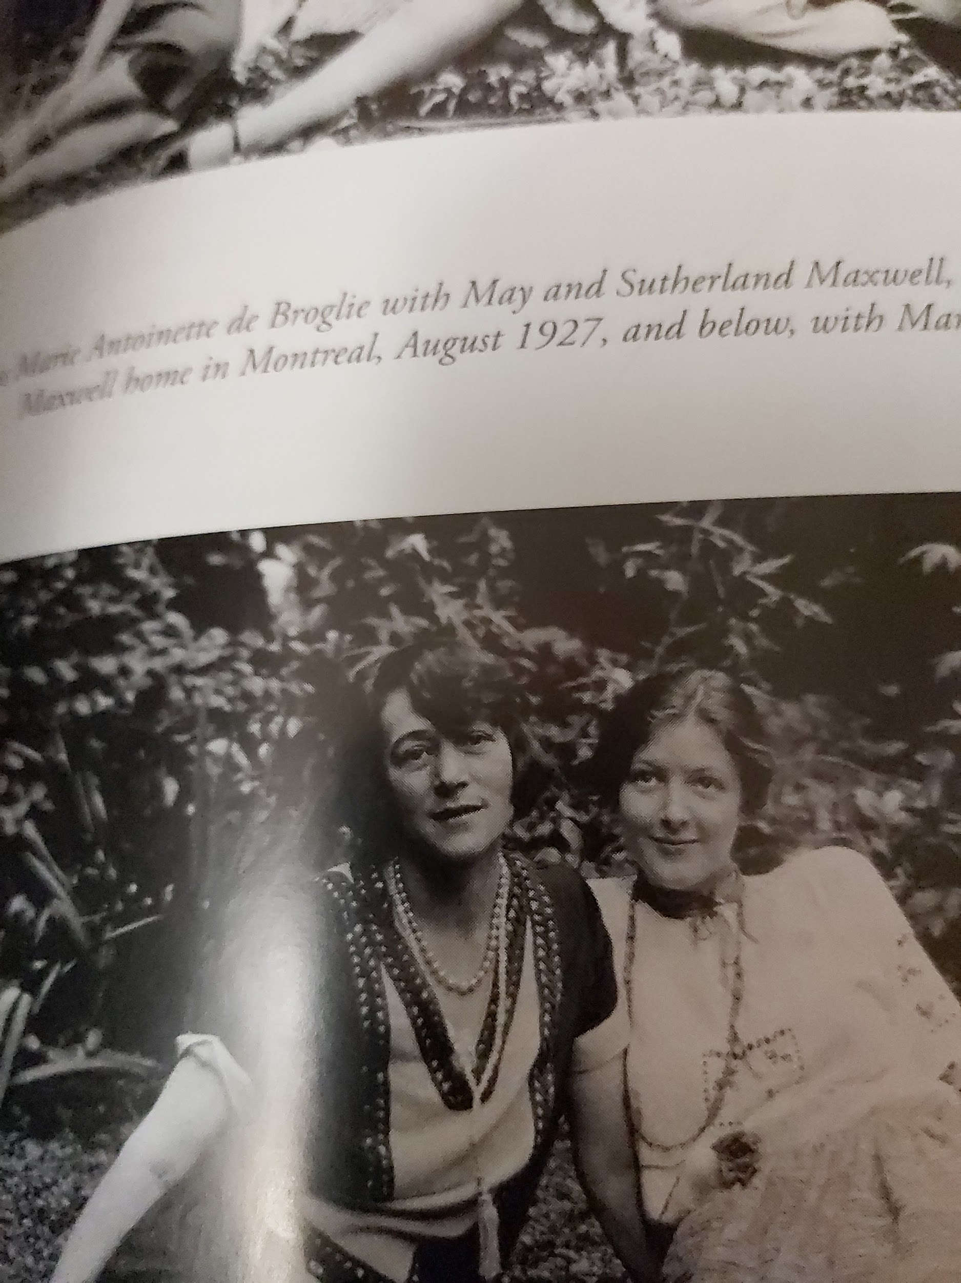
The Accomplished Pianist La Princesse de Broglie (1927)
She was the wife of
Prince Jacques de
Broglie, of one of the oldest,
noble families of France.
May met her on “this arduous
journey towards God and
clasped hands on the way.”
The French physicist, Louis
de Broglie (d. 1987), Nobel laureate for quantum physics (wave properties), belonged to the same family.

Slide 105
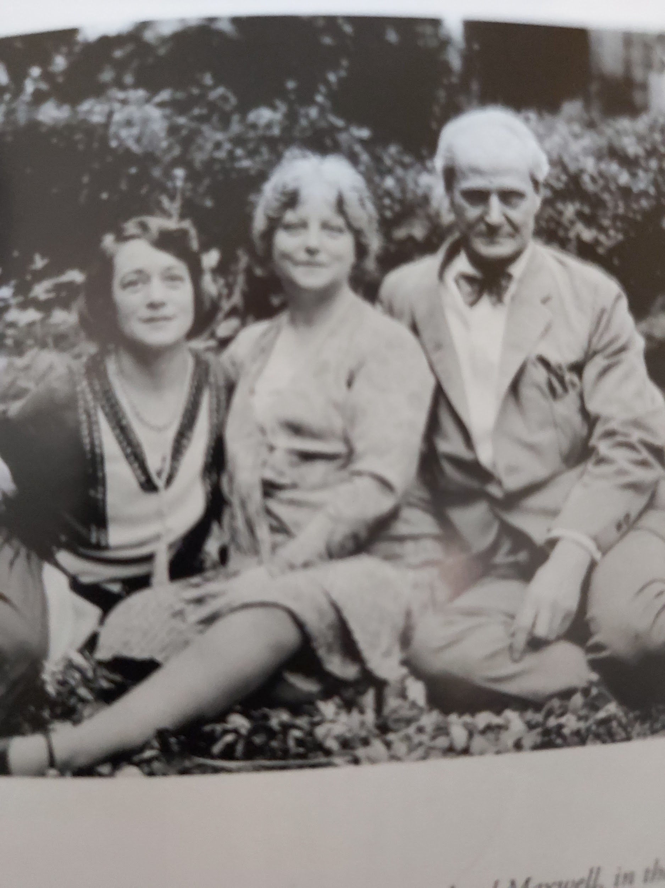
Visit with the Princess de Broglie on Pine Avenue W.

Slide 106
Sutherland’s Art and Architecture Trip Abroad (1925)
The year 1925 marked Sutherland’s turn to take a break from professional activities. His favourite pastime when travelling was to see the sights, particularly to visit churches, cathedrals, exhibitions, auctions, opera houses and any buildings of architectural note that he would sketch and sometimes paint. He booked passage for England on the S.S. Montroyal on September 11th. This was the first time since the pilgrimage in 1909, sixteen years earlier, that he had taken one of his cherished art and architecture trips. His invitation to meet up with May and Mary before he left was written up in this droll little note: “Now kids the question is: what are your plans?And when and where do we meet--can go to you and say au revoir. Of course I couldn’t go without such a performance.”

Slide 107
Mary’s Higher Education (continued) (5)
Mary’s education was spotty as she was growing up. She was exposed to the Montessori method at home as a child. As was typical for a girl of her age and class, most of her education consisted of home-schooling through a series of governesses.The governesses were changed frequently if Mary didn’t get along with them. May approved of her daughter being able to make the choice of whether or not the governesses would be kept. Sometimes there were scenes. By her mid-teens, Mary had had upwards of 10 governesses. May intentionally gave Mary unusual responsibilities for a child and teenager.By the time she was 14 years old Mary was a tall and determined young woman. She was hiring and firing the cooks in the house as well as her governesses. (Once in a while, a housekeeper would prove to be dishonest). All the time she was growing up, Mary practiced painting, drawing, sculpting, and writing verse. She was also interested in the theatre. She took piano lessons, but she did not practice regularly and didn’t really enjoy it.

Slide 108
Mary’s Higher Education: The Weston School (6)
May was “distressed beyond words” to know that Mary was missing so much time from school and not getting a proper education. Between the ages of 14-15 years (1924-25), Mary had a short period at the private Weston School in Montreal. (Founded 1917, closed 2007). Mary generally did not enjoy school. She did not like to be wakened in the morning because she was not trained in “early to bed early to rise.” May also thought it was because Mary was not getting enough sleep, but later in life Ruhiyyih Khanum said it wasn’t true and her mother obsessed about her sleeping pattern believing (mistakenly) that Mary needed absolute quiet to get to sleep. During the Christmas performance of 1924 at the Weston School, Mary played the role of Titania, the queen of the fairies, in A Midsummer Night’s Dream. Mary wrote 4 plays in her early youth and performed in several others at Green Acre. She won a poetry prize at the Weston School. She attended McGill later as a part-time time humanities (liberal arts) student.

Slide 109
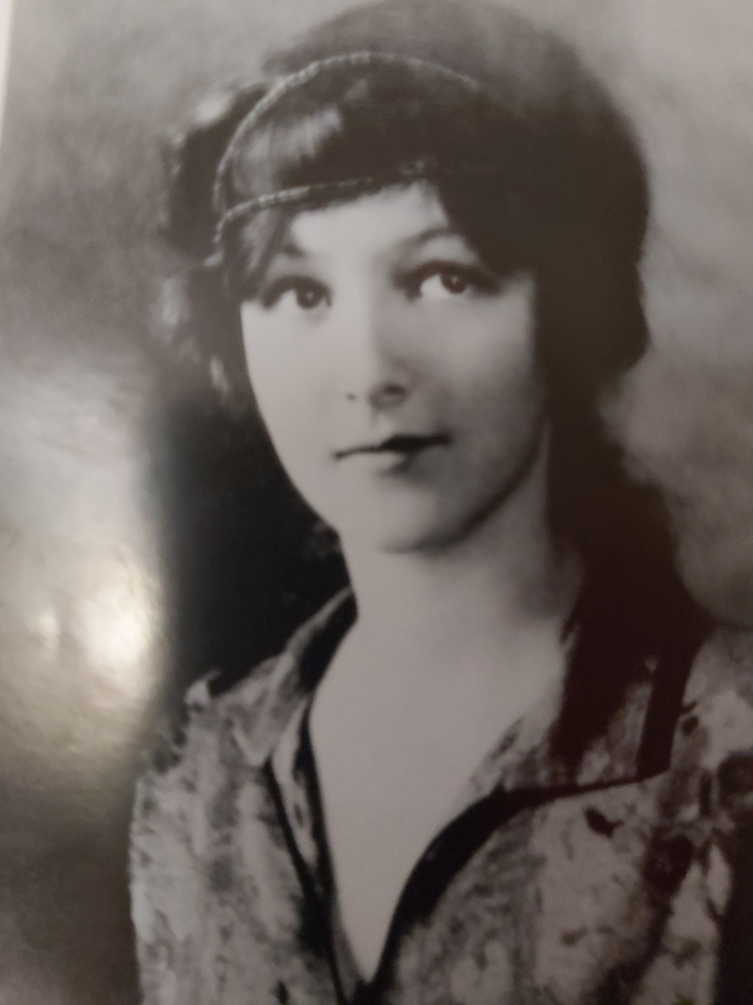
Mary Maxwell (13-14) About the time of the Weston School

Slide 110
The Montreal Youth Group of the 1930’s (1)
Ref: Will C. van den Hoonaard, The Origins of the Baha’i Community of Canada, 1898-1948, Wilfred Laurier University Press, 1996.
The friends in Montreal who became Baha’is in the first two decades of the 20th century were what we used to call “Abdu’l-Baha Baha’is.” They came under the direct magical influence of May’s teaching work. Some of them had even met ‘Abdu’l-Baha during His stay at the Maxwell home and later at the Windsor Hotel. Except for the French Canadian contingent, the few friends of Jewish background, like Hand Fred Schopflocher, and the few friends of African Canadian background, like Eddie Elliot whose mother had been a maid in the Maxwell home, these friends were of Anglo-Saxon background. About 45% of them had been born in England. Except for the children, they were middle-aged and older. These friends were interested in esoteric, mystical groups like New Thought, Rosicrucians and the Theosophists.

Slide 111
The Montreal Youth Group of the 1930’s (2)
The LSA (not the community) officially formed in 1922 under the guidance of May Maxwell who understood the Guardian’s intention in establishing the Administrative Order. These older friends had very little literature, but they shared a strong loving bond centred around May. The love of “the Master” as they called Him united their group. (They never called Him ‘Abdu’l-Baha). When the Baha’i youth of the day came on the scene, things began to change. May took a keen interest in these young people. Rowland Estall, an Englishman, proved to be one of Canada’s finest teachers. Rowland taught Heather Harvey’s aunt, Winnifred Harvey in Winnipeg. Estall had become a believer through Mary and May Maxwell late in 1927. Another young man, a Hungarian Jewish immigrant, Emeric Sala,became a Baha’i in December 1927. Rowland and Emeric, together with Mary, teamed up to attract new believers.They were galvanized by the Guardian’s world order letters. They felt the older believers did not fully appreciate the new spirit that was blowing because of the Guardian’s letters.

Slide 112
The Montreal Youth Group of the 1930’s (3)
The youth group was launched at the Baha’i Centre on Union Street, “the World Library of Today.” May supplied much of the reading material. Every Tuesday evening, Rowland and Emeric took the lead in explaining the Baha’i teachings. They had 4 speakers: two Baha’is and two non-Baha’is who spoke for 10 minutes each. The non-Baha’is spoke on any topic they liked. Emeric and Rowland correlated the non-Baha’i topics to the other talks. This became the first organized youth group in North America that taught the Faith systematically. Between the late 1920’s to the late 1930’s some 59 new believers enrolled in the greater Montreal area, some of them because of the direct influence of the MYG. When they attained the age of majority, some of the youth became members of the LSA. Marriages among the young couples took place including Emeric to the teacher Rosemary Gillies and Rowland to an actress Stella Delanti. David Hofman was also a member of the group. The MYG had a significant impact on the national and international development of the Baha’i Faith.

Slide 113
The Guardian’s Western Education
We have seen previously that the Guardian took steps to distance the Baha’i Faith from its Shia Iranian, Muslim origins. For his formal schooling, he was western educated, both in French and in English--for his primary and secondary education, first at the College des Freres in Haifa and still later in French at the Catholic Jesuit school in Beirut. His university studies were completed at the Syrian Protestant College that became the American University of Beirut, and later at Balliol College in Oxford. Although he wore the black fez, he did not wear a beard or robes. Except for the fez, he wore western clothes. He wore a clipped moustache that he sometimes shaved. He always wore a trenchcoat and a tie. He never went to a mosque, except perhaps as a tourist. He didn’t even say “Allah’u’Abha” when he greeted western believers. Unlike ‘Abdu’l-Baha, he did not entertain clerics or religious dignitaries for profound religious discussions.In fact, he entirely disliked abstract thought. He was a doer, a builder. He was entirely single-minded in building up systematically the World Order of Baha’u’llah.

Slide 114
May and Mary in France and Germany (1935-1937) (1)
Prior to Mary’s marriage to Shoghi Effendi (1937) and in addition to Mary’s contribution to the teaching work of the Montreal Youth Group during the1930’s and May’s teaching and administrative activities in Canada and the USA, both May and Mary served the Faith on the European continent during the same period. May returned to France and helped to lay the foundations of the Faith there, while Mary, with the encouragement of Shoghi Effendi, did extensive travel teaching in Germany. May had suffered terribly from the Canadian winter ever since she left Paris in 1902. A change of climate was one of the factors that induced her to change her theatre of operation to Europe. Mary’s latest passion was to go to Spain and learn Spanish. Sutherland wanted to attend the International Art Exhibition in Brussels. It looked like the trip to Europe in 1935 might become a family affair. But most of all, it was Shoghi Effendi’s call to Europe that had moved May. With the rise of National Socialism in Germany and the swing toward Fascism in Italy and Spain, time was short and the opportunity might soon be lost.

Slide 115
Temporary Plans for Brussels and Spain (1935) (2)
If Mary had acquired a passion for Spain, she had an even greater one for Germany.There was a family connection. May’s sister-in-law, the wife of her brother Randolph Bolles, was of German origin. Another pilgrimage had figured among the strongest incentives for the European trip. May conceived of a family pilgrimage after travel-teaching in Europe. She thought teaching in Europe could be combined with Sutherland’s visit to the Brussels Art Exhibition. The Guardian cabled her in 1935: “APPROVE VISIT BELGIUM PRAYING FERVENTLY HEALTH SUCCESS LOVE SHOGHI” Mary’s plan to visit Spain had to be aborted because of the outbreak of the Spanish Civil War. Mary had left for Europe with her Aunt Bolles and cousins one month earlier than her parents; she decided to remain in Germany with them. After a boat tour on the Rhine, on doctor’s orders because of her heart condition, May had to stay behind in Stuttgart, while Mary and Sutherland continued their tour of Germany.

Slide 116
May, Mary and Sutherland in Germany (1935) (3)
Although May was “alone in a strange hotel in a foreign land,” she was strengthened by the power of her faith: “You find only Baha’u’llah, the One, the Single, the All-Sufficient in all the worlds of God.” While alone in Stuttgart, bad health did not prevent May from teaching. In a letter to Shoghi Effendi (October 9, 1935), she wrote that every day for two weeks, she taught “a lovely young German woman of high culture, Edna Bley,” who became a confirmed believer. All 3 Maxwells later attended the Art Exhibition in Brussels. Sutherland left for Canada from London. He had to return to Montreal to work on some buildings at McGill University with Maxwell and Pitts Architects, the new name given to the firm after Edward died. Because of her health, the plan to teach in Brussels, a virgin territory, had to be changed, but not before attending “one session of the heavenly Summer School at Esslingen [1935] --a never-to-be-forgotten experience!” Instead May went to Paris and then headed south to warmer climes-- to Lyon in the Massif Central of France, a city that had once been the stronghold of the Catholic faith.

Slide 117
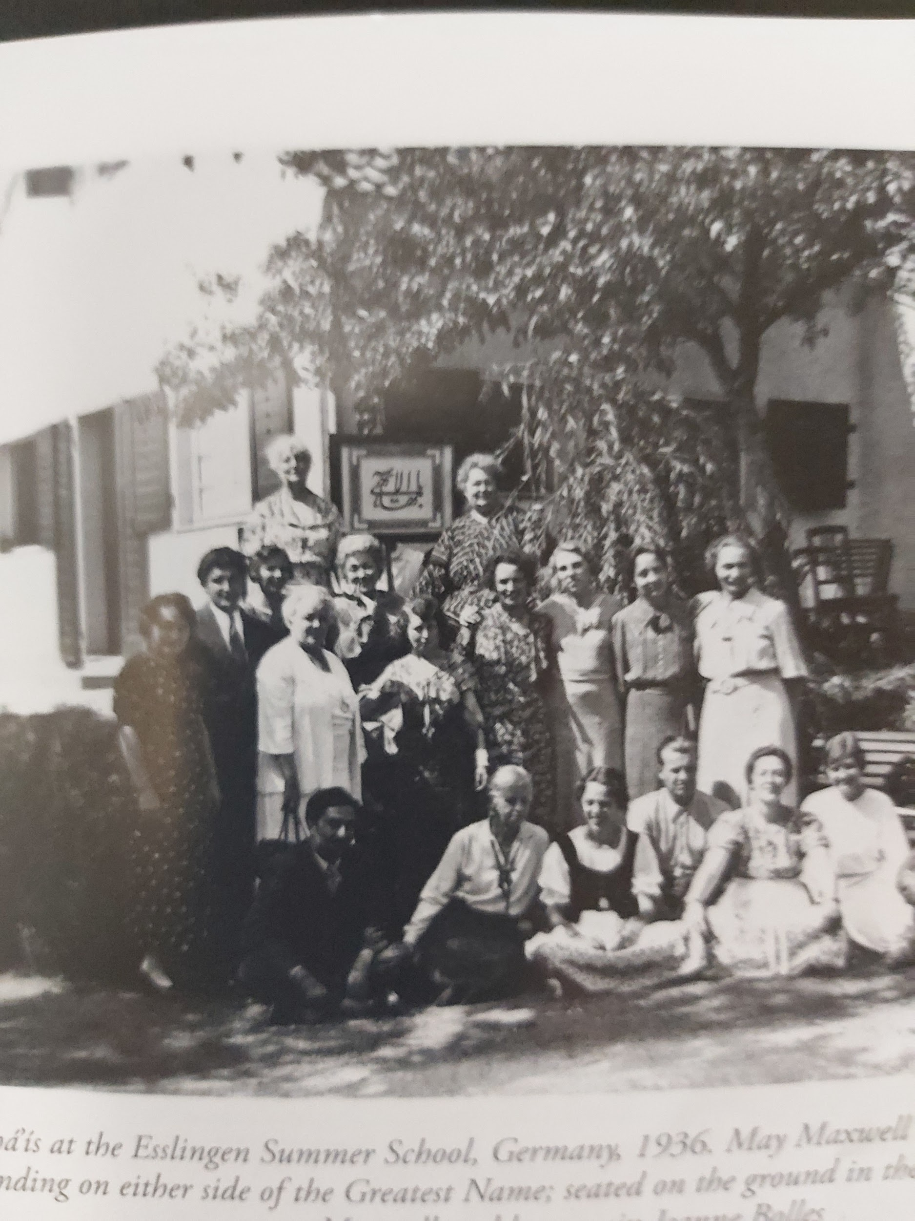
The Marvellous Esslingen Summer School (1936)
Esslingen is in southwest Germany. May Maxwell (l.) and Marion Jack (r.) are standing on either side of the Greatest Name. Seated on the ground in the front row, Jeanne Bolles is wearing a dark German costume with white blouse.
Mary Maxwell, also in German costume (Drindl) is seated to Jeanne’s left.
No one else is identified.

Slide 118
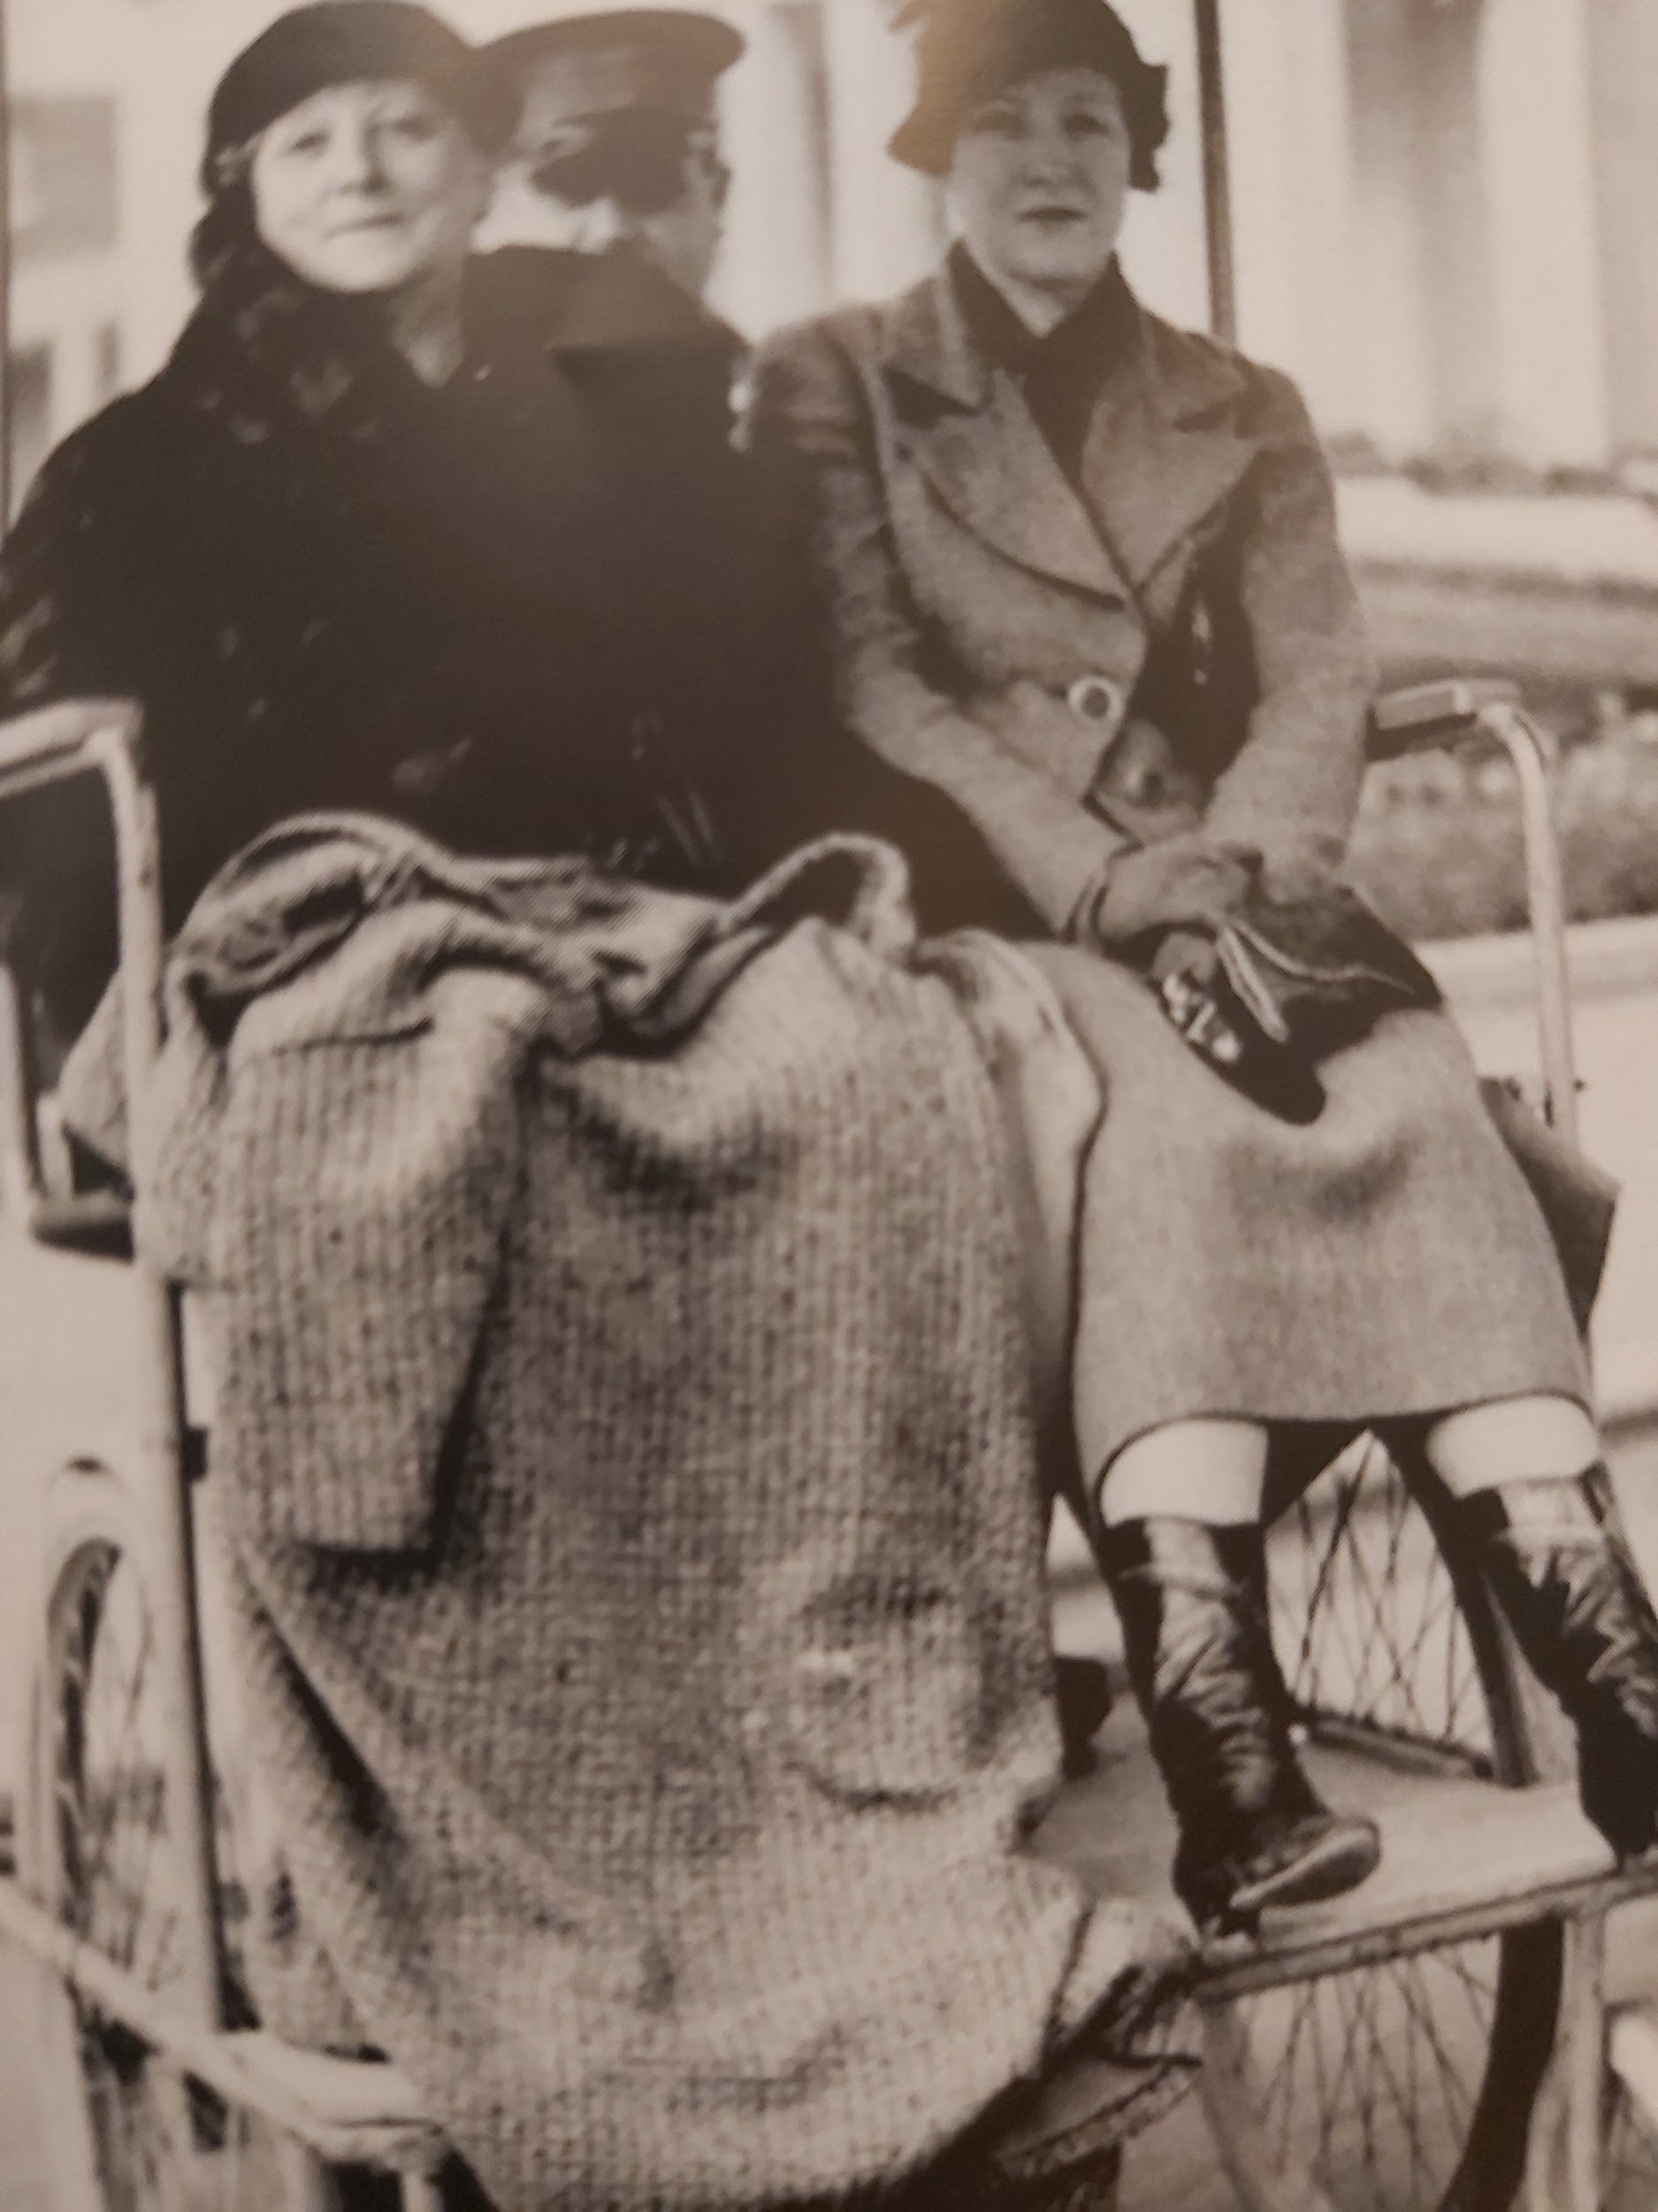
At the Brussels Exposition and Art Exhibition (1935)
May Maxwell could not
walk long distances.
Here May and Mary are
are being transported
in a buggy.

Slide 119
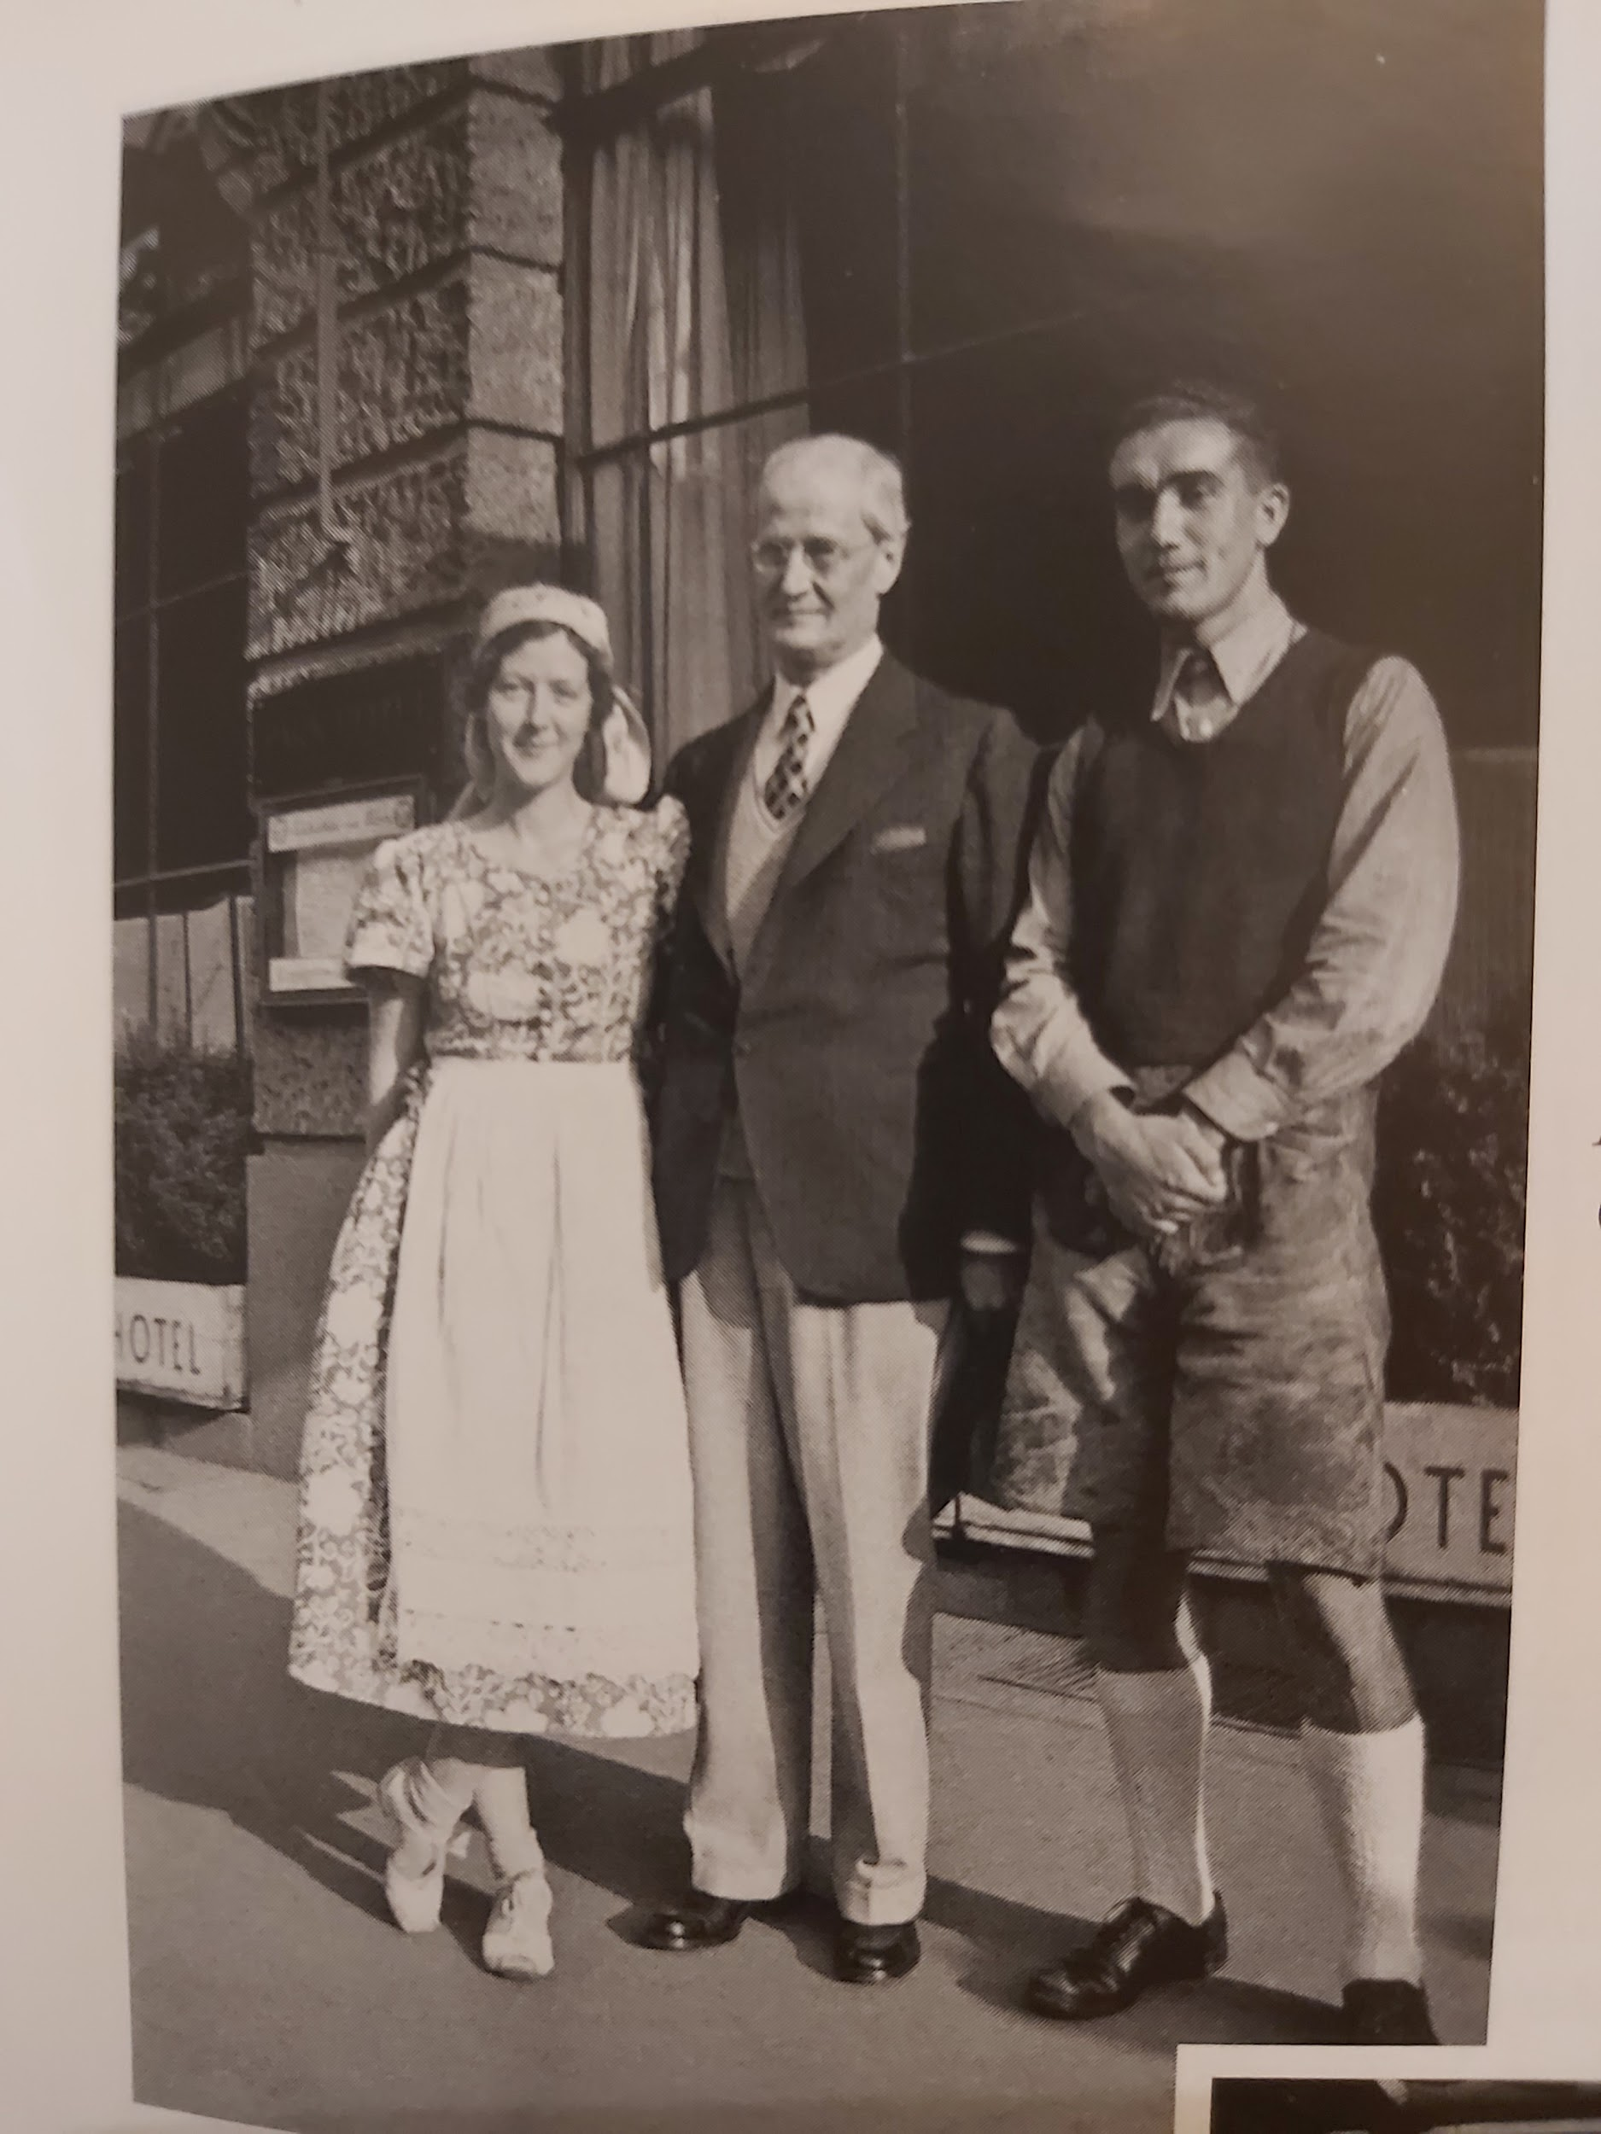
Mary, Sutherland, Alfons Grassle, Munich (1935)

Slide 120
Mary Maxwell in Germany (1935-1936) (4)
In the meantime, Mary had fallen head over heels for Germany and the German language, a tongue that she learned to speak fluently but not entirely correctly. She said in one of her talks that in the North they thought she was from the South, and in the South they thought she was from the North. (Read her letter to May dated August 3, 1935, MM2, pp. 214-215). Her stay of over a year created a “radical change” that greatly widened the range of her limited North American experience and brought about a distinct, mature change of character. The depth of faith of the German believers that she found at the Summer School in Esslingen (August, 1935) greatly impressed her. May attended the same summer school both in 1935 and 1936. Mary viewed Germany largely through the favourable lens that Shoghi Effendi had envisioned for the country’s unique spiritual destiny, although she did note the anti-semitism that she encountered even among the German Baha’is.

Slide 121
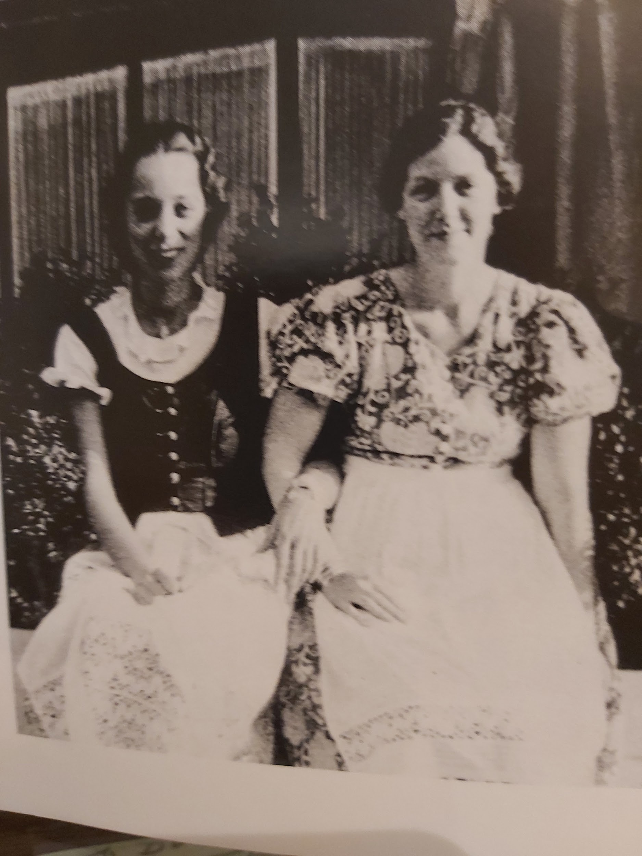
Mary and Cousin Jeanne Bolles in Stuttgart (1936)
Wearing the traditional
German costume, “the
Dirndl.”

Slide 122
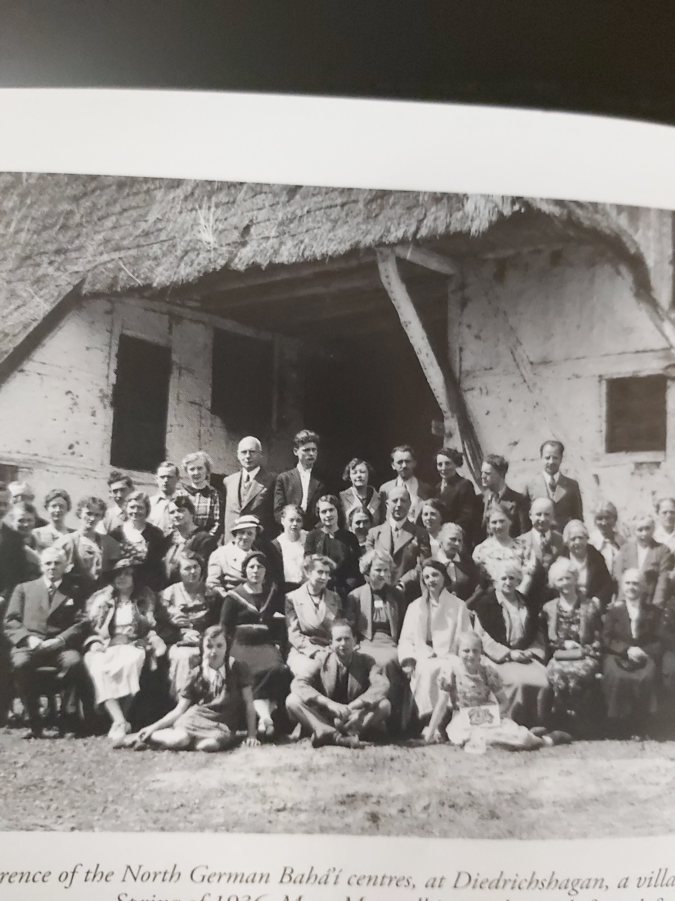
North German Baha’i Conference Spring 1936 Diedrichshagen (Rostock)
Mary Maxwell is standing in the back row, directly behind the man seated on the left in the front row.Mary learned German during the two years she was in Germany. She gave great impetus to the teaching work. On the instructions of Shoghi Effendi, she taught the German friends about the Baha’i Administration. She visited every single individual, group and community during her stay. Both the Master and Shoghi Effendi said that Germany was the leading Baha’i community in Europe. The Guardian said that “Germany is the head and England is the heart” of Europe.

Slide 123
Mary and Mary Maxwell in Germany (1935-1936) (5)
The Guardian approved of Mary’s plans to remain in Germany. He cabled on October 26, 1935: “HEARTILY APPROVE CONCENTRATE PRECIOUS EFFORTS GERMANY DELIGHTED MARY’S PROGRESS LOVE.” May joined Mary at the Summer School at Esslingen (1936). He instructed them to teach the Baha’i Administration to a people who who valued order above all. Over the year, Mary visited every single Baha’i locality where Baha’is resided, either individuals or groups.The cities included Hamburg, Rostock, Dresden, Berlin, Warnemünde, Munich, the Rhône Valley, cities, towns and villages alike. Another Montreal Baha’i, Lorol “Kitty” Schopflocher, the wife of Freddie Schopflocher, the Hand of the Cause of God, the German of Jewish background and “temple builder,” did her own remarkable world travels for the Faith. Lorol was also in Germany and gave one of the best talks that Mary ever heard her give.Reports were sent to Shoghi Effendi by both May and Mary; they received in turn his grateful thanks and praise. May was recognized by all as “the foremost teacher in Europe.”

Slide 124
The Tragedy at the Zugspitze in Bavaria (1936) (1)
The Zugspitze is the highest mountain in the Bavarian Alps (2,962M/9,718F). It lies not far distant from the ski town of Garmish-Partenkirchen. While skiing early in the month of January, Mary met a group of youth, among whom was a very fine young Argentinian medical student. (He is never named). Mary knew him only briefly, but they formed an immediate close bond.The night before he died, during an intimate conversation by the fireside at the ski-lodge, he confided in Mary. He told her how much he loved and missed his parents.They also spoke of spiritual matters.The next day as his group set off for a “climb” in the mountains, Mary decided not to accompany them. But she had a strong premonition of disaster and urged him not to go. He laughed and waved back at her. She watched his red cap disappear in the snow. Hours later word came that the group of climbers had been lost in an avalanche. Only one person survived.

Slide 125
The Tragedy at the Zugspitze in Bavaria (1936) (2)
It was a terrible shock. According to May, Mary was, “frantic with grief” at the sudden extinction of such a young, beautiful and promising life. In a severe state of distress, Mary phoned her mother in Paris. She wrote to the Guardian, asking for prayers. She even wired Leonora Holsapple in South America. She wrote to the young man’s parents, telling them what he had said about them. May was of course anxious to comfort her daughter, but she was thankful that Mary had not gone with them. Sutherland too had a premonition. He wrote: “I had for some period of time been uncomfortable about you and your mother--now this feeling has gone.”....”I am so thankful that providence spared you.” (MM2, p.222). Two years later at the very time in January that the tragedy had occurred, May wrote her own letter of consolation to the bereaved parents, containing some comforting words about immortality.(MM2, p. 222). Six months later, May wrote to Sutherland to express her concern about Mary’s still affected emotional state, reporting her words: “Mother, I think I shall never be myself again until I go to Haifa. I have lived through too much, especially that awful shock in the Zugspitze.” (MM2, p.238).

Slide 126
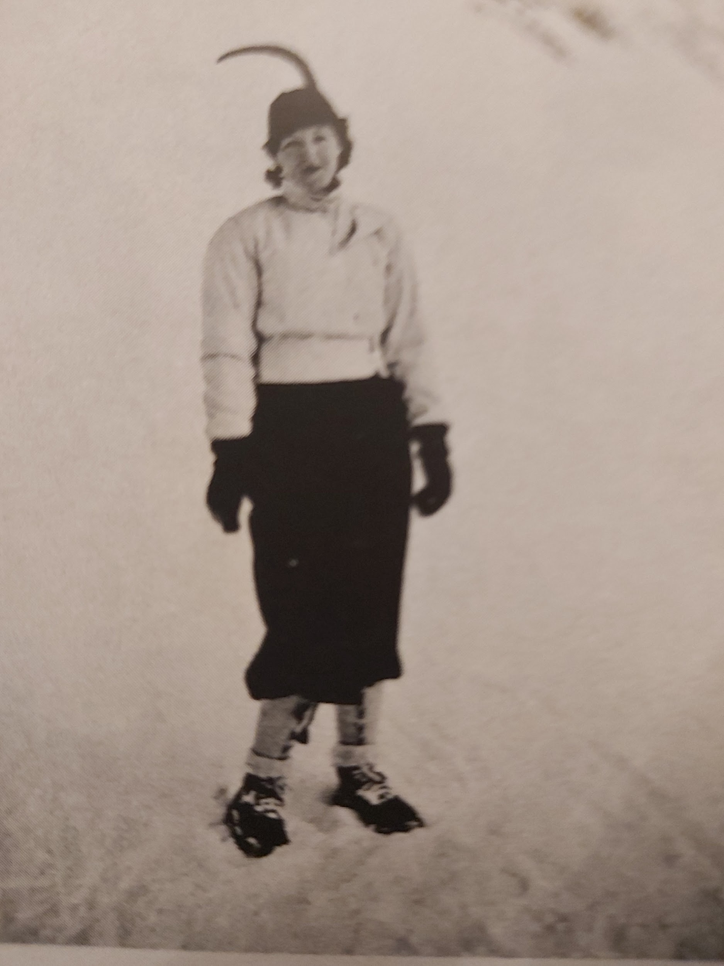
Mary at Zugspitize Where the Avalanche Occurred

Slide 127
May’s Work in Paris and Lyon (1935-37) (1)
May did not want to bother Shoghi Effendi who was on his summer vacation to get his permission to go to Lyon instead of doing the teaching work in Brussels. She was not very fond of Brussels, but since the Guardian had given her permission to teach there, with Mary she planted planted a few seeds there that she returned to water during July of 1936. But Mrs. Maxwell longed to return to France. Mainly because of a happy childhood there and her discovery of the Faith in Paris, she felt more at home in “the city of lights” than anywhere else. Once Mary had left Brussels to return to Germany, May gathered up her affairs and headed for Paris. May stayed in her beloved city from Christmas 1935 until March of 1936. She arrived in Lyon in March, 1936.

Slide 128
Disappointment in the Paris Community of 1935 (2)
In Paris May had known the joy of discovering the Faith through Lua and the great blessing of the 1898 pilgrimage and the bounty of being in the presence of the Master. After her return to Paris, around her loving and magnetic personality, a group of devoted believers had gathered, some of whom became spiritual giants. But most of the believers had been English-speaking American expats. The LSA formed in 1928.The Paris Baha’i community that May visited beginning at Christmas of 1935 did not resemble in any way the community she had known at the turn of the century. No semblance of the Baha’i Administration was operating. They were not aware of the 19 Day Feast, known as a “Unity Feast” in those days. May was shocked and angered that the Paris friends were in a state of spiritual stagnation. They were dominated by the personality of a few individuals and unaware of the the spirit of Baha’i consultation. The Spiritual Assembly was conducted like a social gathering. Not one prayer was said and there was no consultation. “I suffered tortures,” May wrote to Mary.

Slide 129
Disappointment in the Paris Baha’i Community (1935) (3)
May could not contain herself. In a letter to Mary dated January 6, 1936 she wrote: “I don’t know what I said.” She confronted the group with the observation that she had seen no semblance of a unified action, i.e. a decision based on consultation. The Baha’is were shocked by her remarks which indicates how little they really knew of the way that an LSA and a Baha’i community is expected to function. They had tea, but May was “too choked to participate.” In the aftermath of May’s eruption, Edith Sanderson asked May to explain to her what she meant by a Unity Feast (19 Day Feast). This is the same Edith Sanderson that Shoghi Effendi had charged Majorie Morten during Marjorie’s 1933 pilgrimage, only two years earlier, with directing Edith to stay out of partisan politics. Marzieh Gail reported that because Majorie resisted his directive with the observation “But she is my friend,” on this occasion the Guardian became angry. Rising in his chair Shoghi Effendi exclaimed: “Politics is a filthy mess.” (Redman, vol. 1)

Slide 130
May’s Chastening Produces Results
Although May was a loving and gentle soul, when it came to respecting the wishes of ‘Abdu’l-Baha and the Guardian, she was a veritable lioness. She was not one to avoid a reprimand if she felt it was necessary. As soon the meeting was over, May told Edith MacKaye that she was leaving Paris the next day. She could not stand “to see the Cause of God travestied!” (MM2, p. 229). May was after all the spiritual mother of the Paris and the entire French Baha’i community. If anyone had a right to weigh in, she did. The LSA took notice. They decided to put the whole matter on their agenda for consultation in the upcoming week. It was a step in the right direction. May did not follow through on her threat to leave town the next day. She stayed in Paris until March,1936. But good results followed. Sutherland wrote to her later that year to say that Laura DB who was then in New York “said many encouraging and flattering things about your work in Paris.” “Gay Paree spiritually revived by your visit,etc.” wrote Sutherland with his droll sense of humour.

Slide 131
May’s Interview with Orientalist A.L.M. Nicolas (1936) (1)
In April or May of 1936, May had an important interview with the French-Iranian Orientalist Alphonse-Louis-Marie Nicholas. Nicholas could properly be described as a Bábí. He had translated the Persian and Arabic Bayans into French (1905, 1911-14), and the Bab’s “Seven Proofs.” (1902). He also met with local Babi-Baha’is in Rasht who were followers of Yahya Azal. Nicolas himself considered that Yahya was the legitimate successor of the Bab: “I was often dazzled by the explanation that the Bab gives us for certain mysteries,” said Nicolas in a 1939 interview for The Baha’i World with Edith Sanderson. Nicolas became intoxicated with the beauty, power and cogency of the Bab’s sacred writings. He was deeply moved that the “exalted genius” of the Martyr-Prophet of Shiraz had, like Jesus, shed his life’s blood for the purpose of uplifting Islam from the degradation into which it had fallen.

Slide 132
May’s Interview with Orientalist A.L.M. Nicolas (1936) (2)
Nicolas had been deeply hurt because he felt in acknowledging Baha’u’llah as the successor of the Bab, the Baha’is had relegated Him to the station of a lowly forerunner. He did not like ‘Abdu’l-Baha’s Traveller’s Narrative because it was hostile to Yahya whom he believed was the proper successor to the Bab. In writing Shoghi Effendi, May reported that she was building on the previous efforts of Edith Sanderson who for years had been developing “a very fine constructive friendship” with the scholar. May challenged Nicholas about his false attitude toward Baha’u’llah. At first Nicolas was “enraged” but then he softened and said he liked May’s “frankness.” May wrote to the Guardian that Edith had translated “Your sublime Chapter on the Bab,” which must refer to a chapter of Nabil’s Narrative of the Dawnbreakers which was published in 1932. “[It] wrought a miracle,” May wrote. Before he died in 1939, Nicolas heaped praise and glory on Shoghi Effendi who had calmed his persistent anxiety and torment about the Bab. “Now I can die in peace,” he said to Edith Sanderson. The Dispensation of Baha’u’llah and The Dawnbreakers changed everything for Nicolas.

Slide 133
A.L.M. Nicolas Died Content Thanks to Shoghi Effendi

Slide 134
May’s Work in Lyon with Lucienne Migette (1)
At the Esslingen Summer School, Izzatullah Zabih, an Iranian Baha’i studying in Lyon, invited May to come and teach in the great city. He was delighted when May accepted. May arrived in Lyon late in March, 1936. Her arrival “bestowed upon us a new vigor and impetus.” (MM2, p. 242).May stayed periodically in Lyon between 1935-36. The first French believer to accept the Faith in Lyon was a brilliant young chemist Lucienne Migette who met May at Mme Borel’s theosophical meetings.It was there that May spoke of the Faith. Both Mme Borel and Lucienne accepted the Faith. Lucienne’s declaration began a new era of expansion for the Faith in France. She was a prepared soul who caught the Spirit of the Faith immediately. Here is Lucienne’s description of May (MM2, p. 244). As she did with her other spiritual children, May continued to watch over her spiritual child and maintain a close contact with her for the few years that remained of May’s life. It was a special bond. May continued to encourage Lucienne to form the first LSA of Lyon. It was established during the war in 1940, just after May’s passing.

Slide 135
May’s Work in Lyon with Lucienne Migette (2)
Shoghi Effendi wrote that Lucienne Migette was an exceptional believer who moved him, as May reported, by “the flame of your love,” and on whom, he said, the future development of the Faith in France depended. Just as the Master had told May that she was the Baha’i Joan of Arc to France, May felt that Lucienne was following in the footsteps of the martyred saint, “to save France in this new epoch.” “I thank God wholeheartedly that He has raised you up in France, like Joan of Arc to save a part that God must have chosen, as He promised to have a group of every country in the world, and in the Qu’ran, it is written that the names of those who will be saved are already written in the Book of Life.” (MM2, p. 246). Lucienne was May’s chosen disciple.At the Guardian’s behest, they developed a very intimate, loving relationship. Following the fateful 1937 pilgrimage, May and Sutherland returned to Montreal. Soon France would be plunged into the war. May wrote her last letter to Lucienne from New York on January 17, 1940. May would offer up her life just weeks later in Buenos Aires, March 1, 1940.

Slide 136
May, Sutherland and Lucienne Migette in Lyon (1937)
The two other friends
are not identified in the
photo. Lucienne had a
doctorate in industrial
chemistry. She tested
water purification in the
Water Works of Lyon.

Slide 137
May Maxwell & Baha’is of Lyon 1937
Seated left to right:
Dr. Roshan Yazdi,Mrs. Mobader, May Maxwell, Mrs.Mobader, Izatullah Zabih who invited May to Lyon.
Standing: Mr. Mobader.
In the photo below, Madame Borel is holding the small picture of ‘Abdu’l-Baha. May is seated on the far right.

Slide 138
May and Mary’s Pilgrimage of 1937
Part of the incentive of the European teaching trip beginning in 1935 was to make another pilgrimage. On January 21, 1936, Shoghi Effendi in a post-script in his own hand extended to May “a most hearty welcome” to Haifa, but on May 29, Shoghi Effendi’s secretary advised May that the best time to make the pilgrimage would be the fall of 1937. The Guardian was virtually exhausted from 7 months of uninterrupted strenuous labour. He could no longer delay “his summer rest.” In the meantime, Shoghi Effendi advised May to continue her teaching work in Germany and Central Europe with Mary’s and Sutherland’s assistance. But again May had to curtail the teaching work because of high blood pressure and a weak heart. May’s original intention had been to make it a family pilgrimage, but much to her great disappointment, the pressure of Sutherland’s professional work in Montreal did not allow him to absent himself from the city. The 1937 pilgrimage would be her 5th and last: 1898, 1909, 1923-1924 (two visits with the Guardian) and 1937.

Slide 139
Mary Maxwell’s Marriage to Shoghi Effendi (1937) (1)
As it turned out, mother and daughter arrived in Haifa, not in the fall, but on January 12, 1937. Besides the sudden ascension of ‘Abdu’l-Baha, the pilgrimage of 1937 would reserve for the Maxwells the biggest shock of their lives: the marriage of Mary to the Guardian. It happened during the same pilgrimage that produced the best known of all pilgrim’s notes, “The Haifa Notes.” The initial contact was done at the Guardian’s request in the Persian way by a go-between, the Guardian’s mother Ziayyih Khanum to May Maxwell. Ziayyih Khanum broached the topic by mentioning the Master’s Will and the provision for a line of Guardians. She asked May what she thought of her daughter’s qualifications as the Guardian’s wife. She alluded to the great and sudden change it would bring in Mary’s life. May felt “very cold and strange.” At first May resisted with the response that an “Oriental” would be better suited. The negotiations required about three conversations. During the third interview, Ziayyih Khanum said: “The Guardian has given me the ring.” May was speechless.The Guardian had his choice confirmed in a dream.

Slide 140
Mary Maxwell’s Marriage to Shoghi Effendi (1937)(2)
Before the proposal, Shoghi Effendi began to teach Mary Persian. Ruhiyyih Khanum used to say proudly that she thought he did this so that the Guardian could get to know her better. He traced out with his own hand the shape of the Persian letters. He gave her a set of reed pens and ink and special mulberry paper for calligraphy, with 3 calligraphic models from the sacred writings set by Mishkin Qalam. Those papers became a treasured souvenir for Ruhiyyih Khanum. Mary knew nothing about the proposal until the Guardian’s younger sister Ruhangiz took Mary into his presence. It was surely the most overwhelming shock of her life. Mary never divulged what was said during those 15 minutes, the only time she spent alone, she said, with Shoghi Effendi before the marriage. When she returned, she had the ring in her hand. The heart-shaped ring once belonged to the Greatest Holy Leaf. At his instruction she concealed it around her neck until the marriage. She had an identical one made for him.

Slide 141
Ruhiyyih Khanum’s Marriage to Shoghi Effendi (1937) (3)
May cabled Sutherland not for his permission but his “consent.” May summoned Sutherland to Haifa on condition of secrecy. The marriage on March 24 was the essence of reverence, simplicity and dignity. In the Shrine of Baha’u’llah, only the Guardian and Mary were present. Shoghi Effendi chanted two prayers; then he placed the wedding ring she had been concealing around her neck on her finger. When they returned, the Guardian’s mother took them into the room of the Greatest Holy Leaf in the house of ‘Abdu’l-Baha, where the Guardian’s relatives embraced them. The certificate of marriage was signed by the Guardian’s parents. Later that evening, at the Western Pilgrim House, it was the turn of the Maxwells to embrace Shoghi Effendi and “his little western wife” and to sign the marriage certificate. Although she considered the marriage to be the greatest of life’s bounties, its sudden, unexpected nature caused May to be ill. It took her months to recover. It also became May’s “supreme test.” Ruhiyyih Khanum later expressed in great detail how that sudden transition had affected her. (MM2, 311-314)

Slide 142
Mary Maxwell Becomes Ruhiyyih Khanum (1937)
At the end of the evening, the couple walked back across the road and sat with the Guardian’s family for a while; then they went upstairs to the two rooms that the Greatest Holy Leaf had built for him years before. Once the ceremony was completed, it was the Guardian’s wish that Mary become known as Ruhiyyih Khanum, although Shoghi Effendi gave her parents permission and some close friends to continue to call her Mary. The name change was instantaneous once she became a member of the Guardian’s family. May once addressed her daughter by letter as “Ruhiyyih Khanum.” Mary objected, telling her mother she did not like to be called “Khanum.” She signed her letters only “Ruhiyyih.” When the Guardian elevated her to the rank of a Hand of the Cause of God in 1952, her full title became “Amatu’l-Baha Ruhiyyih Khanum.” Amatu’l-Baha was a title chosen by the Master for a select number of women. For her married name, she referred to herself as “Madame Ruhiyyih Rabbani.” After her marriage she signed all her letters “Ruhiyyih.”The Maxwells stayed on for 2 more months after the wedding.

Slide 143
Mary Maxwell Soon to be Ruhiyyih Khanum (1937)
At the time of her
marriage, Mary
Maxwell was 26 years
old. Shoghi Effendi had
just turned 40 years old.
The Guardian must have
been conscious that the
Will and Testament of
‘Abdu’l-Baha stipulated that a line of Guardians would succeed him.

Slide 144
The Guardian’s Marriage: Unity of East and West
Shoghi Effendi said that Baha’is were neither eastern nor western. The Guardian’s marriage was another step in the international development of the Baha’i Faith. ‘Abdu’l-Baha had taught the unity of the East and the West.The Guardian’s marriage symbolized the union of the East and the West.The Guardian cabled the American NSA advice on how to announce the marriage: “EMPHASIZE SIGNIFICANCE INSTITUTION GUARDIANSHIP UNION EAST WEST AND LINKING DESTINIES PERSIA AMERICA. ALLUDE HONOUR CONFERRED BRITISH PEOPLES.” He wrote in another cable to the American NSA: “Institution Guardianship head cornerstone administrative order Cause Baha’u’llah already ennobled through its organic connection with persons of twin Founders Baha’i Faith is now further reinforced through direct association with west and particularly with American believers whose spiritual destiny is to usher in World Order Baha’u’llah. For my part desire congratulate community American believers on acquisition tie vitally binding them to so weighty an organ of their Faith.”(SETPE, 240)

Slide 145
Thank You Letters from Ruhiyyih and May
To Her Parents:
“My dearest, dearest ones, On this most glorious day of my life how can I ever thank you both enough and express my love to you--for the life you gave me? For all your devotion to me; the example of your own happy marriage that gave me an ideal in life; the beauty of our home which has enriched my very soul. From you both I have woven into me so many characteristics that I hope now will be of service to the Guardian and [the] Cause. Surely no child never had two better, more loving parents than I! And as you have always been my pride and my dearests and my joy--so in my new life you will always continue to be!”

Slide 146
Thank you Letter from May
To the Guardian:
“Beloved Guardian,
Today I realize more profoundly than ever in my life the deep meaning of the Master’s Words to me in Montreal-- ‘God has perfected all His bounties in you’ and this, despite my utter unworthiness. Now it is you, who take my dear husband to Bahji, and my thankfulness is overflowing. May I humbly beg, on this blessed day your prayers for all my near and dear ones in the seen and in the unseen worlds; for all those with whom my ‘heart is vitally connected’, for whom the Master made me such wonderful promises… With deepest love and humble devotion, I am yours, May M.” // “The Guardian was nobody’s husband.” Ruhiyyih Khanum reported by my mother Joyce from one of Ruhiyyih Khanum’s talks.

Slide 147
May’s Eloquent Tribute to the Immortal Lua (1)
‘Abdu’l-Baha placed only one photo in His room: Lua’s. When she died He repeated over again: “What a loss! What a loss!” Lua died alone and lonely in Cairo, the victim of gossip and divorced by Dr. Getsinger. As May wrote: “Without home, money, or any earthly hope or refuge--after her years of suffering, service and sacrifice she attained her supreme desire and lay, at last a martyr.” (She had begged the Master to be slain in the path of God). “Then I saw no longer the bruised and broken reed trodden and crushed to earth, whose fragrance shall perfume all regions. I saw the victorious Lua, majestic in her death--the Lua who shall live through all ages--who shall shine from the horizon of eternity upon the world when all the veils which have hidden her today from mortal eyes have been burnt away. As Kurat-ul-Ayn was the Trumpet of the Dawn in the Orient in the Days of Baha’u’llah so Lua Aurora shall wave forever and ever the Banner of the Dawn in the Day of the Covenant. Even as her age and generation knew her not, seeing only her mortal frailties--so future ages and cycles will love her--adore her--

Slide 148
May’s Tribute to the Departed Lua (2)
“--venerate her blessed name--and strive to walk in the path of her utter servitude, severance, and sacrifice. The passion of Divine love that consumed her heart shall light the hearts of mankind forever and forever. Great and wonderful were her qualities--in her own person she bore the sins and weaknesses of us all, and redeeming herself she redeemed us. She broke the path through the untrod forest; like the grasshoppers, she cast her soul and body into the stream and perished making the bridge by which we cross: she was Niobe* all her days, washing our sins in her tears: she was burned to cauterize our wounds...I believe that the last time Lua left her Beloved ‘Abdu’l-Baha she died to all save God and took the “step of the soul” by which the spirit of truth and reality dawned in the Cause in America.” Lua and her revered teacher Mirza Abu’l Fazel died within two years of one another. They are buried together in Cairo under the same monument that May visited years later.

Slide 149
May’s Struggle in Accepting Mary’s New Station (1)
May was ill for the whole two months following the wedding. Although she was overjoyed at the great blessing that came into her daughter’s and their life, she felt acutely the coming separation that Ruhiyyih Khanum’s marriage to the Guardian would inevitably bring. Her recovery from the shock of the marriage was slow. May’s system responded only to homeopathic treatment. There was no homeopathic doctor in all Palestine. Ruhiyyih Khanum had also been treated with homeopathy as she was growing up. (She used it for the rest of her life). May also worried about Ruhiyyih Khanum’s health in Palestine without a homeopathic doctor. In her first letter to her parents after her marriage, Ruhiyyih Khanum reminded her mother that the Guardian wanted her [May] to continue to work on her history of the Baha’i Faith in France, and to complete an In Memoriam article on Thomas Breakwell for vol. VII of The Baha’i World. Through their daughter, he also reminded Sutherland to be “be more active in the teaching work, not to neglect his administrative duties, but to collaborate with you.” [May]

Slide 150
May’s Struggle in Accepting Mary’s New Station (2)
In a letter of February 1, 1938 to Ethel Edell, with her usual candour, May expressed how Mary’s marriage to the Guardian became her “supreme test”: “I learned, dearest Ethel, that even the heart can become a danger to us through the emotional nature, and that only when the soul, with all its surging tendencies, its great quality, is controlled by the will and comes under that sway of the mind, will it be released from the subtle temptations of the self. My very love for my daughter, perhaps the purest and noblest love of my life, became my greatest stumbling block, my supreme test; I had to learn true detachment and utter surrender, the giving of my will entirely to God and the building up of that mighty power of faith which alone lifts us into higher realms of conscious union with the Beloved.” (MM2, p.311)

Slide 151
Ruhiyyih Khanum’s Challenging Adjustment (1937)
It was also a difficult adjustment for Ruhiyyih Khanum. Her life of freedom was cut off in an instant. She had to cover her head when she went out in public and could not travel without male accompaniment. She lived in a Middle-Eastern household. Until she learned Persian, her adjustment must have been difficult. During the early years of her marriage, Mary relied on letters from home more than ever, not just from her parents, but from former friends. May’s correspondence to her daughter greatly increased post 1937 until her death in 1940. She wrote at least 150 letters during these years, some of which were lost because of the war. During this time, the Guardian, May and Ruhiyyih Khanum had to deal with the rebellion of Ahmad Sohrab. What was sadder still was the growing rebellion of the Guardian’s own family. Against his wishes, they gradually politically allied themselves with the Arab community and married covenant-breakers. He suffered greatly because of their disobedience to the Covenant. He waited patiently, but in the end he had to expel them even though they were his own biological family.

Slide 152
Ruhiyyih Khanum’s Supreme Consolation (1938)
Despite the loneliness that she felt in adjusting to life within the Master’s family, the trials associated with defiance of the Guardian’s wishes by them and being suddenly cut off from her own culture and friends, Ruhiyyih Khanum’s consolation was of course entirely associated with serving the beloved Guardian and being his wife. In a lengthy letter of February 6, 1938 to her parents, she wrote: “Gone are my friends, freedom, calm, charm of my home, everything of the past and in contrast to it I have a much harder external life--but look at how I am being spiritually spoiled by being the Guardian’s wife! Is there any greater honour for me than being the wife of the Guardian? We’ll just let it go at the word ‘honour’ and not mention all the other exquisite, wonderful things that go with it! I don’t have to elaborate. You know what I mean...Shoghi Effendi says I have no right to call him a mystery! But I can say that to me he is and the result of my observations is that a Guardian is a touchstone applied to us all the time, he is bigger than he himself realizes--I believe this.” (MM2, pp. 113-114)

Slide 153
On the Way Home from the Holy Land (1937)
The Guardian had given the Maxwells permission to visit the fragile communities of Lyon and also Paris where the Paris World Exposition was taking place. Although May was ill, she was delighted to see Mlle Migette again and the other friends. It was a bitter-sweet return to Canada that summer as they headed to New York. With his all-compelling interest in art, Sutherland had lots of things to see at the Paris Exposition and in the charms of the French countryside. But in addition to not knowing if she would ever see her daughter again because of the condition of her health, May had other things to worry about. She worried that the banning of the Faith in Germany would cause grief to Shoghi Effendi. The Arab-Israeli conflict had only recently begun in Palestine. Under the leadership of the Grand Mufti of Jerusalem, a sworn enemy of Shoghi Effendi, the “Arab Revolt” had begun with attacks on Jewish settlements. May and Sutherland must have worried about their daughter’s safety. In September, Mr. Maxwell returned to Montreal, while May stayed in New York for a few more weeks.

Slide 154
Another Look: Care Taken by May for Others
In attempting to assess the character of May Maxwell, note the care with which she instructed young Mary (14) in this letter. It shows May’s genuine concern for others: “I hope you have not forgotten your promise to take dear old Mrs. Pomeroy out at least twice a week. ...poor, old Mrs. Pomeroy is old and sick and very poor, and I know how she would appreciate these drives, especially if you sometimes go with her yourself...Be sure and telephone your cousins the Maxwells, Mary Stewart and Tillie and anyone else you may think of about Dr. Randall’s lecture on Friday night….Give my love to Aunt Janne [sic] and Uncle Randolph, and call up Annie Savage for me on the telephone and give her my special love and tell her how sorry I was not to have a minute to call her up to say goodby [sic].” (MM1, p.33) To Mary: “First--I must congratulate you on your good management of the household and with regard to the cook. You are a very capable girl and I sure that by the time I get back home, I shall find a far better housekeeper than myself…” (MM1, p.35)

Slide 155
The Last Great Act: Pioneering to Buenos Aires (1940) (1)
May’s life and health was service. Her life was a constant never-ending struggle to find the energy to serve the Cause. But serve the Cause she must. She struggled to serve the Faith but in serving it, her strength was renewed. The same love that ‘Abdu’l-Baha had kindled in her heart burned no less for Shoghi Effendi. He had warned her not to “adore” him, but May was in ever fibre of her being a lover. A great generosity of love was the mystery of her magnetic personality and the key to her influence on other souls, along with her great eloquence in expounding the Teachings. To whom much is given, much is expected. Toward the end of 1939, when she was 69 years old, Leroy Ioas the Chairman of the National Teaching Committee wrote to her, asking May to do some travel-teaching in Quebec “this Fall and Winter” and hinted that Toronto, Vancouver and Winnipeg could use her services. May was motivated by her desire to show her gratitude to Shoghi Effendi who had healed her and bestowed such a great honour on her family by “the sacred tie” of linking the Maxwell family to the Guardianship.

Slide 156
The Last Great Act: Pioneering to Buenos Aires (2)
Shoghi Effendi had initiated the First Seven Year Plan (1937) to systematically execute the Divine Plan of the Master, as revealed in one of the great charter documents, the Tablets of the Divine Plan. May had already been “the first believer to take the Faith to the Latins” by establishing the Faith in Paris. Now the Guardian had raised the call for South America, another Latin continent. May responded. The Guardian approved her desire to travel-teach to South America on condition that she obtain the consent of Sutherland and her doctor. May worked for two months on her husband and her doctor to obtain that consent. She knew that her magnanimous husband had in the past graciously accepted her long absences. Only once did he protest and put his foot down, forbidding her to leave Montreal again. May had actually travelled with Sutherland during the winter to Englewood, to Washington, D.C. and to Philadelphia. May finally obtained Sutherland’s consent. He returned to Montreal while she stayed in New York. She made arrangements with Cooks Travel. Finding the strength for the last great trip was hard.

Slide 157
The Last Great Act: Pioneering to Buenos Aires (3)
She wrote to Sutherland: “You cannot imagine how hard it is for me to take this trip to South America; no wonder the French philosopher and scientist Bergson described the resistance of the atoms, of the whole natural world, to the penetration of a higher force, and I sometimes feel the very atoms of my body, like some dead opaque substance, resisting the penetration of the spirit, and the struggle lays me low.” (MM2, p. 355). May sailed to Buenos Aires from New York on January 24, 1940 on the S.S. Brazil with her niece, Ruhiyyih Khanum’s cousin, Jeanne Bolles. The Guardian did not want May to make a prolonged visit there, but to enjoy the change of climate during the winter and take care of her health. While stopping over in Rio, on hotel stationary, May wrote some journal notes to herself, reminding herself how to behave. (MM2, p.359). In Rio, May was joined by Leonora Holsapple Armstrong, the spiritual mother of South America, who was the first Baha’i to settle in Brazil. After a month long journey, May and Jeanne arrived in Buenos Aires on February 27, 1940.

Slide 158
The Joy of Her Arrival in Buenos Aires
Jeanne Bolles described best her reaction when they first arrived in the city: “She was like a young girl of 16 in her joyous enthusiasm. She leaned out of the taxi as we rode through the streets, saying, ‘Oh, Jeanne, look at the lovely people’ and ‘Oh, Jeanne, look at the pretty shops’, and still again, ‘Look, look at the cute little omnibuses.’ May admired the strong, beautiful, modern city, and its interesting combination of North and South America “with an enchanting climate and delightful people.” But it took them hours to get through customs on a very hot day; May left her purse in a taxi and lost $250 but the purse was returned. The first night at the Hotel Jousten was noisy and sleepless. They moved the next day to the City Hotel where May “had a wonderful rest.” Their last supper was held in May’s room on the 9th floor in room 920. It was strange that even the forks, spoons and knives were marked with a “9”! May was happy that night not only because the Guardian wrote her encouraging post scripts, but also because he sent her his moving account of the interment in the Monument Gardens.

Slide 159
May Takes her Flight to the Abha Kingdom March 1, 1940
Only 4 days after their arrival, May awoke at 6:00 a.m. “with an intense pain deep, deep in her bosom.” The doctor who was called did not think her condition was serious because her pulse was slow but regular, although she was icy cold. He prescribed rest and medicine. But the pain returned with a greater intensity than anything she had ever felt before. Jeanne agonized to see and hear her in such a condition. (Poor Jeanne had lost her father Randolph, May’s brother, shortly before). At 2:15 p.m. she ate a little soup when the fatal heart attack came. May Maxwell fell unconscious. By the time the doctor arrived, she had passed on to the Abha Kingdom, where she gained the greatest desire of her heart by being reunited with the beloved Master, ‘Abdu’l-Baha. On the same day as her death, May sent a cable to Sutherland begging for prayers. Sutherland immediately cabled Shoghi Effendi: “JEANNE BOLLES CABLED MAY DESPERATELY ILL BUENOS AIRES PLEASE PRAY FOR HER PREPARE MARY--SUTHERLAND MAXWELL”. Jeanne sent a cable at 3:37 p.m. to the Guardian:

Slide 160
Preparing the Body
“BELOVED ONE IMPLORING YOUR GUIDING HELP PRAYERS OUR SACRED MAY MAXWELL HAS LEFT OUR MIDST FOR ABHA KINGDOM ALL LOVE TO YOU BELOVED RUHIYYIH KHANUM. JEANNE BOLLES.” Jeanne had to keep a long vigil over the body from Friday to Sunday, without any response to her cables. May’s body could not be washed at the funeral salon because two other funerals were in progress. But the body had to be washed and prepared as soon as possible. There were only 3 firm Baha’is in Buenos Aires at that time: no Baha’i women were among them. Mr. Simon Rosenzweig, the first Uruguayan Baha’i and his children, prepared the body. When they asked for water, they were told there was none, but they were given permission to use the buckets which contained feed for the horses. These buckets were used to carry the water to wash May. Her body lay literally in the courtyard stables. It was there the Rosenzweigs washed her remains.She was finally enclosed in a beautiful casket with a glass top. She had flowers in her hands and lay in a peaceful repose.

Slide 161
The Funeral and Memorial of May Ellis Bolles Maxwell
May’s funeral was held on March 13, 1940. Only 12 people attended. It consisted of the 3 Baha’is and their friends. Only one month after her passing, the Baha’is were joined by friends of the Faith when they decided to form the first LSA of Buenos Aires. It took a couple of weeks to find a suitable cemetery. A temporary burial had to be arranged. About 2 weeks later, Shoghi Effendi approved a location in the cemetery at Quilmes, located in greater Buenos Aires, 17 kms south of the capital. Shoghi Effendi announced a Memorial Service to be held in both Americas. It took place in Foundation Hall of the Wilmette Temple on April 26, 1940. The hall was filled to capacity. The service began at 9 p.m. and lasted until 10:30. It was marked by an unusual reverent stillness never experienced before. Only the voices of the 9 speakers could be heard. Eulogies were given by May’s friends; tablets about her from the Master were read and an excerpt from a letter by Ruhiyyih Khanum. Ali Kuli Khan chanted a prayer for the dead. Ernest Harrison from Montreal read the Prayer for Canada while facing the Qiblih.

Slide 162
May’s Funeral in the Quilmes Cemetery March 13, 1940

Slide 163
May and Jeanne Bolles in Buenos Aires (1940)

Slide 164
May’s Last Photo Taken in Buenos Aires (1940)

Slide 165
The Guardian’s Eulogy to May Maxwell
“ABDULBAHAS BELOVED HANDMAID DISTINGUISHED DISCIPLE MAY MAXWELL GATHERED GLORY ABHA KINGDOM. HER EARTHLY LIFE SO RICH EVENTFUL INCOMPARABLY BLESSED WORTHILY ENDED. TO SACRED TIE HER SIGNAL SERVICES HAD FORGED PRICELESS HONOUR MARTYRS DEATH NOW ADDED. DOUBLE CROWN DESERVEDLY WON. SEVEN YEAR PLAN PARTICULARLY SOUTH AMERICAN CAMPAIGN DERIVE FRESH IMPETUS EXAMPLE HER GLORIOUS SACRIFICE. SOUTHERN OUTPOST FAITH GREATLY ENRICHED THROUGH ASSOCIATION HER HISTORIC RESTING PLACE DESTINED REMAIN POIGNANT REMINDER RESISTLESS MARCH TRIUMPHANT ARMY BAHAULLAH. ADVISE BELIEVERS BOTH AMERICANS HOLD BEFITTING MEMORIAL GATHERINGS SHOGHI”.Sutherland, now alone in Montreal, wrote to Mason Remey: “It is different now with me, but it’s the same just, such a happy experience with such a being can have no ending. Affectionately Sutherland.”

Slide 166
The Guardian’s Cable to Sutherland Maxwell
“GRIEVED PROFOUNDLY YET COMFORTED ABIDING REALIZATION BEFITTING ONE SO NOBLE SUCH VALIANT EXEMPLARY SERVICE CAUSE BAHAULLAH. RUHIYYIH THOUGH ACUTELY CONSCIOUS IRREPARABLE LOSS REJOICES REVERENTLY GRATEFUL IMMORTAL CROWN DESERVEDLY WON HER ILLUSTRIOUS MOTHER. ADVISE INTERMENT BUENOS AIRES. HER TOMB DESIGNED BY YOURSELF ERECTED BY ME SPOT SHE FOUGHT FELL GLORIOUSLY WILL BECOME HISTORIC CENTRE PIONEERS BAHAI ACTIVITY. MOST WELCOME ARRANGE AFFAIRS RESIDE HAIFA. BE ASSURED DEEPEST LOVING SYMPATHY SHOGHI”. (March 2, 1940). On the same day Ruhiyyih Khanum wrote her father a letter from Bahji. She reminded her father that May had prayed to attain martyrdom at the Most Sacred Shrine. Ruhiyyih wrote: “To know I shall not hold her in my arms again, nor confide all I had of joy to tell her--not even to receive another letter from her living hand is almost unbearable.”

Slide 167
Designed by WSM Ruhiyyih and the Guardian
Ruhiyyih Khanum added the wings which are centred by the Greatest Name. Sutherland designed the main body of the monument, while the vases and the sides were suggested by Shoghi Effendi.

Slide 168
Ruhiyyih at her Mother’s Grave (late 1967 or early 1968)

Slide 169
The 6 Month Trip in Europe and Africa During the War (1940)(1)
Within two and a half months of the death of May Maxwell, Shoghi Effendi decided “for reasons of his own” to go to England. Ruhiyyih Khanum does not tell us the reason or reasons, but we can speculate that since he was writing The Promised Day is Come (1941) and God Passes By (1944) that he wanted to do some research. Under the British mandate, severe hostilities had begun in Palestine between the Jews and the Arabs in the 1920’s, leading up to the 1948 Arab-Israeli war. Although the authorities regarded the Guardian as neutral during the fight for Palestine, the Guardian was at personal risk from the Arab community, led by the virulently anti-Jewish, Amin al-Husseini, the Mufti of Jerusalem, a sworn enemy of Shoghi Effendi. The Guardian was also at risk of personal injury. Perhaps he wanted to give Sutherland and Ruhiyyih a change of mind from the deep grief they were feeling at May’s passing. Ruhiyyih Khanum drew a curtain over what precisely the Guardian did in England.Their 6 month trip turned out to be frought with danger for the Guardian, particularly in the early stages.

Slide 170
The 6 Month Trip in Europe and Africa During the War (1940)(2)
Because the Guardian could not obtain a visa to go to England from the authorities in Palestine, he decided to go to Italy because he had a visa for that country. They left Haifa on May 15 “in a small and smelly Italian aquaplane, with the water sloshing around under the boards our feet rested on as if we were in an old rowboat.” (TPP, p. 178) They got to Rome from where Ruhiyyih went to Genoa to meet Sutherland who had arrived on the S.S. Rex. As soon as they arrived, the Guardian sent the Maxwells to the British Consul to inquire about a visa for England. The British Consul said that all visas had to be approved by London, but Shoghi Effendi sent them back again. This time Ruhiyyih Khanum mentioned that Shoghi Effendi was the grandson and successor of Sir Abdu’l-Baha Abbas. The Consul had met the Master. He was deeply touched by some memory as he recalled ‘Abdu’l-Baha. Affirming the visa was not worth the paper it was written on, he stamped it with the caution that they might be refused entry to England.

Slide 171
The 6 Month Trip in Europe and Africa During the War (1940)(3)
Within a few days, Italy entered the war against the Allies. The three of them left immediately for England, passing through Menton and Marseille, France, then heading north. The whole of Europe was engulfed in the chaos of another world war. As they approached Paris by train, they observed thousands of refugees “fleeing before the rapidly crumbling Allied front in the North.” (TPP, p. 179). They discovered upon arrival that all ports to England were closed, but there was a faint hope that they might reach England from the little port of Saint Malo, 70 kms north of Rennes, the capital of Brittany. The three Baha’is, along with hundreds of Brits, were bogged down for a week in Saint Malo waiting for the last boats to take them home to England. Ruhiyyih Khanum wrote that she had never seen the Guardian in such a condition: “From morning to night, he would mostly sit quite still, immobile as a stone image, and I had the impression he was being consumed with suffering, like a candle burning itself away.” (TPP. p. 179). The Guardian sent the Maxwells to the port twice a day for news.

Slide 172
The 6 Month Trip in Europe and Africa During the War (1940)(4)
Ruhiyyih described the whole episode in France as “a brilliantly lit nightmare.” The Guardian’s agony came largely from the fact that, as leader of the Baha’i Faith, if he fell into Nazi hands he would be taken prisoner or executed, in view of the fact that the Faith had already been banned in Germany and that the Nazis supported the anti-British, Arab cause in Palestine. As mentioned, the vicious Mufti of Jerusalem, Amin al-Husseini (d. 1974), was no friend of the Faith. Sutherland Maxwell was at this time 66 years old and still numb with grief from the recent passing of May. On the night of June 2, they embarked from St. Malo on the first of two boats and in total darkness sailed for Southampton, where they arrived the following morning. The Germans marched into St. Malo the day after they embarked. The summer months of June and July were spent in England.The Guardian and the Maxwells had almost as much trouble leaving Britain as they had entering it. It was the time of the “evacuate [to the countryside] the children” drive which had top priority, but they obtained passage on the S.S. Cape Town Castle.

Slide 173
The 6 Month Trip in Europe and Africa During the War (1940) (5)
Since Italy had allied itself with the Axis Powers (Rome-Berlin-Tokyo), returning to Haifa via Italy was excluded. The return to the Holy Land would have to be accomplished the long way around, by sailing to Cape Town and motoring up through Africa to Cairo and regaining Haifa from there. The Guardian and Ruhiyyih Khanum did not want to subject Sutherland at his age to the rigours of such a long and hard overland trip. Sutherland put up in Durban, South Africa, from where he later flew north. The Guardian instructed Mr. Maxwell simply to return to Palestine, to put in a hotel in Nazareth, and to wait for the Guardian and Ruhiyyih Khanum there, from where they would return to Haifa. Leaving from England, the Guardian had motored up through Africa from Cape Town to Cairo early in the Guardianship (1929), a trip during which he took some excellent black-and-white photos. This time the Guardian wanted to see the flowering jungle of the Belgian Congo, but when they set off from Stanleyville, “Alas, it was neither the place nor the season for this and we went on our way disappointed.” (TPP, p. 180).

Slide 174
The 6 Month Trip in Europe and Africa During the War (1940) (6)
One night after dinner, Shoghi Effendi and Ruhiyyih Khanum were sitting on the porch of a local hotel in Khartoum, the very hot capital of Sudan in North-East Africa, when a group of airline passengers approached looking for rooms. And with them, strangely enough, was W.S. Maxwell!!! It was very reassuring for all three members of the Holy Family to find themselves brought together by fate in such a far corner of Africa. Their unforeseen reunion no doubt greatly heartened all three. Sutherland continued his journey alone, while the Guardian and his consort resumed travel after having lunch at the palace with the Governor-General of Sudan, Lieutenant-Colonel, Sir Stewart Symes, a man “of such an old acquaintanceship.” (TPP, p.181). For W.S. Maxwell, it was a more pleasant journey; he had sketched various landmarks along the way. Sutherland had spent several weeks alone in Durban, designing May’s monument. But it was a more exhausting trip for Shoghi Effendi and Ruhiyyih Rabbani, filled as it was with the dangers and suspense of the unknown. They all arrived back in Haifa in early October, 1940.

Slide 175
WSM and Ruhiyyih Khanum: The Pillars of the Guardian’s Life
Shoghi Effendi’s family were cutting themselves off from him by their egregious disloyalty. Both Ruhiyyih Khanum and her father had only recently lost beloved May, as indeed had the Guardian and the entire Baha’i world. When they returned to Haifa, the threesome became a very tightly knit group; they had only one another to rely on in Haifa. Ruhiyyih Khanum became his principal secretary beginning in 1941. Although the Guardian had repeatedly asked for competent assistants to work with him in Haifa, only Dr. Esslemont had been able to fulfill that role prior to his untimely death. Ethel Rosenberg, the first English Baha’i, had provided the Guardian with administrative assistance during the early days of the Guardianship, and photographer Effie Baker, the first Australian Baha’i, served in Haifa from 1925-1936. Ben and Gladys Weeden served also in the late 1940’s and early 1950’s. But until the arrival of Leroy Iaos and Dr. Giachery in the 1950’s, and the formation in 1951 of the Baha’i International Council, Ruhiyyih Khanum had been his mainstay. Sutherland Maxwell and his daughter become Shoghi Effendi’s principal supports during the fourth decade of the 20th century.

Slide 176
The Love Between Shoghi Effendi, Ruhiyyih Khanum and WSM (1)
The distinguished threesome were a great comfort to one another back in Haifa. Amatu’l-Baha had the company of her father under the same roof after many years.Sutherland had the company of his daughter again; by 1942 all living relatives in Montreal his own age had died. The Guardian had been abandoned by his family. The Guardian invited Sutherland to take his meals in the Master’s house with him and Ruhiyyih Khanum. During one meal, Shoghi Effendi cut a choice morsel from his plate and popped it into Sutherland’s mouth. “The expression on Sutherland’s face at that moment, she used to say, was simply radiant.” (MM2, p.383). Like ‘Abdu’l-Baha before him, Shoghi Effendi was fond of wearing the heady perfume of Attar of Roses that he used to trace across his cheeks and moustache. When Shoghi Effendi spontaneously did the same to the unperfumed Scots Canadian, he was “Caught between deference and distaste, he was overwhelmed by confusion.” (MM2, p. 384). Shoghi Effendi later cabled that WSM had brought joy to his heart “DURING DARKEST DAYS MY LIFE.”

Slide 177
The Love Between Shoghi Effendi, Ruhiyyih Khanum and WSM (2)
WSM not only designed the Shrine of the Bab--a design that had been modified by Shoghi Effendi--but along with his daughter, he also served as the administrative assistant to the Guardian, doing the banking, paying the gardners, mailing the letters, sending the telegrams, running errands, attending to visas, government matters, City Hall, consulting, designing and confidential matters. Although he longed to return to Montreal to settle family affairs after May’s death, he hadn’t left Haifa in years. Ruhiyyih Khanum felt that she was neglecting her saintly father: “I, loving him so dearly--suffer very much that I cannot take better care of his old age. I neglect him, his clothes need mending and cleaning, he would enjoy and needs the right diet, but I have no time for him...I feel it very keenly... I’ve had 3 good cries today.” All the work of the Cause periodically fell on his shoulders, a task that despite his age, he accepted humbly with radiant grace.(MM2, p. 385).

Slide 178
Ruhiyyih and WSM in Torquay, England, 1948
Torquay is a seaside resort town in Devon in south west England. It has an ancient monastery, Torre Abbey, art galleries and large gardens.

Slide 179
Designing the Shrine of the Bab (1)
WSM submitted to the Guardian his first studies for the superstructure over the Shrine of the Bab in 1942, although some sketches of stairs for the terraces dated back to 1940. Theirs was a very good working collaboration. Sutherland was usually able to render exactly on paper the inner vision of Shoghi Effendi. Sometimes he asked Sutherland to make a maquette. The model of the circular stairs for the terraces leading to the Shrine of the Bab the Guardian did not like. He asked him to redo it, but the request for modifications, whether for stairs, garden ornaments, vases, birds, lamps, walls or terraces was rare. Much detailed decorative work was involved for columns, arches and doorways. By 1944 the design for the Shrine was completed and accepted by the Guardian. By 1943 the design of May’s monument, a project that had been supervised by Millie Collins, was also complete and approved. By the 1944 centenary, two great works were complete: God Passes By and the model of the Shrine. It was exhibited to the friends gathered to celebrate the 100th centenary in the precincts of the Shrine.

Slide 180
Design and Construction of the Shrine of the Bab (2)
For one year (1945-1946), WSM was entirely in charge of all the Guardian’s work. Having entered his 70’s by then, it was too much for him. “A blood vessel broke in his ear and left him totally deaf on one side, shaken and dizzy for weeks on end.” (MM2, p. 398). Sutherland Maxwell was a meticulous note-taker. Thanks to him, we have an accurate detailed history of the planning and construction of the Shrine. In Montreal, his trusted secretary “AMP”, Miss Parent, had been left in charge of the Maxwell finances, while Dorothy Ward attended to the family home. The LSA of Montreal sought his permission to use 1548 Pine Avenue for Baha’i purposes. WSM gave permission for the first Canadian National Convention to be held in the Maxwell home (1948).The construction of the Shrine took place amid the chaos of the Arab-Israeli war. By 1948, the Guardian received additional help with the arrival of Gladys and Ben Weeden at the World Centre. By 1950 the arcade covering the Shrine was complete. Ugo Giachery and Mr. Weeden assisted WSM in Italy in the important task of selecting the stone.

Slide 181
Sutherland Maxwell’s Health (1950-1951)
On April 5, 1950 Mr. Maxwell collapsed. This marked an agonizing period for Sutherland Maxwell, his family and friends, with doctors and nurses coming and going and two stays in the hospital. He was suffering from enlarged gallstones which could not be removed due to the limited medical means of the time. He was given morphine to endure the pain which left him confused and disoriented. For 10 weeks he lingered in this condition.The Guardian decided to save his life by sending him to Geneva accompanied by Millie Collins. All correspondence in Haifa was interrupted as the Guardian and his wife were preoccupied by Mr. Maxwell’s condition. His state was pronounced hopeless, but under the care of Dr. Pierre Schmidt, who treated Sutherland by a change of diet and homeopathy, he returned to Haifa on January 13, 1951 in good health. Shoghi Effendi wrote that it was a “miraculous recovery.” It would have been a tragedy to have Mr. Maxwell pass away as the crowning achievement of his life’s work as an architect stood on the verge of completion.

Slide 182
His Appointment as a Hand of the Cause of God (Dec. 25, 1951)
It had been for some years Sutherland’s “cherished wish” to return to Montreal. His health had improved to the point that it was decided that he could spend the summer of 1951 in his own home under the care of his devoted French-speaking Swiss nurse. Sutherland’s altered appearance shocked Rosemary Sala and the other friends who awaited his arrival at the airport in May,1951. Both his conversation and concentration were limited, his memory had suffered, but he recognized his Montreal friends and met the new members of the first Canadian NSA. In addition to the symptoms of dementia, he had high blood pressure and a heart condition, like May Maxwell. When it arrived, Emeric Sala had to explain the Guardian’s cable to Sutherland. He did not understand at first. But then the light dawned on his face and with his beautiful humility, he said: “But I didn’t do it all alone. There were so many others to help me!” Rosemary Sala rubbed and then kissed his cold hand. The Master’s prophecy that Mr. Maxwell would perform a great service for Canada was being fulfilled. (Read the Guardian’s cable, MM2, p. 414)

Slide 183
The Passing of William Sutherland Maxwell (March 25, 1952)
Ruhiyyih Khanum agonized over the separation from her father, but her indispensable services were required in Haifa. Rosemary Sala kept her informed of his condition by letter. The Salas reported that they had seen Sutherland about a week before Naw Ruz. Although he was a semi-invalid, Mr. Maxwell was the brightest they had seen him in a while. During a drive with the Salas, he pointed out houses he had designed. But his condition weakened again. He fell unconscious in the Master’s room. Despite the best medical care, he did not regain consciousness. Ruhiyyih Khanum had begun preparations to join him in Montreal, but by the time she received news of his critical condition, it was already too late. Three days later on March 25, 1952 William Sutherland Maxwell slipped away to the land of his heart’s desire. Sadly, Ruhiyyih Khanum was unable to attend the funeral. William Sutherland Maxwell was 78 years old.

Slide 184
The Guardian’s Tribute to William Sutherland Maxwell
“WITH SORROWFUL HEART ANNOUNCE THROUGH NATIONAL ASSEMBLIES HAND CAUSE BAHAULLAH HIGHLY ESTEEMED DEARLY BELOVED SUTHERLAND MAXWELL GATHERED GLORY ABHA KINGDOM. SAINTLY LIFE EXTENDING WELL NIGH FOUR SCORE YEARS ENRICHED COURSE ABDULBAHAS MINISTRY SERVICES DOMINION CANADA ENNOBLED FORMATIVE AGE FAITH DECADE SERVICES HOLY LAND DURING DARKEST DAYS MY LIFE DOUBLY HONOURED THROUGH ASSOCIATION CROWN MARTYRDOM WON MAY MAXWELL INCOMPARABLE HONOUR BESTOWED HIS DAUGHTER ATTAINED CONSUMMATION THROUGH HIS APPOINTMENT ARCHITECT ARCADE SUPERSTRUCTURE BABS SEPULCHER AS WELL AS ELEVATION FRONT RANKS HANDS CAUSE GOD. ADVISE ALL NATIONAL ASSEMBLIES HOLD BEFITTING MEMORIAL GATHERINGS PARTICULARLY MASHRIQULADHKAR WILMETTE HARIZATULQUDS TIHRAN.INSTRUCTED HANDS

Slide 185
The Guardian’s Tribute to William Sutherland Maxwell
CAUSE UNITED STATES CANADA HORACE HOLLEY FRED SCHOPFLOCHER ATTEND MY REPRESENTATIVES FUNERAL MONTREAL. MOVED NAME AFTER HIM SOUTHERN DOOR BABS TOMB TRIBUTE HIS UNIQUE SERVICES SECOND HOLIEST SHRINE BAHAI WORLD. MANTLE HAND CAUSE NOW FALLS SHOULDERS HIS DISTINGUISHED DAUGHTER AMATULBAHA RUHIYYIH WHO ALREADY RENDERED STILL RENDERING MANIFOLD NO LESS MERITORIOUS SELF SACRIFICING SERVICES WORLD CENTRE FAITH BAHAULLAH.”
(Cable sent on March 25, 1952, the same day of Mr. Maxwell’s passing in Montreal)

Slide 186
INSTRUCTIONS REGARDING WSM’S FUNERAL
Cable of March 26, 1952, to Hand of the Cause of God, Mr. Fred (Friedrich) aka “Freddie” Schopflocher:
“HEARTFELT APPRECIATION SYMPATHY. ADVISE ENSURE BEFITTING BAHAI FUNERAL. APPOINT YOU AND ANOTHER HAND CAUSE UNITED STATES ACT MY REPRESENTATIVES FUNERAL. APPRECIATE ARRANGING TWO WREATHS FLOWERS BEHALF MYSELF RUHIYYIH PLACE HIS COFFIN. URGE AS MANY NATIONAL ASSEMBLY MEMBERS BELIEVERS ATTEND FUNERAL PAY TRIBUTE FOREMOST HAND CAUSE. NON BAHA’IS ALSO WELCOME ATTEND. ADVISE PROCURE LARGE BURIAL PLOT BEFITTING HIS STATION DEEPEST LOVE KINDLY CABLE HOUR FUNERAL.”

Slide 187
WSM Monument Mt. Royal Cemetery Montreal

Slide 188
Tributes Honouring William Sutherland Maxwell
Upon his death, tributes began to pour in from Baha’is, their friends and from the outstanding members of the Royal Institutes of Architecture of Canada and Great Britain and the Beaux-Arts Institute of Design, N.Y. An obituary that included his outstanding achievements was printed in the October 1952 issue of the Journal of the Royal Architectural Institute of Canada. Nine years after his passing, Ruhiyyih Khanum received a photograph from H.A. Valentine, the retiring President of the Arts Club of Montreal, of the bronze plaque commemorating the memory of W.S. Maxwell as the first President of the Arts Club of Montreal that she had unveiled. His letter mentions “the loving tribute to your father and the charm of your presence on this occasion.” The plaque reads: “William Sutherland Maxwell, F.R.A.I.C., F.R.I.B.A., R.C.A. (1874-1952), A distinguished architect who designed this room was a leading spirit in the formation of the Arts Club and became its first President. May he long be remembered and future generations appreciate his quality and his outstanding contribution to the arts.”

Slide 189
WSM with his Brother Edward’s Grand-Daughter
Undated photo taken at 1548 Pine Avenue West. Her name is Mary Yates Walker. She is a Baha’i and today resides in Bermuda.

Slide 191
Sketch of Ruhiyyih Khanum’s Tribute to Her Mother (1)
She would not call her mother a saint, but these were the outstanding spiritual attributes, openly manifest and demonstrated by the life that she lived as observed by her daughter: LOVE. She had been recreated by the love of ‘Abdu’l-Baha. She was a “firebrand of the love of God.” Abdu’l-Baha’s words were reserved for May alone according to Mr. Hooper Dunbar.She loved all indiscriminately regardless of their station in life.People gravitated to May. She sought them out. She was their haven. The love she manifested was the love of ‘Abdu’l-Baha, He declared. GENEROSITY. She gave money and food to beggars and started the first milk station in Montreal to thank God for the birth of her child. Her generosity of heart was void of any meanness or bothersome faults of word or deed that almost everyone possesses. FRANKNESS. “She was unspeakably frank,” said her daughter. Although she did not nag, she would lecture at will if she felt you deserved it. She did not wait until people died before she praised them. DETACHMENT. A friend had the impression that May did not live in the world.

Slide 192
Sketch of Ruhiyyih Khanum’s Tribute to Her Mother (2)
She was only visiting. She did not like owning things. In today’s terms she was a minimalist. She possessed almost no jewellery. She didn’t want Sutherland to build a summer home or even a family home, but ‘Abdu’l-Baha told her she had no right to interfere if that’s what Sutherland wanted to do with his own money. Her prized possessions were a large photo of the Master in His youth, a portrait photo of Juliet Thompson’s painting of Lua Getsinger, the Greatest Name designed by Mishkin Qalam, and two small paintings by Mary and Sutherland. DOMESTIC QUALITIES. She had the warmest of feminine qualities in a very successful marriage. Except One, no other man could hold a candle to Sutherland. She greeted him with a kiss and sent him off with one every day. The Master declared the Maxwell House was His home. May ensured it was so--a place of peace and happy domesticity, both for her husband and daughter. They were a blessed and happy family. They fought at times, but they aired their grievances and kept no grudges. Disharmony “simply killed her,” said Ruhiyyih Khanum.

Slide 193
Sketch of Ruhiyyih Khanum’s Tribute to Her Mother (3)
PROBLEM SOLVER. Although May did have a few boundary issues--’Abdu’l-Baha warned her not to be so much a matchmaker in people’s lives--May would intervene to solve crisis situations, whether it was taking in a pregnant young woman who had been seduced by her boyfriend, reprimanding a young mother who was shaking her baby, or facing down the very large, unbalanced black cook who was going to smash May’s head with a jug, or housing young people on 4 occasions for a year, including a severely malnourished baby.TEACHING, SPEAKING AND WRITING. May’s mission in life was teaching the Faith. It was the very breath of life to her. It would bring her out of her sick bed and kept her going when she was feeling weak. She kept up a large correspondance with friends and family. She was a captivating speaker and eloquent writer.SPIRITUAL SENSITIVITY. She was sensitive to the sufferings of others. Her character was finely attuned, dynamic and outgoing. She naturally possessed psychic abilities, but she did not attempt to develop them beyond their spontaneous occurrence.

Slide 194
THE END: THANKS FOR ATTENDING DEAR FRIENDS
Teaching this course has brought me the greatest satisfaction in knowing that the friends have been able to familiarize themselves to a greater degree with the lives of the three extraordinary Baha’is who, along with Shoghi Effendi Rabbani, “the sign of God on earth,” the Guardian of the Baha’i Faith, the consort of Ruhiyyih Khanum and the son-in-law of May and Sutherland, constituted one of the most distinguished families ever to have served the Faith, either in the East or the West. I trust that George Spendlove, a close friend of the Maxwells, and one-time curator of the Chinese, Canadiana and several other collections at the Royal Ontario Museum in Toronto, would have approved that all of us in this class endeavoured to satisfy his observation: “If you don’t know your heroes, they don’t belong to you.” The Maxwells belong to all those who know them, love them and who attempt to serve the Baha’i Faith as they did. Yours sincerely, Jack McLean, Ottawa, October 19, 2019

