Slide 1
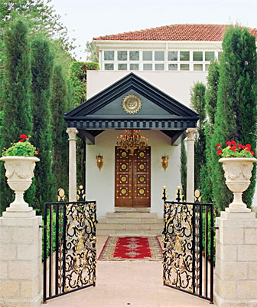

Approaching the Writings of Bahá’u’lláh
Steven Phelps
WILMETTE INSTITUTE WEBINAR, 9 February 2020

Slide 2
Last time:
of 14
Background to this presentation:
  August 18, 2019 WI Webinar: The Writings of the Báb
  http://wilmetteinstitute.org/overview-of-the-writings-of-the-bab/

Slide 3
This time:
The Writings of Bahá’u’lláh: The “Most Great Ocean”
Complete the trilogy of Central Figures: The Writings of Abdu’l-Bahá
Address challenges:
  Access
    What is out there?
    “Chart the coastline”
  Content
    What does it say?
    “Plumb the depths”

Slide 4
Challenges on the path of approach:
The Writings of Bahá’u’lláh
Access
  Both original texts and translations are scattered, uncoordinated (beyond the BWC)
  Majority of original texts (~55-60%) in Arabic
  Majority of texts (>90%) are untranslated
  For those wanting an exhaustive and systematic study: where do they begin and where do they end? And where can I find them?
Content
  Size: ~6 million words (vs. ~5 million for the Báb)
  ~20,000 surviving works (vs. ~2,000 for the Báb)
  Uncharted vastness discourages the approach

Slide 5
The goal
  Create two aids for advanced study
    1. Facilitating access: catalog the accessible sources
      Exhaustive list of what we presently have access to
      Both original texts and translations: focus is on original texts
      Spreadsheet method: see previous webinar
      Include all three Central Figures
    2. Exploring content: thematic reconstructions
      Multiple approaches possible

Slide 6
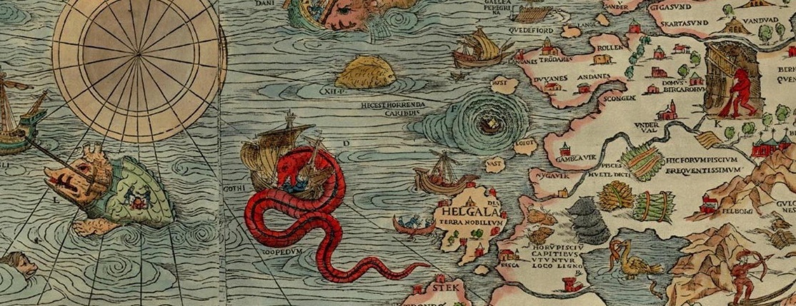
Caveat lector
This is not an “introduction”: Familiarity with the Central Figures and their principal works is assumed
First, get one’s bearings…
  I. Take the sequence of Ruhi courses
  II. Read the available published literature at bahai.org/library/
…before heading into uncharted waters
  III. This resource:

Slide 7
Primary sources for the inventory
Existing lists of Bahá’u’lláh’s Writings, in English
  Shoghi Effendi’s “Best-Known Works” list from the old Baha’i World volumes. ~150 items
  “Leiden List” ~500 items total: 2.5% of the total. Last update >10 years ago.
Core resources
  Bahá’í Reference Library (https://www.bahai.org/library/)
  Iranian Bahá’í National Archives (INBA) (>100 volumes, http://www.afnanlibrary.org/docs/persian-arabic-mss/inba/)
  British Library (>50 volumes)
  Misc. publications, scanned and digitized in Arabic/Persian/English. www.bahailib.com etc.
  Misc. publications still in paper form.
  “internet-original content”: Misc. web sites such as www.bahai-library.com, personal web sites

Slide 8
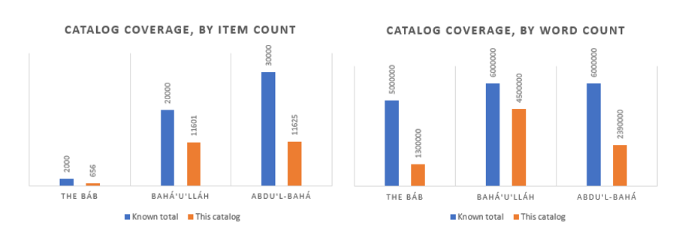
Results of the inventory
Availability:
  The Báb: ~25% in public domain in original languages
  Bahá’u’lláh: ~75%
  ‘Abdu’l-Bahá: ~40%
Reported utterances
  A few thousand more (mostly ‘Abdu’l-Bahá)

Slide 9
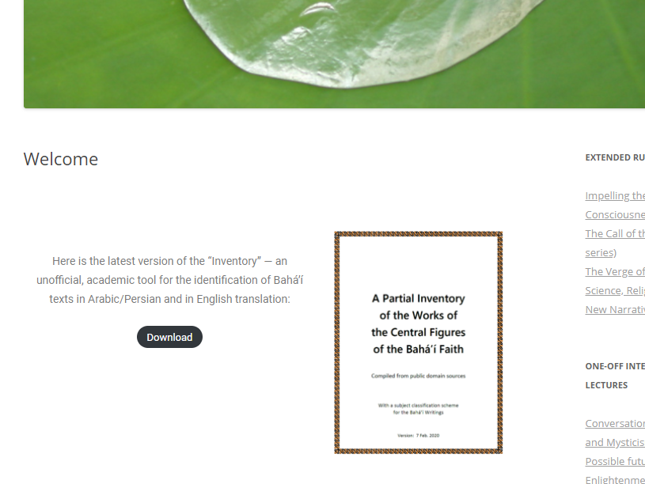
Accessing the inventory (~50MB pdf)
http://blog.loomofreality.org/

Slide 10
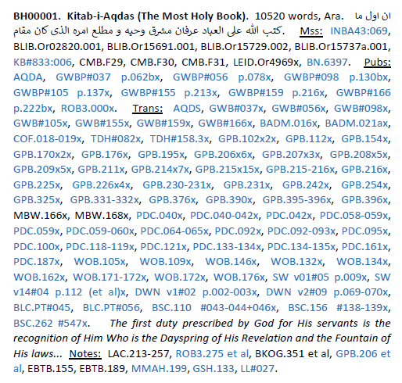
Parsing catalog entries
http://blog.loomofreality.org/
ID
Title
Word Count
Language
First line (Ara/Per)
Manuscripts (Ara/Per)
Publications (Ara/Per)
Translations (Eng only)
First line in translation
Notes
Hyperlinks
Intended as a scholarly tool: assumes acquaintance with original languages, source criticism.

Slide 11
Some use cases
Lookup from source reference (e.g., “GWB#050”)
  Refer to bibliography for source code abbreviations
Lookup from words/phrases in first line
Systematic readthrough
  Longest-to-shortest, shortest-to-longest
Browse titles (from index)
Browse questions (from index)
Collation of original text from multiple manuscripts
  May be useful when authorized text at Bahá’í Reference Library does not exist
http://blog.loomofreality.org/

Slide 12
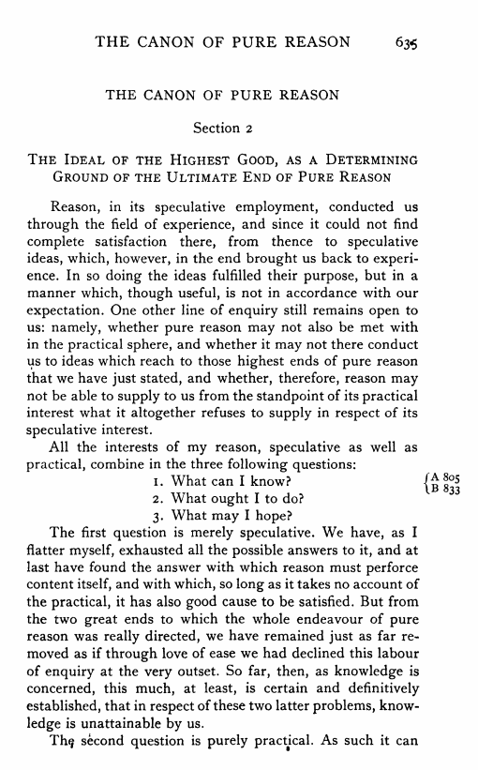
Next step: Content
(appendix to the Inventory)
Kant’s Critique of Pure Reason
What can we know?
What should we do?
What may we hope?

Slide 13
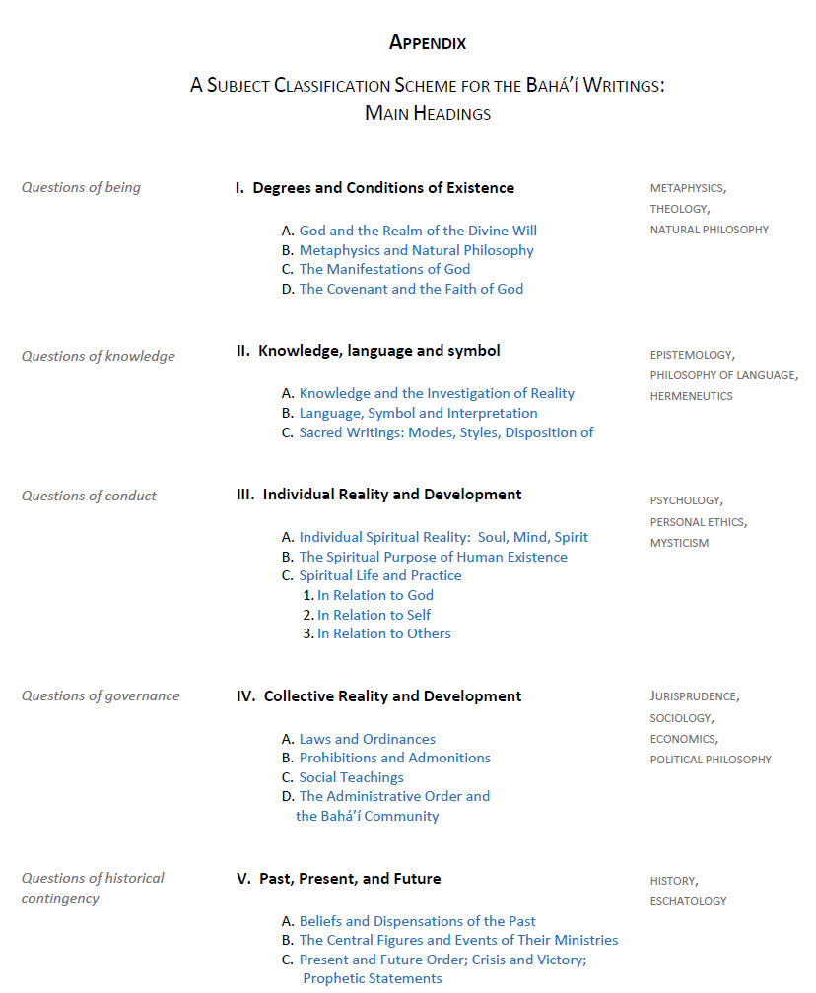
A classification scheme
What can we know?
  What are the ultimate things to know about?
  How do we know them? How does language function as a vehicle for the transmission of knowledge?
What should we do?
  As individuals, in relation to ourselves, others, the Truth?
  As groups of individuals that need to both cooperate and compete?
What shall we hope?
  Where did we come from, and what kind of a world are we creating?

Slide 14
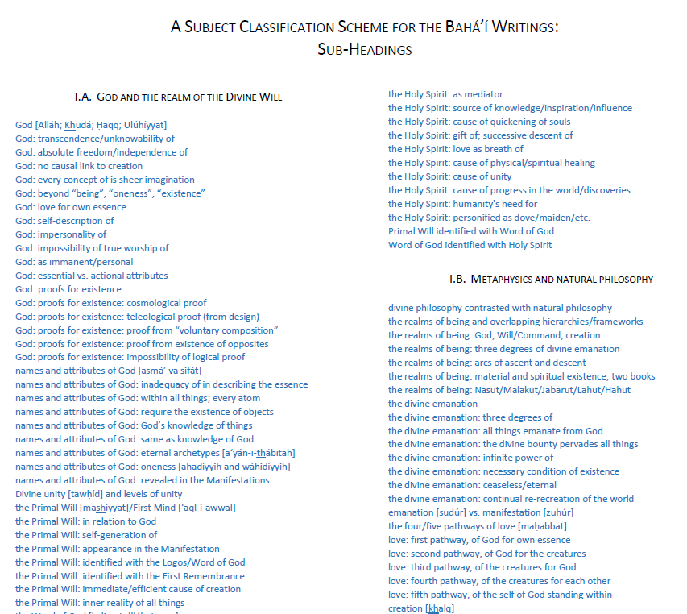
Classification: sub-categories
Links to thematic compilations of extracts
Shoghi Effendi, Universal House of Justice heavily referenced here

