Slide 1
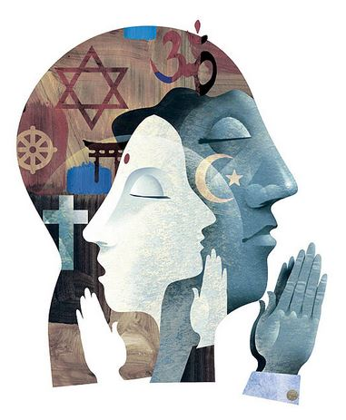
Art
&
Spirituality

Slide 2
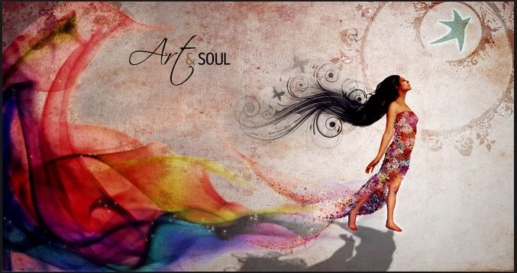
Art
The quality, production, expression, or realm, according to aesthetic principles, of what is beautiful, appealing, or of more than ordinary significance.

Slide 3
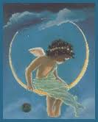
Spirituality
The state, quality,
manner, or fact
of being spiritual.

Slide 4
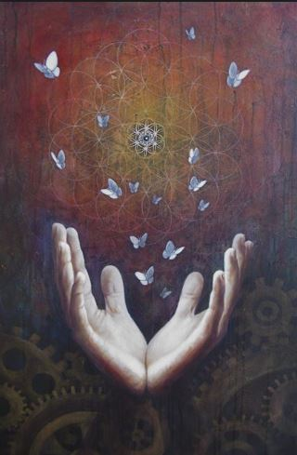
Spiritual
of or pertaining to the spirit or soul, as distinguished from the physical nature
of or pertaining to the spirit as the seat of the moral or religious nature.
of or pertaining to the mind or intellect

Slide 5
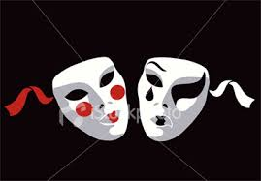
Art Affects Spirituality
To wake the soul by tender strokes of art,
To raise the genius, and to mend the heart;
To make mankind, in conscious virtue bold,
Live o’er each scene, and be what they behold,
For this the Tragic Muse
first trod the stage.
Alexander Pope

Slide 6
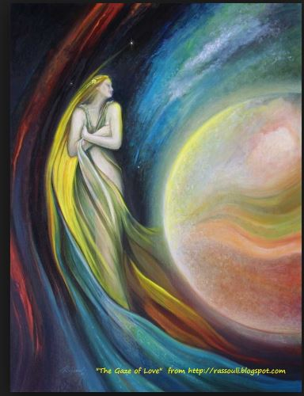
Art − An Antidote For Violence.
Art is an antidote for violence. It gives the ecstasy, the self-transcendence that could otherwise take the form of drug addiction, or terrorism, or suicide or warfare. We have seen that both violence and art—and the beauty which is the center of art—yield the experience of ecstasy and self-transcendence. But art and violence are directly opposite in their effects.
Rollo May

Slide 7
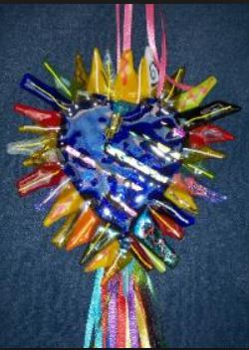
Art has a Message for Us
...art, has a message for us. It says: care, grow, develop, adapt, overcome, nurture, protect, foster, cherish. It says: your reality is spiritual. It says: achieve your full humanness. It invites us to laugh, reflect, cry, strive, persevere. It says: rejoice! Above all, it says to us: be! We cannot turn our backs on art. Art heals.
Roger White

Slide 8
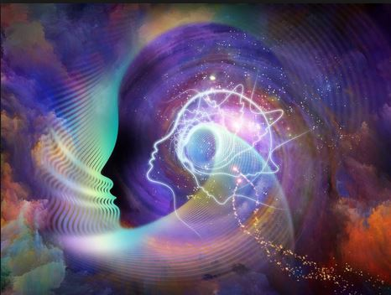
Spirituality Affects Art
Meditation is the key for opening the doors of mysteries. In that state man abstracts himself; in that state man withdraws himself from all outside objects; in that subjective mood he is immersed in the ocean of spiritual life and can unfold the secrets of things-in-themselves. To illustrate this, think of man as endowed with two kinds of sight; when the power of insight is being used the outward power of vision does not see. This faculty of meditation frees man from the animal nature, discerns the reality of things, puts man in touch with God.
This faculty brings forth from the invisible plane the sciences and arts. Through the meditative faculty inventions are made possible, colossal undertakings are carried out; through it governments can run smoothly. Through this faculty man enters into the very kingdom of God.
‘Abdu’l-Bahá

Slide 9
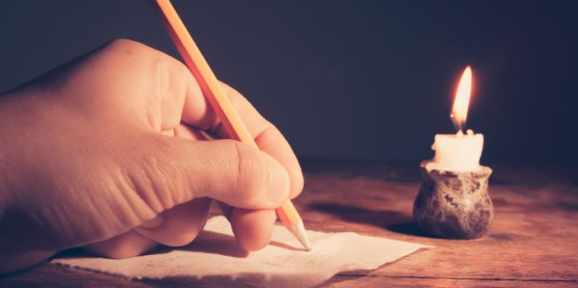
Art Captures Our Experiences
Saving Them for Our Remembrance
Not even the visionary or mystical experience ever lasts very long. It is for art to capture that experience, to offer it to, in the case of literature, its readers; to be, for a secular, materialist culture, some sort of replacement for what the love of god offers in the world of faith.
Salman Rushdie

Slide 10
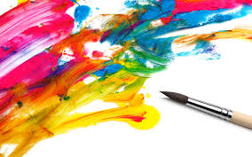
Faith Gives You Sight
I paint not by sight but by faith.
Faith gives you sight.
Amos Ferguson

Slide 11
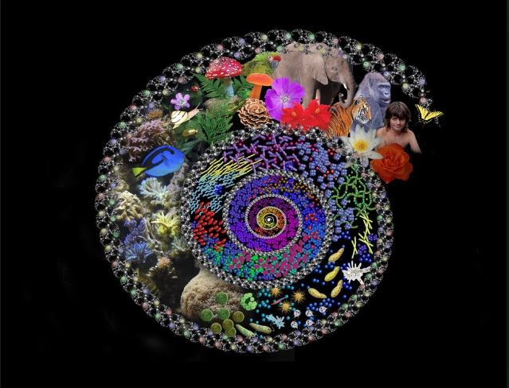
Our Purpose is Twofold
To know and to love God, and
To create an ever-advancing civilization
Bahá’u’lláh

Slide 12

Arts Help Us Achieve Our Purpose
In this great dispensation, art (or a profession) is identical with an act of worship and this will not prevent the teaching of the people in that region. Nay, rather, each should assist s a clear text of the Blessed Perfection. Therefore, extreme effort should be made in art the other in art and guidance. For instance, when the studying of art is with the intention of obeying the command of God this study will certainly be done easily and great progress will be made therein; and when others discover this fragrance of spirituality in the action itself, this same will cause their awakening. Likewise, managing art with propriety will become the means of sociability and affinity, and sociability and affinity themselves tend to guide others to the Truth.⁷
⁷‘Abdu’l-Bahá

Slide 13

Art Has the Power to Change You
Some art has the power to change you, to make you see things you didn’t see before. For those people in love with learning—which I think is everybody, ultimately—art is one of the great experiences.
We learn how to express ourselves by reading good literature, where language is well-used. In the visual world, the arts show us ways of looking that are complex and good.
In addition, storytelling forms of art, such as movies, plays and novels, allow us to identify with characters far different from ourselves. I think that’s terribly important. People have to live potential lives in order to know what real lives they want to live. You have to have models.
Perhaps most basically, the arts let us experience emotions vicariously, in a risk-free environment. This is “practice” for real life, and it explains why people traditionally go to a movie or play on dates. Sensing the other’s response to a drama is a good way of getting to know a person.
...The kind of experience you go through in art is much more all-inclusive. It’s not only intellectual; it can also be emotional and spiritual. It puts you through your paces as a person.
Wendy Steiner

Slide 14
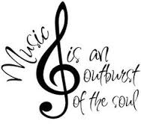
Music
...melodies, though they are material, are connected with the spiritual, therefore, they produce a great effect. A certain kind of melody makes the spirit happy, another kind makes it sad, another excites it to action.
All these feelings can be caused by voice and music, for through the nerves it moves and stirs the spirit....Whatever is in the heart of man, melody moves and awakens. If a heart full of good feelings and a pure voice are joined together, a great effect is produced. For instance, if there be love in the heart, through melody, it will increase until its intensity can scarcely be borne; but if bad thoughts are in the heart, such as hatred, it will increase and multiply. For instance: the music used in war awakens the desire for bloodshed.
'Abdu'l-Bahá

Slide 15
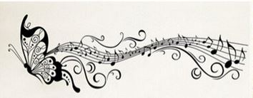
Make Not Music as Wings to Self and Passion
We have made it lawful for you to listen to music and singing.
Take heed, however, lest listening thereto should cause you to overstep the bounds of propriety and dignity. Let your joy be the joy born of My Most Great Name, a Name that bringeth rapture to the heart, and filleth with ecstasy the minds of all who have drawn nigh unto God. We, verily, have made music as a ladder for your souls, a means whereby they may be lifted up unto the realm on high; make it not, therefore, as wings to self and passion. Truly, We are loath to see you numbered with the foolish.
Bahá’u’lláh

Slide 16
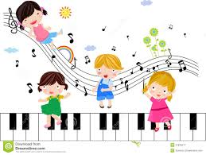

Music
A wondrous melody is wings for the spirit and maketh the soul to tremble for joy.
'Abdu'l-Bahá

Slide 17
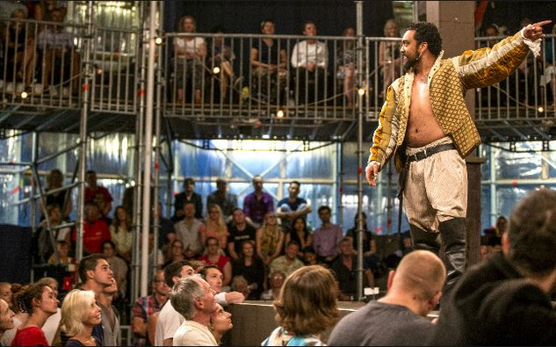
Drama
The drama is of the utmost importance. It has been a great educational power in the past; it will be so again.
'Abdu'l-Bahá

Slide 18
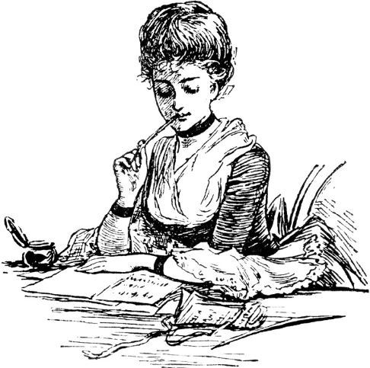
Poetry
What is poetry? It is a symmetrical collection of words. Therefore, they are pleasing through harmony and rhythm. Poetry is much more effective and complete than prose. It stirs more deeply, for it is of a finer composition.
'Abdu'l-Bahá

Slide 19
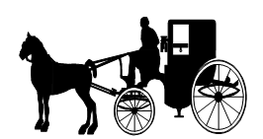
Poetry − Incident
            Once riding in Old Baltimore
            Heart-filled, head-filled with glee
            I saw a Baltimorean
            Keep looking straight at me
            Now I was eight and very small
            And he was no whit bigger,
            And so I smiled, but he poked out
            His tongue and called me "Nigger."
            I saw the whole of Baltimore
            From May until December
            Of all the things that happened there
            That's all that I remember.
Countee Cullen

Slide 20
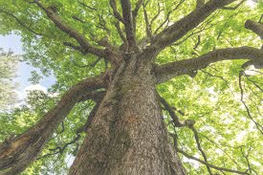
Poetry − The Tree Speaks
A species I shall never see
More perverse than humanity
Ambulant, it boasts of mind,
Praises its God—and kills its kind.
And worse than that—if there be worse—
Lauds fools who put these facts in verse!
Who but God could love mankind?
I’m not the least that way inclined.
But, even as I speak, I see:
Man strikes with axe to silence me. Roger White

Slide 21
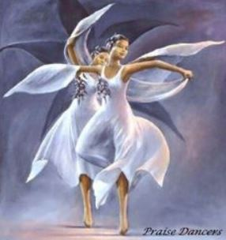
Dance
Dancers are the
athletes of God.
Albert Einstein

Slide 22
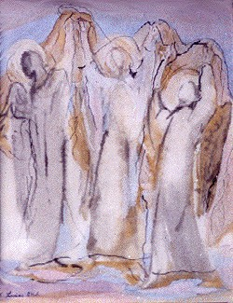
Dance
Dancing is surely the most basic and relevant of all forms of expression. Nothing else can so effectively give outward form to an inner experience. Poetry and music exist in time. Painting and architecture are a part of space. But only the dance lives at once in both space and time. In it the creator and the thing created, the artist and the expression, are one. Each participates completely in the other. There could be no better metaphor for an understanding of the cosmos.
Lyall Watson

Slide 23
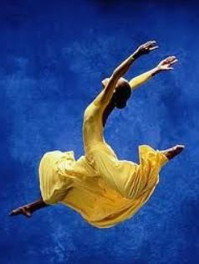
Dance is a Prayer
Laughter, Joy, Exaltation
Beseeching my Lord / In supplication
Offering thanks / Bestowing praise
In such manner / Commence my days
In dance, in song / With music in my heart
Wafting along — My prayer impart
Intoning / chanting / all aglow —
Arms stretched high — Now bowing low
As though in trance / On cosmic plane—
My dance is a prayer / In the mystic Fane
jaine

Slide 24
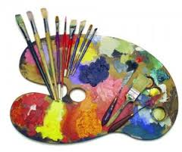
Painting
Painting can do for the illiterate what writing does for those who can read.
Pope Gregory the Great

Slide 25
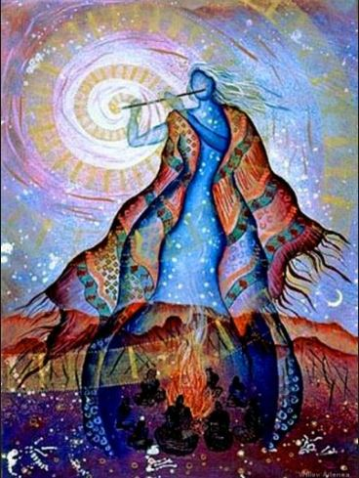
Painting
Art does not
reproduce the visible,
rather it makes visible.
Paul Klee

Slide 26
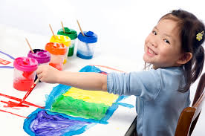
Painting
Art is like words without letters.
Art is a free thing. There are no rules in art. If you “mess up” in art, it’s still a piece of art.
Sarah Bloom and Steven Brantingham
Fourth Grade Students
Main School, Carpinteria, CA

Slide 27
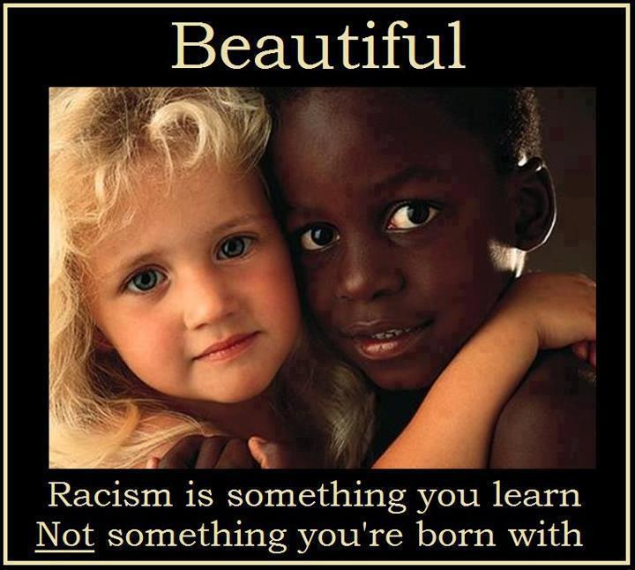
Racism – Not Innate
You've got to be taught
To hate and fear,
You've got to be taught
From year to year,
It's got to be drummed
In your dear little ear
You've got to be carefully taught.
You've got to be taught to be afraid
Of people whose eyes are oddly made,
And people whose skin is a diff'rent shade,
You've got to be carefully taught.
You've got to be taught before it's too late,
Before you are six or seven or eight,
To hate all the people your relatives hate,
You've got to be carefully taught!
Rogers & Hammerstein

Slide 28
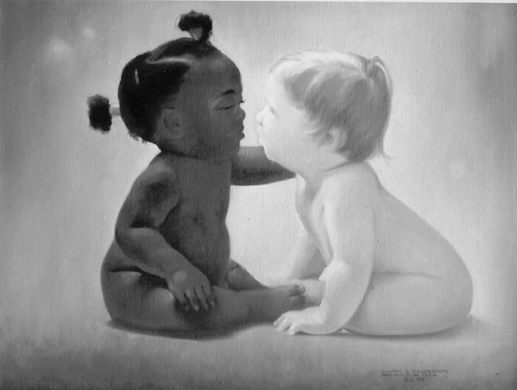
Racism – Not Innate

Slide 29
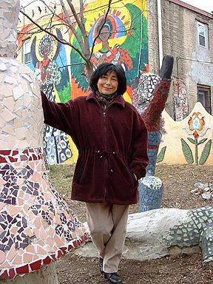
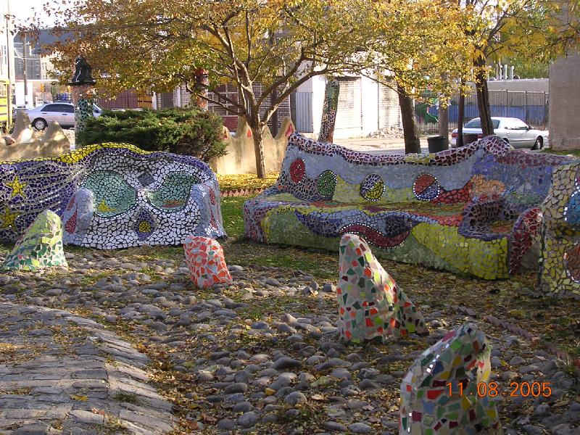
Lily Yeh’s
Magic Village

Slide 30
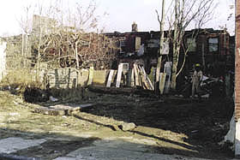
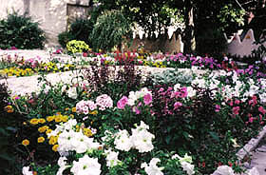
Lily Yeh’s Magic Village
BEFORE
AFTER

Slide 31
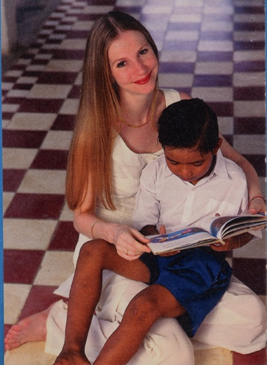
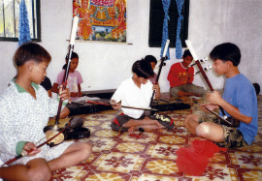
Music of Hope

Slide 32
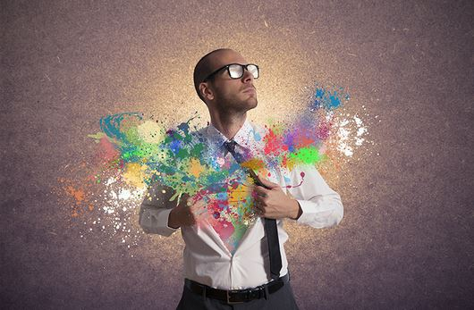
Using Art to
Heal Ourselves
We can all use the arts to heal ourselves and to lift ourselves to higher levels of spirituality. We can benefit from the art of others, but we can also, and to greater benefit, create our own art.

Slide 33
Pen a Poem
Happy? Pen a poem!
The elation will grow; in it’s warmth you will glow.
Sad? Pen a poem!
The hurt will melt away; it will help you thru the day.
Angry? Pen a poem!
The fire will wane and calm you’ll regain.
Confused? Pen a poem!
It will help clear the air so you can see from here to there.
Smitten? Pen a poem!
The jewels from your heart to your Beloved impart.
For every emotion that stirs each want and desire,
pen a poem: soon equanimity you’ll reacquire.
jaine

Slide 34
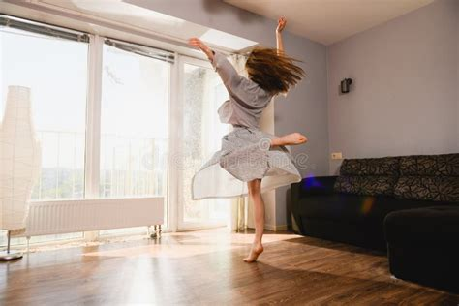
Healing Through Dance
Marcela Lorca, creator of BreathDance, a body awareness technique, maintains that by using breath, voice, and movement, we can release negative emotional patterns without intellectual processing or even conscious understanding....‘Free movement of energy through the body is the definition of health,’ Lorca insists...
So shut the door, pull down the shades, and try a song-and-dance routine to a tune you love. There’s no telling where that freed-up energy might take you. You might feel foolish, but that’s rarely fatal; chances are that, at the very least, you’ll start having more fun.

Slide 35
The Creator
We are Made in the Image of God
The Holy Books tell us we are made in the image of God. Bahá’u’lláh explains that this is not to be understood in anthropomorphic, or physical, terms but that we are all possessed with the ability to mirror forth the attributes of God, e.g. kindness, mercy, trustworthiness, benevolence, etc.
One of the first attributes we think of when listing the Names of God, is

Slide 36
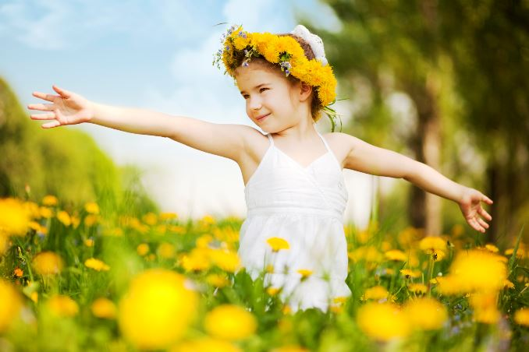
We are Creative Beings
Since we are made in God’s image, and God is the Creator, it follows logically, then, that we are creative beings.
Sing:
I am a creative being
in the garden of humanity
and the light shines within me.

