Slide 1

Day
of the
Covenant

Slide 2
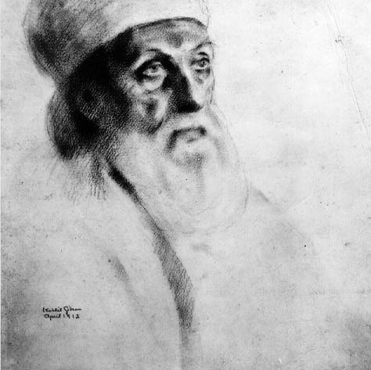
The Appointment of
‘Abdu’l-Bahá
as the
Centre of the Covenant
The setting of the Sun of Bahá gave rise
to the appearance of the Orb of the Covenant.

Slide 3
Named after His grandfather
‘Abbás
Called by contemporaries
‘Abbás Effendi
Called by Bahá’u’lláh
Sirru’lláh
(the Mystery of God)
Ghusn’ i’ A’zam
(the Most Great Branch)
Áqá
(the Master)

Slide 4
He is, and should for all time be regarded, first and foremost, as
the Centre and Pivot of Bahá'u'lláh's peerless and all- ` enfolding Covenant
His most exalted handiwork
the stainless Mirror of His light
the perfect Exemplar of His teachings
the unerring Interpreter of His Word
the embodiment of every Bahá'í ideal
the incarnation of every Bahá'í virtue
the Most Mighty Branch sprung from the Ancient Root
the Limb of the Law of God
the Being "round Whom all names revolve,"
the Mainspring of the Oneness of Humanity
the Ensign of the Most Great Peace
the Moon of the Central Orb of this most holy Dispensation

Slide 5
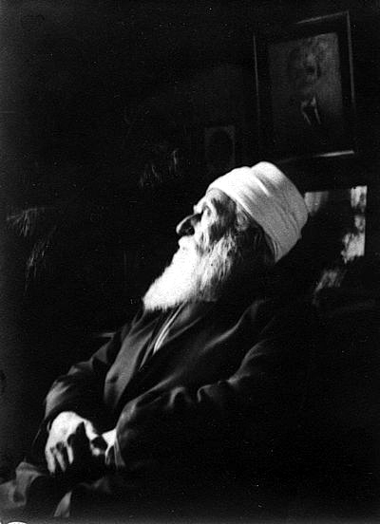
[These are] styles and titles that are implicit and
find their truest, their highest and fairest
expression in the magic name 'Abdu'l-Bahá.
He is, above and beyond these
appellations, the
Mystery of God
an expression by which Bahá'u'lláh
Himself has chosen to designate Him,
and which, while it does not by any
means justify us to assign to Him the
station of Prophethood, indicates how in
the person of 'Abdu'l-Bahá the
incompatible characteristics of a human nature
and superhuman knowledge and perfection have been
blended and are completely harmonized.

Slide 6
Despite these lofty titles bestowed upon Him,
He insisted:

Slide 7
But if any soul asks concerning the station of the Servant, the answer is — ‘Abdu’l- Bahá.
If he inquires after the meaning of the Branch, the answer is — ‘Abdu’l-Bahá.
If he desires to know the significance of the verse regarding The Branch, the answer is — ‘Abdu’l-Bahá.
If he insists upon the explanation of the meaning of the “Branch extended from the Ancient Root,” the answer is — ‘Abdu’l-Bahá.
My name is — ‘Abdu’l-Bahá.
My qualification is — ‘Abdu’l-Bahá.
My reality is — ‘Abdu’l-Bahá.
My praise is — ‘Abdu’l-Bahá.
Thralldom to the Blessed Perfection is my glorious and refulgent diadem, and servitude to all human race my perpetual religion...
No name, no title, no mention, no commendation have I, nor will ever have, except — ‘Abdu’l-Bahá.
.

Slide 8
.
This is my longing.
This is my greatest yearning.
This is my eternal life.
This is my everlasting glory.

Slide 9
He chose to only be called:
‘Abdu’l-Bahá
(the Servant of Bahá)

Slide 10
Descriptions by Contemporaries
There are many favorable descriptions of Him by His contemporaries. Here are just a few:

Slide 11
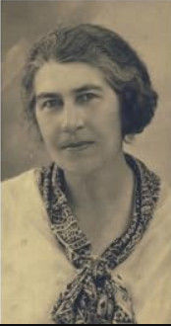
ENGLISH REPORTER ETHEL STEFANA STEVENS
(Lady Drower)
Described Him as one who did not
“…confine himself to things spiritual or theoretical…”
but as One Who also
“…takes a lively interest in political, social, educational movements of the western world.
She advised her readers:
“Regard him well, my friends, for in him you behold one of the most significant figures in the religious world to-day...”

Slide 12
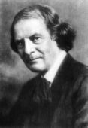
ELBERT HUBBARD
American Columnist
wrote there could be
“…no doubt among thinking people that this man
represents, to a great degree, the growing and evolving spirit of our times.”

Slide 13
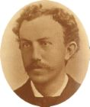
DAVID STARR JORDAN
President, Stanford University
believed:
“‘Abdu’l-Bahá will surely unite the East and the West for He treads the mystic way with practical feet.”

Slide 14
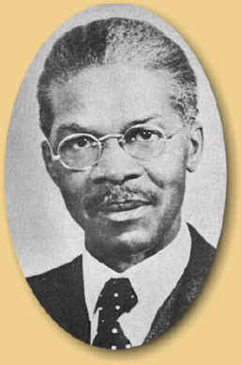
As to His physical appearance, attorney Louis Gregory, who met the Master during His visit to the United States in 1912 and who later was appointed as a Hand of the Cause of God in the Bahá’í Faith, penned the following description:

Slide 15
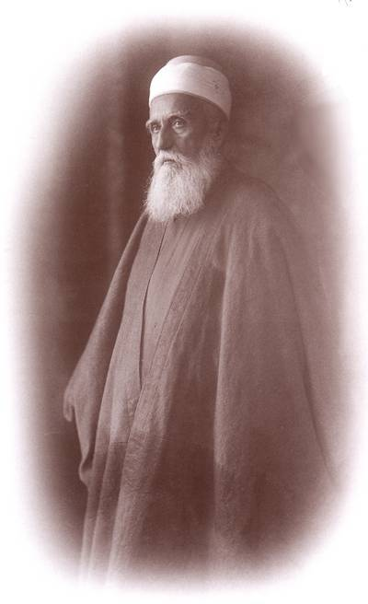
“‘Abdu’l-Bahá appeared about medium height, with a strong frame and symmetrical features.
His face deeply furrowed and His color about that of parchment.
His carriage erect and His entire form strikingly majestic and beautiful.
His hands and nails shapely and pure.
His silver hair long enough to touch the shoulders.
The beard snow white,
eyes light blue and penetrating,
the nose slightly aquiline,
the voice powerful, but capable of infinite pathos, tenderness, and sympathy.
His dress was that of the Oriental gentleman of the highest classes, simple and neat and very graceful.
The color of His apparel was light, the outer robe being made of alpaca.
On His head rested a light fez, surrounded by a white turban.
The meekness of the servant, the majesty of the King, were in His brow and form.”

Slide 16
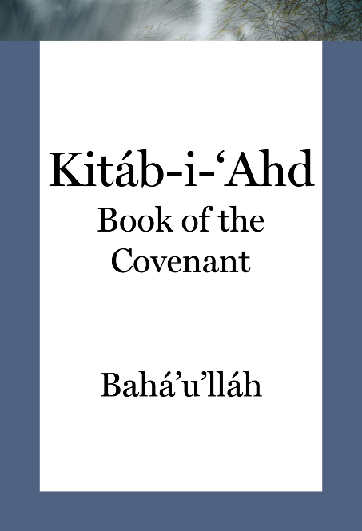
In His Will and Testament, Kitáb-i-’Ad, (the Book of the Covenant), Bahá’u’lláh clearly appointed ‘Abdu’l-Bahá, His eldest son, as His successor, identifying Him as
Him Whom God Hath Purposed
to whom all should turn after Bahá’u’lláh’s passing.

Slide 17
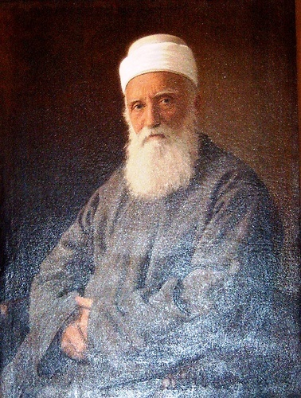
“In the Kitáb-i-Aqdas, and later in His Will Bahá'u'lláh named 'Abdu'l-Bahá Head of the Faith, Centre of the Covenant, sole Interpreter
of the revelation and upon Him He conferred absolute authority, whatsoever He would decide having the same validity as the word of Bahá'u'lláh Himself.”

Slide 18
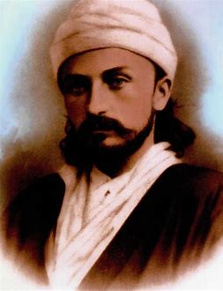
Unique in religious history,
Bahá’u’lláh appointed
‘Abdu’l-Bahá
as the
Centre of the Covenant.

Slide 19
And what is this Covenant
to which Bahá’u’lláh refers?

Slide 20
There are
...two forms of Covenant, both of which are explicitly mentioned in the literature...
of the Bahá’í Faith.

Slide 21
First
is the Covenant that every Prophet makes with humanity or, more definitely, with His people, that they will
  accept and follow the coming Manifestation who will be the reappearance of His reality.

Slide 22
“The second form of covenant
is such as the one Bahá’u’lláh made with His followers:
for them to
accept the Master”
as the head of their Faith.

Slide 23
In this Dispensation, in this
“day which shall not be followed by night”
we have in addition to the
Greater, or Major Covenant
the one in which God promises never to leave mankind without guidance, a
Lesser Covenant
unique in religious history, whereby the Manifestation left written guidance in regard to successorship.

Slide 24
The Lesser Covenant has been described as:
The divinely-ordained ‘instrument’ provided by Bahá’u’lláh
“to direct and canalize these forces let
loose by this Heaven-sent process
[the Revelation of Bahá’u’lláh]
and to ensure their harmonious and
continuous operation after His ascension.”

Slide 25
Shoghi Effendi
Guardian of the Bahá’í Faith
asserts:
“Written entirely in His own hand ... this unique and epoch-making Document..., designated by Baha'u'llah as His "Most Great Tablet"...can find no parallel in the Scriptures of any previous Dispensation...”

Slide 26
In this unique and weighty Tablet, Bahá’u’lláh wrote:
“It is incumbent upon the Aghsán [family of Bahá’u’lláh],
the Afnán [family of the Báb]
and My kindred
to turn, one and all, their faces towards the Most Mighty Branch.
Consider that which we have revealed in Our Most Holy Book:”

Slide 27

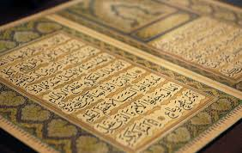
“When the ocean of My presence hath ebbed and the Book of My Revelation is ended, turn your faces toward Him Whom God hath purposed, Who hath branched from this Ancient Root.”

Slide 28


Slide 29
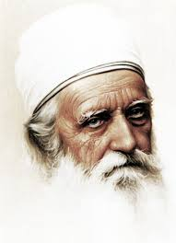
“The object of
this sacred verse
is none other
except the
Most
Mighty Branch”
(‘Abdu’l-Bahá)

Slide 30
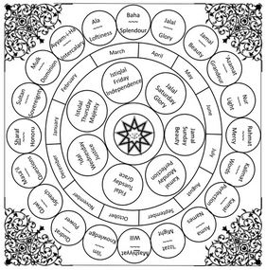
So humble was ‘Abdu’l-Bahá that when the Bahá’ís wanted to celebrate His birthday, He refused.
The day of His birth, May 23, 1844, coincides with the date of the Declaration of the Báb, the Prophet of the dispensation immediately preceding that of Bahá’u’lláh, the glorious date from which the Bahá’í calendar begins.

Slide 31
‘Abdu’l-Bahá was loath to allow anything to interrupt or compete with the celebrations of that auspicious Holy Day. Instead, He suggested, if the friends wished to have something to commemorate in relation to Him, it should address His station—not His person, therefore,

Slide 32
He chose the 4th day
of the Bahá’í month of Qawl (Speech),
the date on which that covenant
was revealed to the world,
as the
Day of the Covenant

Slide 33
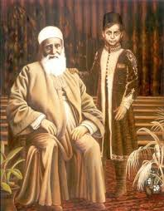
As the Covenant is the guarantee against schism, therefore, it follows that this Covenant must be continuous.
Thus, ‘Abdu’l-Bahá also left His own Will and Testament in which he, too, named His own successor: His eldest grandson, Shoghi Rabbani, who became known as
Shoghi Effendi
Guardian of the Bahá’í Faith

Slide 34
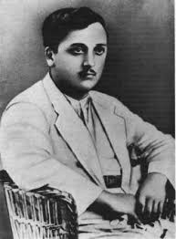
The Guardian is described in 'Abdu'l-Bahá's Will and Testament as.
the youthful branch branched from the two hallowed and sacred Lote-Trees (the Báb and Bahá'u'lláh)
the fruit grown from the union of the two offshoots of the Tree of Holiness
He is the Sign of God
the Chosen Branch
The Guardian of the Cause of God
The Interpreter of the Word of God
He refers to him as sacred
as that primal branch of the Divine and Sacred Lote-Tree
and as a unique and priceless pearl

Slide 35
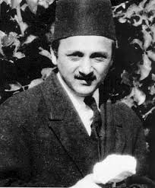
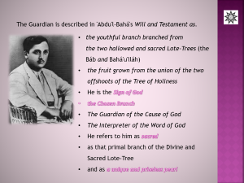

Believers without exception are to show
their obedience,
submissiveness
and subordination unto
The Guardian

Slide 36
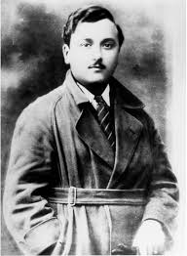
It is interesting to note that:
“Obliged by the Will to protect his own rank, Shoghi Effendi still insisted on being treated as our
‘true brother' and 'co-worker‘
and did not care for either the obsequiousness of some Persians or the off-handedness of some Americans.”

Slide 37
“The intention of the Covenant, ‘Abdu’l-Bahá explains, is the protection of the unity of the Bahá’í Faith:
“The purpose of the Blessed Beauty [Bahá’u’lláh] in entering into this Covenant and Testament was to gather all existent beings around one point so that the thoughtless souls, who in every cycle and generation have been the cause of dissension, may not undermine the Cause.”

Slide 38
To elucidate further on the appointment of the Centre of the Covenant, ‘Abdu’l-Bahá said:
“By this appointment and provision He has safeguarded and protected the religion of God against differences and schisms, making it impossible for anyone to create a new sect or faction of belief.
“To ensure unity and agreement He has entered into a Covenant with all the people of the world including the Interpreter and Explainer of His teachings so that no one may interpret or explain the religion of God according to his own view or opinion and thus create a sect founded upon his individual understanding of the divine words.
“The Book of the Covenant or Testament of Bahá'u'lláh is the means of preventing such a possibility, for whosoever shall speak from the authority of himself alone shall be degraded. Be ye informed and cognizant of this.”

Slide 39
No covenant is one-sided. For
every promise,
every blessing,
every bounty made by God to the people of the World,
made by His Manifestations to their followers,
there are reciprocal duties and obligations on the part of
those people.

Slide 40
COVENANTAL DUTIES
The covenantal duties expected for the people of Bahá (followers of Bahá'u'lláh) have been summarized by the Universal House of Justice, their international governing body:

Slide 41
“The recital each day of one of the Obligatory Prayers
with pure-hearted devotion.”

Slide 42
“The regular reading of the Sacred Scriptures, specifically at least each morning and evening, with reverence, attention, and thought,.”

Slide 43
“Prayerful meditation on the teachings, so that we may understand them more deeply, fulfill them more faithfully, and convey them more accurately to others.”

Slide 44
“Striving every day to bring our behavior more into accordance with the high standards that are set forth in the teachings.”

Slide 45
“Teaching the Cause of God.”

Slide 46
“Selfless service in the work of the Cause and in the carrying on of our trade or profession.”

Slide 47
Living according to the laws and obligations of the Faith may not be easy. We are warned frequently in the Writings that our faith shall be tested.
These tests may come from within as well as without the Faith. But we are promised that we shall not receive tests for which we do not have the strength to overcome. Bahá'u'lláh explains that we are to welcome our tests and difficulties as challenges — opportunities — for spiritual growth.

Slide 48
Bahá’u’lláh wrote:
“O SON OF MAN!
My calamity is My providence,
outwardly it is fire and vengeance,
but inwardly it is light and mercy.
Hasten thereunto that thou mayest become an eternal light and an immortal spirit. This is My command unto thee, do thou observe it.”

Slide 49

This concept is evident in Alma F Engels poem,
The Promise of Stones
The stones of Bahá'u'lláh must
first pass through the fire
of the Love of the Beloved
until so totally consumed
with love for the Beloved
that nothing remains but
a black lumpish mass.
They next face the test
of rejection, suppression
until pressure makes them
pure refractors of light.
Only then can these diamonds
cut through darkness descending
return all Bahá'ís to the Splendour of God.
Friends, now is the time to pray for such stones.

Slide 50
When undergoing our own trials and tribulations, it helps to bear in mind the sufferings of Those blessed souls Who brought us these most precious teachings for the day in which we live. And that includes the Master.
Shoghi Effendi wrote:

Slide 51
“To the mounting tide of trials which laid low the Báb,
to the long-drawn-out calamities which rained on Bahá'u'lláh,
to the warnings sounded by both the Herald and the Author of the Bahá'í Revelation,
must be added the sufferings which, for no less than seventy years, were endured by 'Abdu'l-Bahá, as well as His pleas and entreaties, uttered in the evening of His life, in connection with the dangers that increasingly threatened the whole of mankind.”

Slide 52
Born in the very year that witnessed the inception of the Bábí Revelation;
baptized with the initial fires of persecution that raged around that nascent Cause;
an eyewitness, when a boy of eight, of the violent upheavals that rocked the Faith which His Father had espoused;
sharing with Him, the ignominy, the perils, and rigors consequent upon the successive banishments from His native land to countries far beyond its confines;
arrested and forced to support, in a dark cell, the indignity of imprisonment soon after His arrival in 'Akká;
the object of repeated investigations and the target of continual assaults and insults under the despotic rule of Sultan Abdu'l-Hamid— and later under the ruthless military dictatorship of the suspicious and merciless Jamal Pasha—

Slide 53
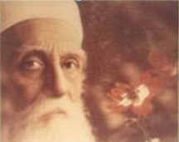
“He, too, the Centre and Pivot of Bahá'u'lláh's peerless Covenant and the perfect Exemplar of His teachings,
was made to taste, at the hands of potentates, ecclesiastics, governments and peoples, the cup of woe which the Báb and Bahá'u'lláh, as well as so many of their followers, had drained.”

Slide 54

British Orientalist E.G. Browne posited,
“Perhaps it was His remarkable understanding and grasp of human suffering and misery and discord and hatred, His patience, long and enduring, His most lucid and penetrating insight, the depth of His knowledge and wisdom rivaled only by His own spiritual way of life, and His humility so compelling and so mighty—perhaps these were some of the attributes that made of 'Abdu'l-Bahá the perfect Exemplar of the quintessence of creation—Man.”

Slide 55
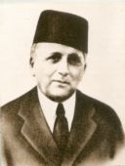
The Guardian, Shoghi Effendi,
explained to the believers,
“We must be careful not to
teach in a fanatical way.
We should teach as the Master
taught. He was the perfect Exemplar
of the Teachings. He proclaimed the universal truths, and, through love and wise demonstration of the universal verities of the Faith, attracted the hearts and the minds.”

Slide 57
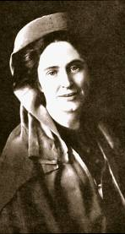
Lua Getsinger, an ardent American believer, loved the Master, yet she had a difficult time being obedient to Him. When He visited the United States, her great desire to ever be in His presence caused her to develop creative scenarios that would prevent her from having to leave. He wished her to travel to California to announce His appointment as the Centre of the Covenant and to prepare the friends for His arrival. She balked, but only because it would take her away from her Beloved. He patiently and lovingly taught her why it was important to heed His advice and she wrote a poem to illustrate the lesson she learned. She titled it:

Slide 58
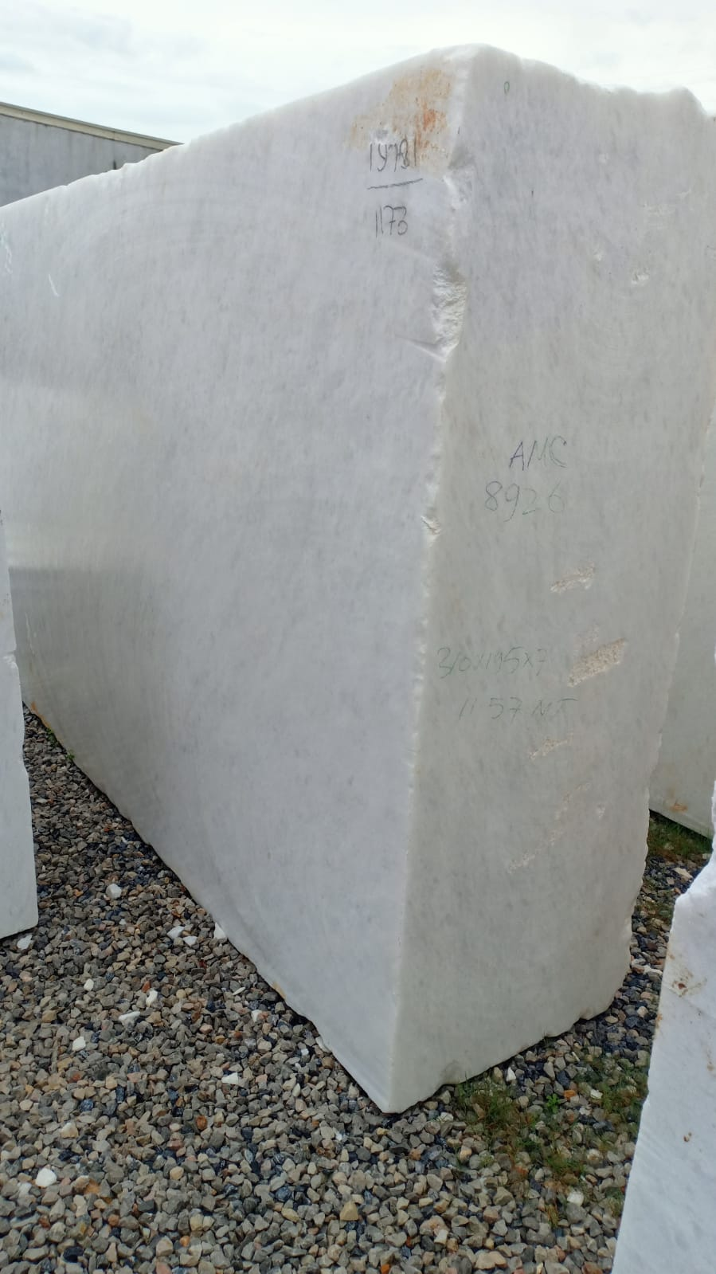
Discipline
A block of marble caught the glance
Of Buonarotti’s eyes;
Which brightened in their deeps
Like meteor-lighted skies.
And one who stood beside him
Listened smiling as he heard
For —”I will make an angel of it,”
Was the sculptor’s word.
Soon mallet hard and chisel sharp
the stubborn block assailed;
And blow by blow, and pang by pang
The fairy form unveiled.
A brow was lifted high and pure,
The waking eyes outshone;
And as the Master fiercely wrought,
A smile broke through the stone.
Beneath the chisel’s edge, the hair
escaped in floating rings;
And plume by plume was slowly freed
In the sweep of half-furled wings.

Slide 59
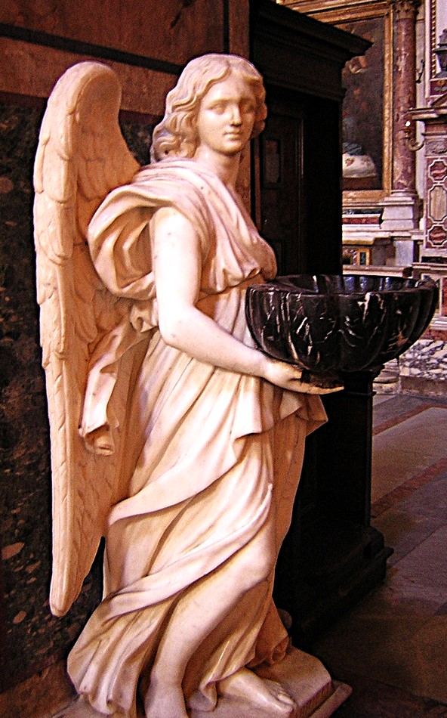
Discipline
The stately bust and graceful limbs
Their marble fetters shed;
And where the shapeless block had been
An Angel stood instead.
O blows that smite! O hurts that pierce
This shrinking heart of mine;
What are ye but the Master’s tools
Forming a work divine?
O hopes that crumble at my feet!
O joys that mock and flee!
Ye only are the mists that hide
God’s greatest gift from me.
Sculptor of souls! I lift to thee
Bound hands and burdened heart;
Spare not Thy chisel. Set me free,
However great the hurt.
How blest if all these seeming ills,
Which drew my thoughts to Thee,
Should only prove that Thou wilt make
An Angel out of me.

Slide 60
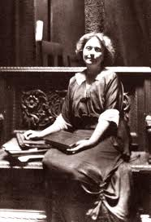
Artist Juliet Thompson,
who painted a portrait of the
Master,and was very close
to Lua, shared her
eyewitness account of the
moment when 'Abdu'l-Bahá
announced to Lua her task:

Slide 61
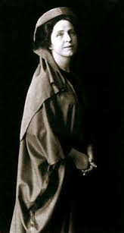
  “Never shall I forget that moment, the flashing eyes of 'Abdu'l-Bahá, the reverberations of His Voice, the Power that still rocked the room. God of lightning and thunder! I thought.
  “’I appoint you, Lua, the Herald of the Covenant. And I AM THE COVENANT, appointed by Bahá'u'lláh. And no one can refute His Word. This is the Testament of Bahá'u'lláh. You will find it in the Holy Book of Aqdas. Go forth and proclaim, 'This is THE COVENANT OF GOD in your midst.’’”

Slide 62
We, too, should honor the exhortations of ‘Abdu’l-Bahá Who once said to the believers:

Slide 63

“I have come with a torch
in my hand, seeking out
those who will arise and help me
to bring about the
Most Great Peace”

Slide 64
And these words,
written toward the end of His life,

Slide 65
“I am now growing old. O very old! All through my life I have carried on my back, gladly, the burdens of the believers; but now I ever anticipate hearing the good news of service actually accomplished by them. Save this, I have no other joy in the world.
Will they not make me happy?
Will they not answer my call, when the shadow of the last night of my earthly life is falling slowly across my path?
Will they not arise with superhuman energy and united effort to spread the Cause and impart to me new vigour?
Will they not listen to me?
How my heart leaps with joy when I hear the friends love each other, always overlooking one another’s small mistakes; and that they are forgiving their enemies!”

Slide 66

Let us consider this excerpt from
Century of Light
by the
Universal House of Justice:

Slide 67
“No phenomenon in any way comparable to His appearance had accompanied any of the Divine Revelations that had given birth to the other great religious systems in recorded history; all of these had been essentially stages preparing humanity for its coming of age. 'Abdu'l-Bahá was Bahá'u'lláh's supreme Creation, the One that made everything else possible.”
“An understanding of this truth moved a perceptive American Bahá'í to write:

Slide 68
‘Now a message from God must be delivered, and there was no mankind to hear this message. Therefore, God gave the world 'Abdu'l-Bahá. ‘Abdu'l-Bahá received the message of Bahá'u'lláh on behalf of the human race.
‘He heard the voice of God;
‘He was inspired by the spirit;
‘He attained complete consciousness and awareness of the meaning of this message,
‘and He pledged the human race to respond to the voice of God.

Slide 69
“‘...to me that is the Covenant — that there was on this earth some one who could be a representative of an as yet uncreated race.
‘There were only tribes, families, creeds, classes, etc., but there was no man except 'Abdu'l-Bahá, and 'Abdu'l-Bahá, as man, took to Himself the message of Bahá'u'lláh and promised God that He would bring the people into the oneness of mankind, and create a humanity that could be the vehicle for the laws of God.’”

Slide 70
The reason it was — and still is — important to heed the Master’s appeals is that He is considered to be
The Perfect Exemplar
after Whose life we should attempt to pattern our own.

Slide 71
When we find ourselves in difficult situations —
When we wonder what our response to them should be —
When we need to make any decisions in our lives —
We should heed the Master’s call:

Slide 72
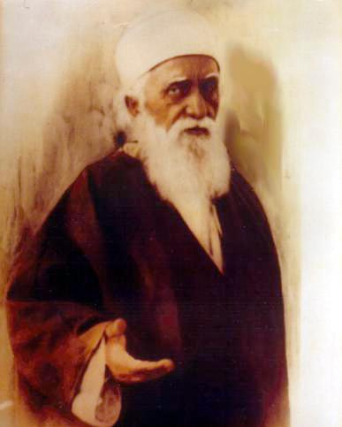
Look at me.
Follow me.
Be as I am.

