Slide 1

No Mud, No Lotus
Thoughts on the Wisdom
of Tests and Difficulties

Slide 2
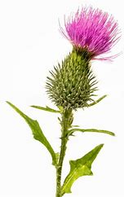
The mind and spirit of man advance when he is tried by suffering. The more the ground is ploughed the better the seed will grow, the better the harvest will be. Just as the plough furrows the earth deeply, purifying it of weeds and thistles, so suffering and tribulation free man from the petty affairs of this worldly life until he arrives at a state of complete detachment. His attitude in this world will be that of divine happiness. Man is, so to speak, unripe: the heat of the fire of suffering will mature him. Look back to the times past and you will find that the greatest men have suffered most.
~ ‘Abdu’l-Bahá ~
Paris Talks, p. 178
~

Slide 3
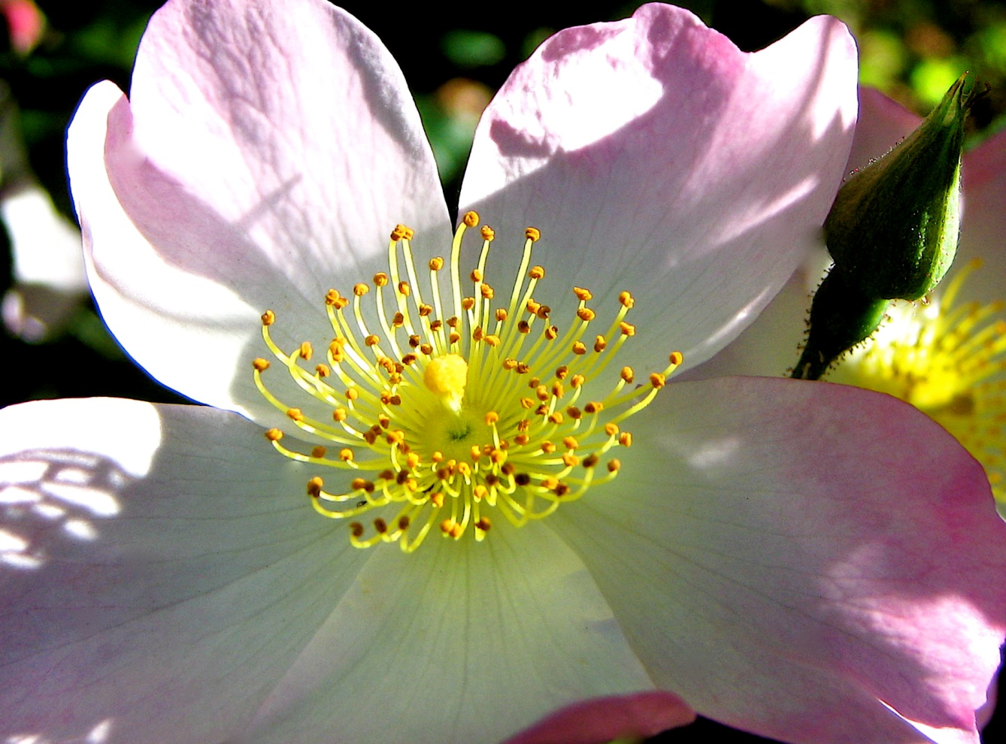
Blessed is the man who perseveres under trial. Because when he has stood the test, he will receive the crown of life…
~ James 1:12 (NIV) ~

Slide 4
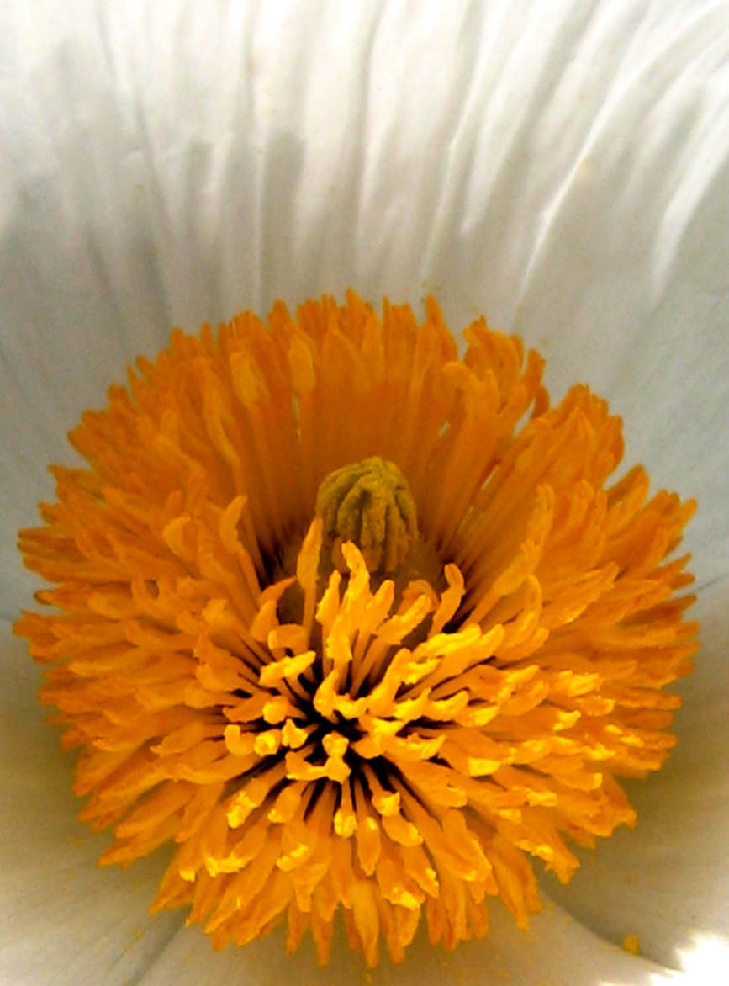
Earth teach me quiet ~ as the grasses are still with new light.
Earth teach me suffering
~ as old stones suffer with memory.
Earth teach me humility
~ as blossoms are humble with beginning.
Earth teach me caring
~ as mothers nurture their young.
Earth teach me courage
~ as the tree that stands alone.
Earth teach me limitation
~ as the ant that crawls on the ground.
Earth teach me freedom
~ as the eagle that soars in the sky.
Earth teach me acceptance
~ as the leaves that die each fall.
Earth teach me renewal
~ as the seed that rises in the spring.
Earth teach me to forget myself
~ as melted snow forgets its life.
Earth teach me to remember kindness
~ as dry fields weep with rain.
~ Native American Prayer ~

Slide 5

That which is on earth We have made but as a glittering show for the earth, in order that We may test them—as to which of them are best in conduct.
~ Qur'án (Yusuf Alí tr), 18:7 ~

Slide 6

My heart today smiles
At its past night of tears
Like a wet tree
glistening in the sun
after the rain has passed.
~ Source Unknown ~

Slide 7
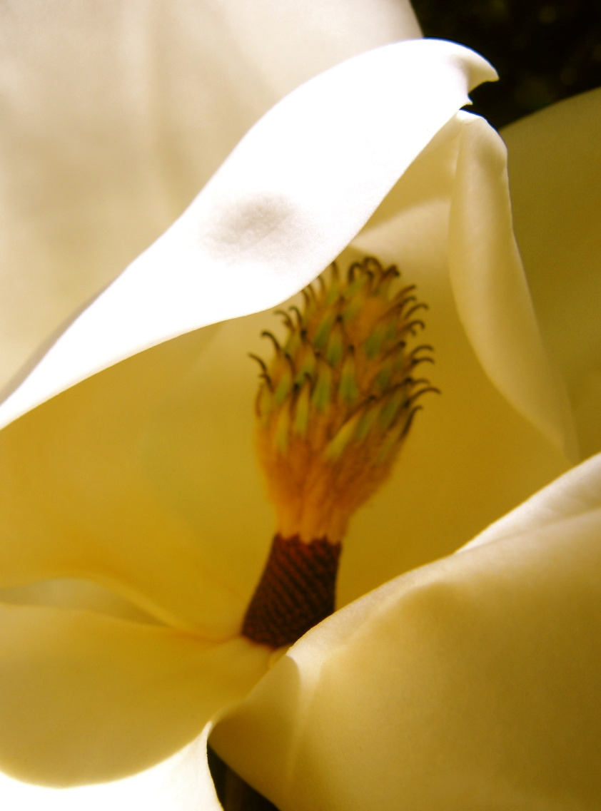
Righteous art thou, O Lord, and upright are Thy judgments. Thou hast commanded Thy testimonies in righteousness and exceeding faithfulness. My zeal hath undone me, because mine adversaries have forgotten Thy words. Thy word is tried to the uttermost, and Thy servant loveth it. I am small and despised, yet I have not forgotten Thy precepts. Thy righteousness is an everlasting righteousness, and Thy law is the truth. Trouble and anguish have overtaken me, yet Thy commandments are my delight. Thy testimonies are righteous for ever; give me understanding and I shall live.
~ Psalms, 119:137-144 ~

Slide 8

Have you ever thought of yourself as an Island?
We all stand alone in the flow of the river around us.
You see all the other islands as the shore which is safe.
They see you as part of that for which they yearn.
We all reach out and try to touch that
which is real and secure.
We exert all of that which we possess—our riches—
our love— our being!
But to truly become a part is not to be, so our hearts are
broken and we are crushed.
Be not sad of heart or broken of spirit.
That which we need so badly is there for us to
reach out and
touch at all times.
The stream which joins us all—
God's Love!
~ Bill Black ~

Slide 9

Then there are among men such as say, "We believe in Allah;” but when they suffer affliction in (the cause of) Allah, they treat men's oppression as if it were the Wrath of Allah! and if help comes (to thee) from thy Lord, they are sure to say, “We have (always) been with you!” Does not Allah know best all that is in the hearts of all Creation?
~ Qur'án (Yusuf Ali tr), 29:10 ~

Slide 10

For the eyes of the Lord are over the righteous, and his ears are open unto their prayers: but the face of the Lord is against them that do evil.
And who is he that will harm you, if ye be followers of that which is good? But and if ye suffer for righteousness‘ sake, happy are ye: and be not afraid of their terror, neither be troubled; But sanctify the Lord God in your hearts: and be ready always to give an answer to every man that asketh you a reason of the hope that is in you with meekness and fear: Having a good conscience; that, whereas they speak evil of you, as of evildoers, they may be ashamed that falsely accuse your good conversation in Christ. For it is better, if the will of God be so, that ye suffer for well doing, than for evil doing.
~ 1 Peter (KJV), 3:12-17 ~

Slide 11

The lotus is the most beautiful flower, whose petals open one by one. But it will only grow in the mud. In order to grow and gain wisdom, first you must have the mud — the obstacles of life and its suffering. ... The mud speaks of the common ground that humans share, no matter what our stations in life. ... Whether we have it all or we have nothing, we are all faced with the same obstacles: sadness, loss, illness, dying and death. If we are to strive as human beings to gain more wisdom, more kindness and more compassion, we must have the intention to grow as a lotus and open each petal one by one.
~ Goldie Hawn ~

Slide 12

If evil come upon us, the sword, judgment, or pestilence, or famine, we will stand before this house, and before Thee—for Thy name is in this house—and cry unto Thee in our affliction, and Thou wilt hear and save.
~ Chronicles, 2:20:9 ~

Slide 13

O SON OF MAN!
My calamity is My providence, outwardly it is fire and vengeance, but inwardly it is light and mercy. Hasten thereunto that thou mayest become an eternal light and an immortal spirit. This is My command unto thee, do thou observe it.
~ Bahá'u'lláh ~
The Hidden Words
(#51 from the Arabic)

Slide 14
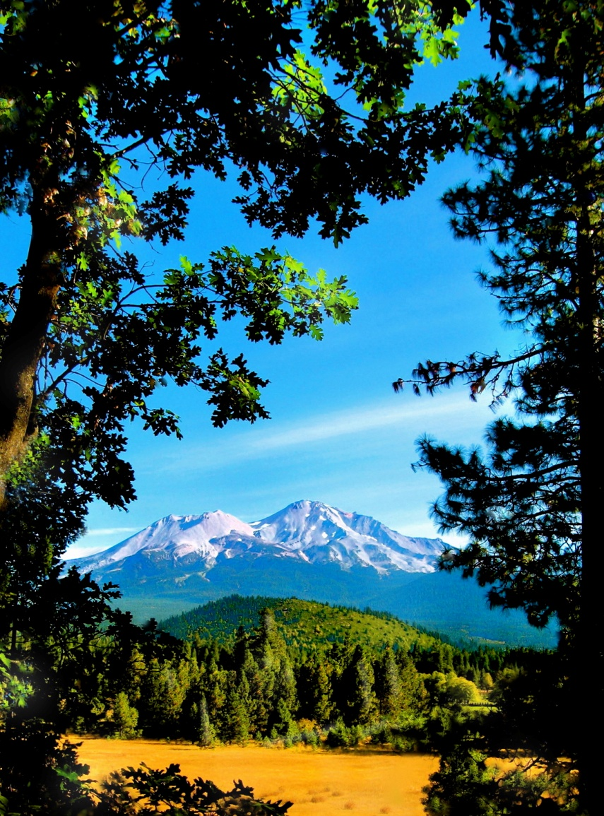
Remembering the Lord in meditation, you shall find bliss and peace forever deep within, and your mind will become tranquil and cool.
~ Shri Guru Granth Sahib 21 ~

Slide 15
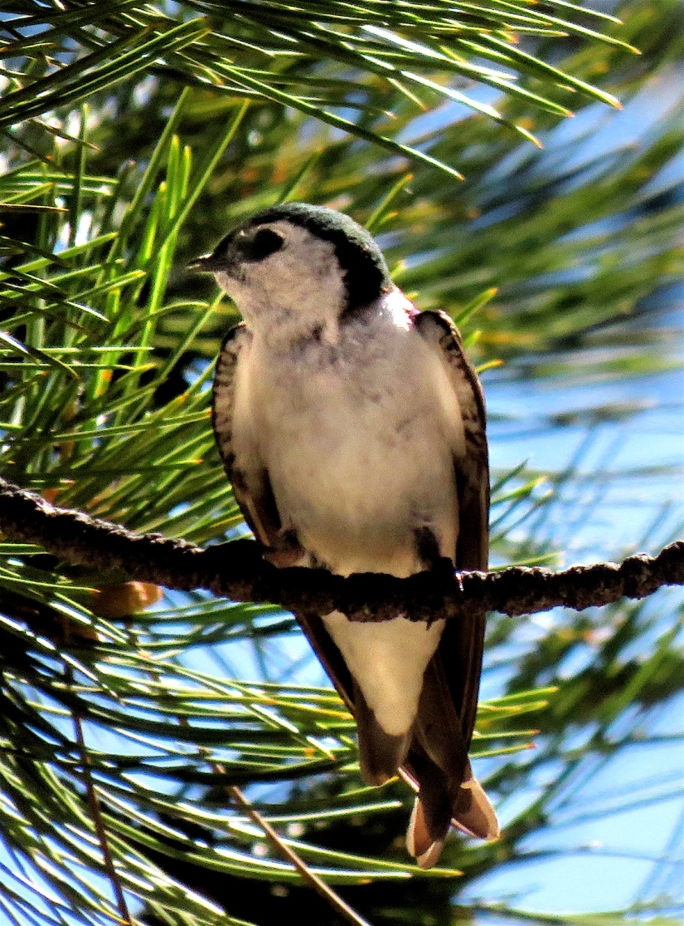
Be like the bird that
halting in her flight
awhile on boughs
too slight
Feels them give way
beneath her
and yet sings
knowing she hath Wings.
~ Victor Hugo ~

Slide 16
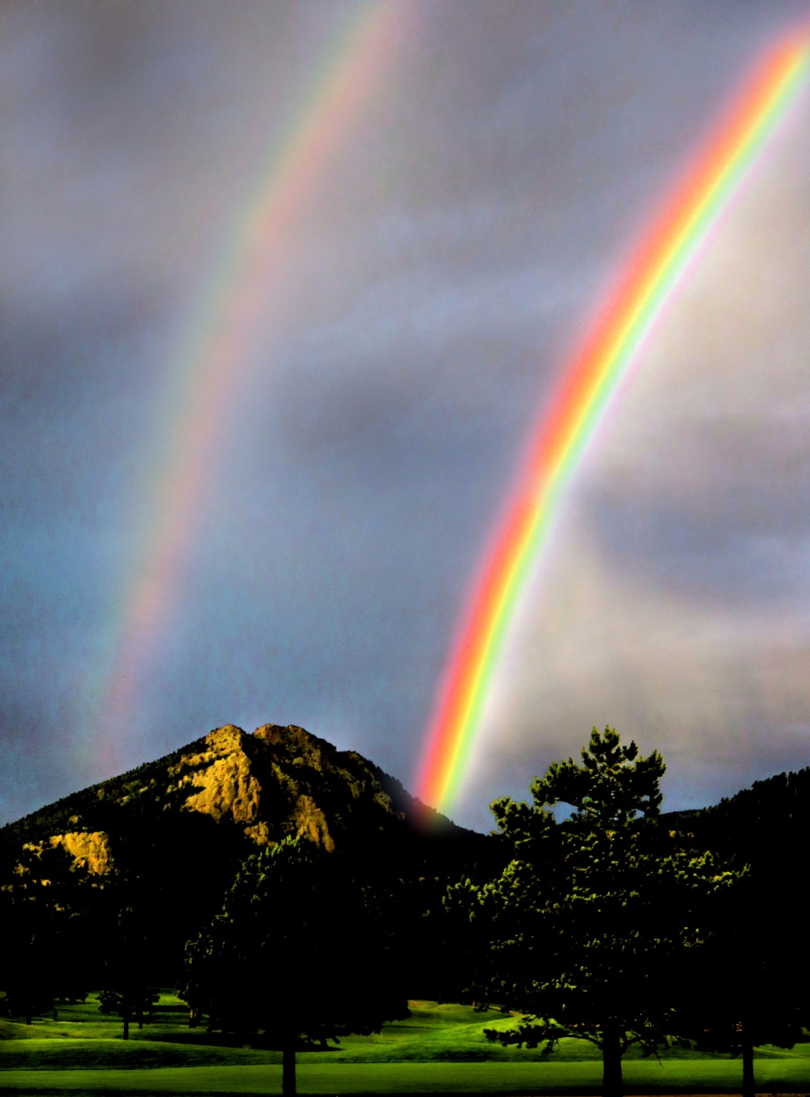
Do men think that they will be left alone on saying, "We believe," and that they will not be tested? We did test those before them, and Allah will certainly know those who are true from those who are false.
~ Qur'án (Yusuf Ali tr), 29:2-3 ~

Slide 17

He delivereth the afflicted by His affliction, and openeth their ear by tribulation.
~ Job, 36:15 ~

Slide 18

When God solves your problems, you have faith in HIS abilities.
When GOD doesn’t solve your problems, HE has faith in YOUR abilities.
~ Rishikajain.com ~

Slide 19

Forgetting the Beloved, even for a moment, the mind is afflicted with terrible diseases.
How can honor be attained in His Court, if the Lord does not dwell in the mind?
~ Shri Guru Granth Sahib ~

Slide 20

So understand this, my man:
Unrestrained men are evil. Don't let greed and wrong doing subject you to lasting suffering.
~ Dhammapada ~
(Sayings of the Buddha)
(tr. J. Richards)

Slide 21
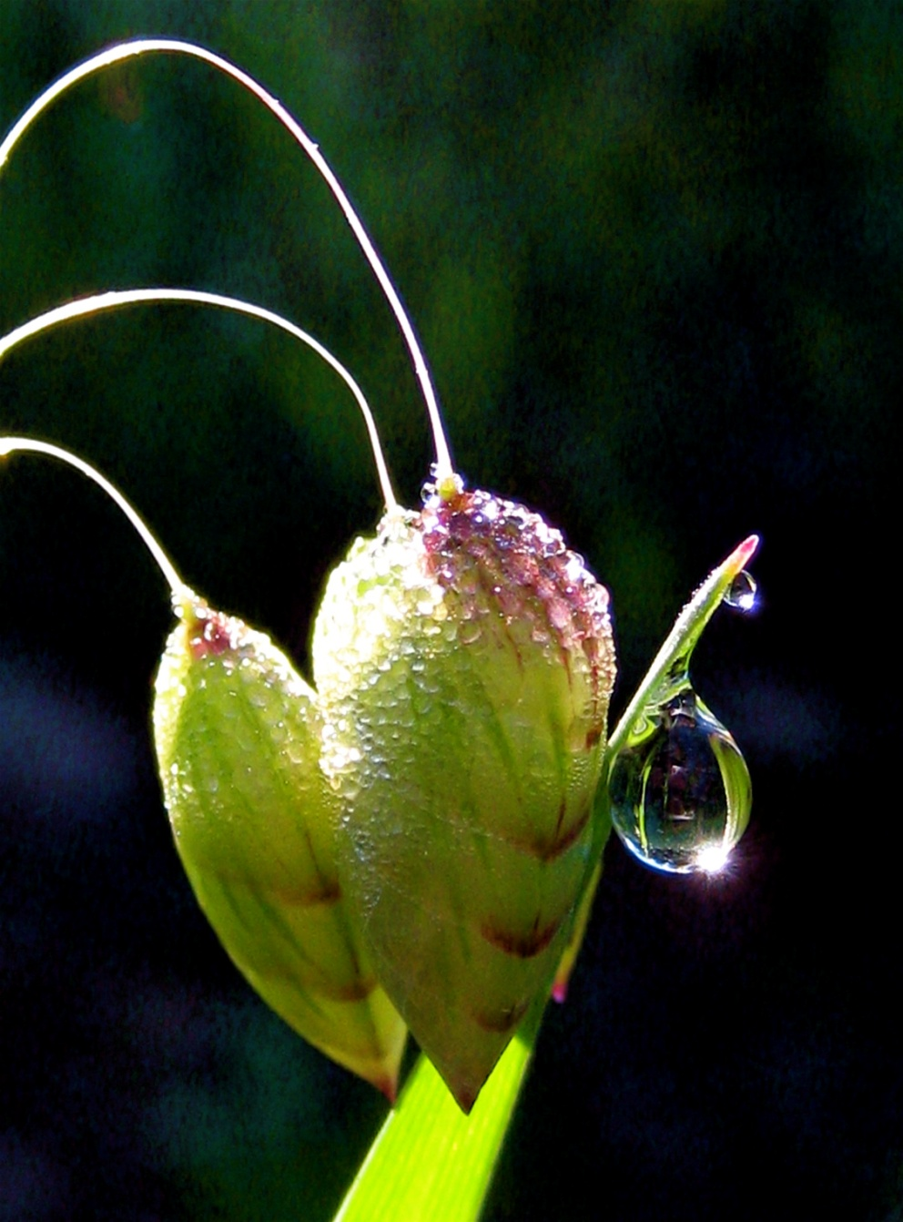
Naturally there will be periods of distress and difficulty, and even severe tests; but if that person turns firmly towards the Divine Manifestation, studies carefully His Spiritual teachings and receives the blessings of the Holy Spirit, he will find that in reality these tests and difficulties have been the gifts of God to enable him to grow and develop.
~ Shoghi Effendi ~
Lights of Guidance, p. 70

Slide 22

Have courage for the great sorrows and patience for the small ones. And when you have accomplished your daily tasks, go to sleep in peace. God is awake.
~Gordon Atkinson ~

Slide 23

Sorrow and suffering, trial and endurance, are a part of the Hindu ideal of a Perfect Life of righteousness. Rama suffers for fourteen years in exile, and is chastened by privations and misfortunes, before he ascends the throne of his father. In a humble way this course of training was passed through by every pious Hindu of the ancient times
~ Ramayana ~
(R. Dutt, abridged tr)

Slide 24
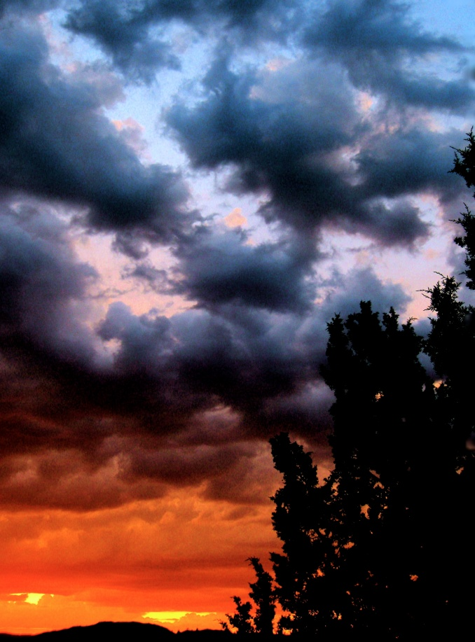
Positive? Negative?
You decide.
Clouds may be black marks against the sky or prisms for the explosive lights of sunset.
~ Patricia Thuner Jones ~
Birds of a Feather

Slide 25
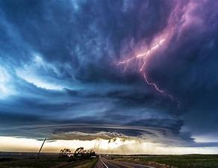
The Lord will either calm your storm . . . or allow it to rage while He calms you.
~ www.catholic365.com/article/4775 ~

Slide 26
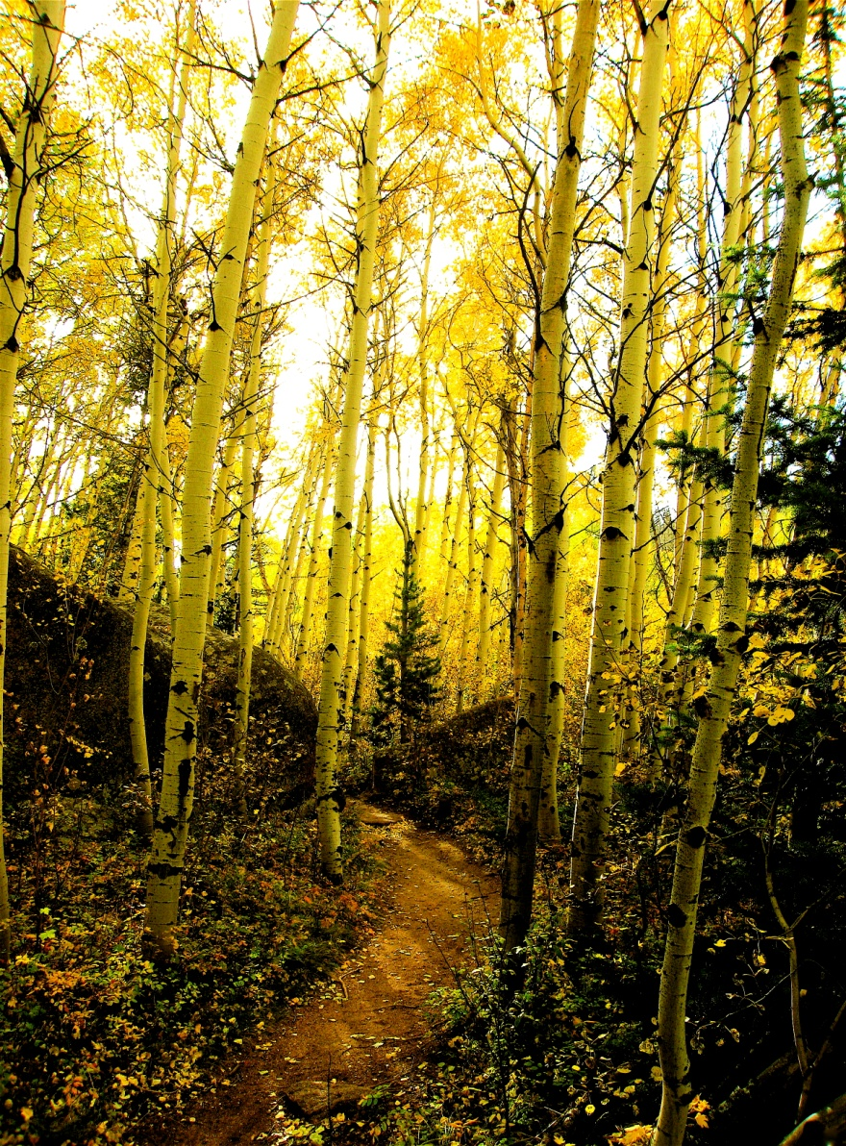
Take, my brethren, the prophets, who have spoken in the name of the Lord, for an example of suffering affliction, and of patience.
Behold, we count them happy which
endure. Ye have heard of the patience of Job, and have seen the end of the Lord; that the Lord is very pitiful, and of tender mercy.
But above all things, my brethren, swear not, neither by heaven, neither by the earth, neither by any other oath: but let your yea be yea; and your nay, nay; lest ye fall into condemnation.
Is any among you afflicted? let him pray. Is any merry? Let him sing psalms.
Is any sick among you? let him call for the elders of the church; and let them pray over him, anointing him with oil in the name of the Lord:
And the prayer of faith shall save the sick, and the Lord shall raise him up; and if he have committed sins, they shall be forgiven him.
~ James (KJV), 5:10-14 ~

Slide 27
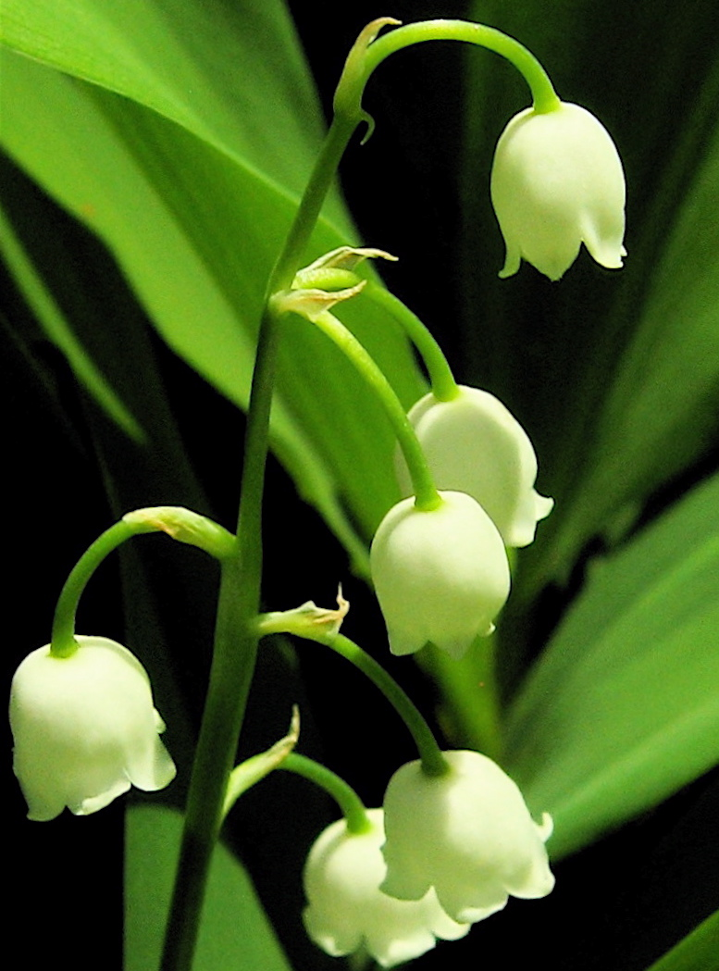
Help me, oh God
To see the beauty around me
To behold every soul
As a beautiful flower
That opens its petals
To the sun and the rain.
Help me to know
I am like a seed
That has been dropped in a furrowed field
With the promise of sun
and of rain.
And if
I lie exposed upon the ground
Or sink too deep within
I will not despair
Because I know
I will struggle again
To feel the warmth of the sun
And the promise of rain.
~ Mavis Lilllywhite ~

Slide 28

O SON OF MAN!
The true lover yearneth for tribulation even as doth the rebel for forgiveness and the sinful for mercy.
~ Bahá'u'lláh ~
The Hidden Words
(#49 from the Arabic)

Slide 29
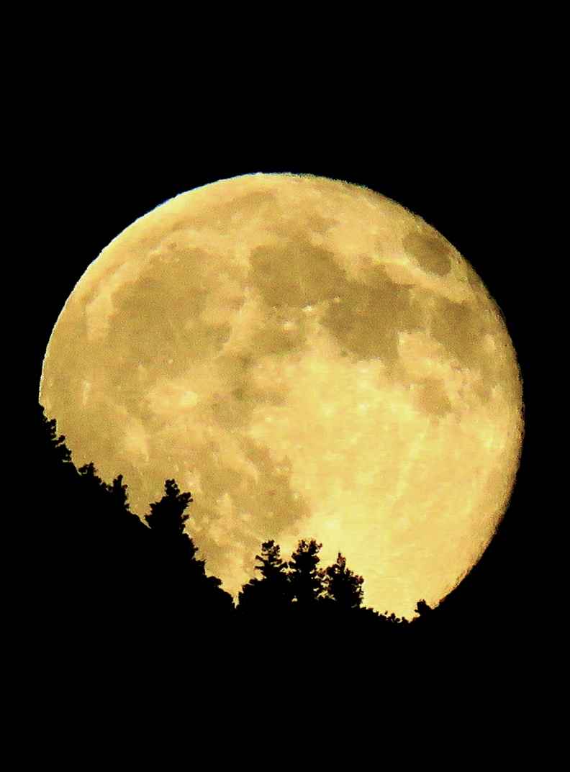
Adversity brings out one’s hidden qualities.
Without nightfall, no one would know how luminous can be the moon.
~ Patricia Thuner Jones ~

Slide 30
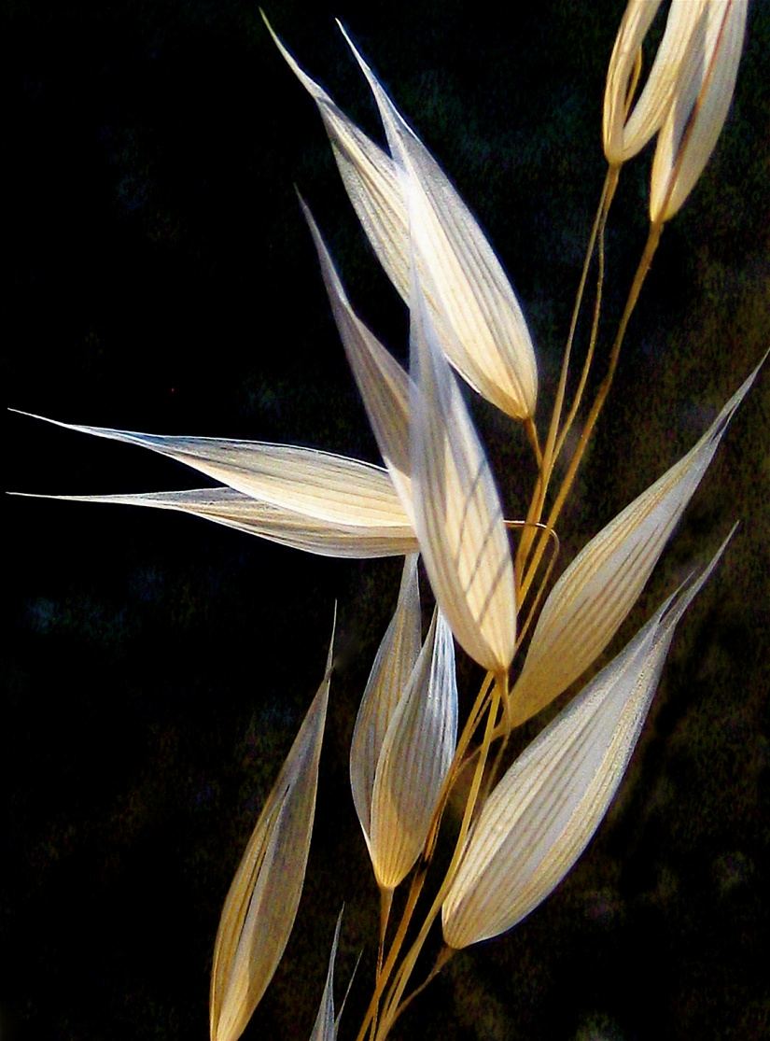
O God! Refresh and gladden my spirit. Purify my heart. Illumine my powers. I lay all my affairs in Thy hand. Thou art my Guide and my Refuge. I will no longer be sorrowful and grieved; I will be a happy and joyful being. O God! I will no longer be full of anxiety, nor will I let trouble harass me. I will not dwell on the unpleasant things of life.
O God! Thou art more friend to me than I am to myself. I dedicate myself to Thee, O Lord.
~ 'Abdu'l-Bahá ~
Baha'i Prayers, p. 150

Slide 31

Compiled by
Jaine Toth
Nature Photography by Doug Jernberg
(except lotus flowers on
title page and first slide)

