Slide 1

Weaving the Arts into Community Life

Slide 2
Generally, during firesides, public meetings, and conferences, artistic offerings are set aside, usually at the end of the program, placing them in the category of
Entertainment

Slide 3
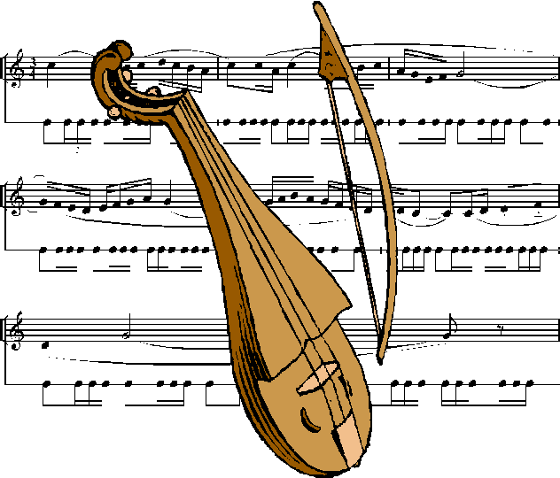
If a person desires to deliver a discourse, it will prove more effectual after musical melodies...
'Abdu'l-Bahá, "Table Talk,"
quoted in Herald of the South, January 13, 1933

Slide 4
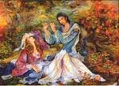
The ancient Greeks, as well as
Persian philosophers, were in the
habit of delivering their discourses
in the following manner: – First,
playing a few musical melodies,
and when their audience attained
a certain receptivity thereby they
would leave their instruments at
once and begin their discourse.
Among the most renowned musicians of Persia was one named Barbod, who, whenever a great question had been pleaded for at the court of the King, they would at once refer the matter to Barbod, whereupon he would go with his instrument to the court and play the most appropriate and touching music, the end being at once attained, because the King was immediately affected by the touching musical melodies, certain feelings of generosity would swell up in his heart, and he would give way.
'Abdu'l-Bahá, "Table Talk," quoted in Herald of the South, January 13, 1933

Slide 5

If you have a great desire and wish to attain your end, try to do so on a large audience after a great solo has been rendered.
'Abdu'l-Bahá, "Table Talk,"
quoted in Herald of the South, January 13, 1933

Slide 6

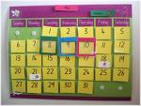
Children learn the alphabet by singing their s
The number of days in any given calendar month is easily recalled by reciting the poem Thirty days hath September…

Slide 7
Changing Education Through the Arts (CETA), a program of the John F. Kennedy Center for the Performing Arts, has as one of it’s main goals, to
  Help students
    learn more fluently and
  with greater motivation
  by providing professional development that builds teachers’ knowledge and skills in
  integrating the arts across the curriculum…

Slide 8
One CETA Teacher remarked:
“Through the CETA program, teachers come to understand that
the arts really turn on lights in
children's minds—their learning
is more meaningful and deeper.”
And a third grade student in the CETA program said:
“Just reading a book doesn’t make things stick in your head, but
when you do a tableau, what you
read really sticks in your head.”

Slide 9
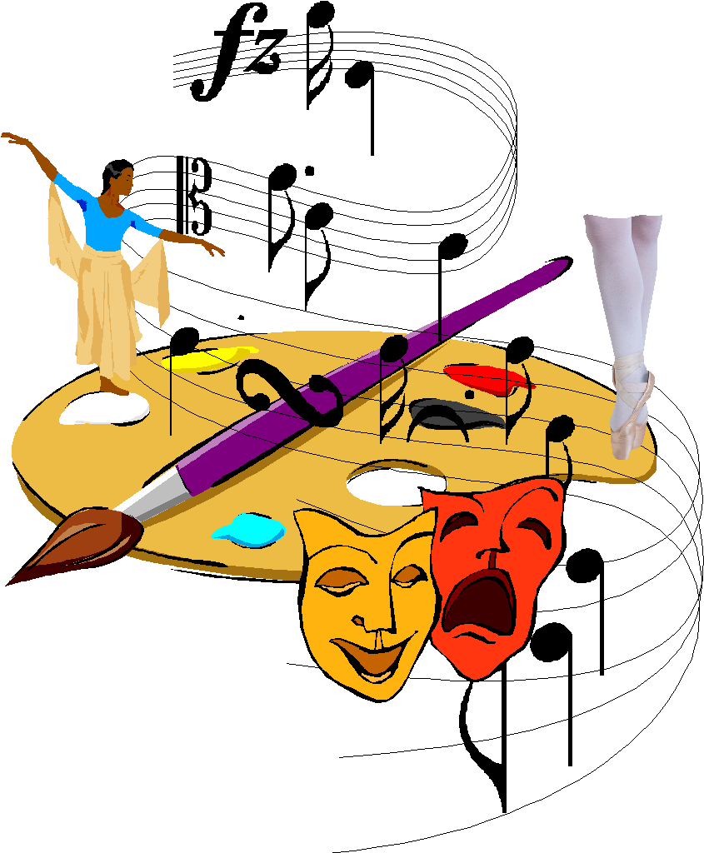
“Use more than one sense. The more of your five senses you pay attention to when trying to create a memory, the more connections you will make in your brain, which leads to a stronger, longer-lasting memory.”
Luna Mohanty
Brain Enhancement Techniques
for Improving Memory

Slide 10
Weaving the Arts into Community Life

Slide 11
WHEN THERE'S NO FUNDS
(As sung by a Spiritual Assembly)
Sung to the tune of "When You're A Jet" from West Side Story
Lyrics by: Jai Kenyatta Anderson
When there's no funds, you can't get nothin' done.
All the teaching work stops. There's no proclamation.
If there were funds, there's no reason to pause.
Gotta donate some more, please give to the Cause.
You're never alone. / Our lives can be so hectic
The choice is your own, / Nothing is rejected . . . You're well protected.
Give to the fund (Yeah!) Don't hesitate. / The more you give, the more you'll relate.
Reach in your pocket, come on take a stand. / These blessings are for every woman and man.
Please, give it your all. / You only go 'round one time.
Whether large or small. / The fund is our life-line; to all God's blessings.
Give to the fund (Yeah!) Don't hesitate.
The more you give, the more you'll feel great.
When you make - that- sac-ri-fice.

Slide 12
TOMORROW
(As sung by a new believer)
Sung to the tune of "Tomorrow" from Annie
Lyrics by: Jai Kenyatta Anderson
The funds will be here tomorrow,
but you got to hang on 'til tomorrow.
There’'ll be funds.
Just thinking about tomorrow
Makes it clear the cobwebs and the sorrows
Are still to come.
Tomorrow, tomorrow I'll donate tomorrow.
It's only a day away
Tomorrow, tomorrow I'll donate tomorrow.
It's only a day away

Slide 13
TONIGHT
(As sung by a longtime believer)
Sung to the tune of "Tonight" from West Side Story
Lyrics by: Jai Kenyatta Anderson
Tonight! Tonight! Give to the fund tonight.
Give to the fund and watch the Faith grow.
Tonight! Tonight! Give to the fund tonight.
Make a pledge, please don't hedge, let god know...
Your faith is strong and it's steadfast, your heart is over-flowing,
You want to make things right.
So here we are. And what was just a wish is a start, tonight!

Slide 14
Weaving the Arts into Community Life

Slide 15
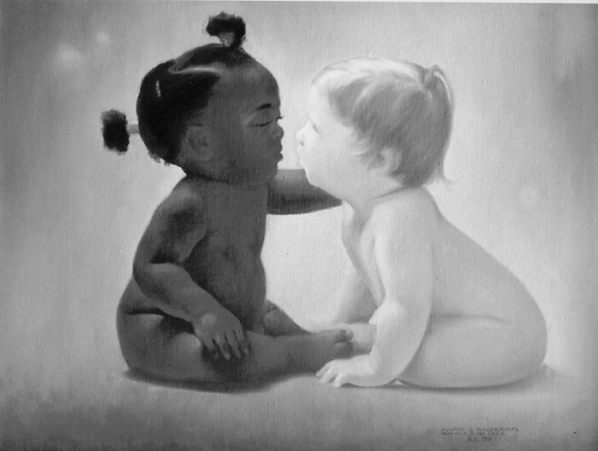

Slide 16
Weaving the Arts into Community Life

