Slide 1
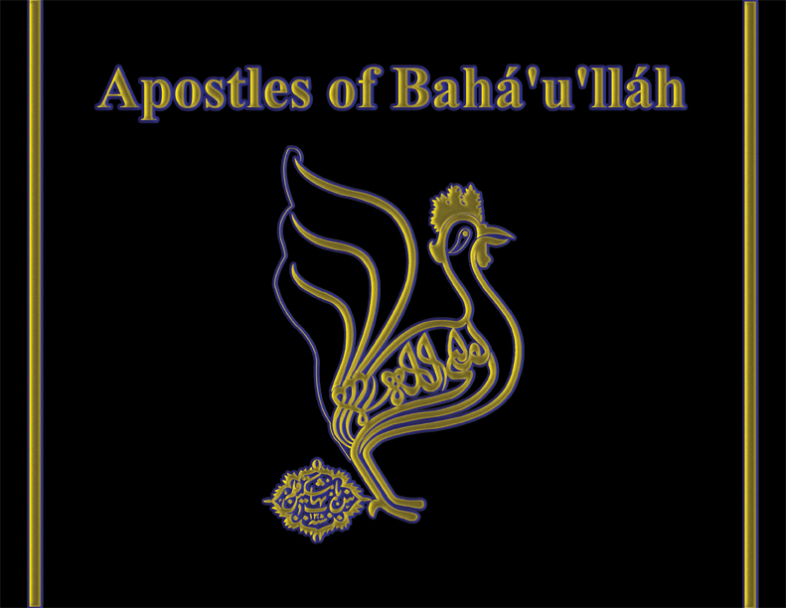

Slide 2
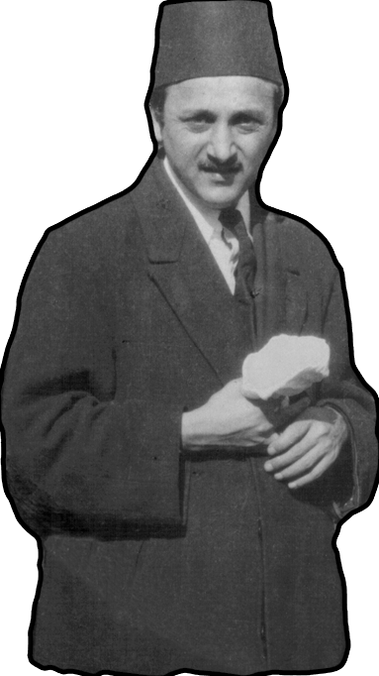
Shoghi Effendi, ‘sign of God on earth’ —great grandson of Bahá’u’lláh — designated the 19 Apostles of Bahá’u’lláh.

Slide 3
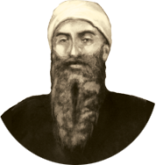
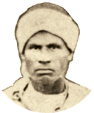
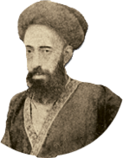
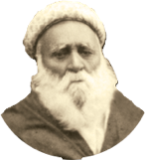
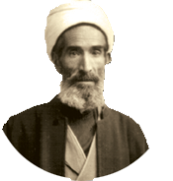
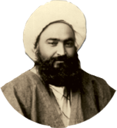
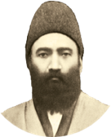
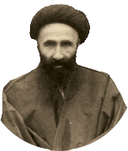
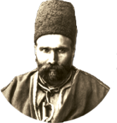
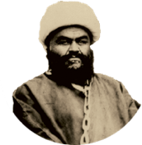
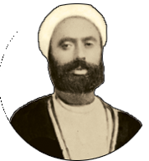
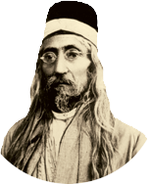
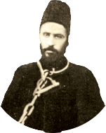
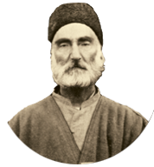
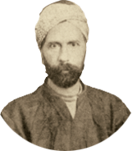
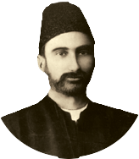
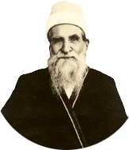
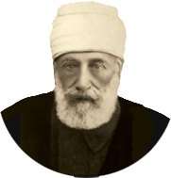
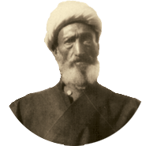
2
3
5
6
7

Slide 4
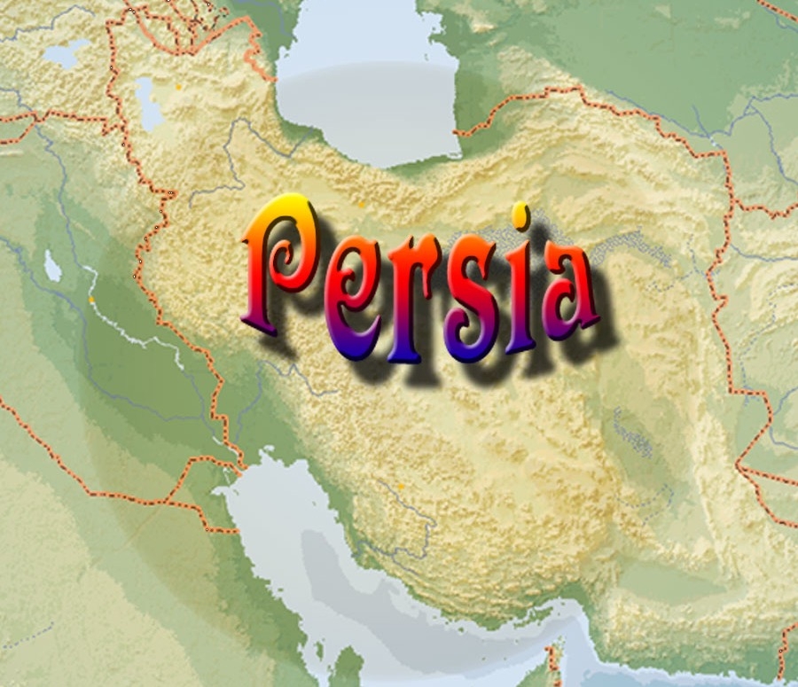

Slide 5
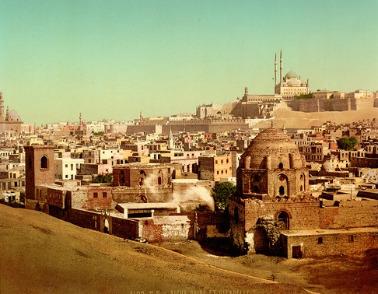
The Apostles of Bahá’u’lláh

Slide 6
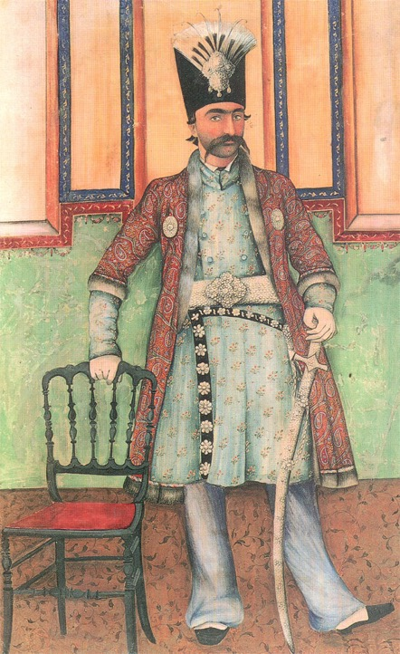
Násiri’d-Dín Sháh
reigned
1848-1896
“Prince of Oppressors”

Slide 7
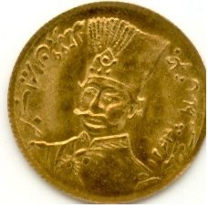
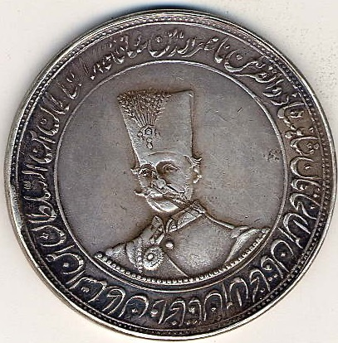
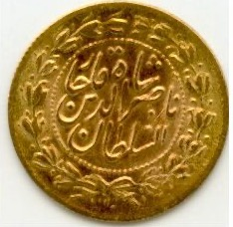

Slide 8
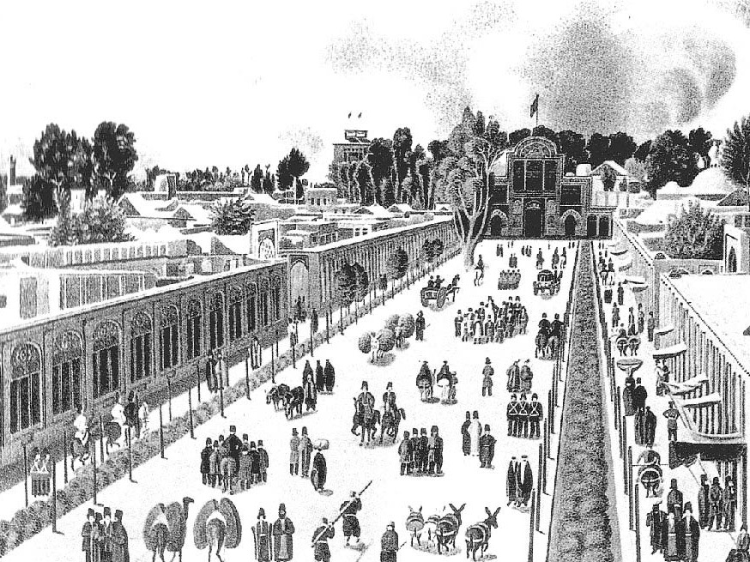
The Apostles of Bahá’u’lláh

Slide 9
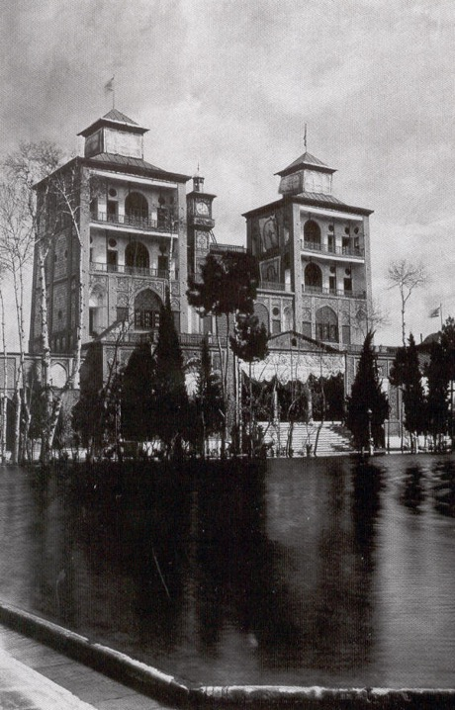
The Apostles of Bahá’u’lláh

Slide 10
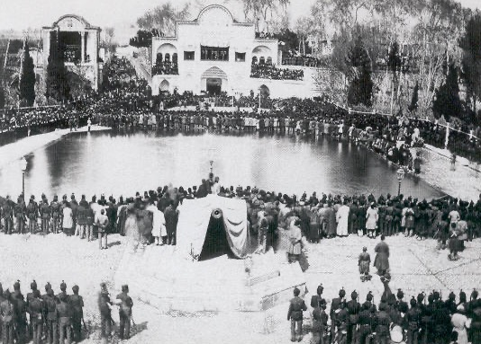
The Apostles of Bahá’u’lláh

Slide 11
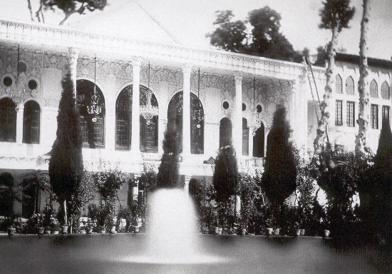

Slide 12
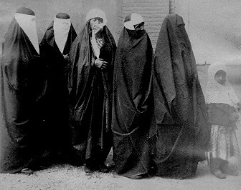

Slide 13
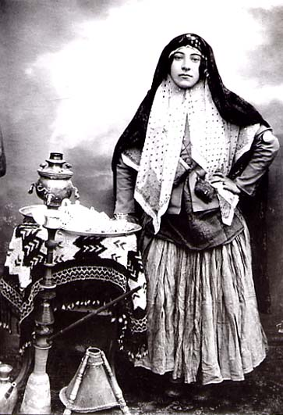
The Apostles of Bahá’u’lláh

Slide 14
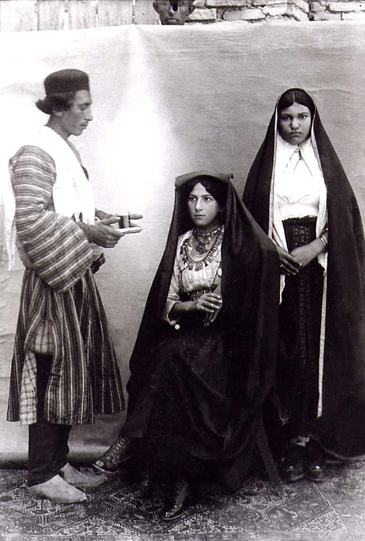
The Apostles of Bahá’u’lláh

Slide 15
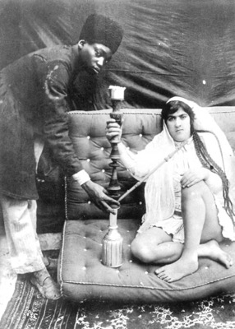
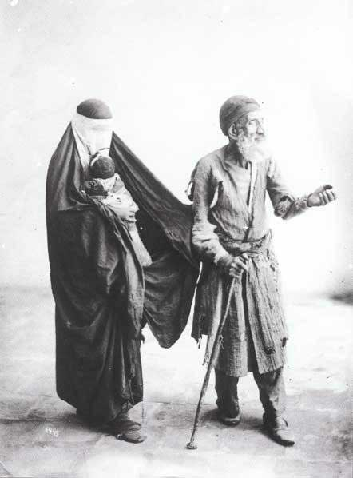

Slide 16
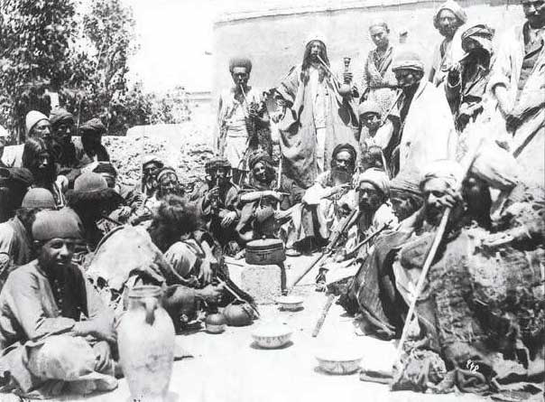

Slide 17
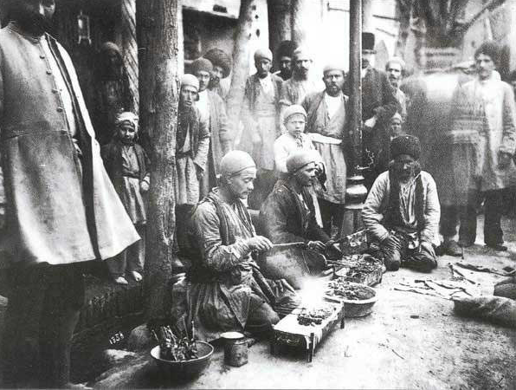

Slide 18
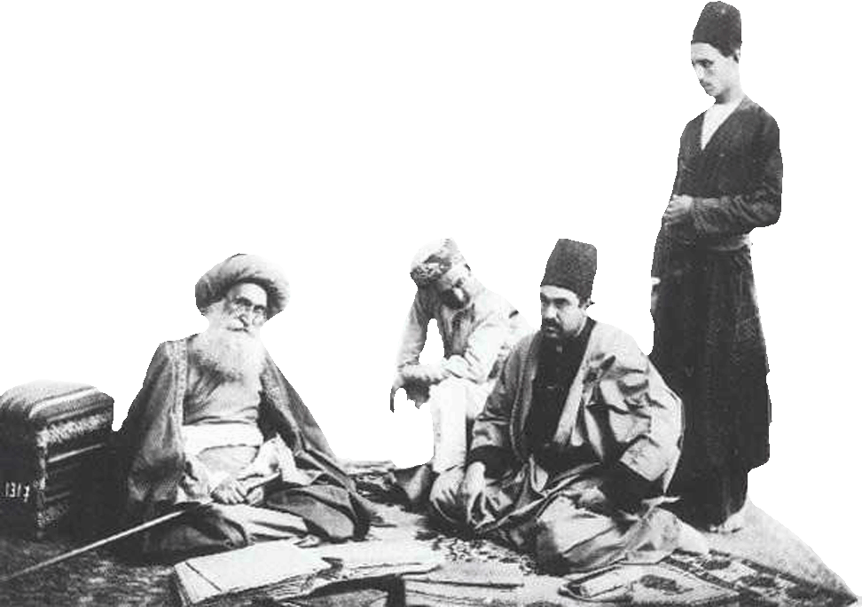
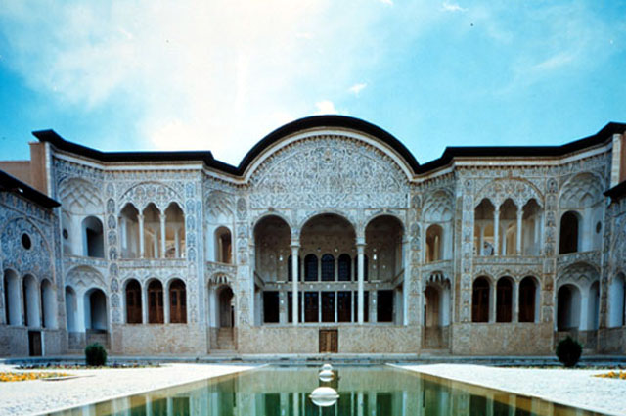

Slide 19
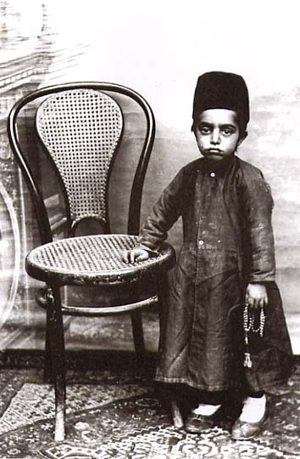
The Apostles of Bahá’u’lláh

Slide 20
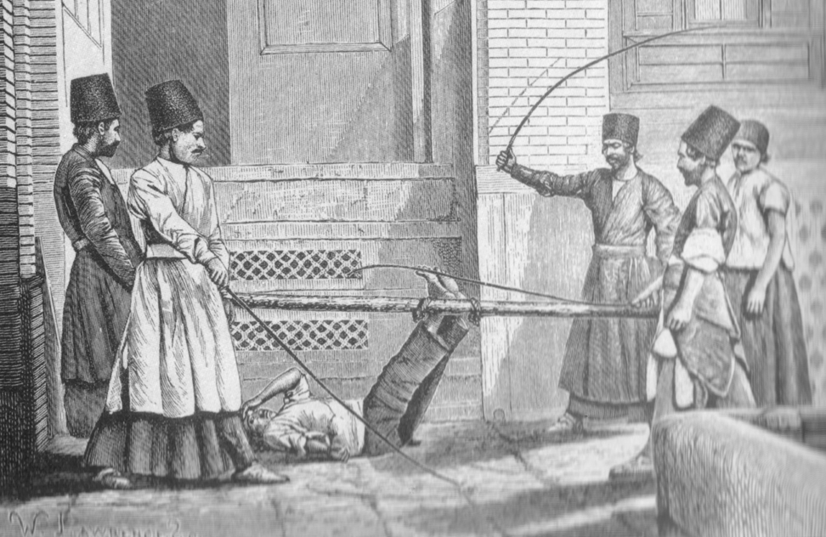

Slide 21
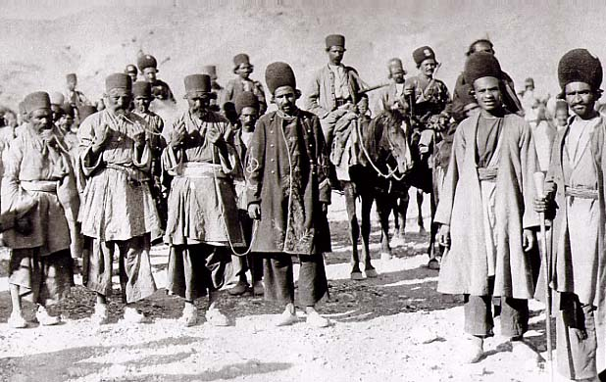
The Apostles of Bahá’u’lláh

Slide 22
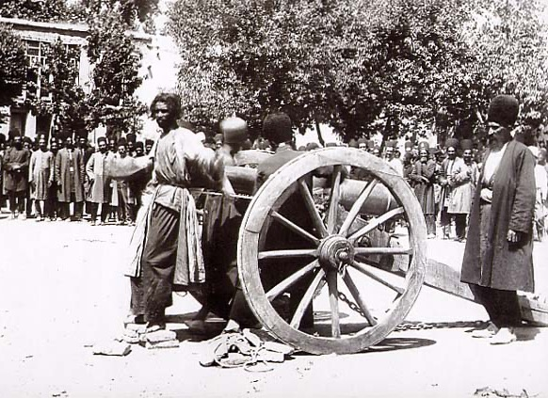
The Apostles of Bahá’u’lláh

Slide 23
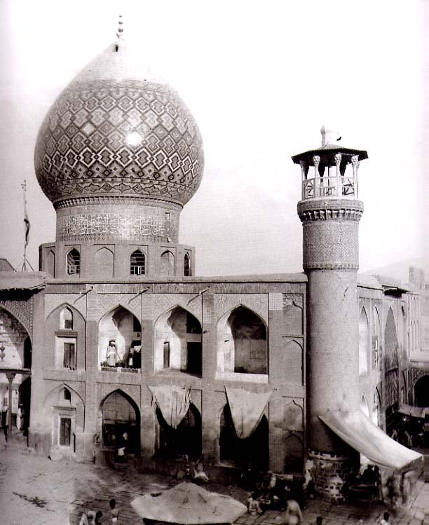
The Apostles of Bahá’u’lláh

Slide 24
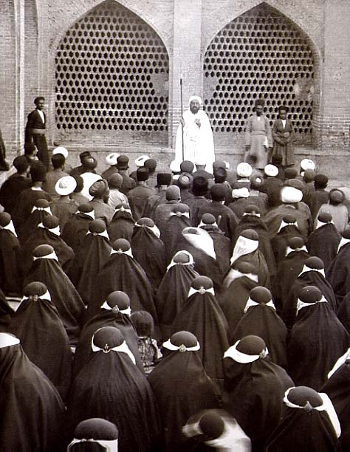
The Apostles of Bahá’u’lláh

Slide 25
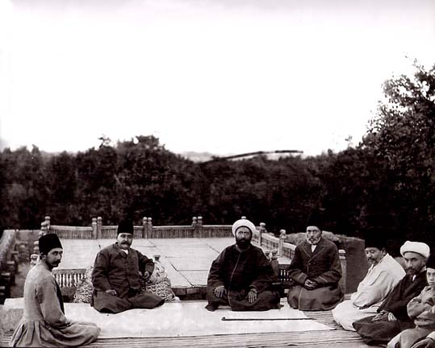
The Apostles of Bahá’u’lláh

Slide 26
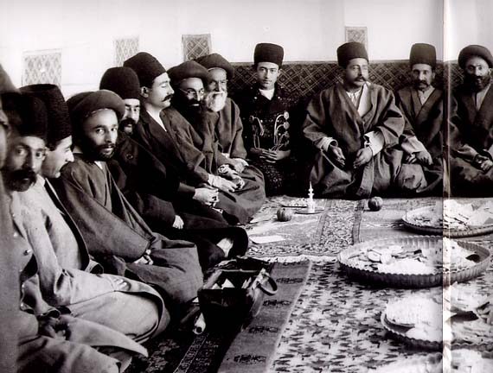
The Apostles of Bahá’u’lláh

Slide 27
CHART OF THE NINETEEN APOSTLES OF BAHÁ’U’LLÁH
1
Mírzá Músá, surnamed Áqáy-i-Kalím ?-1886/7
1 OF 3

Slide 28
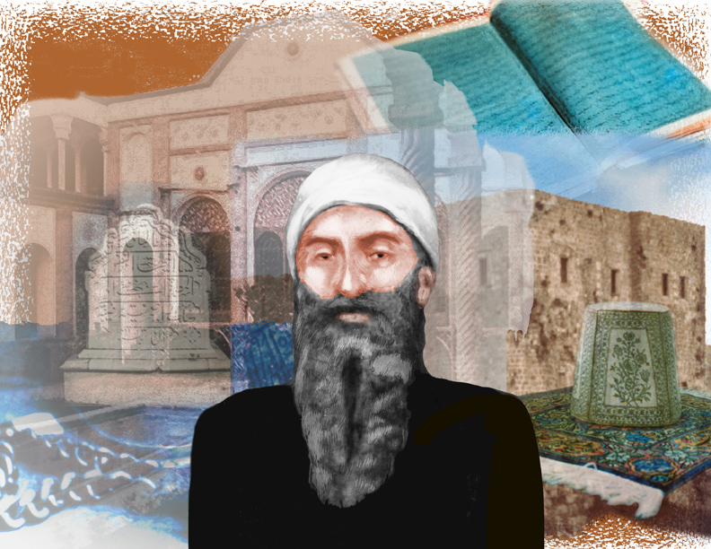
The Apostles of Bahá’u’lláh
Notes:
(1) Mirza Musa, was the ablest and most distinguished among Baha'u'llah's brothers and sisters, and His staunch and valued supporter. [DB 650] This only true brother of Baha’u’llah, [MF 86] was born in Tihran. After the death of his father, Mirza Buzurg in 1839, [BKG 17] Mirza Musa was raised by Baha’u’llah. [MF 86-87] He accompanied Baha’u’llah throughout His exiles. [RB Vol. 1, p.15] He was the head of household during Baha’u’llah’s withdrawal to the mountains of Sulaymaniyyih from 1854-56. [ACEBF 265] He is surnamed Aqay-i-Kalim. AKalim means the Speaker. [EGBBF 78-79] According to Baha’u’llah, only Mirza Musa and his half-brother Mirza Muhammad Quli were adequately informed of the origins of His Faith. [GPB 108] He died in ‘Akka in 1897. [ABBC 116]

Slide 29
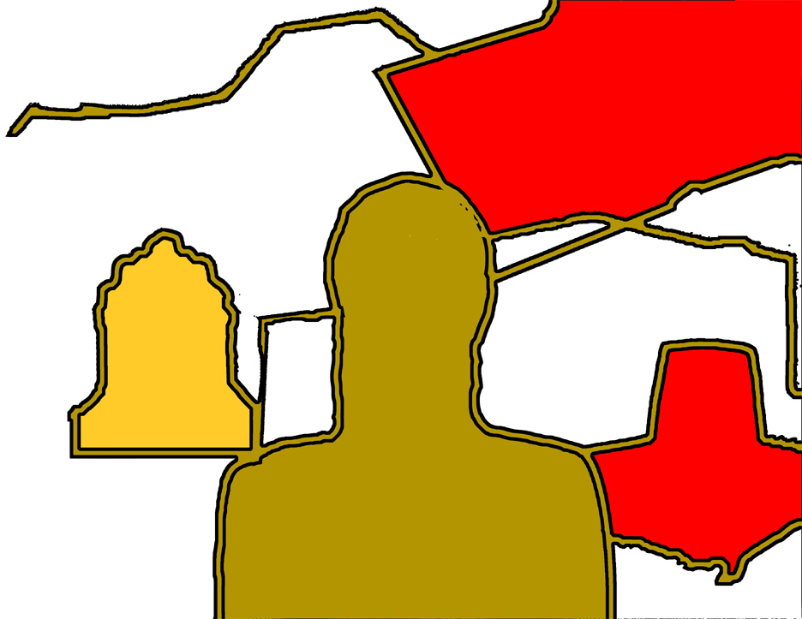
Sacred Writings
The Apostles of Bahá’u’lláh
House of Bahá’u’lláh in Tihran
‘Most Great Prison’
‘Akká
Mírzá Músá’s Tombstone in
‘Akká
Mírzá Músá
Áqáy-i-Kalím
Apostle 1
Bahá’u’lláh’s
Taj
Chains of
Bahá’u’lláh
Notes:
(1) Mirza Musa, was the ablest and most distinguished among Baha'u'llah's brothers and sisters, and His staunch and valued supporter. [DB 650] This only true brother of Baha’u’llah, [MF 86] was born in Tihran. After the death of his father, Mirza Buzurg in 1839, [BKG 17] Mirza Musa was raised by Baha’u’llah. [MF 86-87] He accompanied Baha’u’llah throughout His exiles. [RB Vol. 1, p.15] He was the head of household during Baha’u’llah’s withdrawal to the mountains of Sulaymaniyyih from 1854-56. [ACEBF 265] He is surnamed Aqay-i-Kalim. AKalim means the Speaker. [EGBBF 78-79] According to Baha’u’llah, only Mirza Musa and his half-brother Mirza Muhammad Quli were adequately informed of the origins of His Faith. [GPB 108] He died in ‘Akka in 1897. [ABBC 116]

Slide 30
The Apostles of Bahá’u’lláh
Notes:
(1) Mirza Musa, was the ablest and most distinguished among Baha'u'llah's brothers and sisters, and His staunch and valued supporter. [DB 650] This only true brother of Baha’u’llah, [MF 86] was born in Tihran. After the death of his father, Mirza Buzurg in 1839, [BKG 17] Mirza Musa was raised by Baha’u’llah. [MF 86-87] He accompanied Baha’u’llah throughout His exiles. [RB Vol. 1, p.15] He was the head of household during Baha’u’llah’s withdrawal to the mountains of Sulaymaniyyih from 1854-56. [ACEBF 265] He is surnamed Aqay-i-Kalim. AKalim means the Speaker. [EGBBF 78-79] According to Baha’u’llah, only Mirza Musa and his half-brother Mirza Muhammad Quli were adequately informed of the origins of His Faith. [GPB 108] He died in ‘Akka in 1897. [ABBC 116]

Slide 31



Slide 32

Báb’s Pilgrimage Garb 1844

Slide 33

Articles of the Báb’s clothing

Slide 34
CHART OF THE NINETEEN APOSTLES OF BAHÁ’U’LLÁH
1
Mírzá Músá, surnamed Áqáy-i-Kalím ?-1886/7
2
Áqá Buzurg-i-Khurásání, s. Badí ?-1869
1 OF 3

Slide 35

The Apostles of Bahá’u’lláh
Notes:
(2) the salt of My Tablets - the Pride of Martyrs
Aqa (or Mirza) Buzurg Khurasani, born in Mashhad c. 1852. [ABBC 54], is known to history by the name given him by Baha’u’llah, Badi`(Wonderful). [RB, vol. 3, 179] In 1869 the seventeen year old met with Baha’u’llah in ‘Akka and was given the task of delivering Baha’u’llah’s Tablet to Nasiri’d-Din Shah, the Lawh-i-Sultan. [BKG 297] Badi journeyed on foot to Lar, [A-B 29] the Shah’s summer resort north of Tihran. [BKG 304] After delivering the Tablet he was tortured, then executed.[BKG 307] For three years ABaha'u'llah continued to extol in His writings the heroism of that youth, characterizing the references made by Him to the sublime sacrifice as the "salt of My Tablets" and the Pride of Martyrs [GPB 199], (Fakhru’sh-shuhada). [BKG 300]

Slide 36

Nabíl
Apostle 12
Tablet of
Bahá’u’lláh
Badí
adolescent
Badí
17
“Wonderful”
Apostle 2
Násiri’d-Dín Sháh
1848-1896
“Prince of Oppressors”
Notes:
(2) the salt of My Tablets - the Pride of Martyrs
Aqa (or Mirza) Buzurg Khurasani, born in Mashhad c. 1852. [ABBC 54], is known to history by the name given him by Baha’u’llah, Badi`(Wonderful). [RB, vol. 3, 179] In 1869 the seventeen year old met with Baha’u’llah in ‘Akka and was given the task of delivering Baha’u’llah’s Tablet to Nasiri’d-Din Shah, the Lawh-i-Sultan. [BKG 297] Badi journeyed on foot to Lar, [A-B 29] the Shah’s summer resort north of Tihran. [BKG 304] After delivering the Tablet he was tortured, then executed.[BKG 307] For three years ABaha'u'llah continued to extol in His writings the heroism of that youth, characterizing the references made by Him to the sublime sacrifice as the "salt of My Tablets" and the Pride of Martyrs [GPB 199], (Fakhru’sh-shuhada). [BKG 300]

Slide 37


Slide 38

Nabíl
Apostle 12
Notes:
Nabil played a significant roles in the conversion of a fellow Apostle, Badi. Nabil journed to Nishapur (Neyshabur, some 50 km from Mashhad) in Khurasan and met with Haji Abdu'l‑Majid‑i‑Shalfurush (dealer in shawls), a noted merchant and a survivor of Shaykh Tabarsi...[BKG 294] Badi was the 17 year old son of Haji Abdu'l‑Majid‑i‑Shalfurush but was indifferent to his father’s Faith. Then Nabil began to chant from a poem by Baha’u’llah and melted the heart of that youth who fervently embraced the Cause. [BKG 295-296] Later that year he travelled to ‘Akka where Baha’u’llah entrusted him to carry a Tablet to the Shah of Persia, a act that resulted in Badi’s martyrdom.[BKG 296-300]

Slide 39

The Apostles of Bahá’u’lláh

Slide 40


Slide 41


Slide 42


Slide 43

(2)
Áqá Buzurg-i-Khurásání
Surnamed Badí` “Wonderful”

Slide 44
CHART OF THE NINETEEN APOSTLES OF BAHÁ’U’LLÁH
1
Mírzá Músá, surnamed Áqáy-i-Kalím ?-1886/7
2
Áqá Buzurg-i-Khurásání, s. Badí ?-1869
3
Siyyid Hasan-i-Nahri, s. King of M. 1836/7-1879
1 OF 3

Slide 45

Notes:
(3) King of Martyrs
Siyyid Hasan, surnamed by Baha’u’llah Sultanu’sh-Shuhada (King of Martyrs), was born in Isfahan in 1837. [ABBC 11] ‘Abdu’l-Baha described Siyyid Hasan and his brother Siyyid Husayn, as celebrated for their piety, trustworthiness, and nobility; men of wealth, engaged in commerce, behaving towards all men with perfect kindliness and courtesy. [TN 93] Siyyid Hasan, along with his brother Siyyid Husayn, were publicly beheaded for their faith on 17 March 1879 and their bodies dragged to the Maydan-i-Shah, [DB 228] the main courtyard of Isfahan, and there exposed to the indignities heaped upon them by a degraded and rapacious populace. [GPB 201], [ACEBF 218-219]

Slide 46
Notes:
(3) King of Martyrs
Siyyid Hasan, surnamed by Baha’u’llah Sultanu’sh-Shuhada (King of Martyrs), was born in Isfahan in 1837. [ABBC 11] ‘Abdu’l-Baha described Siyyid Hasan and his brother Siyyid Husayn, as celebrated for their piety, trustworthiness, and nobility; men of wealth, engaged in commerce, behaving towards all men with perfect kindliness and courtesy. [TN 93] Siyyid Hasan, along with his brother Siyyid Husayn, were publicly beheaded for their faith on 17 March 1879 and their bodies dragged to the Maydan-i-Shah, [DB 228] the main courtyard of Isfahan, and there exposed to the indignities heaped upon them by a degraded and rapacious populace. [GPB 201], [ACEBF 218-219]

Slide 47

Mír Muhammad Husayn, Imám Jum’ih (chief of the Mullás) of Isfáhán
‘She Serpent’ Deeply in debt to the brothers d.1881
The Apostles of Bahá’u’lláh
Sultan
Ma’súd Mírzá
(1850-1918) Prince Governor of Isfáhán
Siyyid Hasan-i-Nahri
“The King of Martyrs”
Apostle 3
Shaykh Muhammad Báqir “The Wolf”
d. 1883

Slide 48
Siyyid Husayn-i-Nahri
Notes:
(3) King of Martyrs
Siyyid Hasan, surnamed by Baha’u’llah Sultanu’sh-Shuhada (King of Martyrs), was born in Isfahan in 1837. [ABBC 11] ‘Abdu’l-Baha described Siyyid Hasan and his brother Siyyid Husayn, as celebrated for their piety, trustworthiness, and nobility; men of wealth, engaged in commerce, behaving towards all men with perfect kindliness and courtesy. [TN 93] Siyyid Hasan, along with his brother Siyyid Husayn, were publicly beheaded for their faith on 17 March 1879 and their bodies dragged to the Maydan-i-Shah, [DB 228] the main courtyard of Isfahan, and there exposed to the indignities heaped upon them by a degraded and rapacious populace. [GPB 201], [ACEBF 218-219]

Slide 49


Slide 50


Slide 51


Slide 52


Slide 53


Slide 54


Slide 55


Slide 57

Mírzá Muhammad-Husayn
Mahbúbu’sh-Shuhadá
“Beloved of Martyrs”

Slide 58


Slide 59

O Shaykh!
My Pen is abashed to recount what actually took place. In the land of Sád (Isfahán) the fire of tyranny burned with such a hot flame that every fair-minded person groaned aloud.

Slide 60
CHART OF THE NINETEEN APOSTLES OF BAHÁ’U’LLÁH
1
Mírzá Músá, surnamed Áqáy-i-Kalím ?-1886/7
2
Áqá Buzurg-i-Khurásání, s. Badí ?-1869
3
Siyyid Hasan-i-Nahri, s. King of M. 1836/7-1879
4
Hájí Mírzá Abu’l-Hasan-i-Ardikání 1832-1928
1 OF 3

Slide 61

Hájí Mírzá Abu’l-Hasan-i-Ardikání
c1832 Ardikán d. 1928 Tihrán
Notes:
(4) Mirza Abu'l‑Hasan was so overwhelmed at the majestic presence of his Lord [Baha’u’llah] that he shook, stumbled, and fell to the floor; his head was injured and the blood flowed out. [MF A-B 46]
Mulla Abu'l-Hasan, surnamed Amin, also known as Haji Amin-i-Ilahi, was born c. 1831* in Ardikan near Yazd. [ACEBF 37]. He accepted the Bab around 1851 and then Baha’u’llah. After a time he became the assistant of Haji Shah-Muhammad Manshadi who was the first Trustee of the Huququ’llah. [MF 46] [EBITTB 203] Ache was the first Baha’i from the outside world to be able to meet Baha’u’llah in ‘Akka (in the Public Baths).[GPB 187] [EBITTB 203] [BKG 288] He was appointed Trustee (Amin) of the Huququ’llah in 1880. ... He was imprisoned for the Faith more than once. In 1891 he was imprisoned in Qazvin for about two years. [RB 4, 185][BKG 454][A-B 29] Shoghi Effendi described him as "self-denying." [GPB 187] He died in Tihran in 1928 [ABBC 233] and was posthumously named a Hand of the Cause of God by Shoghi Effendi. [EBITTB 203]

Slide 62


Slide 63

(4)
Hájí Mírzá Abu’l-Hasan-i-Ardikání
Hájí Amín
Amín means “Faithful, honest, trustee”

Slide 65

“Mirza Abu'l‑Hasan was so overwhelmed at the majestic presence of his Lord [Baha’u’llah] that he shook, stumbled, and fell to the floor; his head was injured and the blood flowed out.” –Abdu’l-Bahá

Slide 66
CHART OF THE NINETEEN APOSTLES OF BAHÁ’U’LLÁH
1
Mírzá Músá, surnamed Áqáy-i-Kalím ?-1886/7
2
Áqá Buzurg-i-Khurásání, s. Badí ?-1869
3
Siyyid Hasan-i-Nahri, s. King of M. 1836/7-1879
4
Hájí Mírzá Abu’l-Hasan-i-Ardikání 1832-1928
5
Mírzá Abu’l-Fadl-i-Gulpáygání 1844-1914
1 OF 3

Slide 67

(5)
Mírzá Abu’l-Fadl-i-Gulpáygání
Notes:
Mirza Abu'l-Fadl-i-Gulpaygani (aka Mirza Abu'l-Fada'il)
Mirza Abu'l-Fadl was born in a village near Gulpaygan in 1844. After reading Tablets of Baha'u'llah predicting future events, including downfall of the Ottoman Sultan Abdu’l-Aziz, Abu'l-Fadl determined he would embrace the Baha’i Faith if these prophecies were fulfilled. In that same year (1876) Abdu’l-Aziz was assassinated and Abu’l-Fadl accepted Baha’u’llah. [ACEBF 22-23] He was imprisoned altogether some four years for espousing the Faith of Baha'u'llah. [Ibid].
In 1901 'Abdu'l-Baha sent him to America to deepen the knowledge of Baha'is there about their Faith.[RB 2, 45] To this end he wrote The Behai Proofs, translated by 'Ali Kuli Khan and published in English in 1902.[ACEBF 22-23]
‘Abdu’l-Baha named one of the doors of the Shrine of Bab in his honor. [ACEBF 22-23][SE by U.Giachery 214](The door on the western side of the Shrine of the Bab opening to ‘Abdu’l-Baha’s burial site.)[SE by Ugo 214-216]
His scholarship was almost wholly related to religion and was written in Arabic and Persian. He is unquestionably the most celebrated scholar the Baha'i Faith has yet produced. He died in Cairo, January 21, 1914.[draft article for BE by M.Momen]

Slide 68

Sultán ‘Abdu’l-Azíz deposed in May 1876; Mírzá Abu’l-Fadl embraces Faith shortly thereafter.

Slide 69

Mírzá Abu’l-Fadl, wrote The Behai Proofs, translated by Alí Kuli Khan
Alí Kuli Khan – translator for Mírzá Abu’l-Fadl during American sojourn 1901-1904

Slide 70

The Apostles of Bahá’u’lláh

Slide 71
CHART OF THE NINETEEN APOSTLES OF BAHÁ’U’LLÁH
1
Mírzá Músá, surnamed Áqáy-i-Kalím ?-1886/7
2
Áqá Buzurg-i-Khurásání, s. Badí ?-1869
3
Siyyid Hasan-i-Nahri, s. King of M. 1836/7-1879
4
Hájí Mírzá Abu’l-Hasan-i-Ardikání 1832-1928
5
Mírzá Abu’l-Fadl-i-Gulpáygání 1844-1914
6
Mírzá ‘Alí-Muhammad, s. Varqá c1846-1896
1 OF 3

Slide 72

(6)
Mírzá ‘Alí-Muhammad
Surnamed Varqá -”Dove”
Notes:
(6) Mirza ‘Ali-Muhammad, surnamed Varqa [‘Dove’ EGBBF 30] by Baha’u’llah. Born and brought up in Yazd. [EBITTB 76] His father was Haji Mulla Mihdi [EBITTB 75] Martyred in Tihran, 1 May 1896,[HDBF 422] along with his 12 year old son Ruhu’llah. [BBC 1896] Varqa appears to have been born in Yazd. In 1882 he was arrested and sent to Isfahan where he was imprisoned for a year.[BW18:383][BBC 1882] Hand of the Cause. [EBITTB 78 caption] (His father is buried in Mazra’ih. He died in his quest to reach Bahji and Baha’u’llah. [EBITTB 76]) Varqa was an accomplished poet.[ EBITTB 84] t Baha’u’llah’s direction, Varqa obtained a water-color copy of the portrait of the Bab made by Aqa-Bala of Urumiyyih and sent it to the Holy Land where it now resides in the International Baha’i Archives on Mt. Carmel. [EBITTB 87] Varga, along with his son Ruhu’llah, was martyred by Hajibu’d-Dawlih in the prison of Tihran in the summer of 1896.[EBITTB 96]

Slide 73

Rúhu’lláh “the Spirit of God”, i.e. Jesus
Age 12 martyred in 1896 in the prison of Tihran
The Apostles of Bahá’u’lláh
Mírzá ‘Alí-Muhammad “Varqá” (‘Dove’)
Bahá’u’lláh directed Varqá to get painting of Báb that’s now in the International Bahá’í Archives in Haifa

Slide 74
CHART OF THE NINETEEN APOSTLES OF BAHÁ’U’LLÁH
1
Mírzá Músá, surnamed Áqáy-i-Kalím ?-1886/7
2
Áqá Buzurg-i-Khurásání, s. Badí ?-1869
3
Siyyid Hasan-i-Nahri, s. King of M. 1836/7-1879
4
Hájí Mírzá Abu’l-Hasan-i-Ardikání 1832-1928
5
Mírzá Abu’l-Fadl-i-Gulpáygání 1844-1914
6
Mírzá ‘Alí-Muhammad, s. Varqá c1846-1896
7
Mírzá Mahmúd-i-Furúghí ?-1927
1 OF 3

Slide 75

Mírzá Mahmúd-i-Furúghí
b. Dúghábád
d. 1927
Notes:
(7) Mirza Mahmud (Furughi) Mirza Mahmud was born the village of Dughabad in Khurasan.[ACEBF 162] Baha’u’llah honored Dughabad with the designation Furugh (Splendor, Light).[EBITTB 157] [ACEBF 162] Shortly after the assassination of Nasiri’d-Din Shah, Furughi had an audience with the new Shah, Muzaffarid’d-Din in which he apprised him of the tenents of the Faith of Baha’u’llah in such a manner that the Shah was induced to look favourably upon it. [EBITTB 169] On two occasions in Mashad he survived assassination attempts. [EBITTB 169-170] He died shortly after being deliberately poisoned at a feast in Dughabad in AH 1346 (sometime between 1 July 1927 and 19 June 1928) after being poisoned.[EBITTB 170]

Slide 76

Mullá ‘Alí-Akbar-i-Shahmírzádí
Mírzá Mahmúd-i-Furúghí
(8)
(7)
Also called Hájí Ákhúnd
Notes:
One of the most sacred tasks entrusted to Aminu’l‑Bayan was to go to Iran to receive the Remains of the Bab from their custodian, the devoted and valiant Hand of the Cause of God Jinab‑i‑Haji Akhund, and to transfer them through innumerable dangers to a safe hiding place in the Mosque of the Imamzadih Zayd in Tihran, where they lay concealed until the time when, at the behest of ‘Abdu’l‑Baha, they were transferred to the Holy Land to be laid in their permanent resting place on the slopes of Mount Carmel.
(Letters of The Universal House of Justice, 2002 Jul 30, Revised ‑ Development of Institution of Huququ'llah, p. 3)
Died March 4, 1910 in Tihran. [ABBC 1910][EBITTB 266]

Slide 77

(7) Mírzá Mahmúd-i-Furúghí
(17) Shaykh Muhammad ‘Alí

Slide 78

Informed new Shah, Muzaffarid’d-Dín, of the Bahá’í teachings who looked favorable upon them (1896)

Slide 79
CHART OF THE NINETEEN APOSTLES OF BAHÁ’U’LLÁH
8
Mullá ‘Alí-Akbar-i-Shahmírzádí 1842/3-1910
2 OF 3

Slide 80

“This honored man was successful in converting a multitude. For the sake of God he cast all caution aside, as he hastened along the ways of love. He became as one frenzied, as a vagrant and one known to be mad.”
–’Abdu’l-Bahá
Mullá ‘Alí-Akbar-i-Shahmírzádí
Known as Hájí
Akhund
1842/3-1910
b. Shahmírzád
d. Tihrán
Notes:
(8) Mulla ‘Ali-Akbar (Haji Akhund) This honored man was successful in converting a multitude. For the sake of God he cast all caution aside, as he hastened along the ways of love. He became as one frenzied, as a vagrant and one known to be mad. [A-B, MF 10-11]
[USE S CAPTION] The photograph of this blessed individual, together with that of the great Amin, taken of them in their chains, will serve as an example to whoever has eyes to see. There they sit, those two distinguished men, hung with chains, shackled, yet composed, acquiescent, undisturbed. [A-B, MF 11]
Born in Shahmirzad (near Simnan) around 1842. [EBITTB 265][ACEBF 31]. He attended the religious colleges in Mashad. He became a Babi in 1861 after reading the Kitab-i-Iqan and meeting with Babis.[EBITTB 266][ACEBF 31] He was arrested an imprisoned for the Faith at least five times.[EBITTB 266] (MORE ON NEXT NOTE PG)

Slide 81
Mullá ‘Alí-Akbar-i-Shahmírzádí
Mírzá Mahmúd-i-Furúghí
(8)
(7)
Also called Hájí Ákhúnd
Notes:
One of the most sacred tasks entrusted to Aminu’l‑Bayan was to go to Iran to receive the Remains of the Bab from their custodian, the devoted and valiant Hand of the Cause of God Jinab‑i‑Haji Akhund, and to transfer them through innumerable dangers to a safe hiding place in the Mosque of the Imamzadih Zayd in Tihran, where they lay concealed until the time when, at the behest of ‘Abdu’l‑Baha, they were transferred to the Holy Land to be laid in their permanent resting place on the slopes of Mount Carmel.
(Letters of The Universal House of Justice, 2002 Jul 30, Revised ‑ Development of Institution of Huququ'llah, p. 3)
Died March 4, 1910 in Tihran. [ABBC 1910][EBITTB 266]

Slide 82
CHART OF THE NINETEEN APOSTLES OF BAHÁ’U’LLÁH
8
Mullá ‘Alí-Akbar-i-Shahmírzádí 1842/3-1910
9
Áqá Muhammad-i-Qá’ini 1829-1892
2 OF 3

Slide 83

(17)
(9)
Surnamed Nabíl-i-Akbar
Nabíl means “Learned or Noble”
Áqá Shaykh Muhammad-‘Alíy-i-Qá’ini
Áqá Muhammad-i-Qá’ini
Notes:
(9)
When his eyes were opened to the light of Divine guidance, and he breathed in the fragrances of Heaven, he became a flame of God. [MF 1] Mulla Muhammad Qa’ini, surnamed Nabil-i-Akbar, was born in the village of Naw-Firist, near Birjand, Persia on March 29, 1829.[EBTTB 113] It has been claimed that no one within the enclave of the Baha’i Faith has ever surpassed the profundity of his erudition.[EBBTB 112] Baha’u’llah addressed the Lawh-i-Hikmat (Tablet of Wisdom), which sets forth the fundamentals of true philosophy [GPB 219), in honor of Nabil-i-Akbar. [BKG 382]
Nabil attained the presence of Baha’u’llah in the House of Abbud in ‘Akka sometime in 1873 or 1874.[RB Vol. 4, 33]
He was imprisoned a number of times in Iran for his Baha’i activities and eventually moved to Ashkhabad (Ishqabad, Turkmenistan).[ACEBF 257]
Also named a Hand of the Cause of God by A-B. (Tablet of Hikmat addressed to) Died in Bukhara, Uzbekistan 6 July 1892.[ACEBF 257] [EBITTB 115]
(MORE ON NEXT NOTE PG)

Slide 84

“A thousand ways I tried
My love to hide ‑
But how could I,
upon that blazing pyre
Not catch fire!”
Quoted by ‘Abdu’l-Bahá referring to Nabíl-i-Akbar
(Tablet of Wisdom (Hikmat) revealed in his honor.)
Notes:
(9)
When his eyes were opened to the light of Divine guidance, and he breathed in the fragrances of Heaven, he became a flame of God. [MF 1] Mulla Muhammad Qa’ini, surnamed Nabil-i-Akbar, was born in the village of Naw-Firist, near Birjand, Persia on March 29, 1829.[EBTTB 113] It has been claimed that no one within the enclave of the Baha’i Faith has ever surpassed the profundity of his erudition.[EBBTB 112] Baha’u’llah addressed the Lawh-i-Hikmat (Tablet of Wisdom), which sets forth the fundamentals of true philosophy [GPB 219), in honor of Nabil-i-Akbar. [BKG 382]
Nabil attained the presence of Baha’u’llah in the House of Abbud in ‘Akka sometime in 1873 or 1874.[RB Vol. 4, 33]
He was imprisoned a number of times in Iran for his Baha’i activities and eventually moved to Ashkhabad (Ishqabad, Turkmenistan).[ACEBF 257]
Also named a Hand of the Cause of God by A-B. (Tablet of Hikmat addressed to) Died in Bukhara, Uzbekistan 6 July

Slide 85
CHART OF THE NINETEEN APOSTLES OF BAHÁ’U’LLÁH
8
Mullá ‘Alí-Akbar-i-Shahmírzádí 1842/3-1910
9
Áqá Muhammad-i-Qá’ini 1829-1892
10
Hájí Mírzá Muhammad-Taqí 1830/1-1911
2 OF 3

Slide 86

(10)
Hájí Mírzá Muhammad-Taqí
(Vakílu’d-Dawlih)
Notes:
’Abdu’l‑Baha wrote to Haji Mirza Taqi Afnan, the cousin of the Bab and chief builder of the ‘Ishqabad Temple, commanding him to arrange for the election of the Universal House of Justice should the threats against the Master materialize.[F63. WT, p. 20; WOB, p. 17.] (Msgs UHJ 63-86, p.53)
He died in Haifa in 1909 and is buried in the Baha’i cemetery at the foot of Mount Carmel.[EB 268] ‘Abdu’l-Baha said His bright grave is in Haifa, beside the Haziratu'l‑Quds, near Elijah's Cave. A tomb must be erected there, and built solidly and well.
(`Abdu'l‑Baha: Memorials of the Faithful, Page: 129)

Slide 87


Slide 88


Hájí Mírzá oversaw the construction of the first Bahá’í house of worship (Turkmenistan) for ‘Abdu’l-Bahá.
Notes:
(10) His life was righteous, his speech agreeable, his deeds worthy.
(`Abdu'l‑Baha, ref. To Haji Mirza in Memorials of the Faithful, Page: 127) *** [He was] the first builder of a House to unify man.
(`Abdu'l‑Baha: Memorials of the Faithful, Page: 128)
Haji Mirza Muhammad-Taqi. He was an Afnan, a relative of the Bab. He is also known by the title Vakilu’d-Dawlih, meaning ‘representative of the government’.[ACEBF 254] He was born in Shiraz sometime between 1830 and 1831.[ACEBF 254][EBITTB 266] his father was the Bab’s maternal uncle, Haji Sayyid Muhammad.[ACEBF 254]
As a youth he met the Bab. Baha’u’llah confirmed Haji Mirza’s belief in the Bab when the Haji met Him in Baghdad in 1857.[EBITTB 266]
t the request of ‘Abdu’l-Baha he traveled to Ishqabad, Turkmenistan in 1900 to supervise the construction of the first Baha’i Mashriqu’l-Adhkar in the world.[ACEBF 254][EB 267] The cornerstone was laid in 1902 [ABBC 1902] in the presence of General Krupatkin, the governor-general of Turkistan.[GPB 300; RB4, 122]

Slide 89
CHART OF THE NINETEEN APOSTLES OF BAHÁ’U’LLÁH
8
Mullá ‘Alí-Akbar-i-Shahmírzádí 1842/3-1910
9
Áqá Muhammad-i-Qá’ini 1829-1892
10
Hájí Mírzá Muhammad-Taqí 1830/1-1911
11
Hájí Mírzá Muhammad-Taqíy-i-Abharí 1853/4-1919
2 OF 3

Slide 90

(11)
Hájí Mírzá Muhammad Taqíy-i-Abharí
Notes:
Haji Mirza Muhammad-Taqi, Ibn-i-Abhar (Abhar 1853/4 -1917 Tihran)
Appointed Hand by Baha’u’llah in 1886. [ABBC 1886]. Provided material to A.L.M. Nicholas for his book on the Bab.
A number of people in the village of Abhar became Baha'is from about 1285/1868 onwards, through the conversion of the mujtahid of the village, Mirza `Abdu'r-Rahim (d. 1290/1873). The latter's son, Mirza `Adbu'l-`tuuf remained as religious leader in the village while another son, Mirza Muhammad Taqi, Ibn-i-Abhar, became a prominent Baha'i and was named a Hand of the Cause by Baha'u'llah.

Slide 91

He is God! The Hand of the Cause of God, Jinab-i-Ibn-i-Abhar, upon him be the Glory of God
O thou who art steadfast in the Covenant, A few days ago I was glancing at some photographs of the friends. By chance I came across thy photograph. As I beheld thy person standing poised and in the utmost dignity with chains around thy neck, I was so affected that all sorrow was turned into joy and radiance, and I praised God that the world's Greatest Luminary hath nurtured and trained such servants who, while tied in chains and under the threat of the sword, shine forth in the utmost exultation and rapture. And this is but a token of the grace of thy Lord,… -’Abdu’l-Bahá
Notes:
Two early believers (the latter a Hand of the Cause) who were both arrested during this same period in 1891. Haji Amin was sent to the prison of Qazvin, and Ibn-i-Abhar was consigned for four years in Tihran, in which he bore the same chains as Baha'u'llah did, during the Latter's imprisonment in 1852. [Mehdi Wolf's note] He was addressed by Baha’u’llah as ibn-i-Abhar (the son of Abhar). [RB 4, 304-305] His father was murdered (for the Faith?) In 1874.[ACEBF 192] He was imprisoned for the Faith in 1878-9 and again between 1890 and 1894.[ACEBF 192]. He travelled to India in 1907 to promote the Faith and consolidation of the Baha'i community in that country. In one of His Tablets[22] Baha'u'llah states that Ibn‑i‑Abhar was created to extol God and magnify His name, to teach His Cause and to serve Him. [RB 4, 306]

Slide 92
CHART OF THE NINETEEN APOSTLES OF BAHÁ’U’LLÁH
8
Mullá ‘Alí-Akbar-i-Shahmírzádí 1842/3-1910
9
Áqá Muhammad-i-Qá’ini 1829-1892
10
Hájí Mírzá Muhammad-Taqí 1830/1-1911
11
Hájí Mírzá Muhammad-Taqíy-i-Abharí 1853/4-1919
12
Mullá Muhammad-i-Zarandi 1831-1892
2 OF 3

Slide 93

(12)
(14)
Áqá Muhammad
Mustafá-Baghdádí
Mullá Muhammad-i-Zarandi
Surnamed Nabíl-A’zam
Nabíl means “Learned”
A’zam means “Greatest”
Notes:
(12) Mulla Muhammad, surnamed Nabil-i-A’zam (Zarand 29 July 1831-1892 ‘Akka)
He became a chief of the army of lovers... [MF 33] He was a gifted poet, and his tongue most eloquent; a man of mettle, and on fire with passionate love.[MF 34]
Nabil-i-A’zam, Muhammad-i-Zarandi, was born in Zarand [EB 268] (north of Kirman in south-central Persia)[ENCARTA] on 29 July 1831.[ABBC 1831][DB 434]. His first occupation was that of a shepherd. He became a Babi around 1847 and was one who transcribed and circulated the Writings of the Bab.[ACEBF 257]. At one time Nabil proclaimed himself AHim Whom God Shall Make Manifest but renounced this claim after meeting Baha’u’llah in Baghdad and becoming His follower.[ACEBF 257].
Baha’u’llah sent Nabil on many teaching trips through Persia.[EB 269] Nabil was the first to perform the newly revealed Pilgrimage rituals to the House of the Bab in Shiraz and the House of Baha’u’llah in Baghdad.[ACEBF 257][EB 269]

Slide 94

The Apostles of Bahá’u’lláh
Shepherd – poet – transcribed & circulated Tablets of the Báb – assisted conversion Badí – 1st to perform Bahá’í pilgrimage to House of Báb & House of Bahá’u’lláh – Taught first Christian (Dr Faris) in Alexandria, Egypt in 1868 – Author authoritative history of Babí Dispensation: The Dawn-Breakers
Notes:
Nabil was, perhaps, also the first to convert a Christian to the Baha’i fold. While in prison in Alexandria, Nabil met a Christian physician and clergyman named Faris Effendi.[RB 1, 204] Nabil taught Faris the Faith which he embraced whole-heartedly. During that time Baha’u’llah’s ship B bound from Gallipoli to ‘Akka B stopped in Alexandria and Faris was favored with a written address from the hand of Baha’u’llah.[RB 1, 204][BKG 268] Nabil eventually travelled to ‘Akka and joined the companions of Baha’u’llah. In 1892 he drowned himself in the Mediterranean Sea following the death of Baha’u’llah.[ACEBF 257-258]. He was an accomplished writer of poetry and prose. He is best known for his historical narration of The Dawn-Breakers, the earliest authoritative history of the Babi Faith which was translated into English by Shoghi Effendi.[ACEBF 258].

Slide 95
CHART OF THE NINETEEN APOSTLES OF BAHÁ’U’LLÁH
8
Mullá ‘Alí-Akbar-i-Shahmírzádí 1842/3-1910
9
Áqá Muhammad-i-Qá’ini 1829-1892
10
Hájí Mírzá Muhammad-Taqí 1830/1-1911
11
Hájí Mírzá Muhammad-Taqíy-i-Abharí 1853/4-1919
12
Mullá Muhammad-i-Zarandi 1831-1892
13
Shaykh Muhammad KáÝim-i-Qazvíní 1844-1918
2 OF 3

Slide 96

(16)
(13)
Mírzá Hasan
Surnamed Adíb
Adíb means “Refined, cultured, scholar, writer”
Shaykh Muhammad
Kázim-i-Qazvíní
Surnamed Samandar
“Phoenix”
Notes:
(13) Shaykh Kazim, surnamed Samandar [A legendary bird supposed to live in fire - RB3, 89 Phoenix ACEBF 303] Born in Qazvin (c150 km NW Tihran) 7 Feb 1844.[ABBC 1844] His father was a Baha’i of great distinction. Shaykh Kazim-i-Samandar excelled both in trade and in learning. [EB 200] A...as soon as Baha’u’llah made known His Mission, Samandar gave Him his fealty.[EB 200] He twice obtained the presence of Baha’u’llah. [EB 206]He first attained the presence of Baha’u’llah in Akka sometime in 1874 or 1875.[EB 200] The 2nd time he attained the presence was between 1890 and 1891.[EB 208] Between 1899 and 1900 Samandar made a third pilgrimage. This time to visit ‘Abdu’l-Baha.[EB 209] AHis [Samandar’s] daughter Thurayya had been married to Mirza Diya’u’llah, the third surviving son of Baha’u’lah and a breaker of His Covenant.[EB 209] Diya’u’llah was alredy dead and Thurayya had to meet her father in the Most Holy Tomb. The Covenant-Breakers refused to let her leave the Mansion of Bahji. She too wished to be near her husband’s grave, which was in the chamber adjacent to the MHT. Samandar went to the home of ‘Abdu’l-Baha in ‘Akka. The Master advised Samandar to leave his wife there, which he did.

Slide 97

Notes:
Over the course of 63 years (age 11 to 74) Samandar kept meticulous records of his teaching and business journeys.[EB 211]Tablets revealed in his honour by Baha’u’llah were legion. [EB 215] Baha’u’llah Himself testified that were they collected together they would make a book. [EB 215] He died in in 1918.[EB 211]

Slide 98

His father was a Bahá’í of great distinction. Shaykh Kazim-i-Samandar excelled both in trade and in learning. ...As soon as Baha’u’llah made known His Mission, Samandar gave Him his fealty.
Notes:
(13) Shaykh Kazim, surnamed Samandar [A legendary bird supposed to live in fire - RB3, 89 Phoenix ACEBF 303] Born in Qazvin (c150 km NW Tihran) 7 Feb 1844.[ABBC 1844] His father was a Baha’i of great distinction. Shaykh Kazim-i-Samandar excelled both in trade and in learning. [EB 200]...as soon as Baha’u’llah made known His Mission, Samandar gave Him his fealty.[EB 200] He twice obtained the presence of Baha’u’llah. [EB 206]He first attained the presence of Baha’u’llah in Akka sometime in 1874 or 1875.[EB 200] The 2nd time he attained the presence was between 1890 and 1891.[EB 208] Between 1899 and 1900 Samandar made a third pilgrimage. This time to visit ‘Abdu’l-Baha.[EB 209] His [Samandar’s] daughter Thurayya had been married to Mirza Diya’u’llah, the third surviving son of Baha’u’lah and a breaker of His Covenant.[EB 209] Diya’u’llah was alredy dead and Thurayya had to meet her father in the Most Holy Tomb. The Covenant-Breakers refused to let her leave the Mansion of Bahji. She too wished to be near her husband’s grave, which was in the chamber adjacent to the MHT. Samandar went to the home of ‘Abdu’l-Baha in ‘Akka. The Master advised Samandar to leave his wife there, which he did.

Slide 99
CHART OF THE NINETEEN APOSTLES OF BAHÁ’U’LLÁH
8
Mullá ‘Alí-Akbar-i-Shahmírzádí 1842/3-1910
9
Áqá Muhammad-i-Qá’ini 1829-1892
10
Hájí Mírzá Muhammad-Taqí 1830/1-1911
11
Hájí Mírzá Muhammad-Taqíy-i-Abharí 1853/4-1919
12
Mullá Muhammad-i-Zarandi 1831-1892
13
Shaykh Muhammad KáÝim-i-Qazvíní 1844-1918
14
Áqá Muhammad Mustafá-Baghdádí 1837/8-1910
2 OF 3

Slide 100
(12)
(14)
Áqá Muhammad
Mustafá-Baghdádí
Mullá Muhammad-i-Zarandi
Surnamed Nabíl-A’zam
Nabíl means “Learned”
A’zam means “Greatest”
Assisted with movement of Báb’s remains to ‘Akká. Bahá’u’lláh’s assistant in Beirut. (Father of Dr Zia Baghdadi.)
Notes:
(12) Mulla Muhammad, surnamed Nabil-i-A’zam (Zarand 29 July 1831-1892 ‘Akka)
He became a chief of the army of lovers... [MF 33] He was a gifted poet, and his tongue most eloquent; a man of mettle, and on fire with passionate love.[MF 34]
Nabil-i-A’zam, Muhammad-i-Zarandi, was born in Zarand [EB 268] (north of Kirman in south-central Persia)[ENCARTA] on 29 July 1831.[ABBC 1831][DB 434]. His first occupation was that of a shepherd. He became a Babi around 1847 and was one who transcribed and circulated the Writings of the Bab.[ACEBF 257]. At one time Nabil proclaimed himself AHim Whom God Shall Make Manifest but renounced this claim after meeting Baha’u’llah in Baghdad and becoming His follower.[ACEBF 257].
Baha’u’llah sent Nabil on many teaching trips through Persia.[EB 269] Nabil was the first to perform the newly revealed Pilgrimage rituals to the House of the Bab in Shiraz and the House of Baha’u’llah in Baghdad.[ACEBF 257][EB 269]

Slide 101

(14)
Muhammad‑Mustafa was a blazing light. He was like a shooting star, a missile hurled against the demons; against the violators, an avenging sword.
—’Abdu’l-Bahá
Áqá Muhammad Mustafá-Baghdádí
Notes:
(14) Mirza Muhammad Mustafa Bagdadi (Baghdad c1837-1910 Alexandretta)
Muhammad‑Mustafa was a blazing light[MF 129] He was like a shooting star, a missile hurled against the demons; against the violators, an avenging sword. [MF 133]
Born in c1837[ABBC 1837] or 1838.[ACEBF 252]His father was Shaykh Muhammad Ash-Shibi. When Mirza Muhammad Mustafa Bagdadi was just a boy he became a follower of Baha’u’llah. He later became Aone of the leading Iraqi Baha’is.[ACEBF 252] AIn the late 1870s he moved to Beirut where he served as Baha’u’llah’s representative, responsible for the movement of Baha’i pilgrims. He was also involved in the movement of the Bab’s remains to Akka.[ACEBF 252-253]

Slide 102
CHART OF THE NINETEEN APOSTLES OF BAHÁ’U’LLÁH
15
Mírzá Husayn, s. Mishkín-Qalam 1826/7-1912
3 OF 3

Slide 103

Mírzá Husayn, surnamed Mishkín-Qalam
1826/7 Isfahán 1912 `Akká

Slide 104

He had amazing verve, intense love. He was a compendium of perfections: believing, confident, serene, detached from the world, a peerless companion, a wit ‑ and his character like a garden in full bloom. He was selflessness itself, living on the breaths of the spirit. -’Abdu’l-Bahá

Slide 105

The Apostles of Bahá’u’lláh

Slide 106
CHART OF THE NINETEEN APOSTLES OF BAHÁ’U’LLÁH
15
Mírzá Husayn, s. Mishkín-Qalam 1826/7-1912
16
Mírzá Hasan, surnamed Adíb 1848-1919
3 OF 3

Slide 107

He was one of the founders of the Tarbiat Schools in Tihran.
Mírzá Hasan
Surnamed Adíb
Adíb means “Refined, cultured, scholar, writer”
Notes:
(16) Haji Mirza Hasan, surnamed Adib (Talaqan 1848- 2 Sep 1919 Tihran)
Mirza Hasan became a Baha’i around 1889.[CC 324]
Mirza Muhammad-Hasan was born in Talaqan in 1848.[ACEBF 23] He was an accomplished poet[ACEBF 23]. He became a Baha’i around 1889 after conversations with Nabil-i-Akbar [another Apostle]. He was appointed a Hand by Baha’u’llah.[ACEBF 23]. With the exception of Mirza Hasan‑i‑Adib, who embraced the Faith about three years before the ascension of Baha'u'llah, the other three Hands of the Cause were long‑standing believers.[RB 4, 277]
Born in Talaqan in September 1848.[EB 272]He underwent the usual religious education at Tihran and Mashhad. He was for a time employed by one of the Qajar princes, I`tidadu’s-Saltanih, and later by another prince, Mu`tamidu’d-Dawlih.[EB 272] He participated in the meetings of the Hands of the Cause of God which evolved into the Central Spiritual Assembly of Tihran[EB 272]. He became chairman of that body. He was one of the founders of the Tarbiat Schools in Tihran.[EB 272] Obedient to the request of ‘Abdu’l-Baha, he travelled through India and Burma in the company of Sidney Sprague, an American Baha’i.[EB 273] He died in Tihran on 2 September 1919.[EB 273]

Slide 108

(16)
(19)
(8)
Consulting Assembly of Tihrán - 1899
(16) Adíb
(19) Ibn-i-Asdaq
(8) Hají Akhund

Slide 109
CHART OF THE NINETEEN APOSTLES OF BAHÁ’U’LLÁH
15
Mírzá Husayn, s. Mishkín-Qalam 1826/7-1912
16
Mírzá Hasan, surnamed Adíb 1848-1919
17
Áqá Shaykh Muhammad-‘Alíy-i-Qá’ini 1860/1-1924
3 OF 3

Slide 110

(17) Shaykh Muhammad-’Aliy-i-Qa’ini – born near Birjand 1860/61. Died April 1924 Ishqabad)
Notes:
(17) Shaykh Muhammad-’Aliy-i-Qa’ini (near Birjand 1860/61-April 1924 Ishqabad)
Shaykh Muhammad-’Ali was the nephew of Nabil-i-Akbar.[EB 273] He was possessed of many talents, excelling in oratory, calligraphy and music. He was born in Naw-Firist near Birjand in AH 1277 (AD 20 July 1860-8July 1861).[EB 273] His parents died when he was young and he was brought up by an uncle, Mulla Aqa ‘Ali.[EB 273] He embraced the Faith while still young and soon became an ardent believer.[EB 274] He became the close companion of his erudite uncle Nabil-i-Akbar until the latter’s death in 1892.[EB 274] He married a daughter of Nabil-i-Akbar in Tihran.[EB 274]
He suffered for the Faith in Isfahan and was severely beaten and stripped of his possessions.[EB 274] While visiting ‘Abdu’l-Baha in Haifa he was directed to Ishqabad to take charge of the education of the children there.[EB 274]
He established himself in ‘Ishqabad and apart from various journeys made for the service of the Faith, he lived there for the rest of his life. .. He fell ill in Ishqabad and after a prolonged illness died in April 1924.[EB 274]

Slide 111


Slide 112
(7) Mírzá Mahmúd-i-Furúghí
(17) Shaykh Muhammad ‘Alí

Slide 113
CHART OF THE NINETEEN APOSTLES OF BAHÁ’U’LLÁH
15
Mírzá Husayn, s. Mishkín-Qalam 1826/7-1912
16
Mírzá Hasan, surnamed Adíb 1848-1919
17
Áqá Shaykh Muhammad-‘Alíy-i-Qá’ini 1860/1-1924
18
Mullá Zaynu’l-‘Ábidín-i-Najafábádí 1818-1903
3 OF 3

Slide 114

(18)
(19)
Áqá Mírzá ‘Alí-Muhammad
Ibn-i-Asdaq
Mullá Zaynu’l-
‘Ábidín-i-Najafábádí
Surnamed Zaynu’l-Muqarrabín
“Ornament of the Near Ones”

Slide 115

“This distinguished man was one of the greatest of all the Bab's companions and all the loved ones of Baha'u'llah.” –’Abdu’l-Bahá
O Zayn! Upon thee be My glory and My loving‑kindness –Bahá’u’lláh
He was like refreshing waters to those who thirsted, and to seekers, a clear answer from the Concourse on high. –’Abdu’l-Bahá

Slide 116
CHART OF THE NINETEEN APOSTLES OF BAHÁ’U’LLÁH
15
Mírzá Husayn, s. Mishkín-Qalam 1826/7-1912
16
Mírzá Hasan, surnamed Adíb 1848-1919
17
Áqá Shaykh Muhammad-‘Alíy-i-Qá’ini 1860/1-1924
18
Mullá Zaynu’l-‘Ábidín-i-Najafábádí 1818-1903
19
Áqá Mírzá ‘Alí-Muhammad 1850/1-1928
3 OF 3

Slide 117
(18)
(19)
Áqá Mírzá ‘Alí-Muhammad
Ibn-i-Asdaq
Mullá Zaynu’l-
‘Ábidín-i-Najafábádí
Surnamed Zaynu’l-Muqarrabín
“Ornament of the Near Ones”

Slide 118

Áqá Mírzá ‘Alí-Muhammad
b. 1850/1 Mashhad d.1928 Tihrán
He was specially charged by ’Abdu’l-Bahá to teach the ruling class. He began the preliminary work for the construction of the house of worship in Ishqabad.
Bahá’u’lláh appointed him a Hand of the Cause

Slide 119

The Apostles of Bahá’u’lláh

Slide 120


Slide 121


Slide 122

The Apostles of Bahá’u’lláh

Slide 123

The Apostles of Bahá’u’lláh

Slide 124
Iran
The Apostles of Bahá’u’lláh
“the land of Iran [will become] the envy and the admiration of the peoples and nations of the world”
-Shoghi Effendi

Slide 125

“’…the government of the native land of the Blessed Perfection will become the most honoured government of the world, and Iran will become the most prosperous of all lands.’ …
The day is approaching when that country will have turned into a blissful paradise, when the wronged ones of Persia will have become the pride of the world and the leaders of mankind. And this is a promise that will not be belied. “ -Shoghi Effendi Fire & Light, Bahá’í World 18, p.34

Slide 126
Would you like to be an Apostle?
The Apostles of Bahá’u’lláh

Slide 127


Slide 128

Bahá’u’lláh’s Calligraphic Style

Slide 129


Slide 130


Slide 131


Slide 132


Slide 133



Slide 134
The Apostles of Bahá’u’lláh

Slide 135


Slide 136


Slide 137

Napoleon III “Emperor of the French”
1808-1873
Defeated at the Battle of Sedan in 1870 in the Franco-Prussian War (1870-1871)
The Apostles of Bahá’u’lláh

Slide 138


Slide 139


Slide 140


Slide 141


Slide 142
CHART OF THE NINETEEN APOSTLES OF BAHÁ’U’LLÁH
8
Mullá ‘Alí-Akbar-i-Shahmírzádí 1842/3-1910
9
Áqá Muhammad-i-Qá’ini 1829-1892
10
Hájí Mírzá Muhammad-Taqí 1830/1-1911
11
Hájí Mírzá Muhammad-Taqíy-i-Abharí 1853/4-1919
12
Mullá Muhammad-i-Zarandi 1831-1892
13
Shaykh Muhammad KáÝim-i-Qazvíní 1844-1918
14
Áqá Muhammad Mustafá-Baghdádí 1837/8-1910
2 OF 3

Slide 143
CHART OF THE NINETEEN APOSTLES OF BAHÁ’U’LLÁH
15
Mírzá Husayn, s. Mishkín-Qalam 1826/7-1912
16
Mírzá Hasan, surnamed Adíb 1848-1919
17
Áqá Shaykh Muhammad-‘Alíy-i-Qá’ini 1860/1-1924
18
Mullá Zaynu’l-‘Ábidín-i-Najafábádí 1818-1903
19
Áqá Mírzá ‘Alí-Muhammad 1850/1-1928
3 OF 3

Slide 145


Slide 146

The Apostles of Bahá’u’lláh

Slide 147

Tajs & Prayer Beads of Bahá’u’lláh

Slide 148


Slide 149

The Apostles of Bahá’u’lláh

Slide 150


BAHÁ’U’LLÁH ASCENDED
MAY 29, 1892

Slide 151

The Apostles of Bahá’u’lláh

Slide 152
Designed & Produced
By
Dr Duane K. Troxel

