Slide 1


Slide 2
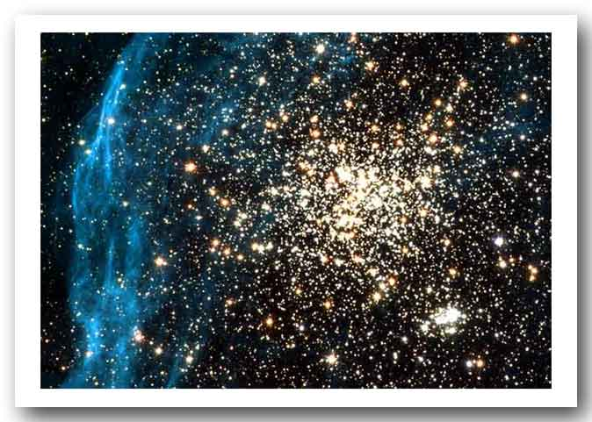

Digital Transformations Ltd.
presents

Slide 3
The Early Years of the Bahá’í Faith in the West
1890 - 1912

Slide 4
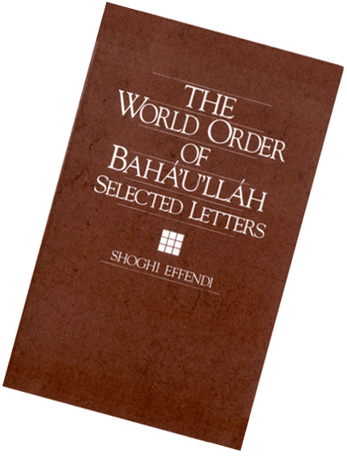
In The World Order of Bahá’u’lláh Shoghi Effendi directs our attention to the earliest years of the Cause in America in his 1933 letter, “America and the Most Great Peace.”

Slide 5
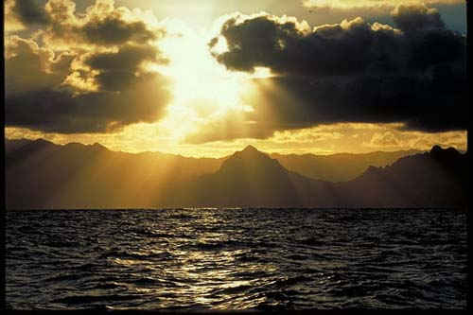
"The East hath verily been illumined with the light of the Kingdom. Ere long will this same light shed a still greater illumination upon the West. … Rejoice, therefore, O denizens of America, rejoice with exceeding gladness!"

Slide 6
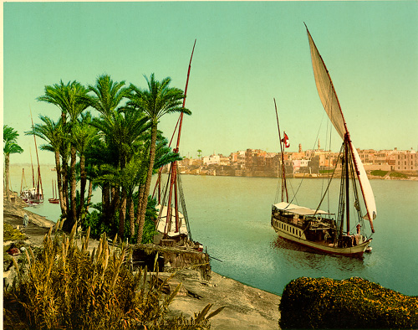
Our story begins in the late 1880s in Cairo, Egypt.

Slide 7
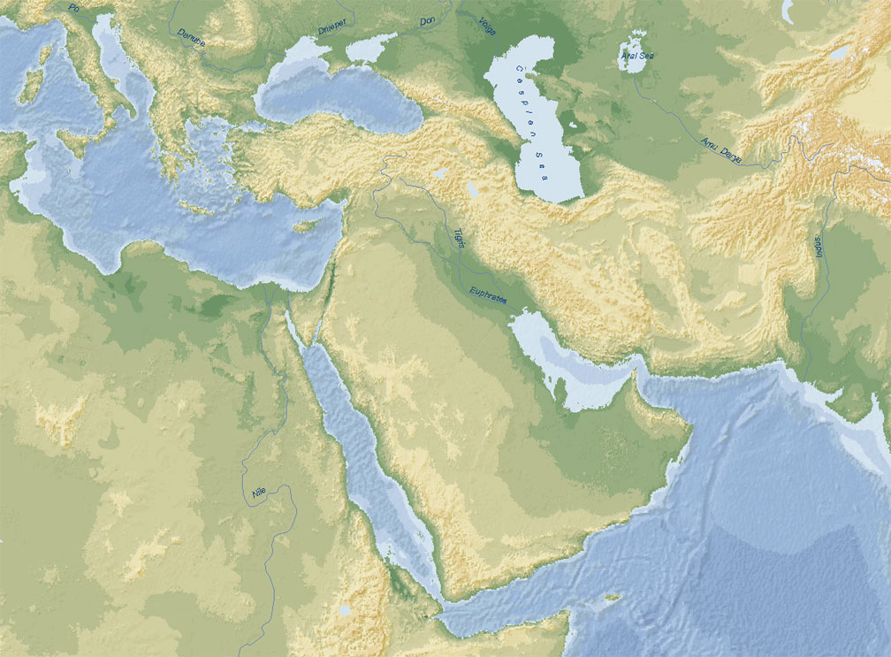
Turkey
OTTOMAN EMPIRE
Persia
Syria
Egypt
Arabia

Slide 8
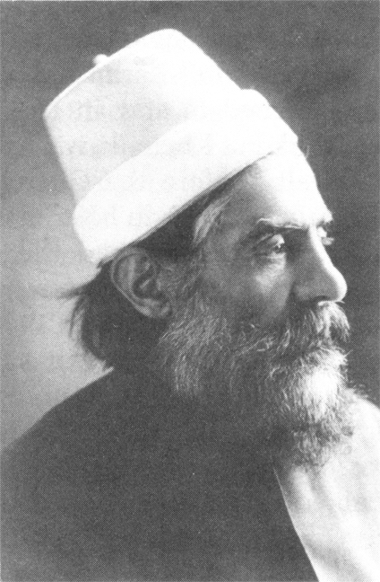
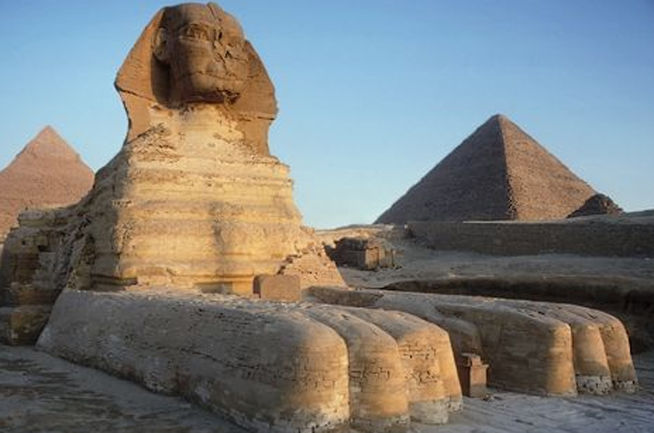
‘Abdu’l-Karím-i-Tihrání Persian merchant living in Cairo

Slide 9
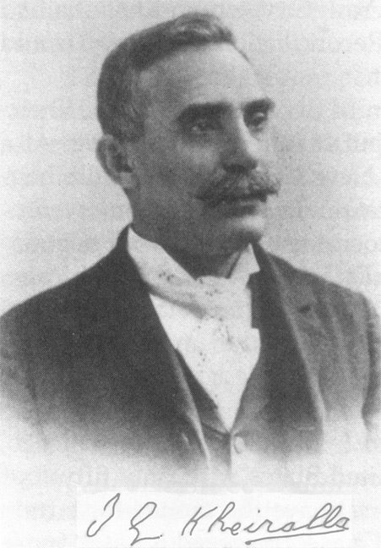
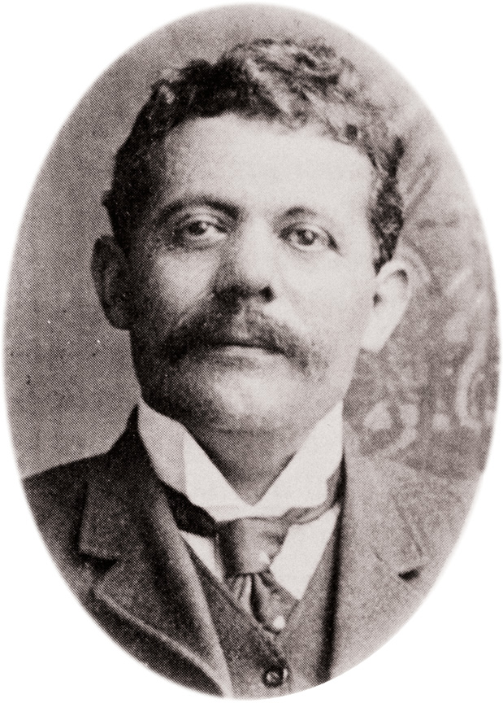
Ibrahim George Kheiralla 1849-1929
Anton Haddad 1862-1924

Slide 10
Both became Bahá’ís and eventually travelled to the United States in 1892.
Ibrahim George Kheiralla
Anton Haddad

Slide 11
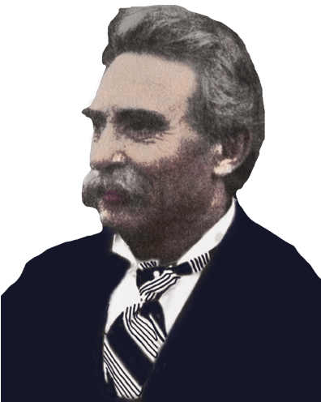
Ibrahim Kheiralla became a Bahá’í in 1890. He received a Tablet from Bahá’u’lláh that urged him to be “charitable, upright and pious, holding fast to that which will draw you nearer to God…”
Four years later he became the first Bahá’í teacher in America.

Slide 12
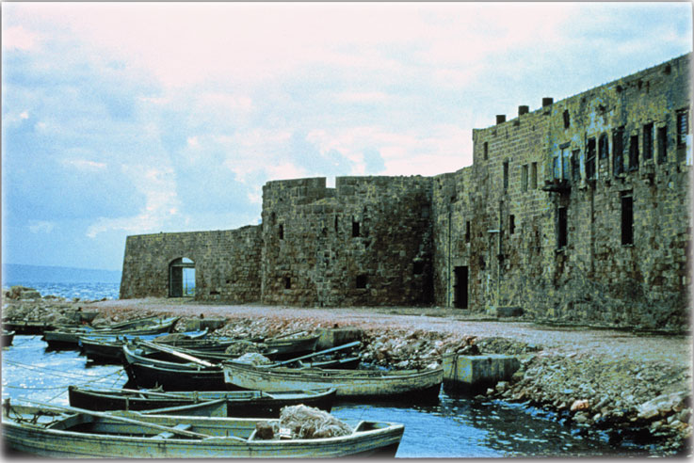
‘Akka, Syria
April 1890

Slide 13
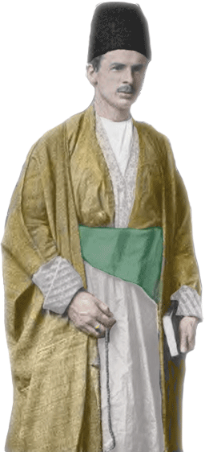
Prof. Edward Granville Browne of Cambridge University who had come to the Holy Land to interview Bahá’u’lláh as part of his scholarly work as an orientalist.
He had just come from visiting Mírzá Yahya—the Arch-Breaker of the Báb’s Covenant—in Famagusta, Cyprus.

Slide 14
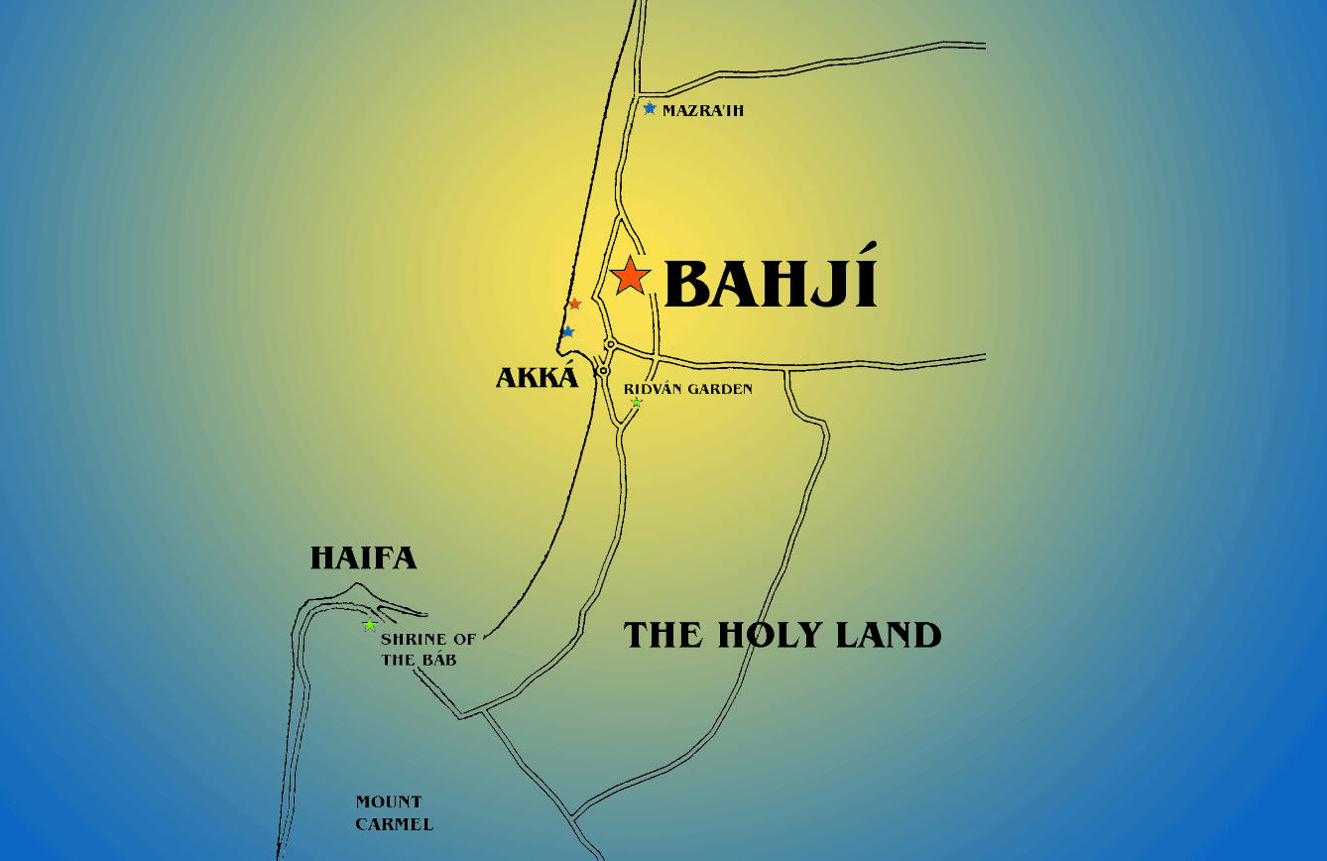
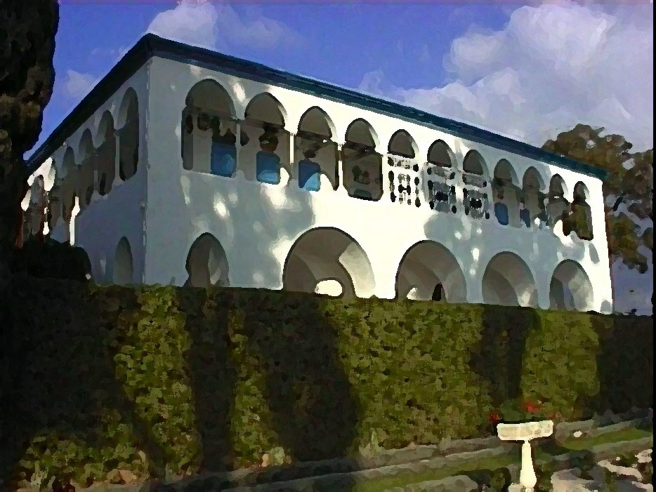
Mediterranean Sea

Slide 15
…[H]ere did I spend five most memorable days,… … It was in truth a strange and moving experience, but one whereof I despair of conveying any save the feeblest impression.

Slide 16
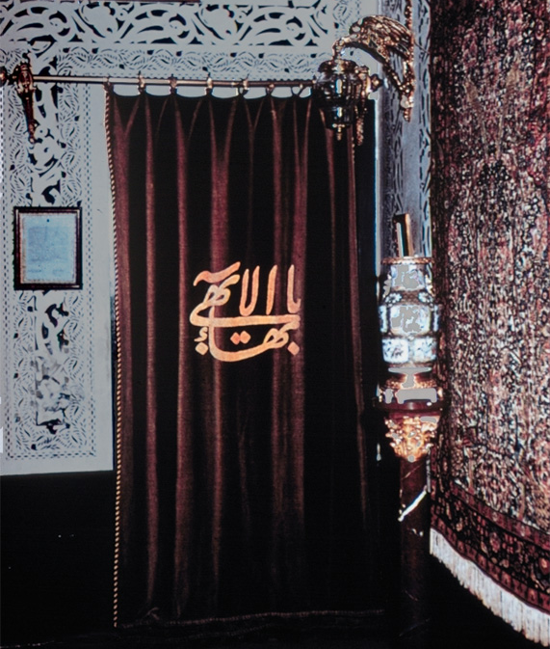
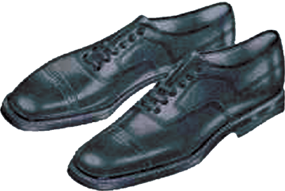
. . . My conductor paused for a moment while I removed my shoes. Then, with a quick movement of the hand, he withdrew, and, as I passed replaced the curtain …

Slide 17
…A second or two elapsed ere, with a throb of wonder and awe, I became definitely conscious that the room was not untenanted.

Slide 18
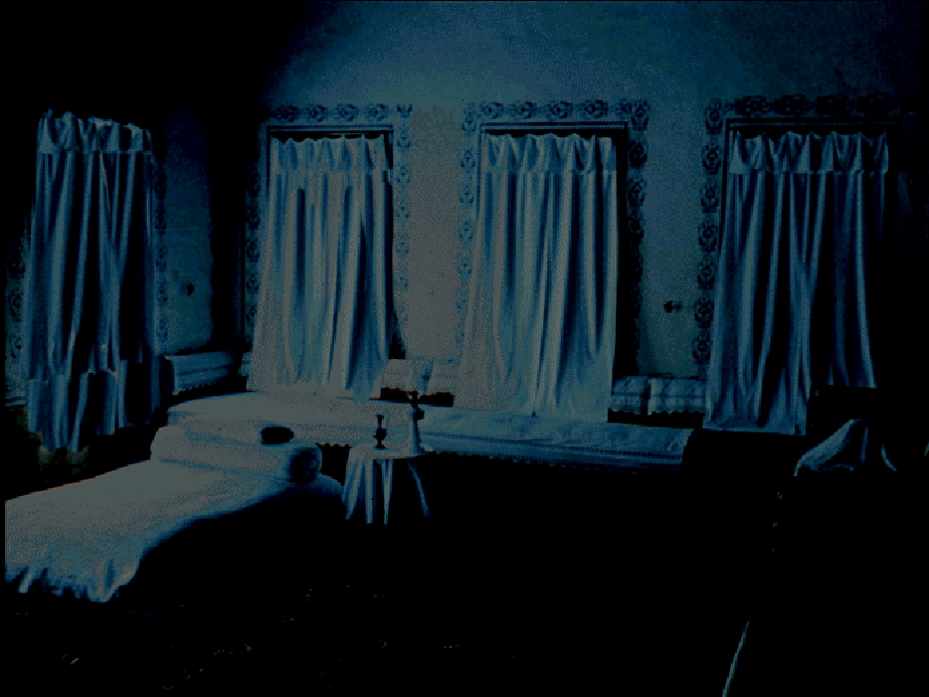

In the corner where the divan met the wall sat a wondrous and venerable figure ….

Slide 19
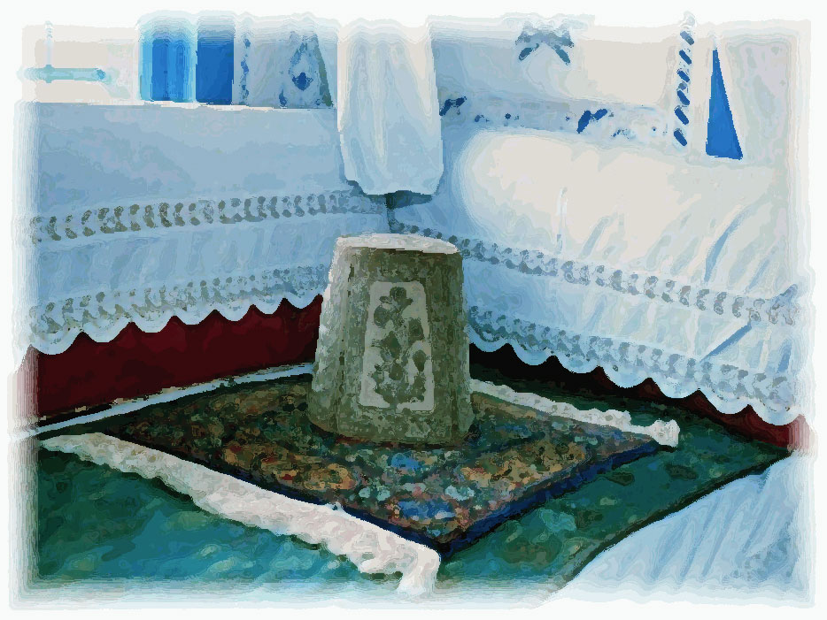

Slide 20
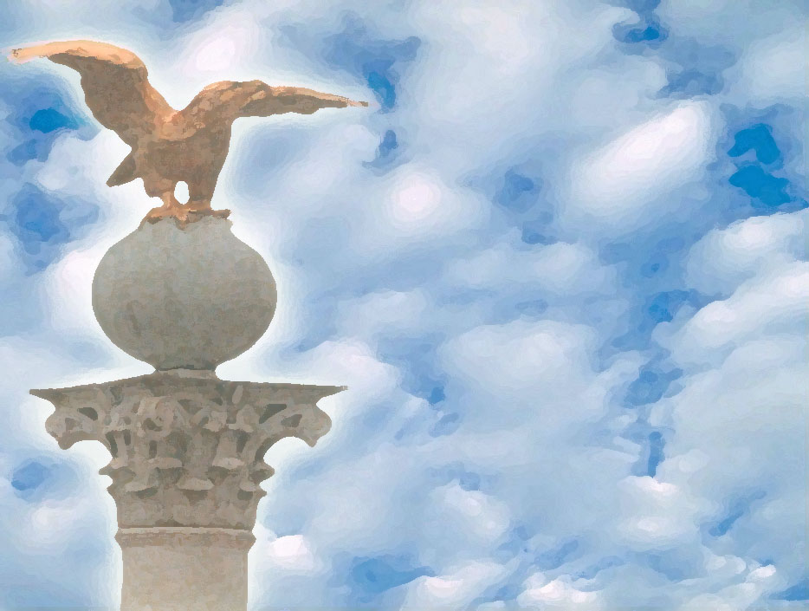
THAT all nations should become one in faith and all men as brothers; that the bonds of affection and unity between the sons of men should be strengthened;

Slide 21
that diversity of religion should cease and differences of race be annulled –
What harm is there in this?

Slide 22
. . . These fruitless strifes, these ruinous wars shall pass away, and the 'Most Great Peace' shall come . . .

Slide 23
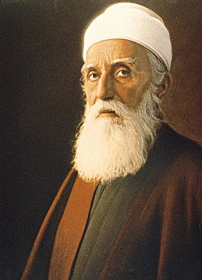
“Seldom have I seen one whose appearance impressed me more. A tall strongly-built man holding himself straight as an arrow. … About the greatness of this man and his power no one who had seen him could entertain a doubt.”
Prof. Browne was also greatly impressed with meeting ‘Abdu’l-Bahá.

Slide 24
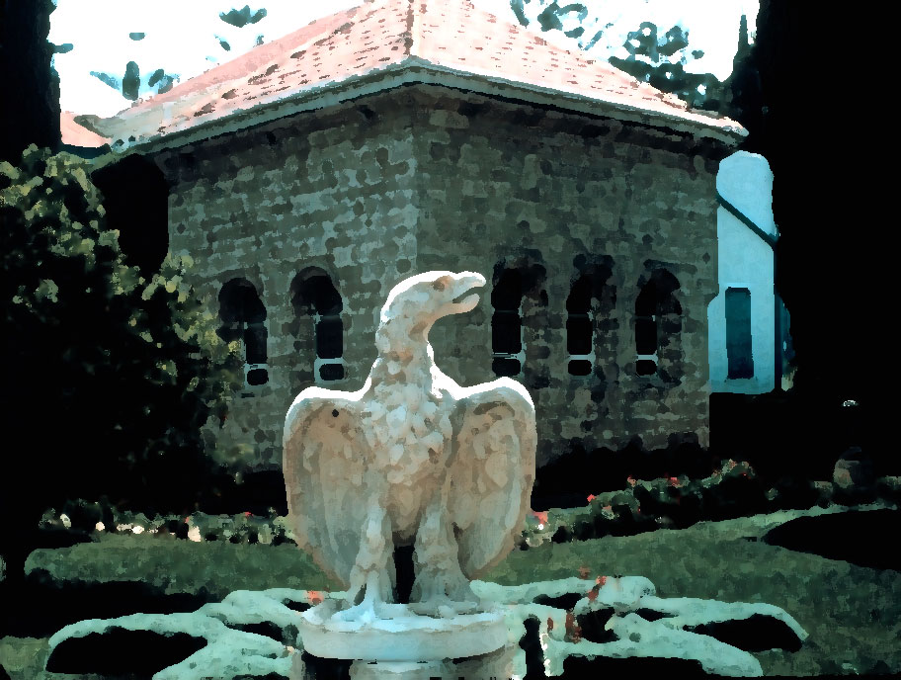

Slide 25
‘ABDU’L-BAHÁ CENTRE OF THE COVENANT
***
HEAD OF THE BAHÁ’Í FAITH FROM 1892-1921

Slide 26
USA
Russia
Just 11 days after Bahá’u’lláh’s passing Haddad headed for America.
He and Kheiralla had a business arrangement. Haddad was to go to America to sell Kheiralla’s ticket invention. Kheiralla went to Russia and joined Haddad later in the U.S.

Slide 27
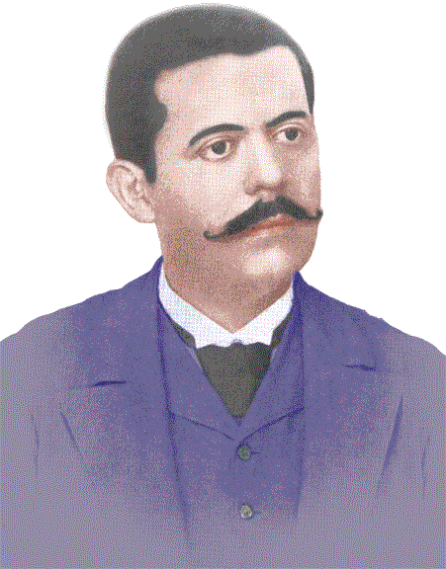
When Haddad reached America in the summer of 1892, he became the first Bahá’í to set foot on American soil.

Slide 28
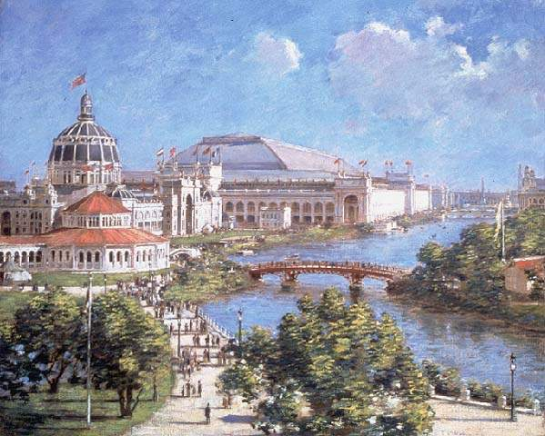
FIRST PUBLIC MENTION of the BAHÁ’Í FAITH IN THE WEST Chicago September 1893

Slide 29
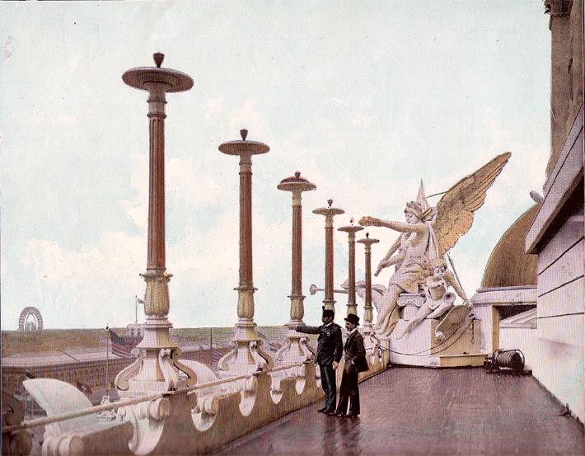
Columbian Exposition
The Chicago World’s Fair of 1893

Slide 30
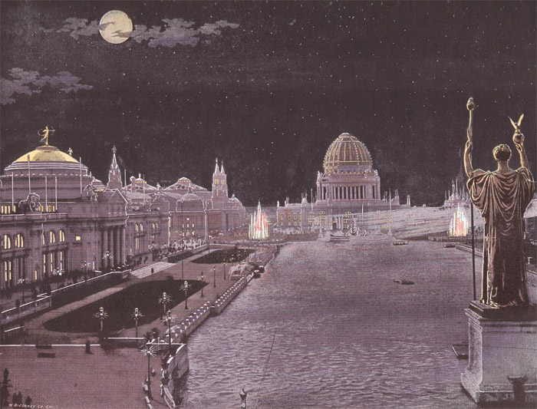
‘The White City’

Slide 31
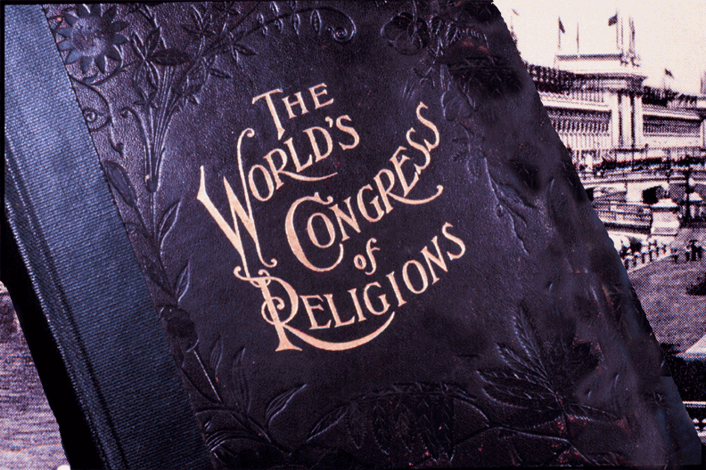

Slide 32
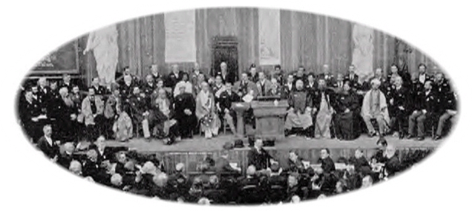
REPRESENTATIVES OF THE WORLD’S RELIGIONS

Slide 33
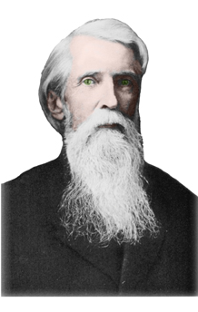
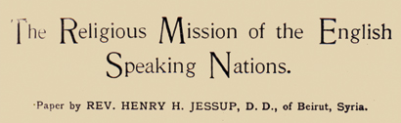
"In the palace of Bahji, or Delight, just outside the fortress of Acca, on the Syrian Coast, there died, a few months since, a famous Persian sage named BAHA'O'LLAH—the Glory of God. "Three years ago he was visited by a Cambridge scholar to whom he uttered sentiments so noble, so Christ-like that we repeat them as our closing words— 'We desire but the good of the world and the happiness of the nations—that all nations should become one in faith and all men as brothers; that the bonds of affection and unity between the sons of men should be strengthened; that diversity of religion should cease and differences of race be annulled—and so shall it be; these fruitless strifes, these ruinous wars shall pass away, and the most great peace shall come.
The Rev. Henry H. Jessup

Slide 34
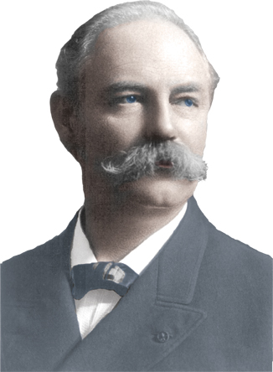
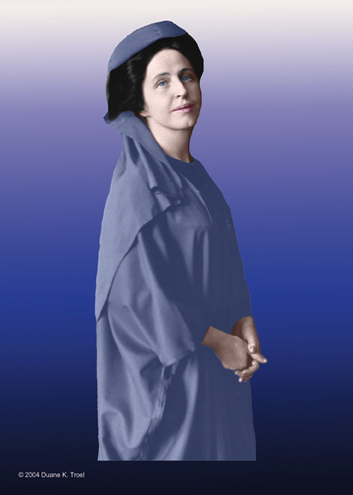
Both Thornton Chase–first American Bahá’í–and Lua Getsinger–’Mother teacher of the West’–trace their first contact with the Bahá’í Faith back to the 1893 World Parliament of Religions.

Slide 35
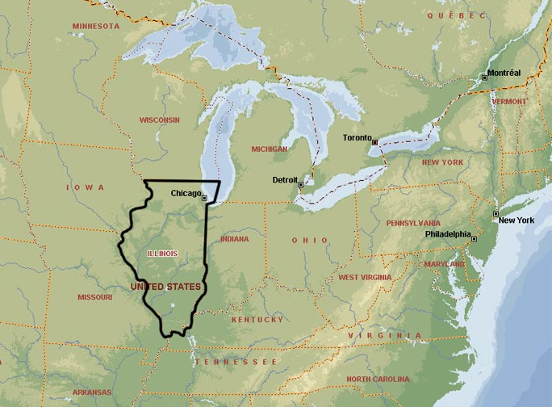
By Feb. 1894 he had settled in Chicago.
Ibrahim Khayru’llah arrived NYC Dec. 1892.

Slide 36
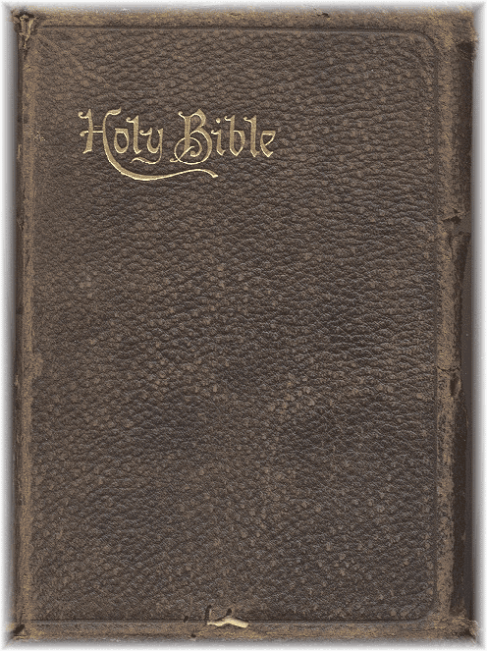
In 1894 Khayru’llah began offering 13 secret lessons on the Bahá’í Faith. Almost the entire course was invented by him. He did use the Bible as a reference for some of his interpretations of prophecy and doctrine.

Slide 37
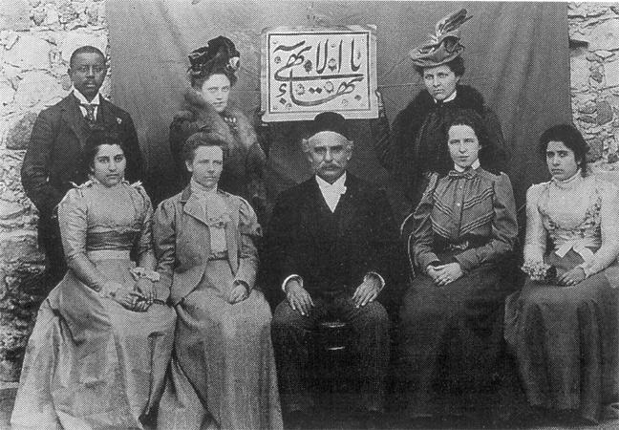
Although he did accept Bahá’u’lláh he knew very little about His teachings. Kheiralla taught his own erroneous version of the Bahá’í Faith:
Bahá’u’lláh was God incarnate.
‘Abdu’l-Bahá was Christ returned.
Abraham had founded Hinduism.
Bahá’ís believed in reincarnation!
Kheiralla purchased a bogus “Dr.” degree for $20.00 and used the title for the rest of his life.
There was no mention of Bahá’í ethical teachings, Bahá’í administration, and almost no Sacred Writings.

Slide 38
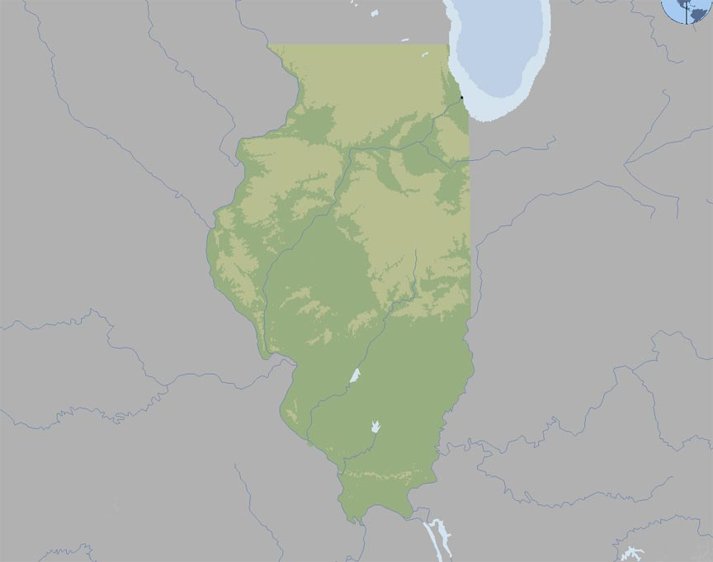
WISCONSIN
CHICAGO
IOWA
INDIANA
ILLINOIS
First state where the Faith was taught
MISSOURI
KENTUCKY

Slide 39
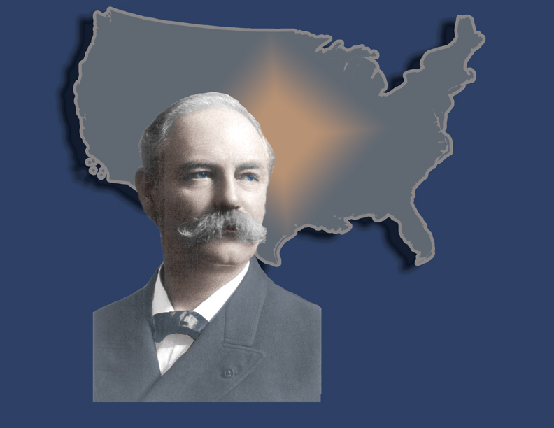

Slide 40
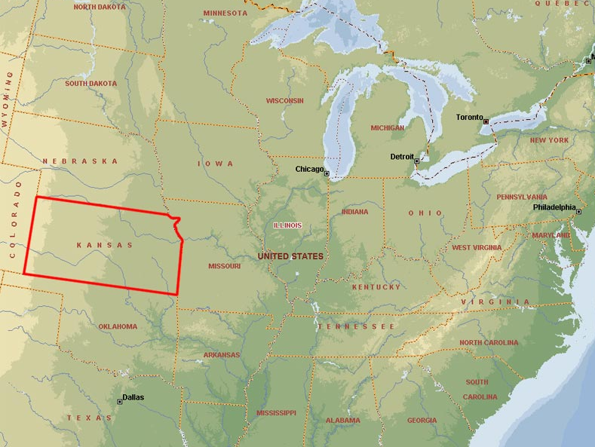

Slide 41
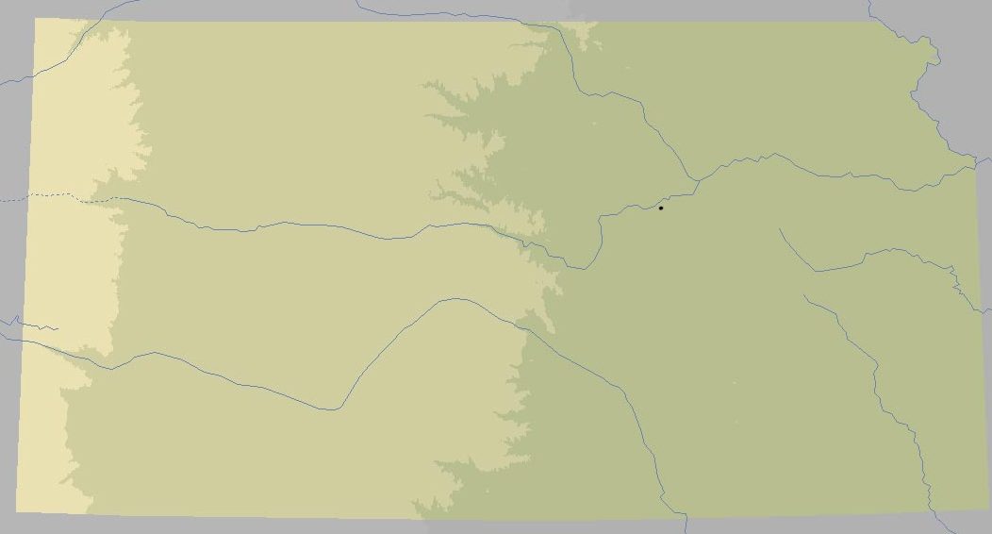
N E B R A S K A
K A N S A S
Second state where the Faith was established.
MO.
ENTERPRISE
C O .
TEXAS

Slide 42
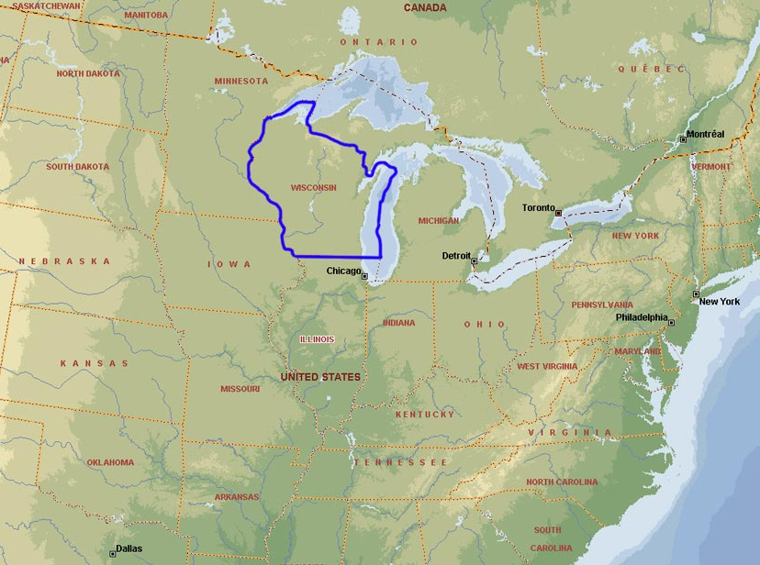

Slide 43
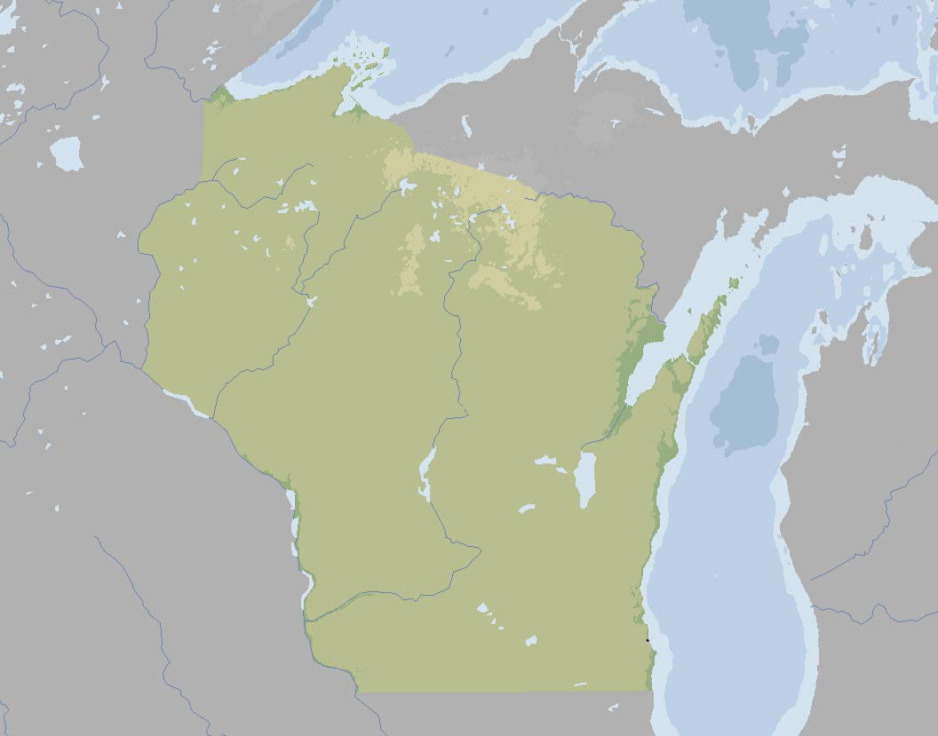
M N .
M I C H I G A N
W I S C O N S I N
Third U.S. state where the Faith was taught and a community established.
M I C H .
I O W A
KENOSHA
I L L I N O I S

Slide 44
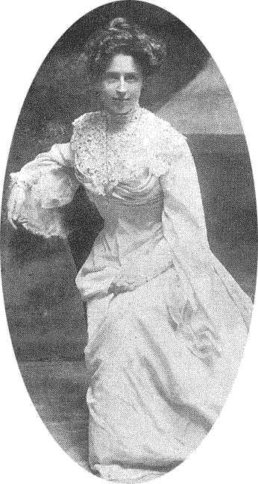
Louisa Aurora Moore embraced the Bahá’í Faith 21 May 1897.
Five days later she married Edward Getsinger.

Slide 45
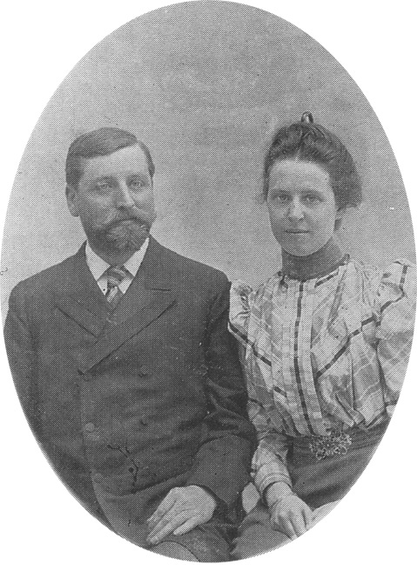
I daresay most American Bahá’ís in this room can trace their spiritual lineage back to Lua.

Slide 46
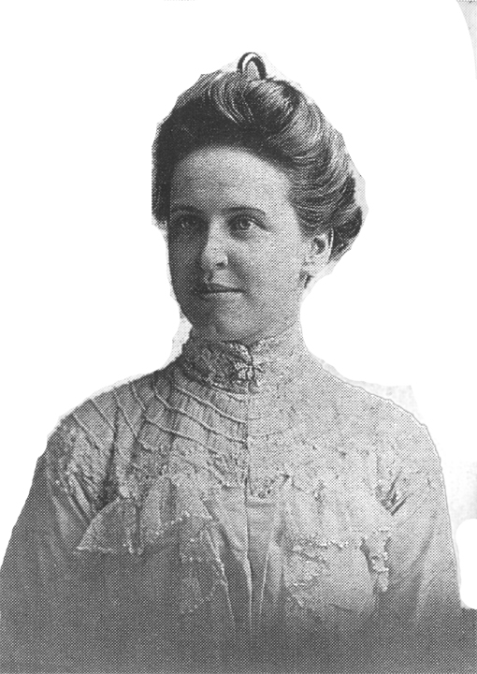
Almost immediately after her declaration Lua began to teach.

Slide 47
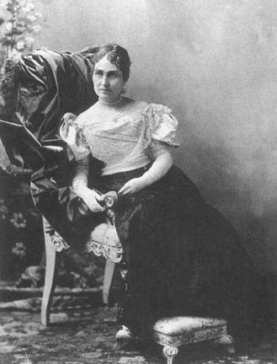

Slide 48
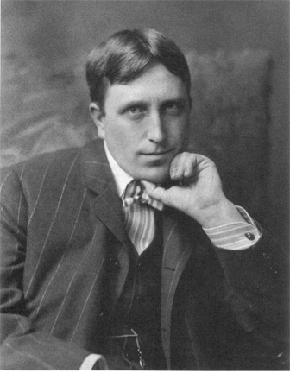
William Randolph Hearst
“Citizen Kane”

Slide 49
S O M E E A R L Y B A H Á ’ Í S
of the W E S T

Slide 50
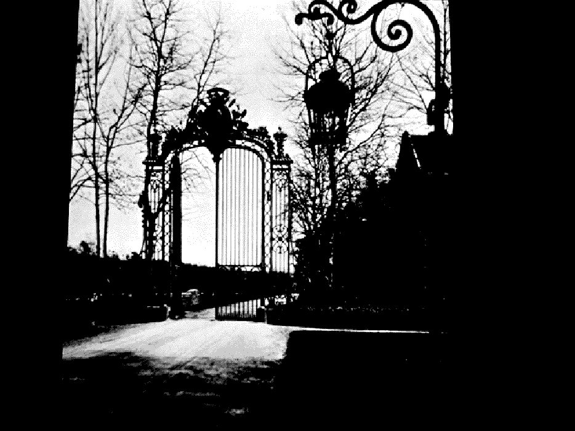
PARIS
November 1898

Slide 51
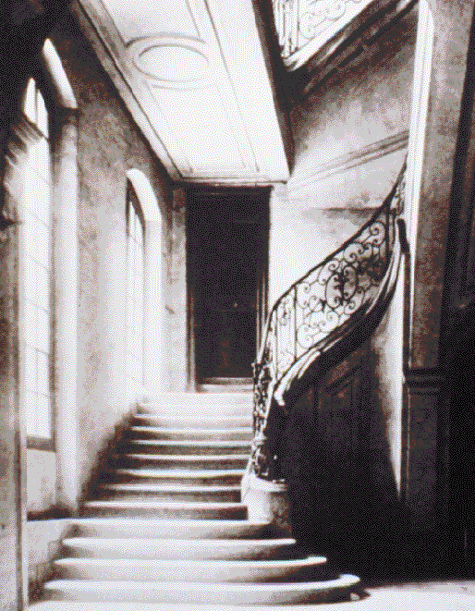
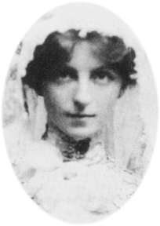
May Bolles

Slide 52
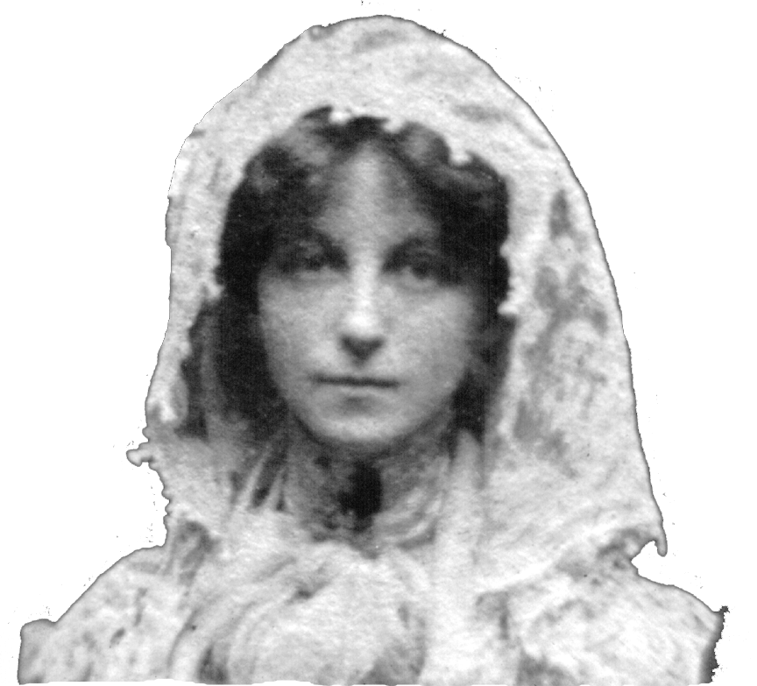
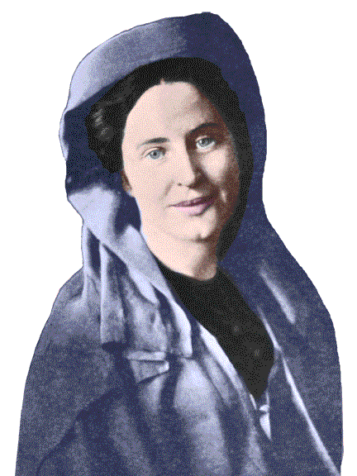
May Bolles
Lua Getsinger

Slide 53


Slide 54



Slide 55


Slide 56
RobertTurner
Dr Kheiralla
Marion Miller Kheiralla
Kheiralla’s daughter
Kheiralla’s daughter
Lua M. Getsinger
FIRST WESTERN PILGRIMS – NOV 1898 MAR 1899

Slide 57

Kheiralla and his family had gone ahead from Cairo to ‘Akka with Lua’s petition for ‘Abdu’l-Baha’s permission to come on pilgrimage. He granted her wish and Lua’s group arrived in Haifa on 8 December 1898.
Haifa & Mt. Carmel in the late 1800s

Slide 58

… We took a carriage after night had fallen, and drove along the hard sand … which led us to the gates of the prison city.

Slide 59



…[W]e started up the uneven stairs that led to Him. Someone went before us with a small piece of candle, which cast strange shadows on the walls of this silent place.
Suddenly the light caught a form that at first seemed a vision of mist and light. It was the Master…. His white robe, and silver, flowing hair, and shining blue eyes gave the impression of a spirit, rather than of a human being.”

Slide 60


Lua said, We stood for a moment “unable to move—then my heart gave a great throb and scarcely knowing what I was doing I held out my arms, crying: “My Lord, my Lord!” and rushed to Him kneeling at His Blessed Feet, sobbing like a child… … He put His dear hand on our bowed heads and said, in a voice that seemed … like a strain of sweet music, “Welcome, welcome, my dear children, …”

Slide 61

"OF THAT first meeting, I can remember neither joy nor pain, nor anything that I can name. I had been carried suddenly to too great a height, my soul had come in contact with the Divine Spirit, and this force, so pure, so holy, so mighty, had overwhelmed me ... We could not remove our eyes from His glorious face … existence seemed suspended; and when He arose and suddenly left us, we came back with a start to life; but never again, oh! never again, thank God, the same life on this earth.”
May Bolles

Slide 62

The Greatest Holy Leaf

Slide 63

Bahji around the turn of the century.

Slide 64


Most Holy Tomb

Slide 65
While Lua and May and the other Western pilgrims were attaining heights of spiritual ecstasy, the principle of light and darkness was at work in the heart of Ibrahim Kheiralla.

Slide 66


“Baha’s Peter”

Slide 67

Kheiralla proposed to Ibn Abhar—one of the Hands of the Cause of God—his notion that God has a personality. Abhar disagreed and placed the matter before ‘Abdu’l-Bahá Who explained this was not so. By this and the Master’s other clarifications of Bahá’í beliefs, Kheiralla realized his manuscript would not be approved.
Haji Mírzá Muhammad-Taqí-i-Abhari (1853/4-1919)

Slide 68
Lua’s husband, Edward, did not help matters by baiting Kheiralla and bringing up the subject of reincarnation in the presence of ‘Abdu’l-Bahá to hear it refuted. Kheiralla got angrier and angrier—and it became apparent later—refused to alter his views to conform to the true teachings of the Faith.
Dr. Edward Getsinger

Slide 69

On a more positive note, Robert Turner, Phoebe Hearst’s butler, dropped to his knees when he came face-to-Face with the Master crying, ‘My Lord! My Lord! I am not worthy to be here!” Whereupon the Master raised him to his feet and “embraced him like a loving father.” He became the first of his race in the West to embrace the Bahá’í Faith.
Mr. Robert Turner 1855-1909
‘Disciple of ‘Abdu’l-Bahá’

Slide 70

AFTER tearful farewells the pilgrims made their way back to America, while ‘Abdu’l-Bahá remained a Prisoner of the Ottoman Empire; though He once reminded us that the only prison was the ‘prison of self.’

Slide 71

Kheiralla reached New York on 1 May 1899. He had an untranslated copy of Bahá’u’lláh’s Hidden Words and spoke glowingly of the Master and His family.

Slide 72
Perhaps fearing the Getsinger’s would expose his many false teachings that had been corrected by the Master, he began to slander Lua and Edward to the friends.

Slide 73



The Getsingers returned to the US just 19 days after Kheiralla. They brought along, The Kitab-i-Aqdas; a voice recording of ‘Abdu’l-Baha; and His photograph. Instead of slandering Kheiralla they praised him to the skies. This caused Kheiralla to undermine his own credibility with the Bahá’ís.
1
Kitab-i-Aqdas
Voice recording of ‘Abdu’l-Bahá
2
3
Photograph of ‘Abdu’l-
Bahá as a young Man

Slide 74
ANOTHER CONTROVERSY
Is the Bahá’í Faith a ‘Movement’ or a religion to be organized?
Most Bahá’ís retained their membership & participation in their church or synagogue.
Many believed the Faith was never supposed to be organized feeling it was a zeit geist ‘spirit of the times’.
The Getsingers brought news from the Master that a House of Justice was to be established in every city & town.

Slide 75
A time of great testing had come for the American Bahá’í Community.
Their teacher—Ibrahim Kheiralla—was no longer the sole authority of Bahá’í knowledge. Many Americans had gone on pilgrimage and learned of the Faith from the Master Himself.
Kheiralla asked Haddad to write the Master and ask that He authorize the publication of his book “as the fundamental basis of the Behai teachings in America”
He wanted Tablets from the Master praising his work and commanding the American Believers to obey him.
These and other demands deeply concerned Haddad who informed Phoebe Hearst.

Slide 76


Mrs. Hearst financed Haddad to travel to ‘Akka and lay the matter before ‘Abdu’l-Bahá.

Slide 77
It was around this time that Kheiralla gave an interview to the New York Herald newspaper in which he announced that he was the head of the Bahá’í ‘centre’ in America.

Slide 78
Kheiralla initiated correspondence with Mírzá Muhammad ‘Alí—Arch-Breaker of Bahá’u’lláh’s Covenant. For the edition of his book published in 1900 carried photographs of …

Slide 79


Mírzá Muhammad ‘Alí (1853/4-1937) ‘Arch-Breaker of Bahá’u’lláh’s Covenant and half-brother of the Master.
Mírzá Badí’u’lláh (1853/4-1937)—another half-brother of the Master—and a vacillating Covenant-Breaker, who wrote a Confession of his deeds that is mentioned in The Will & Testament of ‘Abdu’l-Bahá.

Slide 80
In late December 1899 Haddad returned from ‘Abdu’l-Bahá and wrote “A Message From ‘Akka” which emphasized the spiritual requirements of Bahá’í teachers and suggested that believers should not claim special distinctions for themselves. And though ‘Abdu’l-Bahá was loving and forgiving towards Kheiralla and sent him Tablets—Kheiralla was outraged.

Slide 81


Thornton Chase
Anton Haddad
In April 1900 ‘Abdu’l-Bahá sent ‘Abdu’l-Karím Tihrání—Kheiralla’s first teacher—to America to save Kheiralla and protect the Faith. He also did some valuable deepening.

Slide 82
By May 1900 matters had come to a head.
?
The believers were now obligated to choose between their first teacher—Kheiralla—and ‘Abdu’l-Bahá, appointed Center of the Covenant by Bahá’u’lláh and Authorized Interpreter of Bahá’í Scriptures and teachings.

Slide 83
The overwhelming majority of the Bahá’ís chose ‘Abdu’l-Bahá. The few who followed Kheiralla in his newly established “Church of the Manifestation” vanished within a decade.
Bahá’í enrollments had increased exponentially from 1894 to 1899. They now underwent a serious decline. The crisis divided the Bahá’í community into two groups.
Those who followed ‘Abdu’l-Bahá, and wished to be obedient to the Covenant.
Those who wanted nothing more to do with the Faith and left it “to seek religious satisfaction elsewhere.”

Slide 84


CONSOLIDATING INFLUENCES
Behai Publishing Board which printed The Hidden Words & eventually grew to become the Bahá’í Publishing Trust.
Visit (1901-1904) of Mírzá Abu’l-Fadl, foremost Bahá’í scholar in the world, and publication of his book “Bahá’í Proofs.”
Mírzá Abu’l-Fadl (1844-1914)

Slide 85


CONSOLIDATING INFLUENCES
Green Acre Bahá’í School founded by Sarah Jane Farmer. It was a rallying place for Bahá’ís and center of Bahá’í learning.
Mírzá Abu’l-Fadl gave classes at Green Acre.
Sarah Jane Farmer & Green Acre
(1847-1916)
Mírzá Abu’l-Fadl and his translator ‘Alí Kuli Khan.

Slide 86

CONSOLIDATING INFLUENCES
Anton Haddad
William Hoar
Hooper Harris
Howard MacNutt
Arthur Dodge
NYC Board of Counsel - 1900

Slide 87

When the Aqdas—brought back by the Getsingers—was translated it was seen that the administrative bodies were called “Houses of Justice;” the Boards changed their names accordingly. In 1902 ‘Abdu’l-Bahá advised that “Spiritual Assemblies” be used instead. Someday the name ‘Local House of Justice’ will replace ‘Local Spiritual Assembly.’

Slide 88


CONSOLIDATING INFLUENCES
Typed Tablets
Bahá’í House of Worship
Permission granted in 1903
HE IS GOD!
O Thou Almighty Lord!
Strengthen all mankind that they may do according …
The cornerstone of the ‘Ishqábád House of worship laid in 1902.
Laura Barney stands on Bahá’í Temple Land in Wilmette c1908.

Slide 89

Bahá’í Temple Unity - 1909

Slide 90



By an amazing coincidence that day—March 21st 1909—was the same day ‘Abdu’l-Bahá’í placed the remains of the Báb in His Shrine on Mt. Carmel.
Clothing and possessions of the Báb

Slide 91



CONSOLIDATING INFLUENCES
Bahá'í traveling teachers, authors and letter writers….
Isabella Brittingham
Lua Getsinger
Thornton Chase
May Maxwell
Martha Root

Slide 92


CONSOLIDATING INFLUENCES
Returning pilgrims
Shoghi Effendi
Lua Getsinger
Laura Barney
Ethel Rosenberg
"Blessed the man," He, moreover, as confirmed by Baha'u'llah, had declared, "that hath visited `Akka, and blessed he that hath visited the visitor of `Akka."
Claudia Coles
Charles Mason Remey
1901 PILGRIMS

Slide 93


CONSOLIDATING INFLUENCES
IN GALILEE
pilgrimage (1907)
(second half is “In Wonderland”
by Arthur Agnew)
Chase also wrote “Bahá’í Revelation” (1909)

Slide 94


Tarbíyat Bahá’í School Tihran
CONSOLIDATING INFLUENCES
Lillian Kappes (1878-1920)
Dr. Susan Moody (1851-1934)
Elizabeth Stewart (left 1922)
Dr Sarah Clock (d. 1922)
Dr Moody
Elizabeth Stewart
Lillian Kappes

Slide 95


Slide 96


Charles Mason Remey
Howard Struven
First global teaching trip
1909 -1910
Honolulu 1909

Slide 97


CONSOLIDATING INFLUENCES
Baha’i Bulletin
1908-1909
Star of the West began publication in March, 1910 and continued until March 1935.

Slide 98

STORYTELLING
MAY (NEE BOLLES) MAXWELL (1870-1940)
AGNES BALDWIN ALEXANDER (1875-1971)
THOMAS BREAKWELL
(1872-1902)
May Bolles

Slide 99

MAY MAXWELL
As a child she had a dream in which she experienced a flash of light so bright she was blinded for a day.

Slide 100
MAY MAXWELL
In another dream she saw the earth from space. A single word was written across the globe but the only two letters she could make out were “B” and “H.”
B H

Slide 101


May also experienced a vision in which a Man in eastern garb beckoned to to her from across the Mediterranean Sea.
MAY MAXWELL

Slide 102


MAY MAXWELL
When May reached Akka and met ‘Abdu’l-Bahá she was amazed to discover He was the same Man she had seen in her vision years before.

Slide 103


MAY MAXWELL
May Bolles – Paris 1901 – She became the “Heart” of the Paris Bahá’í community.

Slide 104

MAY MAXWELL
On August 8, 1910 she gave birth to Mary Sutherland Maxwell who would marry Shoghi Effendi in 1937. The Master once said of May, that association with her “uplifts and develops the soul.”

Slide 105


MAY MAXWELL
MAY MAXWELL WON A ‘DOUBLE CROWN’ OF MARTYRDOM ‘DESERVEDLY WON’ UPON HER PASSING IN BUENOS AIRES, ARGENTINA ON MARCH 1ST, 1940.
1870-1940

Slide 106

STORYTELLING
AGNES BALDWIN ALEXANDER (1875-1971)

Slide 107

AGNES ALEXANDER
Agnes around 1900.

Slide 108

AGNES ALEXANDER
By late November she was staying in a pension in Rome when she noticed a radiant lady and her two daughters.

Slide 109

Mrs. Charlotte Dixon of Maryland
AGNES ALEXANDER

Slide 110

AGNES ALEXANDER
THE THIRD evening after meeting with Mrs. Dixon, when I retired to my room, sleep did not come. That night an overwhelming realization came to me, which was neither a dream nor vision, that Christ had come on the earth.

Slide 111

AGNES ALEXANDER
The next morning Agnes said to Mrs. Dixon "Christ is on this earth!" She replied, "Yes, I can see by your face that you know it." 'Abdu'l-Bahá later wrote her in Tablet "By God, the Truth, the Spirit of Christ from the Supreme Concourse doth in every time and aspect announce to thee this Great Good News.”

Slide 112

AGNES ALEXANDER

Slide 113


AGNES ALEXANDER

Slide 114

AGNES ALEXANDER
1902
KANICHI YAMAMOTO
1879-1961
1st Japanese Bahá’í in the World

Slide 115

AGNES ALEXANDER
In 1964 Miss Alexander represented The Universal House of Justice at the election of the first National Spiritual Assembly of the Bahá’ís of the Hawaiian Islands.

Slide 116

AGNES ALEXANDER
“At this time, in the island of Hawaii, through the efforts of Miss Alexander, a number of souls have reached the shore of the sea of faith! Consider ye, what happiness, what joy is this! I declare by the Lord of Hosts that had this respected daughter founded an empire, that empire would not have been so great! For this sovereignty is eternal sovereignty and this glory is everlasting glory.”
-’Abdu’l-Bahá

Slide 117

STORYTELLING
THOMAS BREAKWELL (1872-1902)

Slide 118
THOMAS BREAKWELL
In the summer of 1901 May’s mother wanted her daughter to accompany her to Brittany. May said she could not. ‘Abdu’l-Bahá had told her she must not—under any circumstance—leave Paris at that time.

Slide 119

THOMAS BREAKWELL
Meanwhile a young Englishman—Thomas Breakwell—who was on holidays from his job in America was directed to meet May if he wanted to discuss spiritual topics.

Slide 120
THOMAS BREAKWELL
May did not mention the Faith by name at their first meeting. The next day he arrived and said, “When I was here yesterday, I felt a power, an influence that I had felt once before in my life, when for a period of three months I was continually in communion with God.”

Slide 121
THOMAS BREAKWELL
He said that the day before he had walked along the Champs Elysees when a wind came up and from that wind a “voice said, with an indescribable sweetness and penetration, 'Christ has come again! Christ has come again!‘” May then told him of the Faith and he accepted at once. He penned his declaration to ‘Abdu’l-Baha in these two lines:
'My Lord, I believe, forgive me,
Thy servant Thomas Breakwell.'

Slide 122
THOMAS BREAKWELL
The next day May posted Breakwell’s declaration to ‘Akka. That evening, before Breakwell’s letter could have reached ‘Akka, a cable came from ‘Abdu’l-Bahá which said,
YOU MAY LEAVE PARIS AT ANY TIME

Slide 123


THOMAS BREAKWELL
That same year Breakwell made a three day pilgrimage to his Lord. One of the Persian believers living there said of Breakwell’s visit,
'The fervour and the faith of this young man were so sublime in character that the blessed name of Breakwell shall ring throughout the centuries, and shall be remembered with deep affection in many chronicles.’

Slide 124
THOMAS BREAKWELL
Breakwell was a Bahá’í only one year when he died of tuberculosis in Paris. One of the believers in ‘Akka said that the Master seemed to be in some kind of mystic communication with him. Breakwell did not appeal for healing and said shortly before passing,
'Suffering is a heady wine … torments of the flesh have enabled me to draw much nearer to my Lord’

Slide 125

THOMAS BREAKWELL
One day in ‘Akka the Master suddenly turned to one of his secretaries and said, 'Have you heard?' 'No, Master,' I replied, He said:
'Breakwell has passed away. I am grieved, very grieved. I have revealed a prayer of visitation for him. It is very moving, so moving that twice I could not withhold my tears when I was writing it. You must translate it well, so that whoever reads it will weep.'

Slide 126

THOMAS BREAKWELL
O Breakwell, O my dear one!
Where now is thy fair face? Where is thy fluent tongue? Where thy clear brow? Where thy bright comeliness?
O Breakwell, O my dear one!
Where is thy fire, blazing with God's love? Where is thy rapture at His holy breaths? Where are thy praises, lifted unto Him? Where is thy rising up to serve His Cause?

Slide 127
THOMAS BREAKWELL
O Breakwell, O my dear one!
Where are thy beauteous eyes? Thy smiling lips?
Thy princely cheek? Thy graceful form?
O Breakwell, O my dear one!
Thou hast quit this earthly world and risen upward to the Kingdom, thou hast reached unto the grace of the invisible realm, and offered thyself at the threshold of its Lord.
O Breakwell, O my dear one!

Slide 128

THOMAS BREAKWELL
THOMAS BREAKWELL was a Bahá’í only one year but was so transformed that his name will live forever.
When Hand of the Cause of God George Townshend died Shoghi Effendi said that Townshend would rank as one of the “three luminaries” of the United Kingdom along with Thomas Breakwell and Dr John Esslemont.

Slide 129
Young Turk Revolution of 1908
‘Abdu’l-Bahá began His
Western Tour 1911-1913

Slide 130

‘Abdu’l-Bahá’s
Visit to America
April – December 1912
A FEW VIGNETTES OF HIS SOJOURN IN AMERICA

Slide 131

The Apostles of Bahá’u’lláh

Slide 132

ABDU’L-BAHÁ ARRIVED 11 APRIL 1912

Slide 133


Martha Root arranged a public meeting at the Hotel Schenley in Pittsburgh where 400 heard Him speak!
7 May 1912

Slide 134

Single Tax Movement asked the Master for a message for their members.

Slide 135


‘Abdu’l-Bahá & Sarah Jane Farmer - 1912

Slide 136


THE APPOINTMENT
of the
HERALD
of the
COVENANT

Slide 137

The Master in Juliet Thompson’s studio with Lua on 5 July 1912
Juliet Thompson 1873-1956

Slide 138

The Master had sat a number of times for Juliet to paint Him. On this day He closed His eyes as if sleeping.
“Suddenly, with a great flash like lightening He opened His eyes and the room seemed to rock like a ship in a storm… Lua and I sat shaking and sobbing.”

Slide 139
He spoke to Lua.
“I appoint you, Lua, Herald of the Covenant. And I AM THE COVENANT appointed by Bahá’u’lláh. . . . Go forth and proclaim, ‘This is THE COVENANT OF GOD in your midst.’”

Slide 140
“A great joy had lifted Lua up. Her eyes were full of light. She looked like a winged angel. “O recreate me,” she cried, “that I may do this work for Thee!”
“Juliet too wants to be recreated.”
Juliet

Slide 141

Enroute to Visit
ALEXANDER GRAHAM BELL
‘Abdu’l-Bahá’s automobile

Slide 142

'O Baha'u'llah! What hast Thou done!
O Baha'u'llah! May my life be sacrificed for Thee!
O Baha'u'llah! May my soul be offered up for Thy sake!
How full were Thy days with trials and tribulation! How severe the ordeals Thou didst endure! How solid the foundations Thou hast finally laid, and how glorious the banner Thou didst hoist.'
ALEXANDER
GRAHAM BELL

Slide 143
The Master Dedicates
the Bahá’í House of Worship in Wilmette, Illinois
May 1, 1912

Slide 144


'Abdu'l-Baha laid the cornerstone of the Mashriqu'l-Adhkár in Chicago. The stone had been brought to the building site with great difficulty by Mrs. Nettie Tobin, a believer who had no money and nothing else to offer.

Slide 145

[Jesus said]
‘And have ye not read this scripture; The stone which the builders rejected is become the head of the corner’
-Mark 12:10

Slide 146

The Master visits the Maxwell home in Montreal, Canada

Slide 147

May Bolles Maxwell
William Sutherland Maxwell

Slide 148

“Today I was resting on the chaise longue in my bedroom. The little girl came in to me and pushed my eyelids up with her small finger and said, …

Slide 149


“Wake up, ‘Abdu’l-Bahá!’ I took her in my arms and placed her head on my chest and we both had a good sleep.”
2 year old Mary

Slide 150

In the garden of existence a rose hath bloomed with the utmost freshness, fragrance and beauty. Educate her according to the divine teachings so that she may grow up to be a real Bahá’í and strive with all thy heart that she may receive the Holy Spirit.
—’Abdu’l-Bahá

Slide 151

‘Abdu’l-Bahá’s Travels West & Back
Minneapolis
Buffalo
Salt Lake City
Omaha Lincoln
Chicago
San Francisco
Denver
Wash. D.C.
Cincinnati
Los Angeles
Sept 12 – 6 Nov 1912

Slide 152

The Master Visits the Grave
of
THORNTON CHASE
FIRST AMERICAN BELIEVER

Slide 153



Mahmud

Slide 154


Slide 155


Slide 156


Slide 157



Slide 158

‘Abdu’l-Bahá “the incarnation of every Baha'i virtue and the embodiment of every Baha'i ideal, continued for three crowded years to trumpet to a world sunk in materialism and already in the shadow of war, the healing, the God-given truths enshrined in His Father's Revelation.”

Slide 159


Slide 160
THE END

Slide 161
This program was written, narrated and produced by Duane K. Troxel for
Digital Transformations Ltd.
© 2007 Duane K. Troxel
DrTroxel@Netscape.com
847-868-4090
PLEASE DO NOT MAKE ILLEGAL COPIES OF THIS PROGRAM

