Slide 1
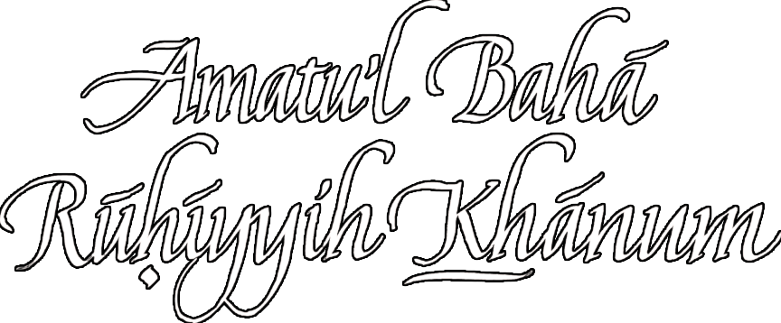

Slide 2


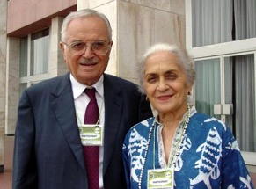
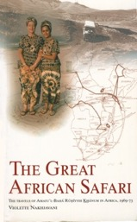


Some Sources Consulted for this Presentation
NOW FREE http://www.
bahaiebooks.org/
Five Books by Mrs. Violette
Nakhjavani
(shown with Mr. ‘Ali Nakhjavani, her husband).

Slide 3
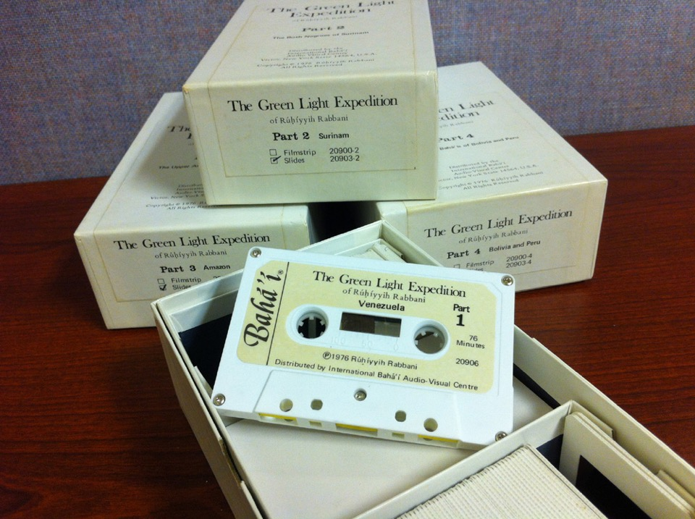
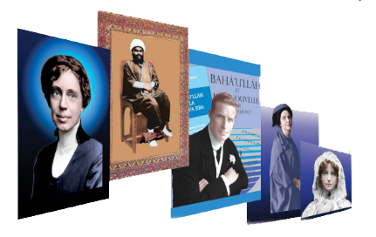
The Baha’i Heritage Project
http://heritage.bahai.us/about/

Slide 4
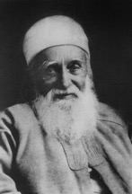
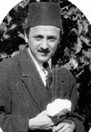
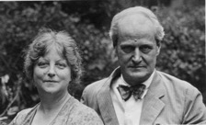
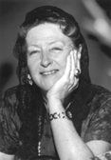
‘Abdu’l-Bahá (1844-1921)
Shoghi Effendi Rabbani (1897-1957)
May Maxwell (1870-1940)
William Sutherland Maxwell (1874-1952)
Mary Maxwell (1910-2000)
‘Amatu’l-Bahá Rúhíyyih
Khánum

Slide 5
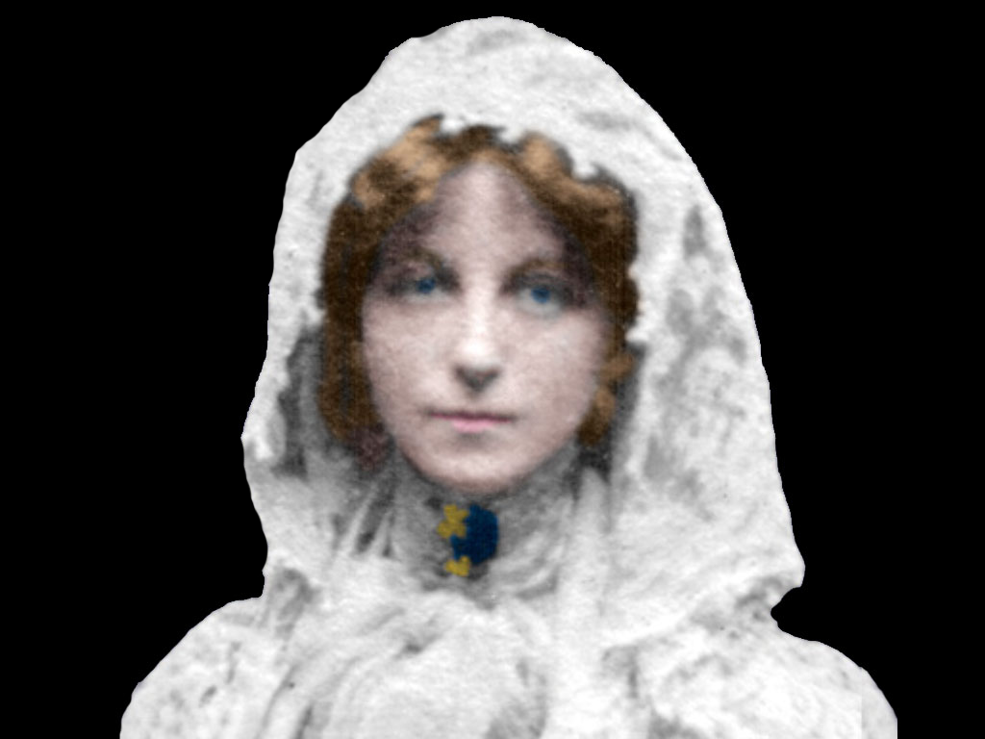
May Ellis Bolles (Maxwell) 1870-1940)

Slide 6
May Ellis Bolles (Maxwell) 1870-1940)

Slide 7

As a child she had a dream in which she experienced a flash of light so bright she was blinded for a day.

Slide 8
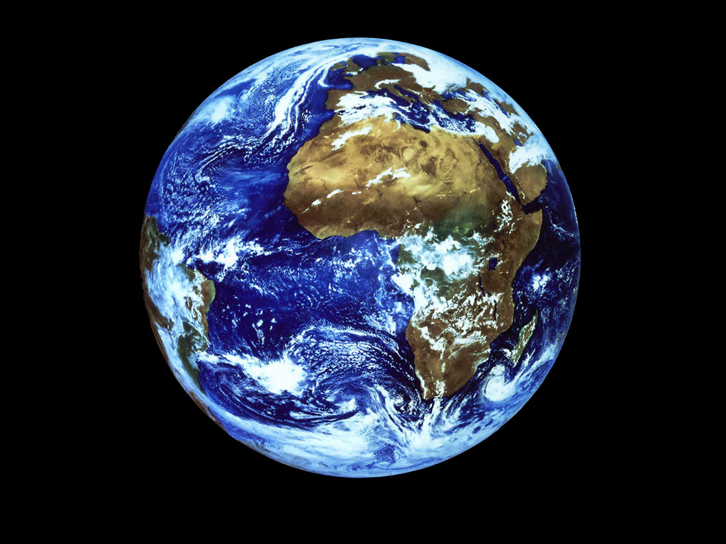
In another dream she saw the earth from space. A single word was written across the globe but the only two letters she could make out were
“B” and “H”

Slide 9
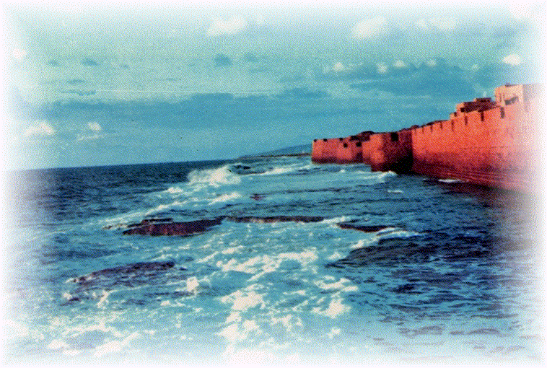
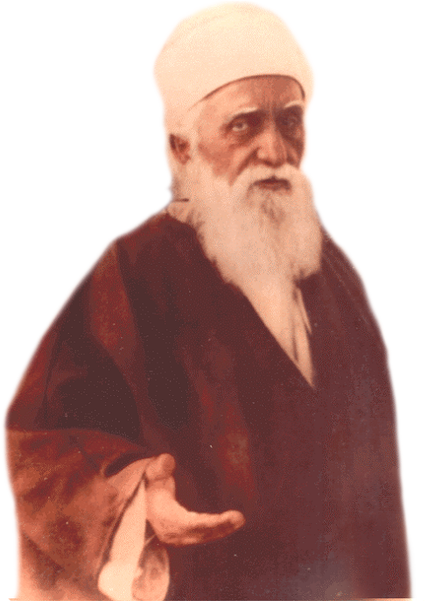
May also experienced a vision in which a Man in eastern garb beckoned to to her from across the Mediterranean Sea.

Slide 10
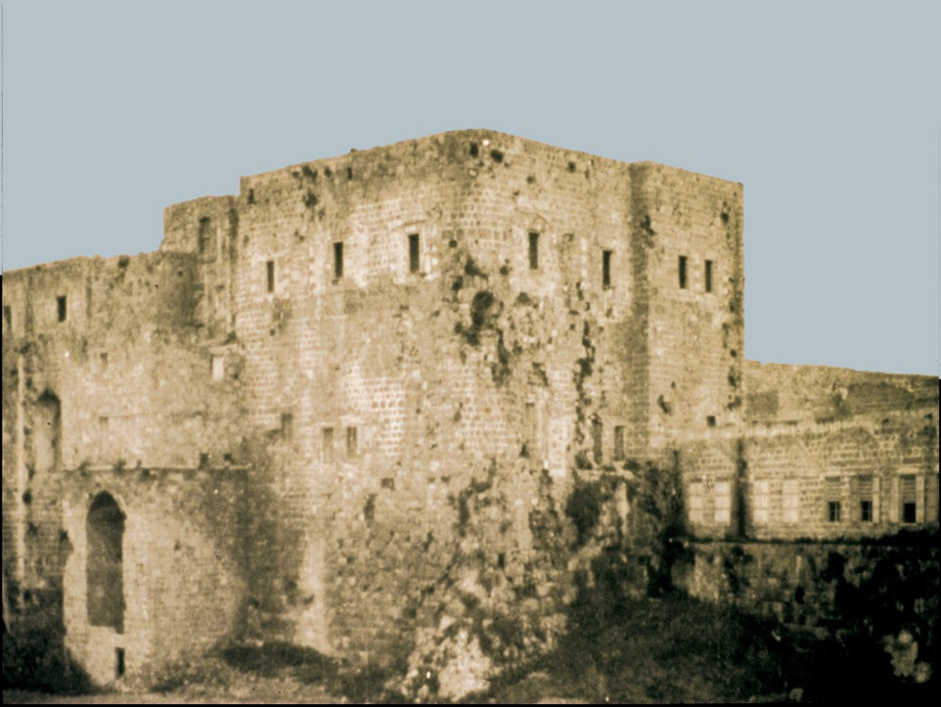
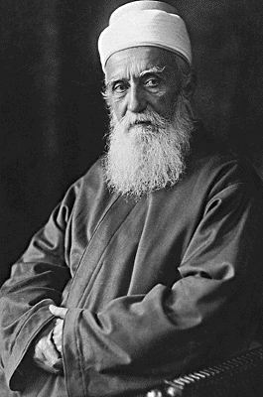
When May reached Akka and met ‘Abdu’l-Bahá she was amazed to discover He was the same Man she had seen in her vision years before.

Slide 11
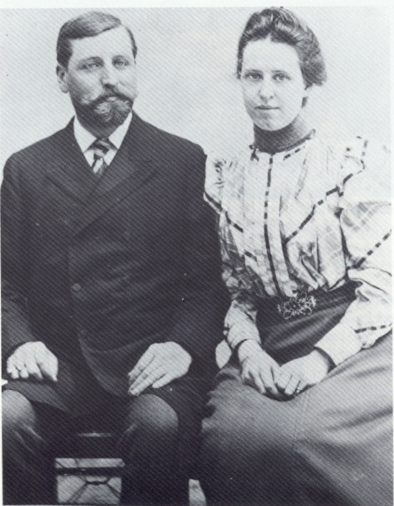
Edward & Lua Getsinger were among the the earliest Bahá’ís of North America.

Slide 12
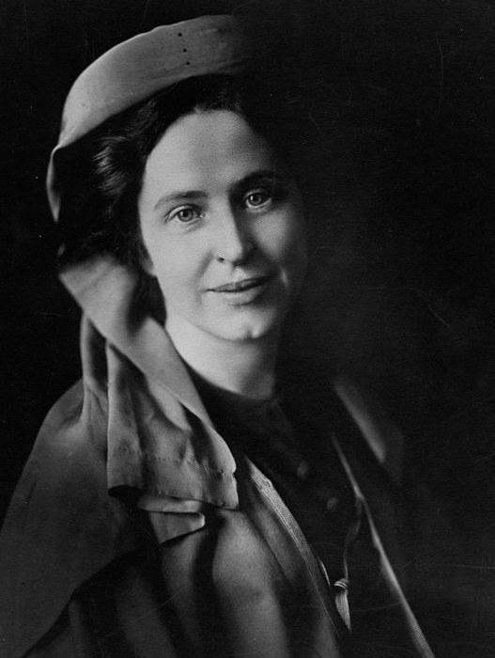
Louisa (“Lua”) Aurora Moore Getsinger
(1871-1916)
‘Herald of the Covenant’ ‘Mother Teacher of the West’

Slide 13
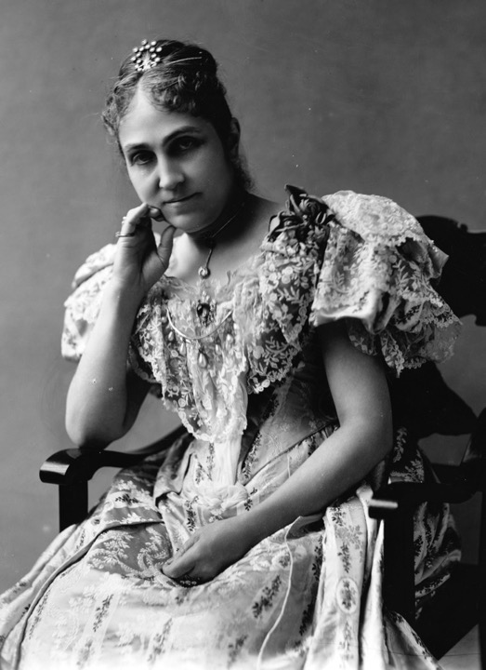
Phoebe Hearst (1842-1919)
Financed the First Western Pilgrimage of 1898-1899

Slide 14
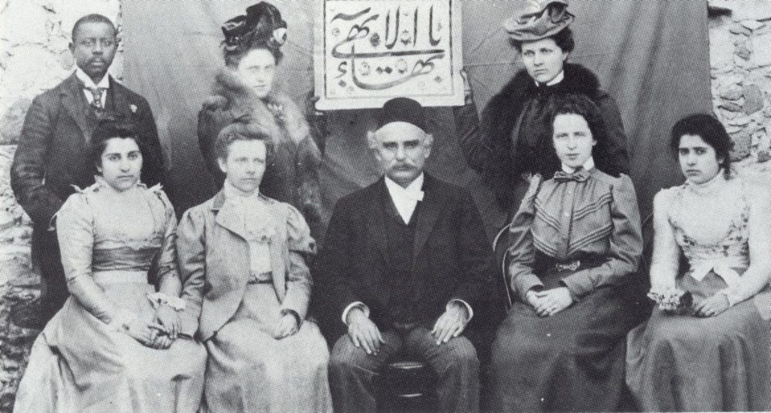
First Western Pilgrims
(Mrs. Hearst not in this photo.)

Slide 15
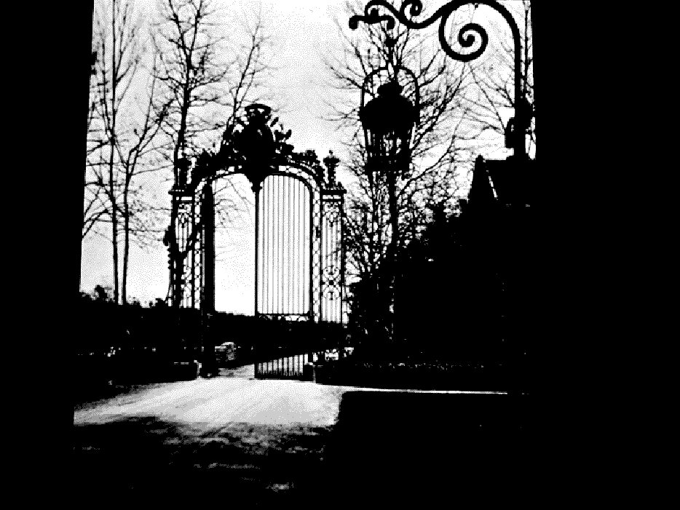
PARIS
November 1898
Notes:
15

Slide 16
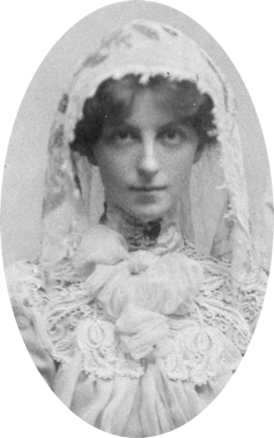
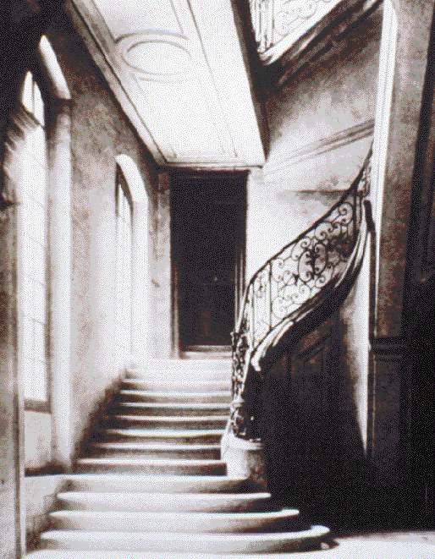
May Bolles was ill at that time.
Notes:
16

Slide 17
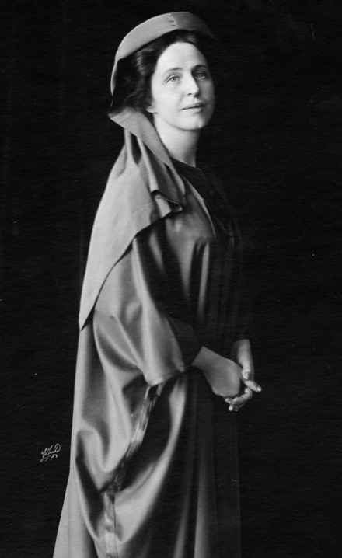
Lua Getsinger

Slide 18
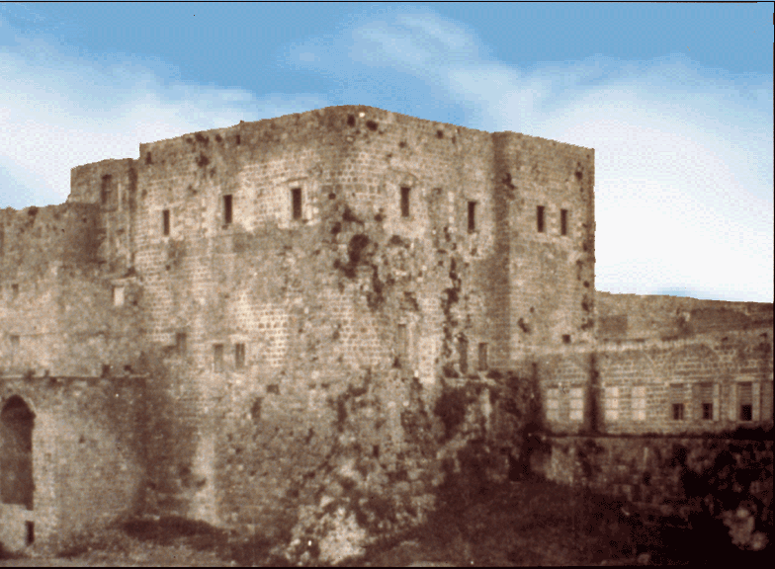
The Prison City of ‘Akká - 1898

Slide 19
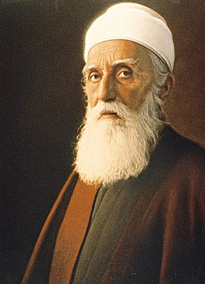
May Bolles (Maxwell)
"Of that first meeting, I can remember neither joy nor pain, nor anything that I can name. I had been carried suddenly to too great a height, my soul had come in contact with the Divine Spirit, and this force, so pure, so holy, so mighty, had overwhelmed me ... We could not remove our eyes from His glorious face … existence seemed suspended; and when He arose and suddenly left us, we came back with a start to life; but never again, oh! never again, thank God, the same life on this earth.”

Slide 20
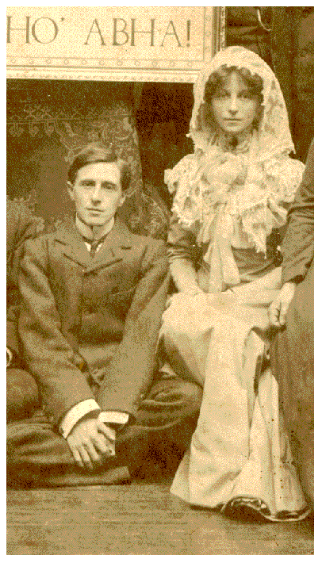
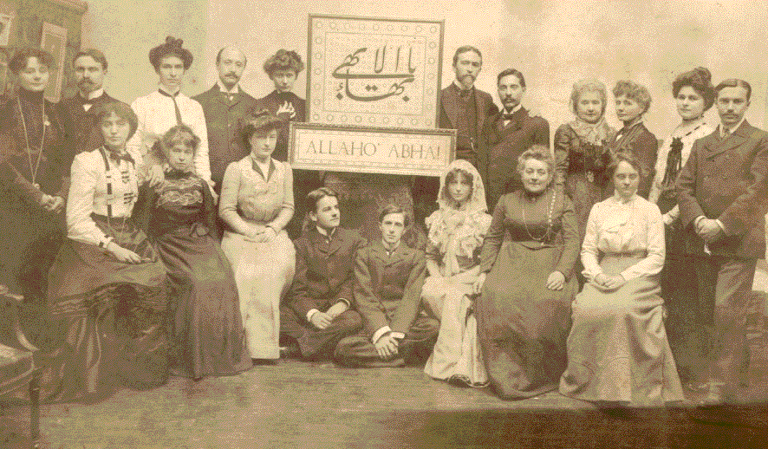
May Bolles – 1st European believer - and Thomas Breakwell - Paris 1902

Slide 21
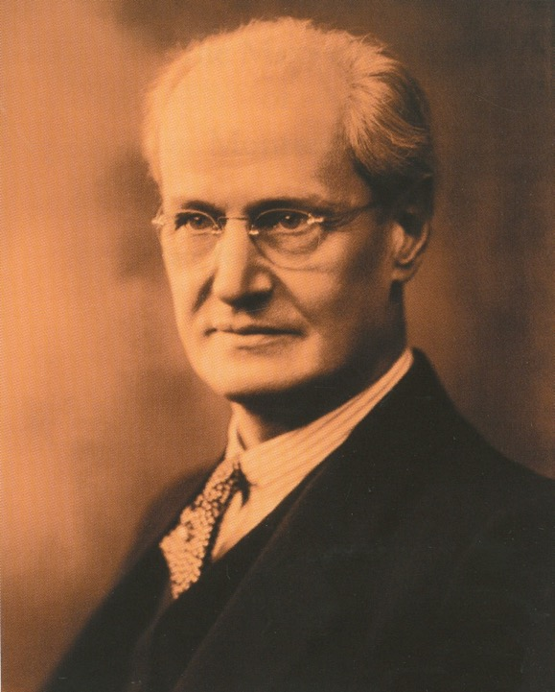
William Sutherland Maxwell 1874-1952)

Slide 22
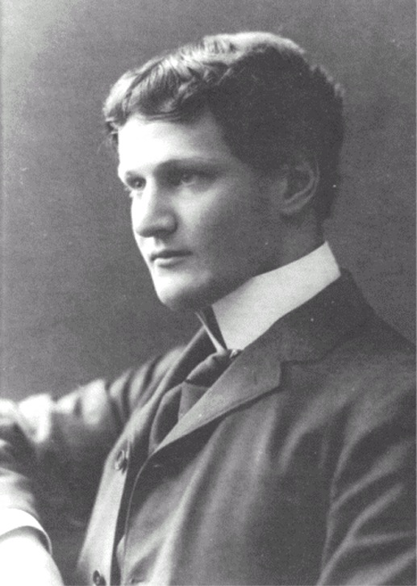
William Sutherland Maxwell as a young man

Slide 23
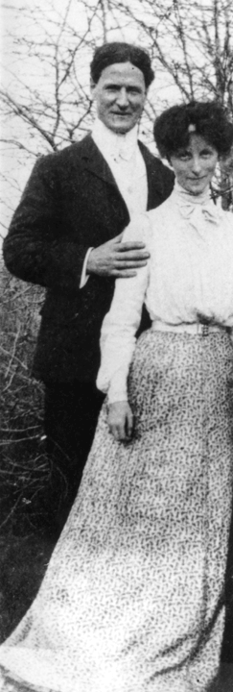
William Sutherland Maxwell & his bride May Bolles
1902

Slide 24
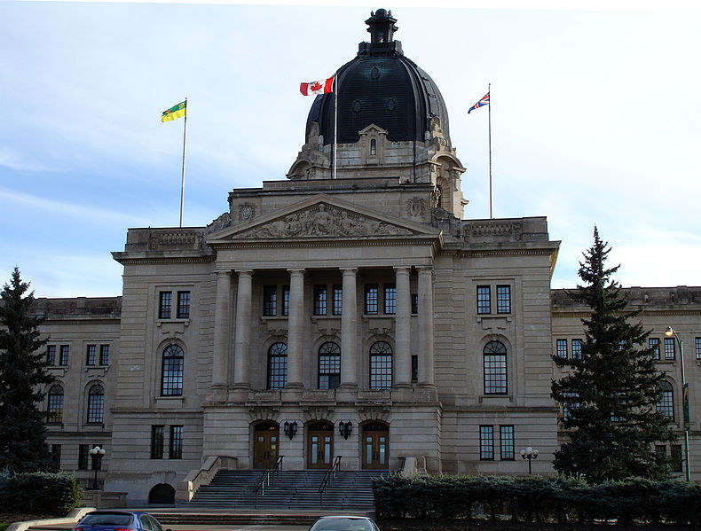
Saskatchewan Legislature

Slide 25
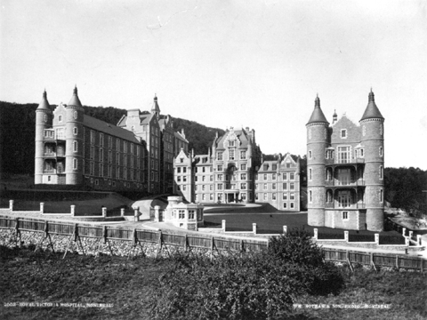
Royal Victoria Hotel - Montreal

Slide 26
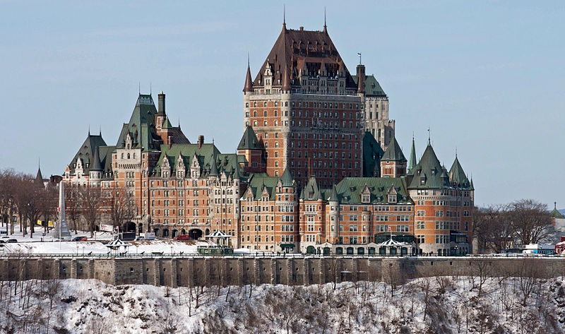
Wings of Hotel Chateau Frontenace designed by WSM and his brother.

Slide 27
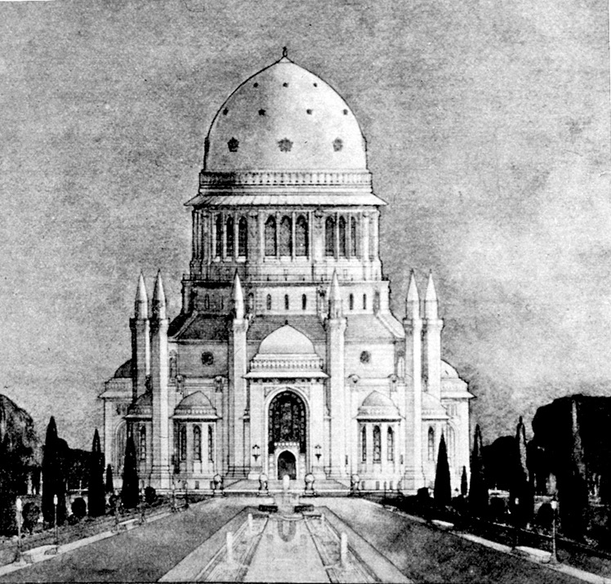
William Maxwell’s Design for the Wilmette House of Worship. There were 15 designs submitted and displayed at the 1920 National Convention.
The Dawning Place, p.88.

Slide 28
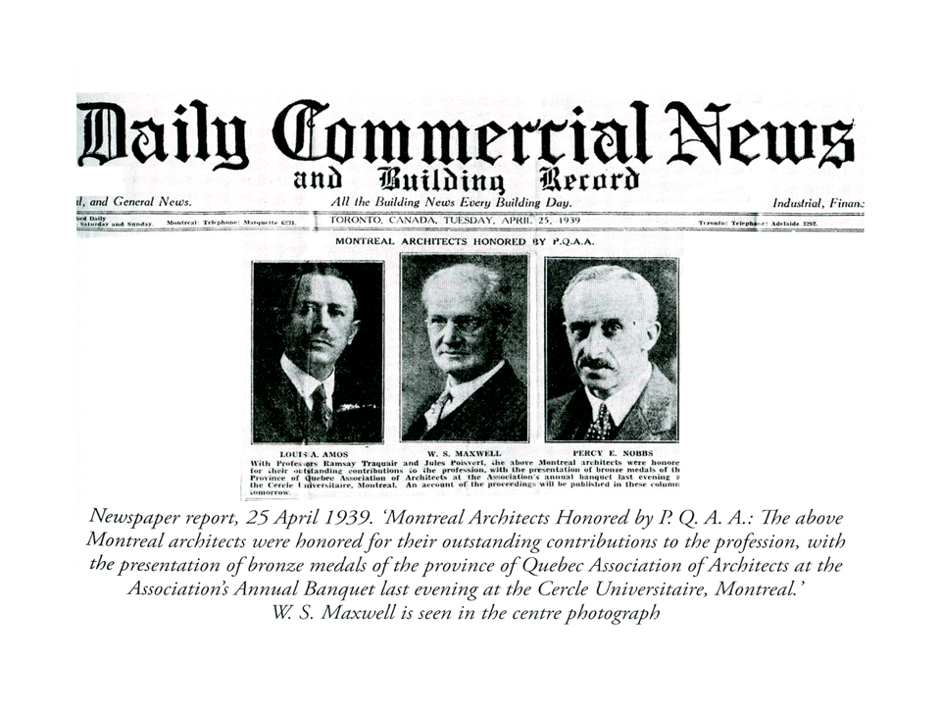
William Sutherland Maxwell honored for his architectural work in 1939.

Slide 29
PART I
The Early Years
1910-1937

Slide 30
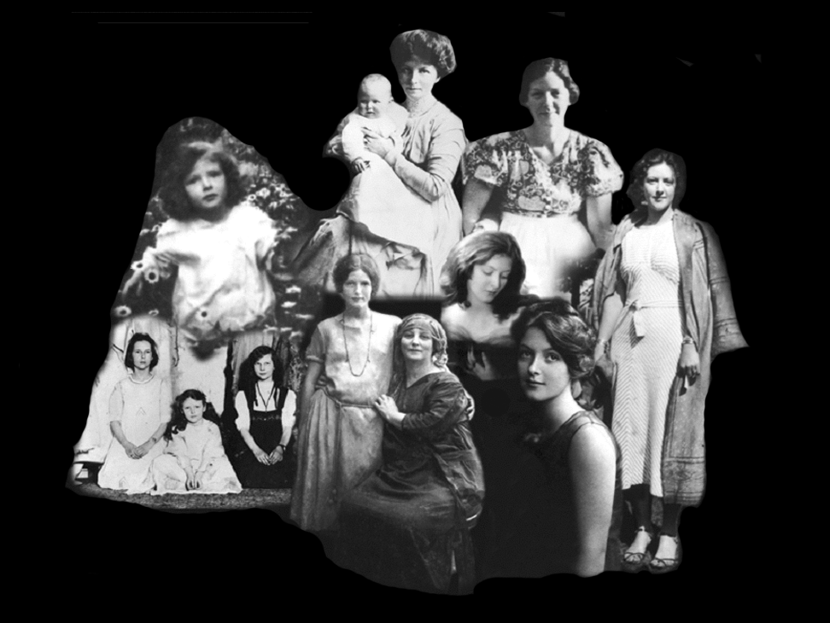
Mary Sutherland Maxwell

Slide 31
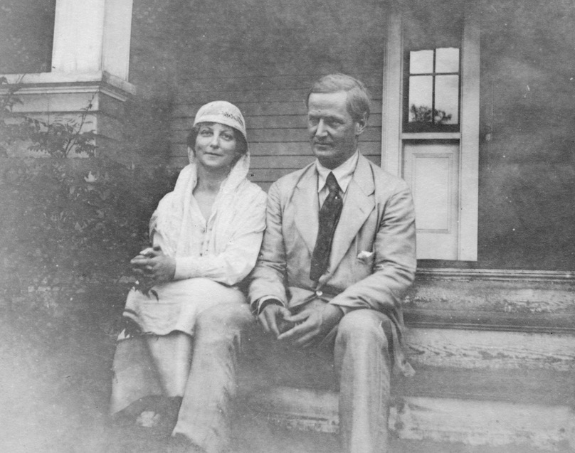
William & May went on pilgrimage in 1909

Slide 32
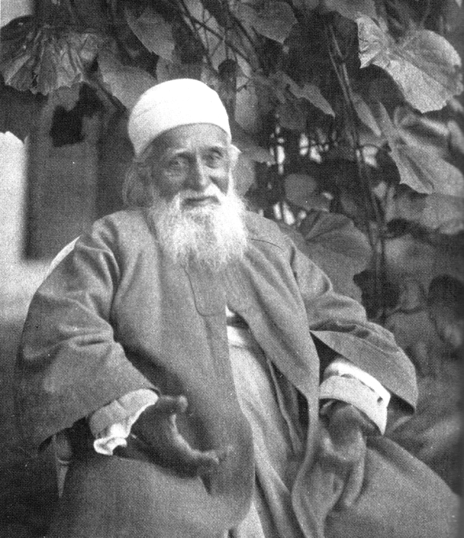
“Speak, do you choose to have a child, you may choose!”
“I choose whatever God chooses — I have no choice but His.”
“This is the best choice, the Will of God is the best choice.”

Slide 33
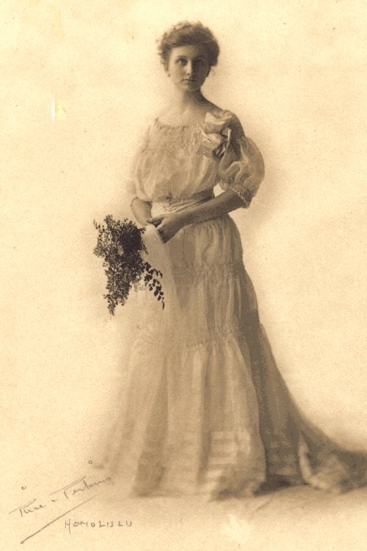
My dear Agnes, “I am going to confide to a secret. Our dear Lord has favored His maidservant past all her hope … In a few months Inshallah, the babe He is sending to my husband and me will be born …
Agnes Alexander

Slide 34
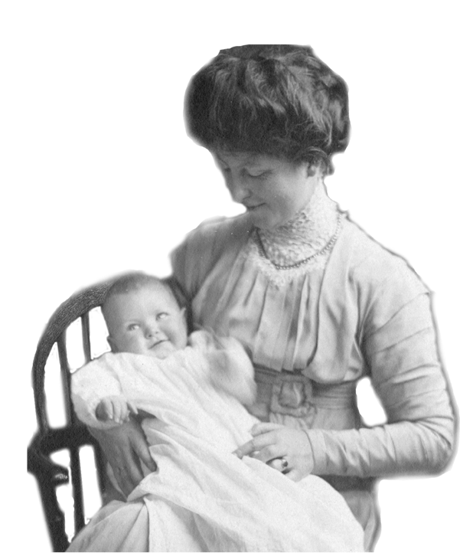
Mary Sutherland Maxwell
Born August 8, 1910 in New York City

Slide 35
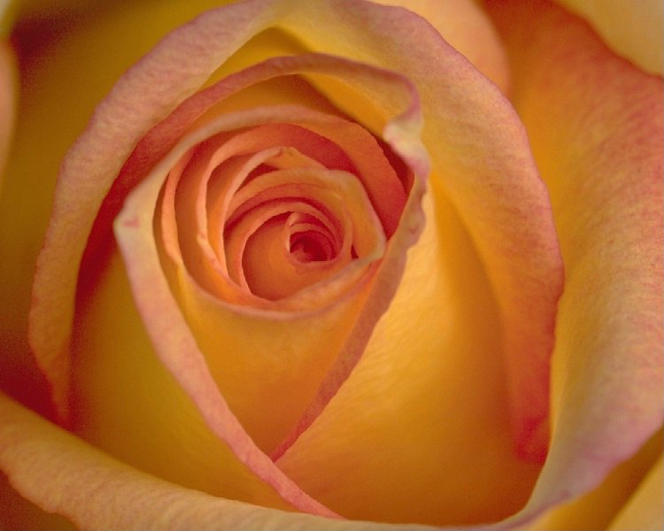
In the garden of existence a rose hath bloomed with the utmost freshness, fragrance and beauty. Educate her according to the divine teachings so that she may grow up to be a real Bahá’í and strive with all thy heart that she may receive the Holy Spirit.
—’Abdu’l-Bahá

Slide 36
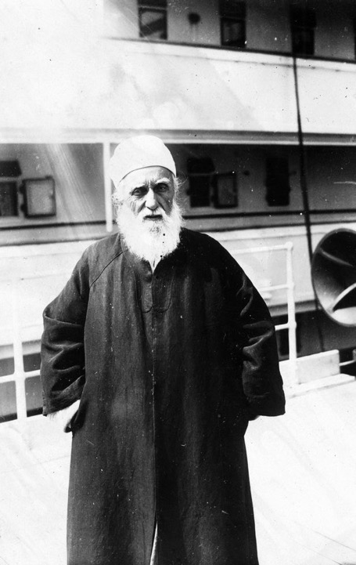
‘Abdu’l-Bahá’s North American Tour 1912
April - December

Slide 37
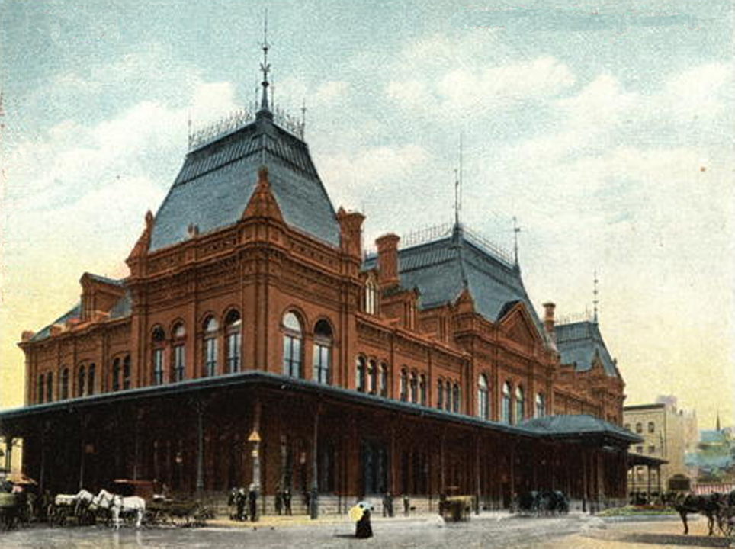
‘Abdu’l-Bahá arrives at Montreal Railway Station August 30, 1912

Slide 38
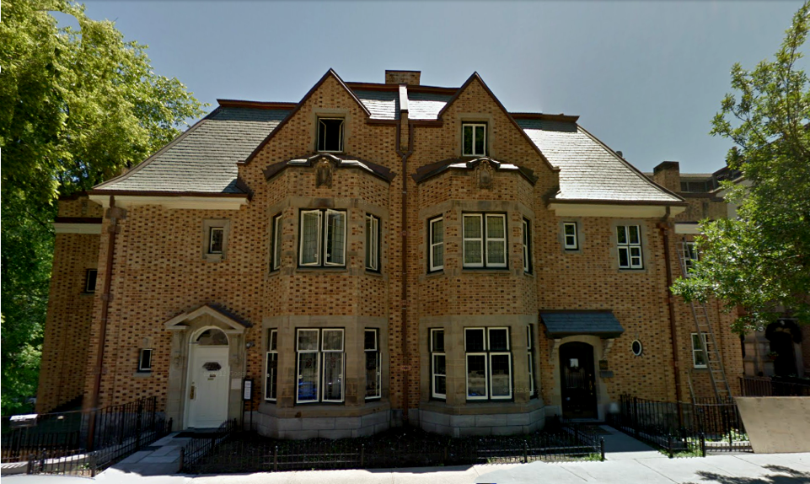
'This is my home,' He said, 'All that is in it is mine' - turning with an ineffable look, He continued - 'You are mine - your husband and child. This is my home.’
- ‘Abdu’l-Bahá’s words upon entering the Maxwell home.
‘Abdu’l-Bahá spent three nights, four days at the Maxwell Home.

Slide 39
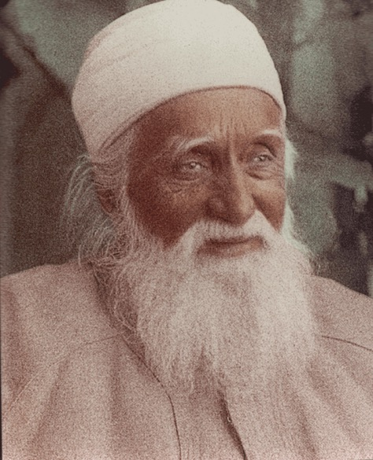
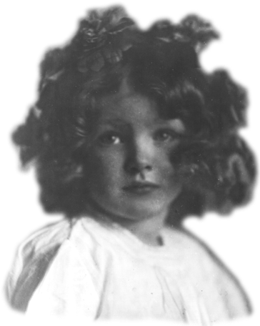
“Wake up , ‘Abdu’l-Bahá!”
2 year old Mary

Slide 40
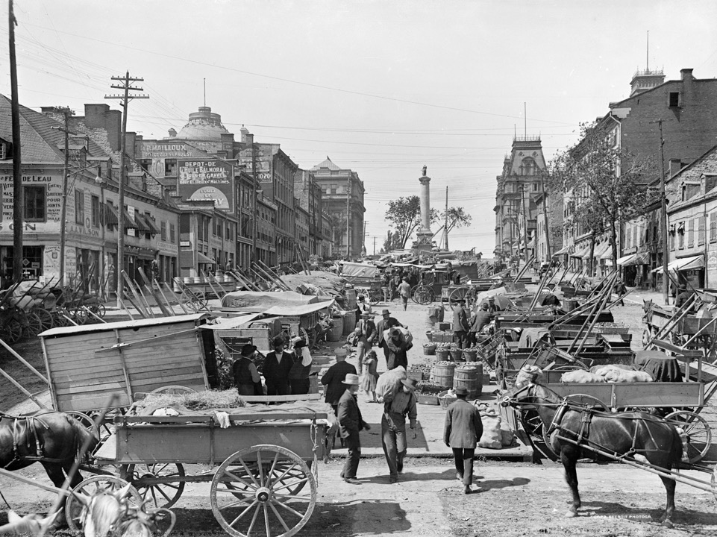
Some Scenes of Montreal, Canada where Mary Maxwell grew up

Slide 41
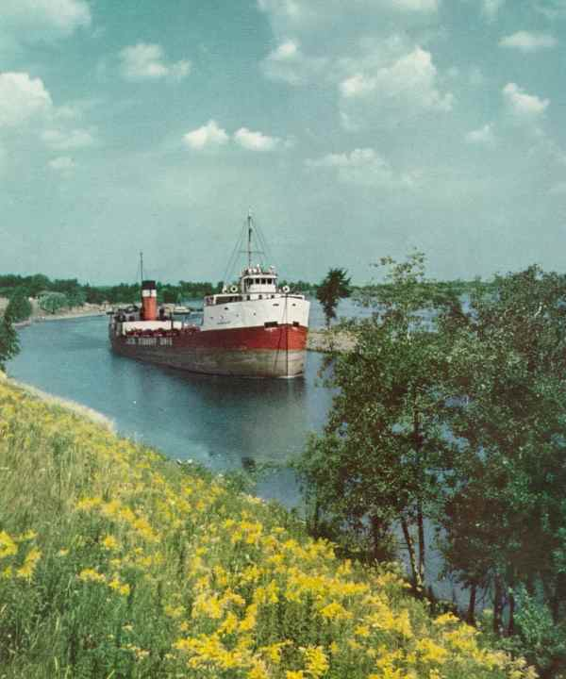
The St Lawrence seaway dominates the setting of the city

Slide 42
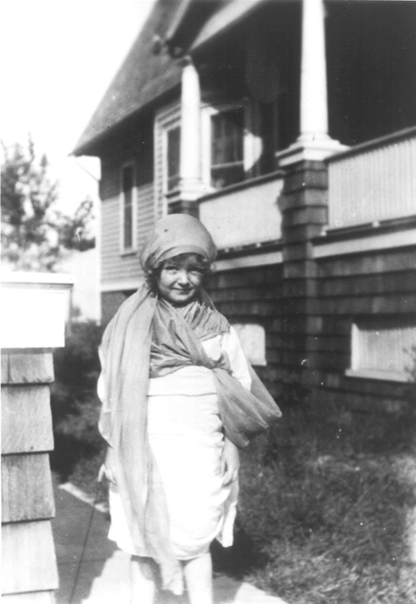
Age 4
All dressed up.

Slide 43
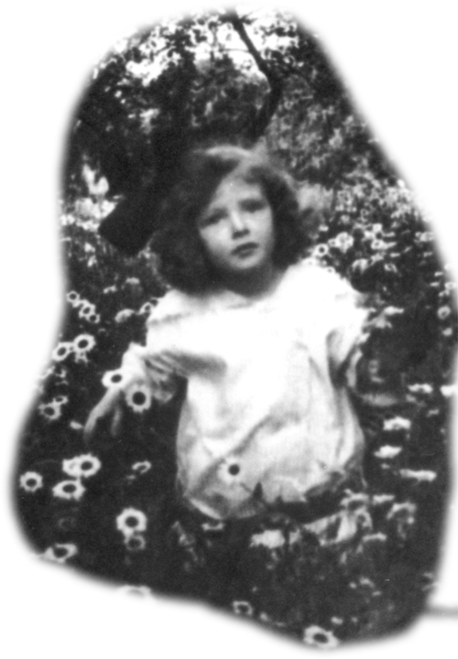
May Maxwell
“This picture reveals almost all of Mary. If we were so developed that we could see the inner things as well as the outer we would know all about Mary by studying this picture. Here she is in her own world—the kingdom of Nature which she so loves …
Age 5
Bursting through a bed of daisies

Slide 44

1919
Unveiling the Tablets of the Divine Plan
MCALPIN HOTEL
NEW YORK CITY

Slide 45

Young Mary Age 8

Slide 46

      C A N A D A
Montreal
OTTOWA
35 MI / 56 KM
      Vermont
      New York
      U S A

Slide 47

Montreal
215 MI / 347KM
Green Acre
Eliot, Maine

Slide 48


Sarah Farmer Inn
at Green Acre Bahá’í School

Slide 49

Young Mary associated with the leading Bahá’ís of the West from her earliest days
Martha Root

Slide 50

Juliet
Thompson
May Maxwell

Slide 51

Marion “General” Jack who the Guardian later said was an “example” to future pioneers.

Slide 52

Young Mary plays an angel in a Green Acre play.
(Type casting?)

Slide 53

May and young Mary.

Slide 54

1923
1st Pilgrimage
Photo Taken in Egypt

Slide 55

Age 12, riding ‘Petty’ in front of the Western Pilgrim House, Haifa. 1923.

Slide 56

Shoghi Effendi near in time when Mary Maxwell first met him.

Slide 57

Age 13
c1923

Slide 58

Mary does the “Egyptian shimmy” for the Greatest Holy Leaf who is overcome with laughter.

Slide 59

On her 2nd pilgrimage in 1925 Mary was accompanied by Juliet Thompson & Margarite ‘Daisy’ Smythe.
Juliet Thompson

Slide 60

Age 15
c1925
Mary at the time of her second pilgrimage

Slide 61

Age 16

Slide 62

My dear co-worker:
I am much pleased to learn of your growing activities in the Cause & I will supplicate from the depths of my heart in your behalf at the holy Shrines that the Beloved may graciously guide you & assist you to render inestimable services to His Cause in the days to come.
Your true brother,
Shoghi
First Letter from Guardian
29 May 1928

Slide 63

The Montreal Youth Group c1930 - after her 21st birthday she was elected to the LSA of Montreal.

Slide 64

At the construction of the Wilmette House of Worship
September 1933
Age 23

Slide 65


Mary at Green Acre - where she gave a course on the Dawn-Breakers in 1934

Slide 66

Only photograph of three Maxwells together in Canada, 1927.

Slide 67

Mary and her mother in Brussels, Belgium in 1935.

Slide 68

PIONEERING FIRST COUSINS
Jeanne Bolles and Mary Maxwell in Stuttgart, Germany, 1936

Slide 69

Pilgrimage to Bahá’í Shrines in Israel begins January 12th, 1937

Slide 70


Slide 71


“Mary Maxwell!”
“The Guardian is married and you will never guess to whom.”
Aziz Yazdi
Port Said, Egypt
Notes:
Agnes’ answer is all the more extraordinary when one considers that no one had the slightest intimation that the Guardian was planning to marry at all!

Slide 72

The two volumes of ‘Pilgrim’s Notes of Mary and her Mother May (Jan-Mar 1937) ‘go viral’ and cause quite a stir at the 1938 National Convention in America.
See volume 2 of The Maxwell’s of Montreal.
[My own attempt at Pilgrim Notes in 1967.]

Slide 73
PART II
Years of Marriage
1937-1957

Slide 74

Marriage to the Guardian 1937-1957

Slide 75

THE MARRIAGE
Mother & Father-in-Law of Shoghi Effendi
May & William Sutherland Maxwell

Slide 76

THE MARRIAGE
No one, with the exception of his parents, my parents and a brother and two sisters of his living in Haifa, knew it [marriage] was to take place. He felt strongly urged to keep it a secret, knowing from past experience how much trouble any major event in the Cause invariably stirred up. It was therefore a stunning surprise to both the servants and the local Bahá‘ís when his chauffeur drove him off, with me beside him, to visit the Holy Tomb of Bahá'u'lláh on the afternoon of 24 March 1937.
Mother & Father-in-Law of Shoghi Effendi
May & William Sutherland Maxwell

Slide 77

When we arrived at Bahjí and entered the Shrine he requested me to give him his ring, which I was still wearing concealed about my neck, and this he placed on the ring-finger of my right hand, the same finger that corresponded to the one of his own on which he himself had always worn it. This was the only gesture he made. … After he had chanted the Tablet of Visitation we came back to Haifa and in the room of the Greatest Holy Leaf our actual marriage took place …

Slide 78


Slide 79
THERE was no celebration, no flowers, no elaborate ceremony, no wedding dress, no reception. … At dinner-time, quite as usual, the Guardian appeared, showering his love and congratulations on my mother and father. … My parents also signed the marriage certificate and after dinner and these events were over I walked home with Shoghi Effendi … . We sat for a while with the Guardian's family and then went up to his two rooms which the Greatest Holy Leaf had had built for him so long ago.

Slide 80


Slide 81

Amatu’l-Bahá
‘Handmaid of the Most High’
Rúhíyyih
‘Spirit’
Khánum
‘Lady’

Slide 82


Slide 83


1939-1945

Slide 84



The Passing of May Maxwell in Argentina in 1940
‘Amatu’l-Baha loses her ‘soul-mate’

Slide 85


Slide 86

Rúhíyyih Khánum said the symbols of the columns and the lion best expressed her mother’s nature of courage and steadfastness. “…[S]he was lionlike in her courage and a true pillar of the Faith in every way.”

Slide 87
Shoghi Effendi’s attempts to console Rúhíyyih Khánum over the loss of her mother by telling her how her mother was going around the Abha Kingdom saying, “Do let me tell you about my daughter.” until each holy soul became tired and passed her on to someone else.
p.38 A Tribute to ‘Amatu’l-Baha Ruhiyyih Khanum

Slide 88


Slide 89


Slide 90


Slide 91

Shoghi Effendi then invited William Sutherland Maxwell to come live in Haifa. He resided across the street from the house of ‘Abdu’l-Bahá.

Slide 92

By 1941 all of ‘Abdu’l-Bahá’s family had abandoned the Guardian. From that date forward ‘Amatu’l-Bahá became Shoghi Effendi’s principal secretary.

Slide 93


Rúhíyyih Khánum’s Diary Nov 29, 1943
I don't think the Guardian ever worked so hard during his 'vacation‘ before, and I am sure I didn't! He often says 'this book is killing me' to which I invariably answer 'me too'.

Slide 94

Mount Carmel around 1900

Slide 95

Cypress Trees mark the spot chosen by Bahá’u’lláh for the Shrine of the Báb

Slide 96

First 6 rooms under construction by the Master

Slide 97

First 6 rooms completed in the time of the Master

Slide 98

Some early changes by the Guardian

Slide 99

Collaboration on the Shrine of Báb between WSM and the Guardian

Slide 100


Slide 101


Slide 102


Slide 103


Slide 104


Slide 105

Shoghi Effendi elevates William Sutherland Maxwell to the rank of Hand of the Cause of God on 24 December 1951 in the First Contingent of 12 Hands named.

Slide 106

26 March 1952
William Sutherland Maxwell, Hand of the Cause of God, architect of the Shrine of the Báb, dies in Montreal 3 months after being named Hand. Shoghi Effendi named a door in this Shrine after Mr. Maxwell.

Slide 107


Memorial in Montreal for William Sutherland Maxwell
Hand of the Cause of God
(1874-1952)

Slide 108

‘THE mantle of Hand of Cause now falls upon the shoulders of his distinguished daughter, 'Amatu'l-Bahá Rúhíyyih Khánum, who has already rendered and is still rendering manifold no less meritorious self-sacrificing services at World Center of Faith of Bahá'u'lláh.’
-Shoghi Effendi
26 March 1952

Slide 109

Wilmette, USA Dedication, May 1953

Slide 110


Slide 111

Reading Shoghi Effendi’s address at the dedication

Slide 112
Donates Maxwell House to the National Spiritual Assembly of Canada
1548, Pine Avenue West, Montreal

Slide 113


Slide 114

LONDON NOV 4, 1957
When I went to his room in the morning to ask him how he was I did not recognize that he was dead. His eyes were half-open with no look of pain, alarm or surprise in them. He lay as if he had wakened up and was quietly thinking about something in a relaxed and comfortable position.

Slide 115

LONDON NOV 9, 1957 Great Northern Cemetery

Slide 116



Slide 117

“He was our Guardian, King of the world. We know he was noble because he was our Guardian. We know that God gave him peace in the end. But as I looked at him all I could think of was — how beautiful he is, how beautiful!”
'Amatu'l-Bahá Rúhíyyih Khánum
The Passing of Shoghi Effendi

Slide 118
PART III
The Interregnum
1957-1963

Slide 119
The Interregnum 1957-1963
    interregnum
    Temporary authority or rule exercised during a vacancy of the throne or a suspension of the normal government.
    - New Shorter Oxford English Dictionary

Slide 120
Two Chief Tasks of the Hands during the Interregnum:
Complete the goals of the 10 Year World Crusade (1953-1963).
2. Arrange for the Election of the Universal House Justice at the end of the World Crusade (1963).

Slide 121

The Hands met at Bahji every fall to make their plans for the coming year. These meetings were called “conclaves”. The first one was held 18-25 November, 1957.

Slide 122

Proclamation by the Hands that there could not be another Guardian. Nov. 25, 1957

Slide 123

Kampala Cornerstone laying 1958
Though still grieving, she wore the clothing chosen by Shoghi Effendi for this occasion.

Slide 124
1960s

Slide 125

14 January 1961
Dedication of Mother Temple of Africa

Slide 126

Sydney, Australia Dedication 1961

Slide 127

21 April 1963
Election of First Universal House of Justice in the House of the Master

Slide 128

World Congress Royal Albert Hall London 1963

Slide 129

‘Amatu’l-Bahá Khánum recalls Shoghi Effendi at the World Congress

Slide 130

Khánum with ‘Uncle Fred’ – the 1st Australian aborigine who had never flown in a plane before the London Congress
(Airplane: “kangaroo pouch”)

Slide 131
PART IV
Leading Ambassadress of the
Bahá’í Faith
1964 - 1997

Slide 132


Slide 133


INDIA
February- October 1964

Slide 134

With Prime Minister Indira Gandhi (who was assassinated 13 days later).

Slide 135

New Delhi, India
Cornerstone 1977
Dedication 1986

Slide 136


Slide 137


Slide 138

Boliva 1967

Slide 139

She “gave me the gift of life, but better still, the beloved mother of my soul”.
Rúhíyyih Khánum
Visiting May Maxwell’s Grave in Buenos Aires - 1967

Slide 140

At the laying of the cornerstone of the Panama House of Worship October 1967

Slide 141

Los Muchos, Venezuela, 1968

Slide 142

Haifa 1968

Slide 143


Slide 144


Slide 145


1970s
Africa & South America

Slide 146


Covered 36,000 miles overland
Met 19 Heads of State
Over 40,000 people
Addressed 410 gatherings
51 newspaper int.
42 radio interviews
20 TV interviews

Slide 147

“The Great Safari” August 1969 – January 1973

Slide 148

‘Amatu’l-Bahá interrupts “The Great Safari” to speak to 2,000+ youth in Evanston 1970

Slide 149


Slide 150


Slide 151

Botswana 1972

Slide 152

Dedication Panama House of Worship - 1972

Slide 153
2 NOVEMBER 1972
LT
AMATULBAHA RUHIYYIH RABBANI CARE YAZDI
NAIROBI KENYA
YOUR TRAVELS AFRICAN CONTINENT UNIQUE UNPARALLELED IN NUMBER COUNTRIES VISITED HEADS STATE INTERVIEWED EXTENSIVE PUBLICITY OBTAINED LOVING ENCOURAGEMENT SPIRITUAL STIMULATION IMPARTED STANDARD HEROISM EXAMPLE SELFSACRIFICE EVINCED OVER SUCH LONG PERIOD UNDER SUCH ARDUOUS CONDITIONS STOP FEEL ASSURED GLORIOUS SPIRIT BELOVED GUARDIAN

Slide 154
RADIANT SOULS YOUR DISTINGUISHED PARENTS HIGHLY ELATED SINGULARLY PROUD OVER RANGE QUALITY RESULTS YOUR SPLENDID ENDEAVOURS STOP LOVING THOUGHTS TENDERLY WITH YOU THIS DAY FERVENTLY PRAYING SHRINES BLESSINGS BAHAULLAH MAY INCREASINGLY SURROUND YOU GUIDE YOUR STEPS REINFORCE PRODIGIOUS EFFORTS STOP SPIRIT YOUR LOVE FIDELITY DEDICATION SO BRILLIANTLY DEMONSTRATED SETS SHINING EXAMPLE HIS ARDENT LOVERS LABOURING ALL CONTINENTS AND COUNTLESS GENERATIONS YET UNBORN WITH DEEPEST AFFECTION UNIVERSAL HOUSE OF JUSTICE

Slide 155

Alaska 1973

Slide 156

Paris 1974

Slide 157

“Journey of Friendship”

Slide 158

David
Walker
Anthony
Worley
Rodney Charters
Mas’úd.
Khamsí
Mark
Sadan
Dr.
Nosrat
Rabbani

Slide 159


Slide 160


Slide 161


Slide 162


Slide 163


Slide 164


Slide 165


Slide 166


Slide 167


Slide 168


Slide 169


Slide 170


Slide 171

With Leorna Stirling (Hopsapple) Armstrong “Spiritual Mother of South America”

Slide 172

Inspecting the tiles on the Shrine of the Báb, 1977

Slide 173

Robbers murder Hand of the Cause of God, Enoch Olinga – 1979
Rúhíyyíh Khánum publishes “The Story of Enoch Olinga” in 1984

Slide 174
1980s

Slide 175


Slide 176

Haifa 1983

Slide 177
IF YOU HAVE A MESSAGE FOR MISS REVELL OR WISH TO SEE HER, PLEASE GO TO THE KITCHEN DOOR OF THE MASTER’S HOUSE AND ASK TO SEE HER.
AMATU’L-BAHÁ RÚHÍYYIH KHÁNUM

Slide 178

His Highness Malietoa Tanumafili II Western Samoa Sept 1984
First reigning monarch to embrace the Faith.

Slide 179


Slide 180


Slide 181

Apia, Samoa Dedication 1984

Slide 182


Slide 183

Dedication of the Bahá’í House of Worship in New Delhi, December 1986

Slide 184


Slide 185


Slide 186

50TH Anniversary of her permanent move to the Holy Land

Slide 187


Slide 188


Slide 189

Dedication of the Maxwell Bahá’í School 1989

Slide 190
1990s

Slide 191

Depositing the Scroll of the “Knights of Bahá’u’lláh” in the Threshold of the Most Holy Tomb.
Hundreth Anniversary of the passing of Bahá’u’lláh. 1992

Slide 192


Slide 193

World Congress New York City November 1992

Slide 194

With Xie ZongZing (her left) China Taoist Association and Indian Ambassador to Mongolia
London, May 1995

Slide 195

With fellow Hands ‘Alí Akbar Furutan and ‘Alí Muhammad Varqá at the International Teaching Centre in Haifa, 1998

Slide 196
Rúhíyyih Khánum was at once
A Hand of the Cause of God
The leading Ambassadress of the Bahá’í Faith
A writer
A poet
A playright
A public speaker
A world traveller
A documentary filmmaker

Slide 197
2000

Slide 198

19 January 2000 To the Bahá’ís of the World
IN THE early hours of this morning, the soul of Amatu’l-Bahá Rúhíyyih Khánum, beloved consort of Shoghi Effendi and the Bahá’í world’s last remaining link with the family of ‘Abdu’l-Bahá, was released from the limitations of this earthly existence. In the midst of our grief, we are sustained by our confidence that she has been gathered to the glory of the Concourse on High in the presence of the Abhá Beauty.

Slide 199
A life so noble in its provenance, so crucial to the preservation of the Faith’s integrity, and so rich in its dedicated, uninterrupted and selfless service, moves us to call for befitting commemorations … With yearning hearts, we supplicate at the Holy Threshold for inifinite heavenly bounties to surround her soul, as she assumes her rightful and well-earned position among the exalted company in the Abhá Kingdom.
-The Universal House of Justice

Slide 200

I HAVE A RENDEZVOUS WITH DEATH
I have a rendezvous with death —
Sweet death, dear death,
Soon or late I come to thee.
My ancestors were wild folk,
Highland folk, deep, keen,
They plied the sword
For those they loved,
They grinned and parried,
Spilt their blood,
Died for lost causes
Counting not the cost!

Slide 201
The same blood flows in me,
I'll race fate one last course
About the green,
Give destiny a run
For its black money-
And then, my friends,
I have a rendezvous with death —
Dear death, sweet death,
I'll come to thee.
Shoghi Effendi once found some of her poems and read them. He told her they made him cry!

Slide 202

THE END

Slide 203




Slide 204










1946

Slide 205

1950

Slide 206

1958

Slide 207

1969

Slide 208


Where to Pioneer
What to Do When You Get There
Depression
Problems that Face Pioneers
A Short Course on How to Love Your Fellowmen
The Pioneer and the Administration
Public Contacts
Patience
"Culture Shock”
How to Speak
Laziness and Customs and Clocks
Children
Husbands
Tribal and Local Customs
Boredom and Curiosity
1974

Slide 209

1982

Slide 210

1988

Slide 211

1992

Slide 212

1996

Slide 213

“Growing Pains of a Local Spiritual Assembly,”
The Community Development Committee's first recording, "Growing Pains of a Local Spiritual Assembly" is about the conduct, duties, and responsibilities of the assembly, its members and its officers. This playlet was written by Hand of the Cause 'Amatu'l-Baha Ruhiyyih Khanum, portraying in humorous but effective manner the mistakes, the planning, the devotion and the earnestness evident in assembly meetings. It was produced by a group of professional Baha'is in California. The Committee has made a gift of a tape to each local assembly. Others may wish copies and these are now available for the use of Baha'is only. It should not be used in firesides.
Five inch reel tape, speed 3 3/4th i.p.s., postpaid ... $2.50

Slide 214


Slide 215
’Amatu’l-Bahá Rúhíyyih Khánum wrote and directed two documentary motion picture films:
The “Green Light Expedition” covering an 8,000 mile journey through the Amazon Basin, the Peruvian and Bolivian altiplano, all the way to the Bush Negroes of Suriname.
“The Pilgrimage” a visual pilgrimage to the Bahá’í Holy Shrines in Haifa and ‘Akká, with ‘Amatu’l-Bahá as guide.

Slide 216


World Traveler

Slide 217

185 Countries

