Slide 1

THOU hast assisted Thy servants in the past and, though they were the weakest of Thy creatures, the lowliest of Thy servants and the most insignificant of those who lived upon the earth, through Thy sanction and potency they took precedence over the most glorious of Thy people and the most noble of mankind. -Bahá’í Prayers 180

Slide 2
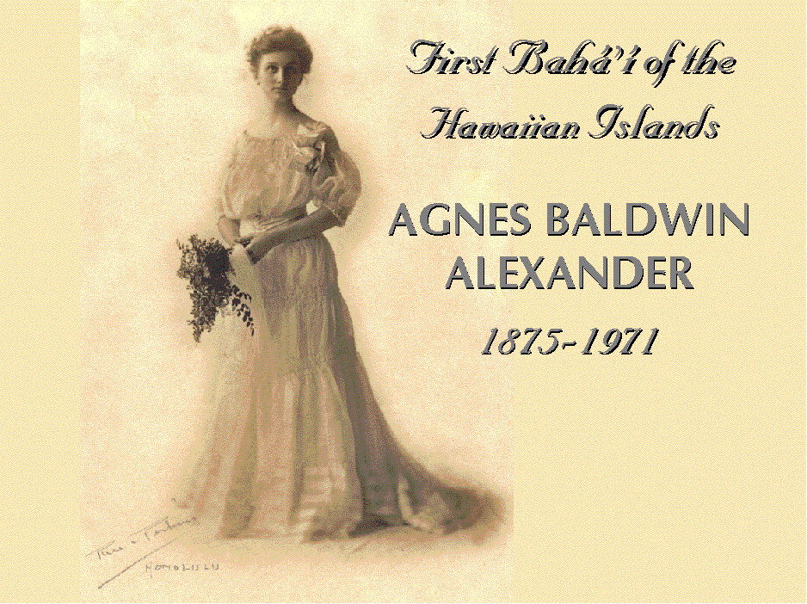

Slide 3
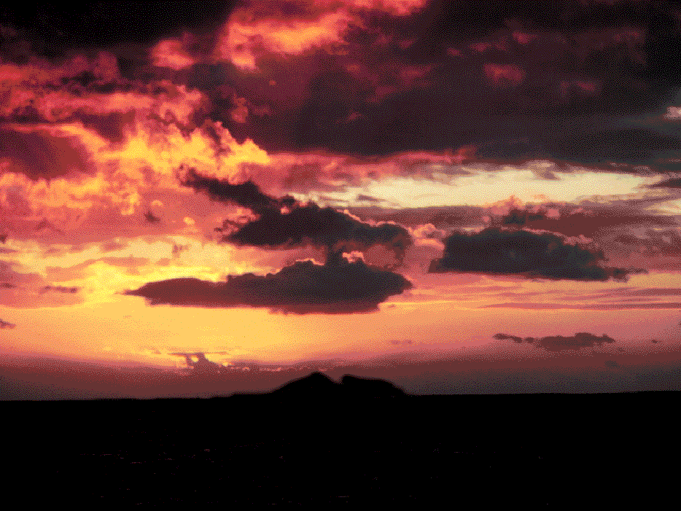
In May 1832 a young
missionary couple strained
at the horizon for their first
glimpse of land in months.

Slide 4
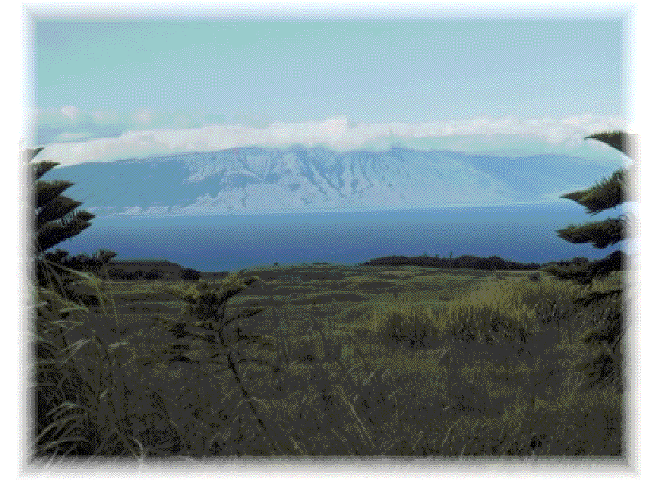
Out of the sapphire depths arose “the loveliest fleet of islands that lies anchored in any ocean” – the Kingdom of Hawaii.

Slide 5
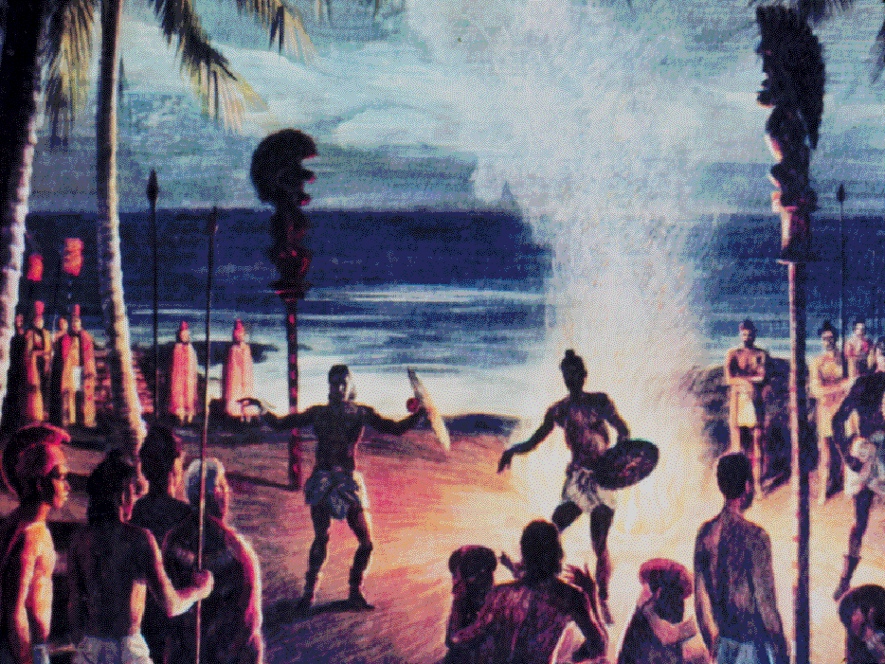

Slide 6
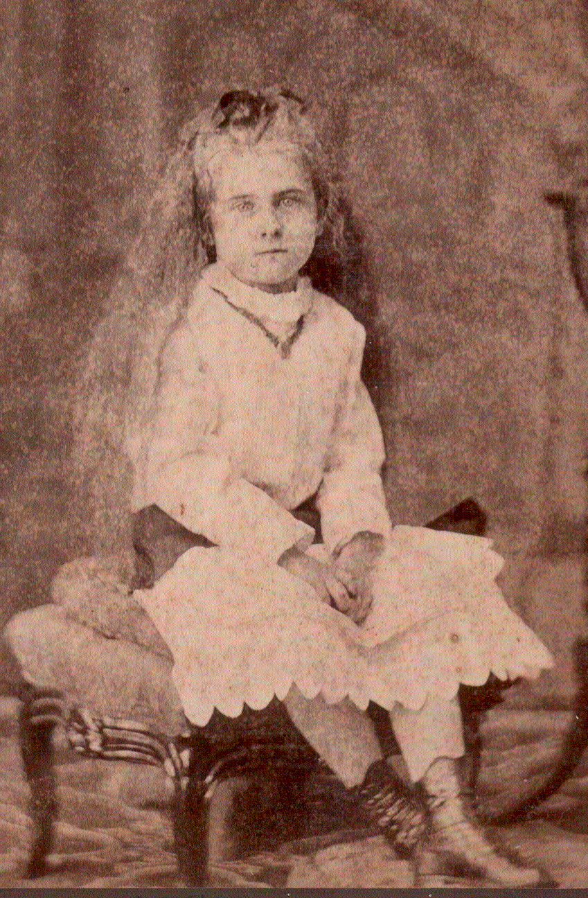
AGNES BALDWIN ALEXANDER

Slide 7
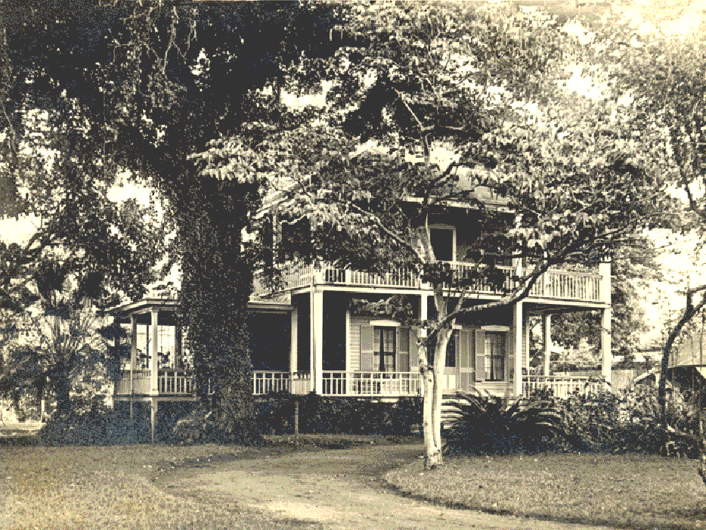
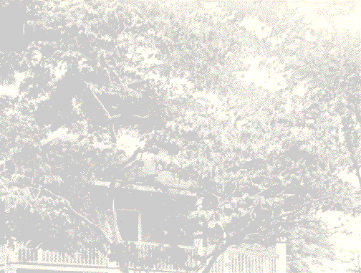
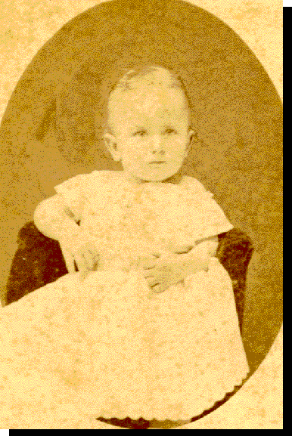
Agnes Alexander was born at home in Honolulu on
July 21st, 1875

Slide 8
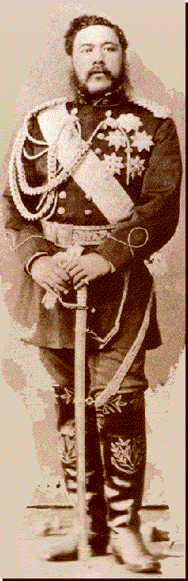

KING DAVID KALAKUA
Reigned 1874-1891

Slide 9
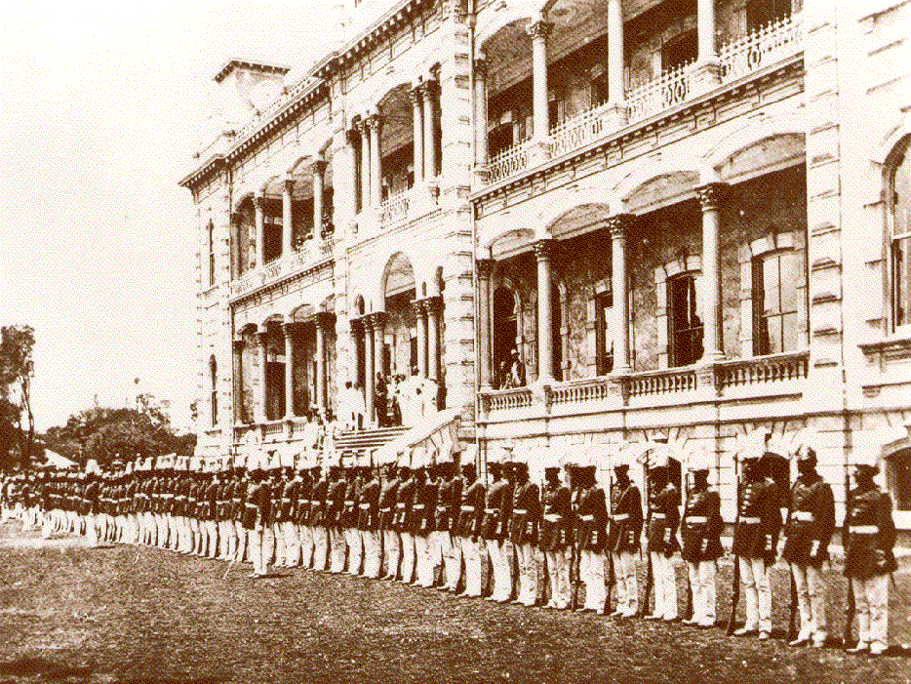

Slide 10
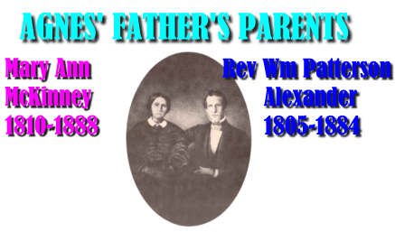
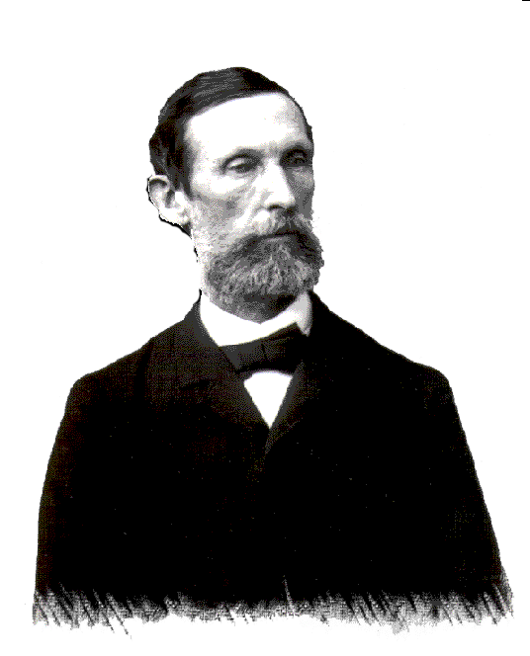
William De Witt
ALEXANDER
Agnes’ Father
Her paternal grandparents came as Christian missionaries in 1831

Slide 11
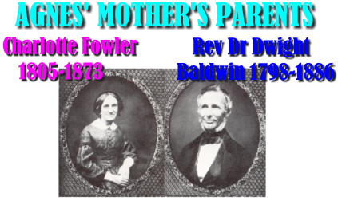
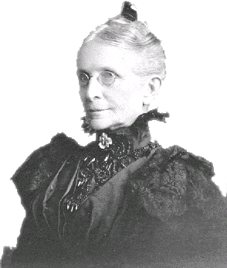
Her maternal grandparents sent out by the American Board for Foreign Missions
Abigail Charlotte
BALDWIN
Agnes’ Mother

Slide 12
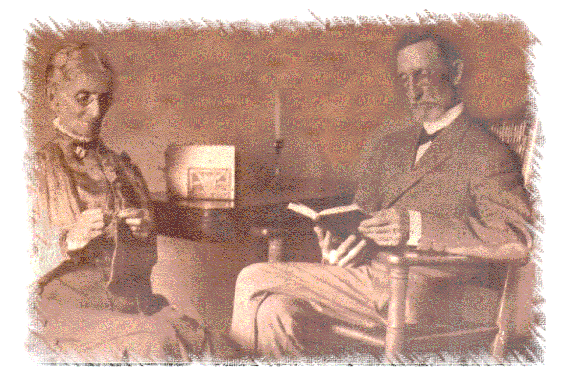
My parents were “real Christians,” “we always had family prayers every day.”

Slide 13
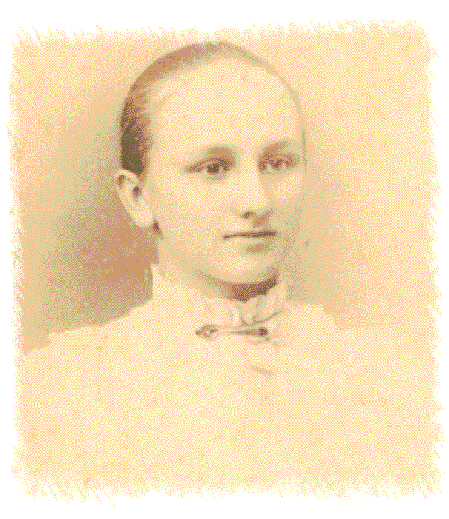
“But I felt that something was wrong with me, because Christ said we must be born again, and I had never experienced something like that. So I thought something was wrong with me.”
Agnes, 9

Slide 14
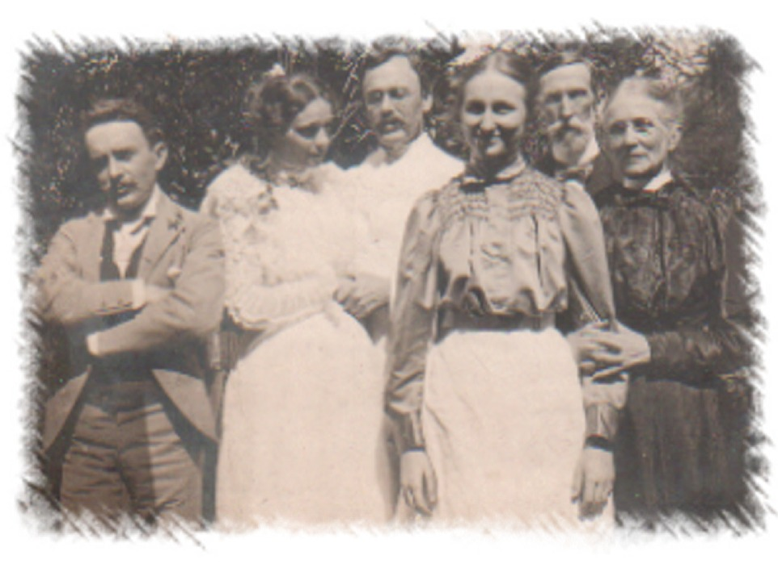
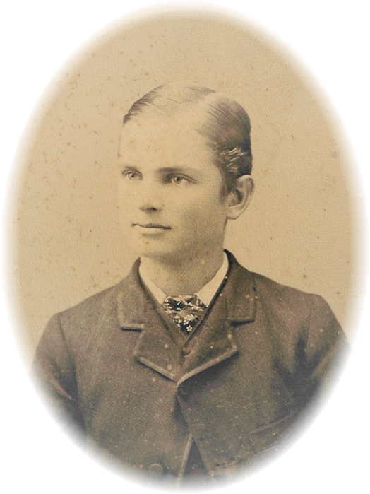
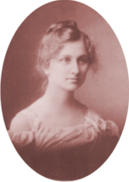
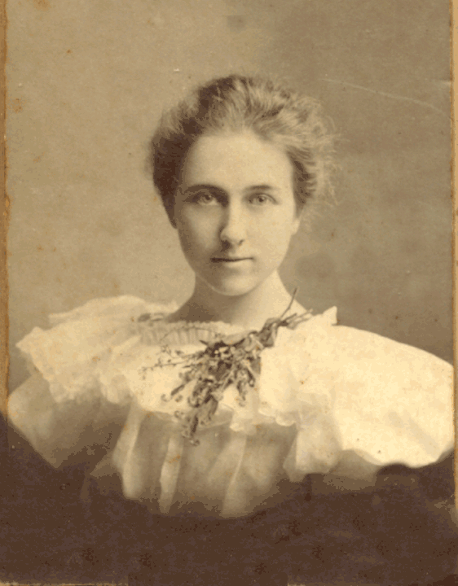
William De Witt Alexander 1833-1913
AGNES ALEXANDER’S FAMILY
Married Lahaina, Maui July 18, 1860
Abigail Charlotte Baldwin 1833-1913
Wm Douglas
1861-1936
Henry Edward 1868-1900
Arthur Chambers 1863-1954
AGNES BALDWIN 1875-1971
Mary Charlotte 1874-1961

Slide 15
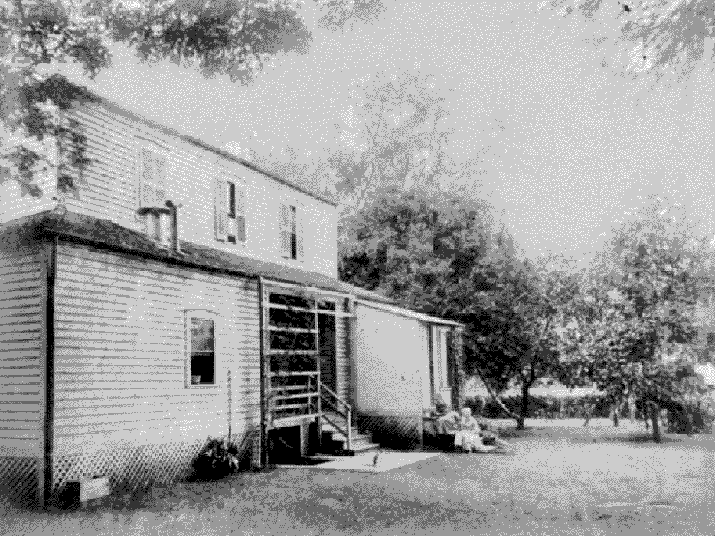
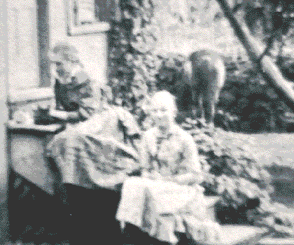
‘Koko’
Mary
Agnes

Slide 16
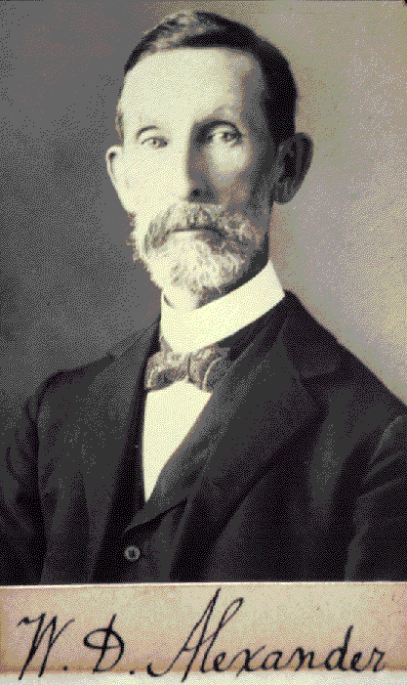
William De Witt
Alexander
Yale U. grad 1855
    Member of King’s
    Privy Council
Pres. Oahu College
A Founder Hawaiian
Historical Society
Surveyor-General
Hawaiian Islands
Notes:
Graduated Yale University with honors.
Professor of Greek at Oahu C. 1858-64
Pres OC 1864-1870
Mmbr Privy Council King Kalakaua & Queen Liliuokalani
1870 organized and carried on Bureau of Govt Survey for over 30 years.
Fellow of Royal Geographical Society
Mbr of Astronomical Society

Slide 17
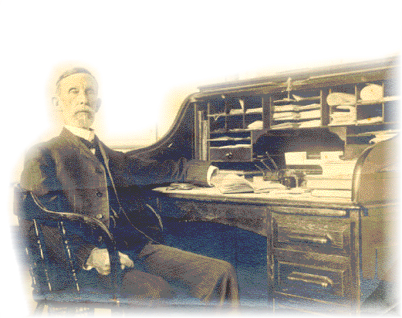
A Brief History of the Hawaiian People by W.D. Alexander

Slide 18
Abigail Charlotte (Baldwin) Alexander
1833-1913

Slide 19
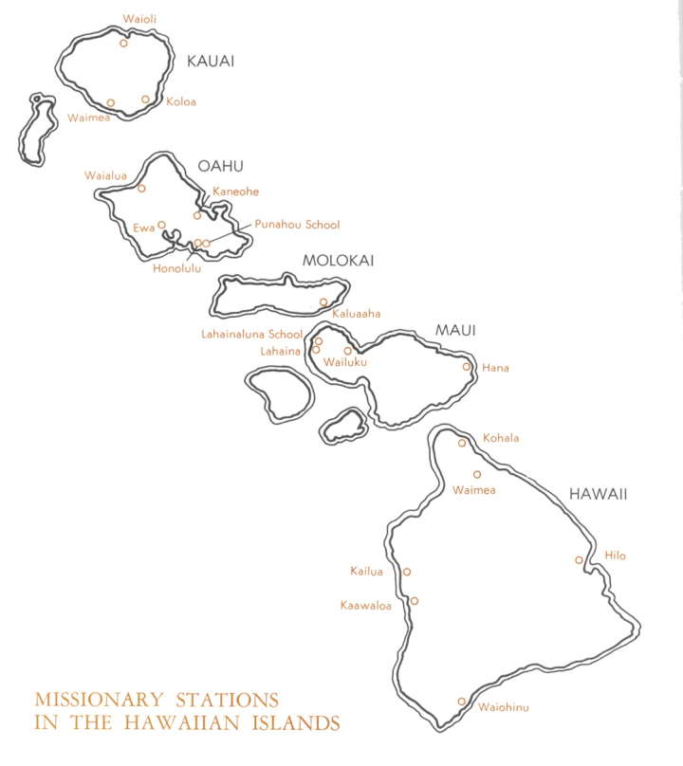
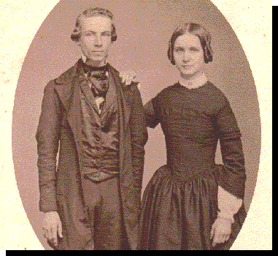

Abigail Charlotte Baldwin—Agnes’ mother— was born in a grass house in Waimea on the Big Island.
Abigail & her brother David Dwight Baldwin
HAWAII

Slide 20
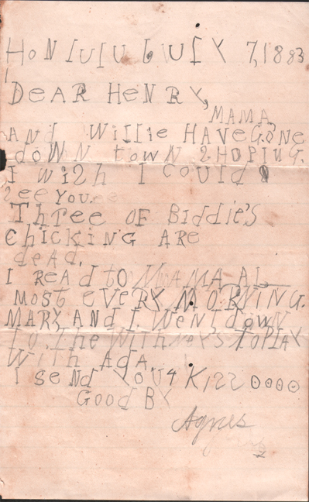
Honolulu July 7, 1883
Dear Henry,
Mama and Willie have gone down town shopping. I wish I could see you. Three of Biddie’s chicking are dead.
I read to Mama almost every morning. Mary and I went down to the Whitney’s to play with Ada.
I send you a kiss oooo
Good By
Agnes
Agnes, 8

Slide 21
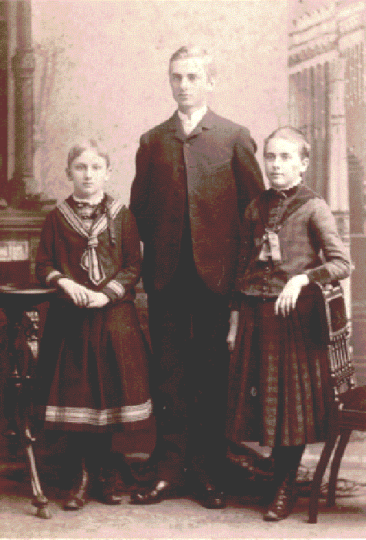
Henry
Mary
Agnes

Slide 22
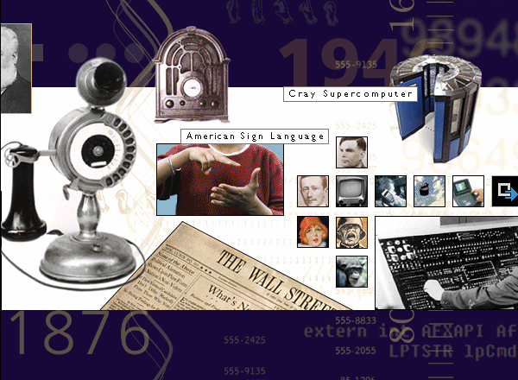
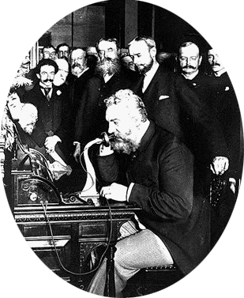
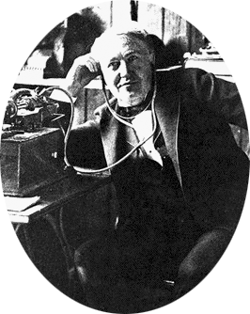
THOMAS EDISON
Electric Light
Phonograph
Movies
ALEXANDER
GRAHAM BELL
Telephone

Slide 23
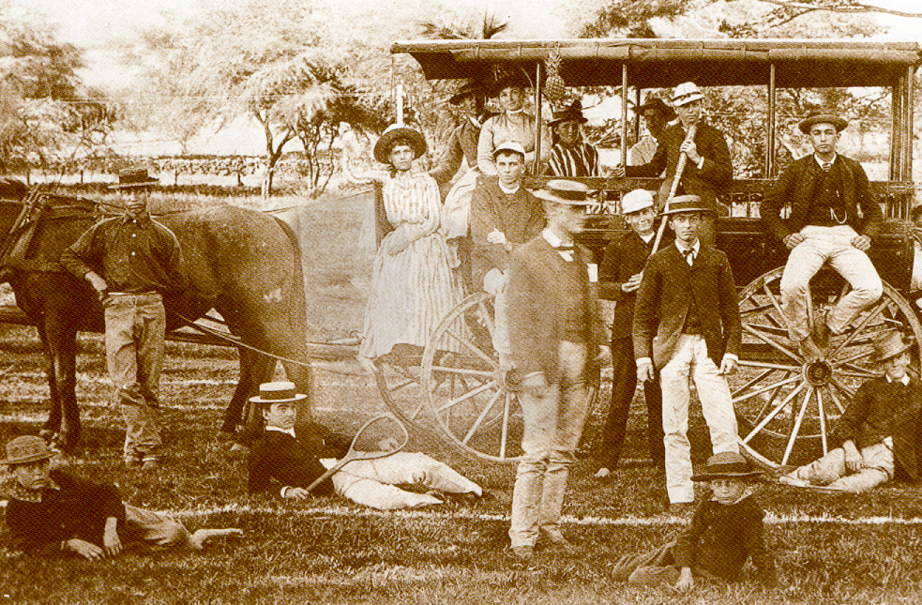

Slide 24
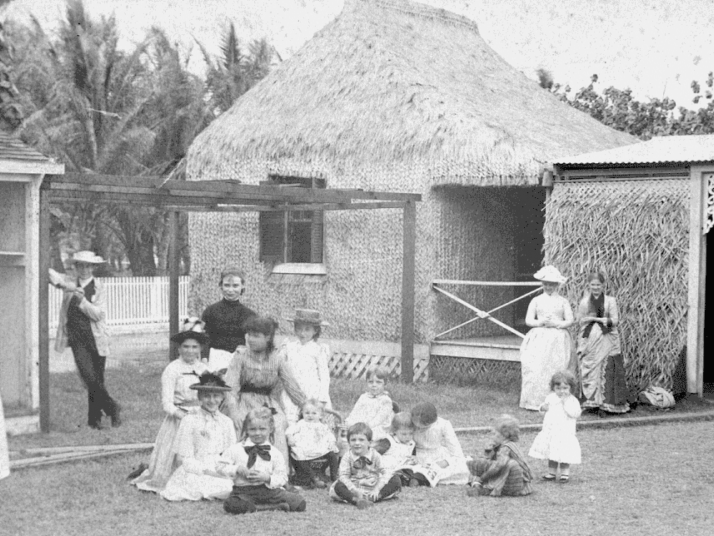
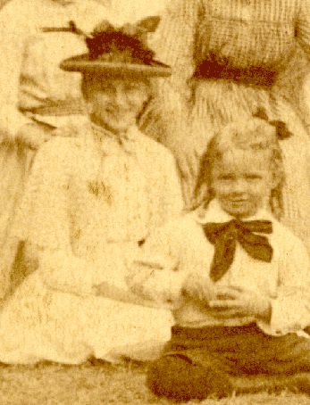
WAIKIKI IN THE 1880s

Slide 25

Mary Charlotte Alexander

Slide 26
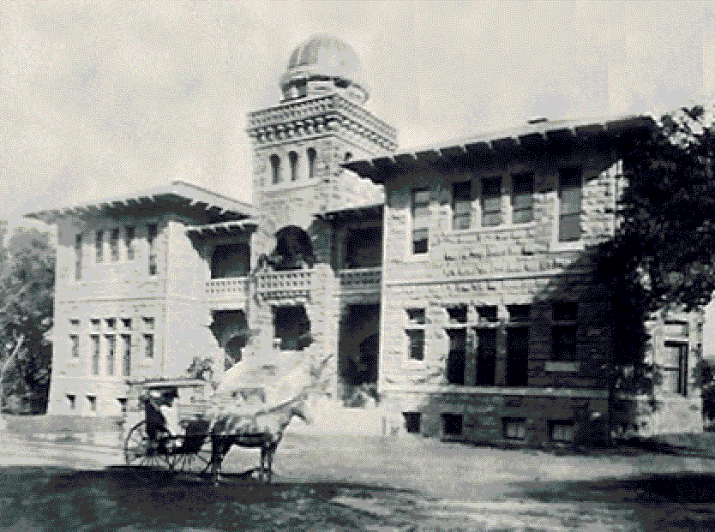
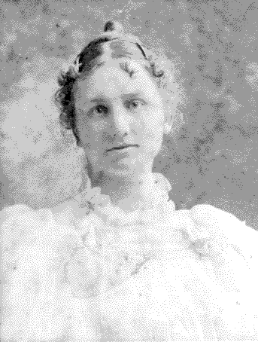
PUNAHOU ACADEMY
Founded 1841

Slide 27
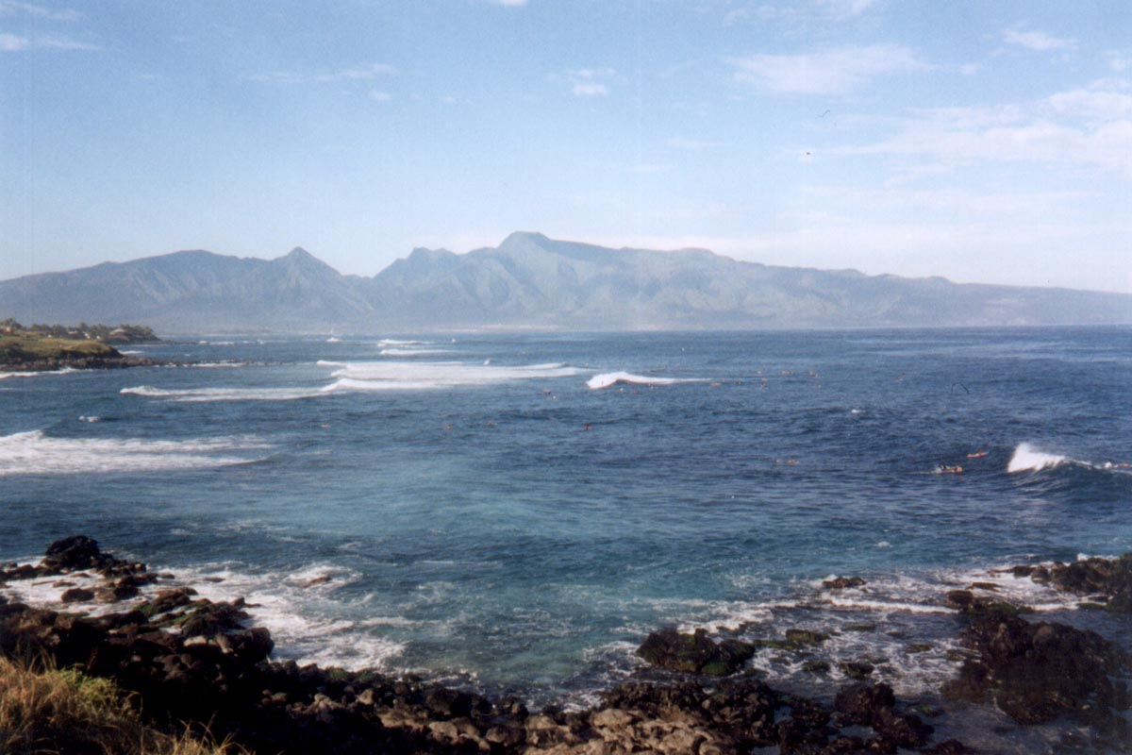

Slide 28
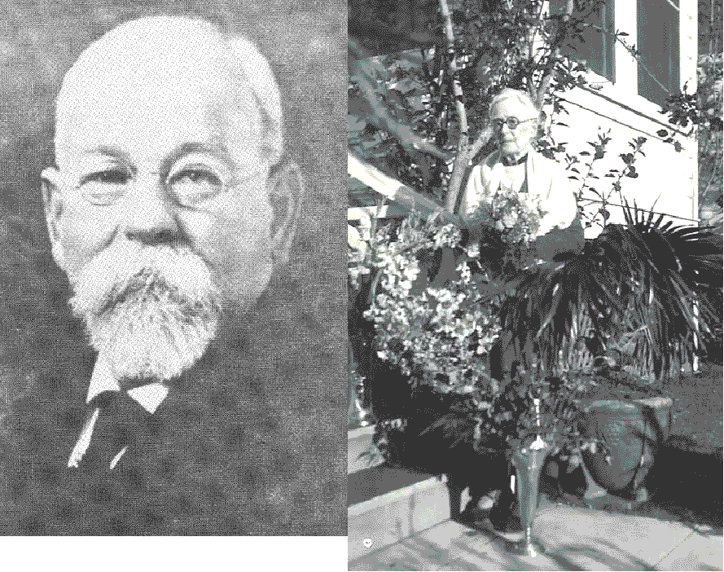
“Father of Maui” Henry Perrine Baldwin & His Wife Emily

Slide 29



Slide 30
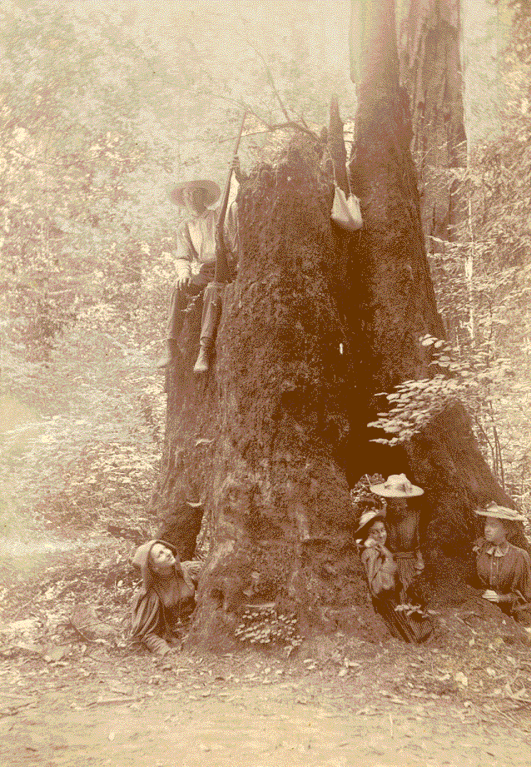
At Camp Azalea in California

Slide 31
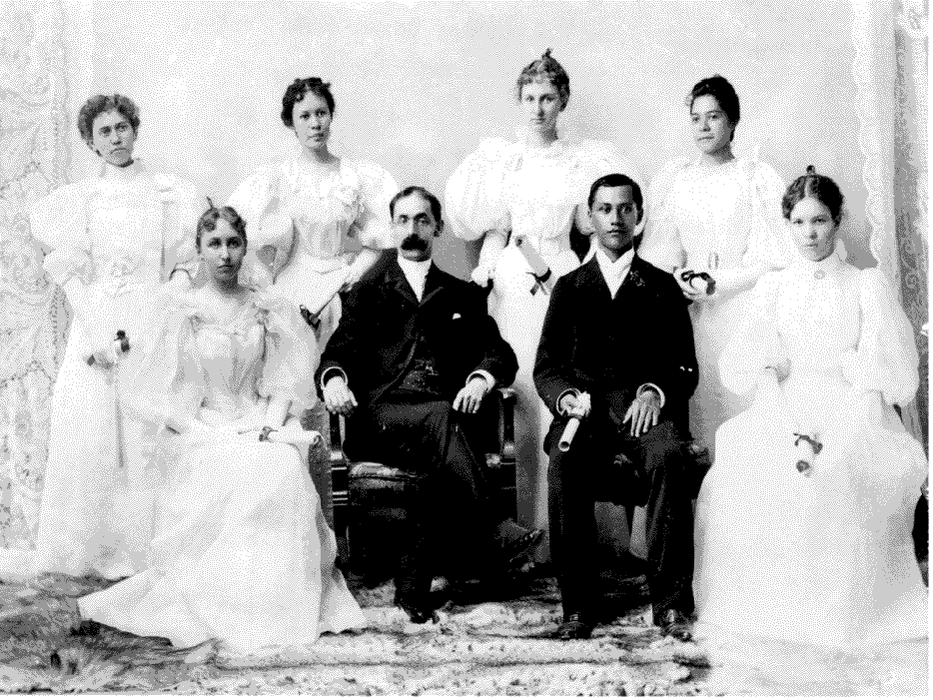
PUNAHOU GRADUATION 1895
Agnes
Ada Whitney
Agnes’ graduation essay “Our Poor Relations” was on kindness to animals

Slide 32
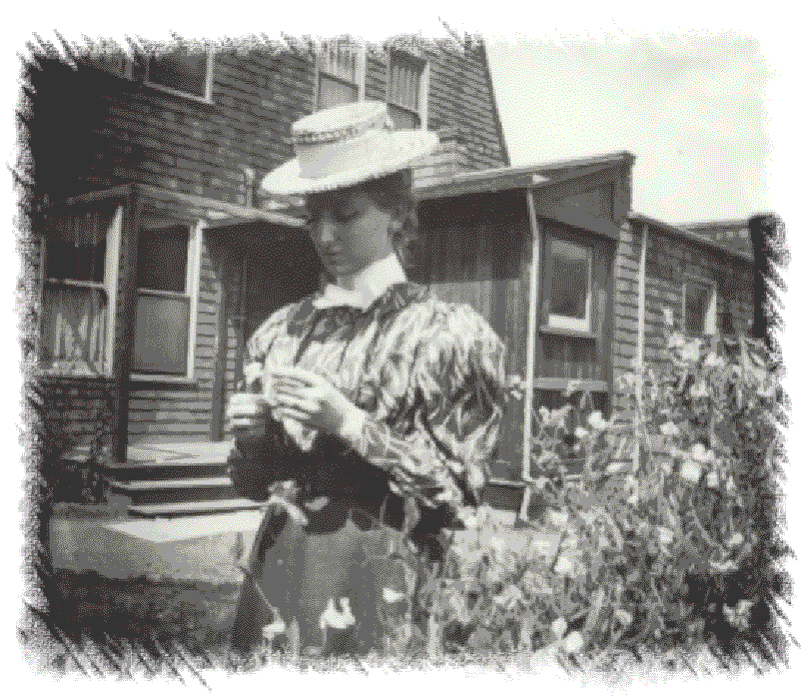

Slide 33
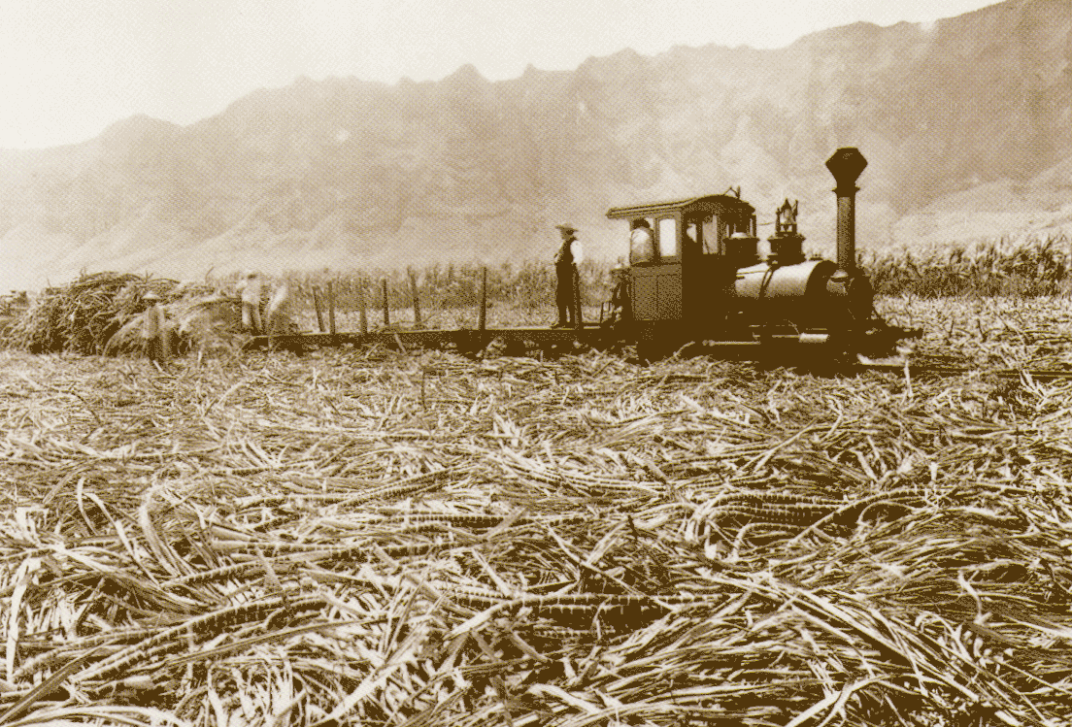

Slide 34

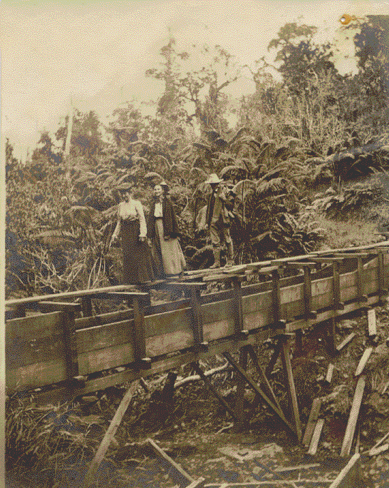
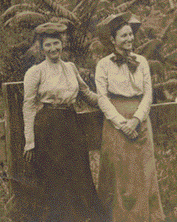
Mary & Agnes

Slide 35
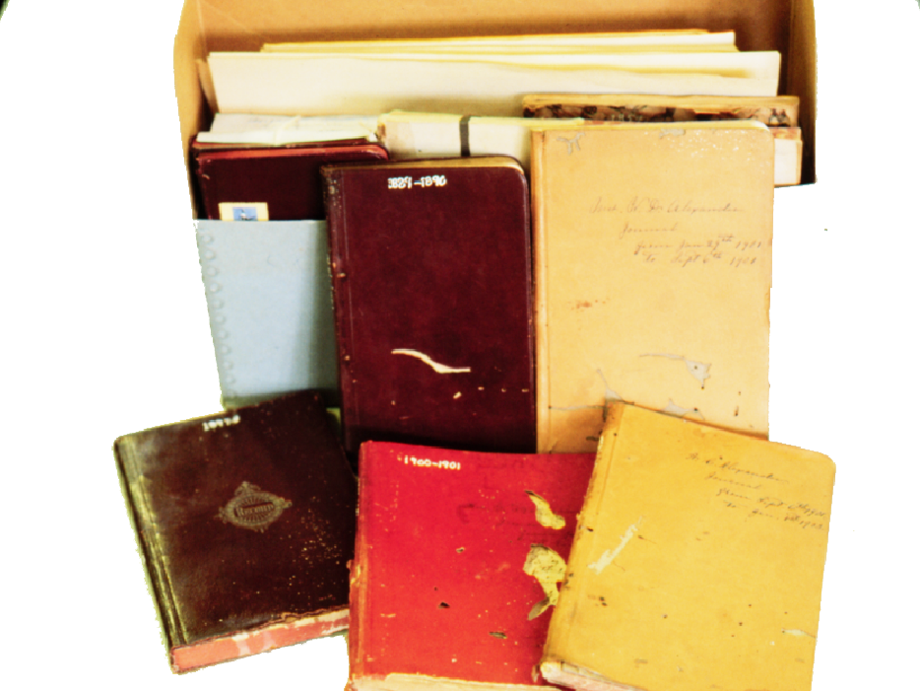
Diaries of Agnes’ Mother

Slide 36
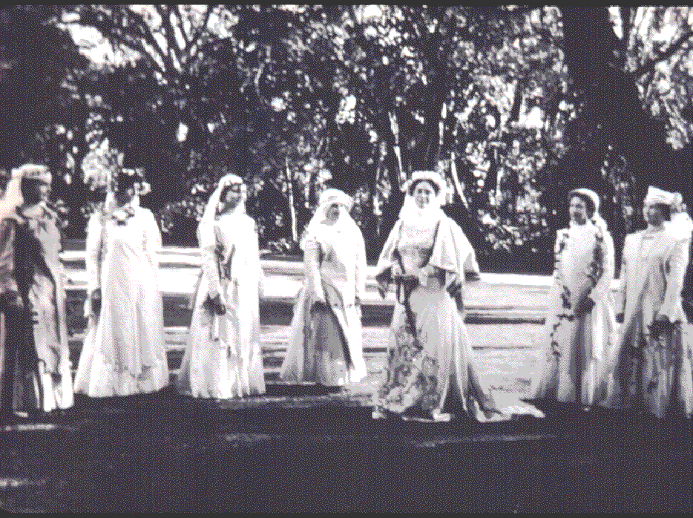

Slide 37
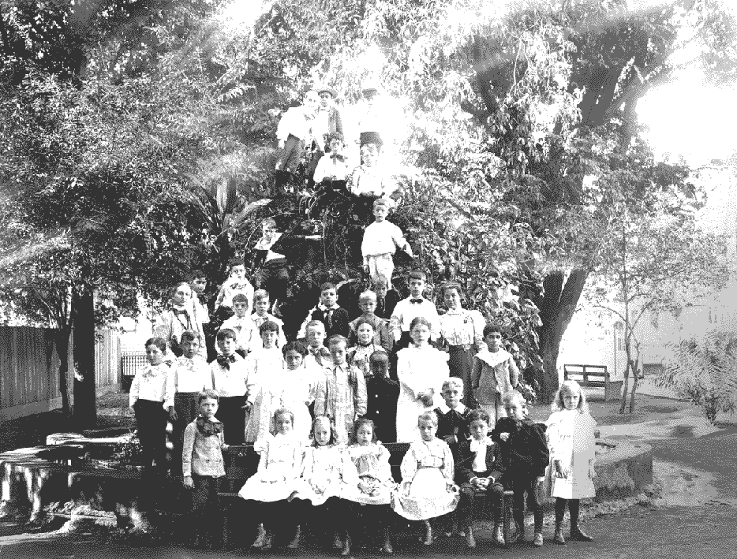
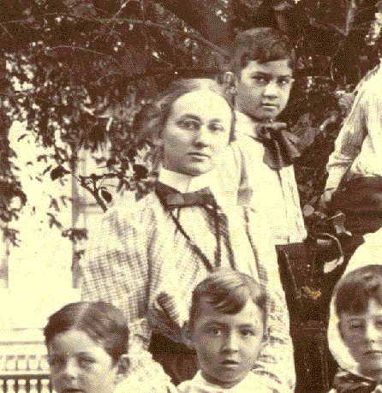

Slide 38
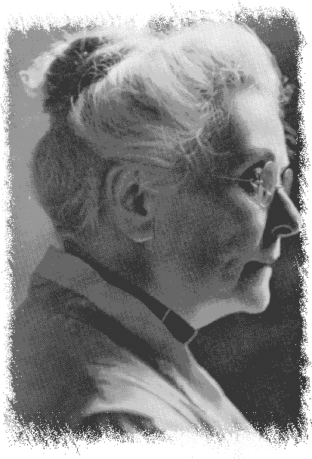
ANGNES GOT A TICKET FROM HER EMILY ALEXANDER “AUNT EM” OF MAUI.

Slide 39
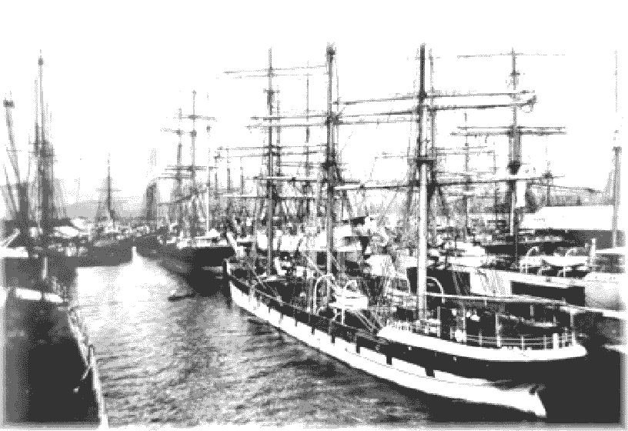
HONOLULU HARBOR
5 May 1900

Slide 40

EUROPE

Slide 41
Henry Edward Mansfield Alexander
Died at Napa, California, Aug 22, 1900

Slide 42



Slide 43

In late November 1900 Agnes Alexander was staying in a pension in Rome when she noticed a radiant lady and her two daughters.

Slide 44

Mrs. Charlotte Dixon of Maryland

Slide 45

‘Abdu’l-Bahá
Head of Bahá’í Faith from 1892-1921

Slide 46


Slide 47


Slide 48

The third evening after meeting with Mrs. Dixon, when I retired to my room, sleep did not come. That night an overwhelming realization came to me, which was neither a dream nor vision, that Christ had come on the earth.

Slide 49

All night I waited, unable to close my eyes. When morning came, I met Mrs. Dixon as she came from breakfast, and together we entered my room. There I turned to her and said, "Christ is on this earth!" She replied, "Yes, I can see by your face that you know it." In a Tablet which I later received from 'Abdu'l-Bahá, He wrote: "By God, the Truth, the Spirit of Christ from the Supreme Concourse doth in every time and aspect announce to thee this Great Good News.

Slide 50


Agnes

Slide 51

PARIS
March 1901

Slide 52


Slide 53

Bahá’ís of Europe in Paris – 1902
The ‘Spiritual Heart’ of the European Continent

Slide 54

MAY BOLLES

Slide 55

The Prison City of ‘Akká - 1898

Slide 56

May Bolles (Maxwell)
"Of that first meeting, I can remember neither joy nor pain, nor anything that I can name. I had been carried suddenly to too great a height, my soul had come in contact with the Divine Spirit, and this force, so pure, so holy, so mighty, had overwhelmed me ... We could not remove our eyes from His glorious face … existence seemed suspended; and when He arose and suddenly left us, we came back with a start to life; but never again, oh! never again, thank God, the same life on this earth.”

Slide 57


Slide 58


Sarah Farmer Inn
at Green Acre Bahá’í School

Slide 59

Mírzá Abu’l Fadl

Slide 60

Agnes Baldwin Alexander
Photograph taken December 1901
Shortly before sailing to Honolulu

Slide 61


Be … a divine bird, proceed to thy native country, spread the wings of sanctity over those spots and sing and chant and celebrate the name of thy Lord, … and make the seeking souls hasten unto thee as the moths hasten to the lamp, and thus illumine that distant country by the light of God.

Slide 62

Strange feelings came over me as the steamer on which I voyaged to Honolulu neared the shore, for alone I was to stand there, the first Bahá‘í to touch that soil. The youngest of my family, and hitherto extremely timid, God raised me up to carry His Message to these islands of the Pacific.

Slide 63

Among my relatives a rumor had spread that I had taken up some strange belief. I had them to show through my life, and not by words, the great happiness that had come into my life.

Slide 64

Ada
Agnes
HOMECOMING

Slide 65



Slide 66
Arthur Chambers (Brother)
Agnes
William Douglas (Oldest brother)
Mary Hillebrand (Sister-in-law)

Slide 67

ADA WHITNEY WEINRICH
No doubt the first to learn about Bahá’u’lláh from Agnes upon her return

Slide 68

ELIZABETH MUTHER
1858-1940
First on Hawaiian soil
to embrace the Bahá’í Faith (1902)

Slide 69



Slide 70

KANICHI YAMAMOTO
1879-1961
1st Japanese Bahá’í in the World

Slide 71

Muther
Alexander
Yamamoto

Slide 72

Charles Mason Remey
Howard Struven
NOV-DEC 1909

Slide 73


Virginia & Agnes

Slide 74


Slide 75

Mrs. Augur
Dr George J. Augur

Slide 76


Slide 77

Pacific Commercial Advertiser
Honolulu, Hawaii, Territory, Monday, November 29, 1909
WOULD UNITE MANKIND
Followers of the Baha Explain Their expectations. UNIVERSAL PEACE IS COMING World Arriving at Spiritual Maturity, and War Will Be Banished.
The establishment of a universal religion…

Slide 78



THE PACIFIC COMMERCIAL ADVERTISER, HONOLULU, TUESDAY, NOVEMBER 30, 1909
WHAT THE “BAHAI”
MOVEMENT REALLY IS

Slide 79


Slide 80


1913
Agnes’ parents die within 3 months of each other

Slide 81

Agnes sails to the US Mainland

Slide 82

Agnes travels to Montreal, Canada to spend time with her spiritual mother

Slide 83


May Maxwell
Mary Maxwell
(later ‘Amatu’l-Bahá)

Slide 84

Agnes was in NYC when a Tablet came from ‘Abdu’l-Bahá to travel “toward Japan”

Slide 85

EUROPE
N. AMERICA
New York
Italy
ATLANTIC OCEAN
AFRICA
S. AMERICA

Slide 86

ITALY
Milan
ITALY
Genoa

Slide 87


Agnes’ Uncle Guido Ferrari and Aunt “Lottie” of Milan

Slide 88

SWITZERLAND
Geneva
Milan
ITALY

Slide 89

June 28, 1914
Assassination of the Archduke Ferdinand

Slide 90

BOARDING HOUSE FOR YOUNG LADIES
VILLA “LES PAQUERETTES”
GENEVA
August 1914

Slide 91

“Unforeseen Calamity”

Slide 92

Agnes was ‘stuck’ in Switzerland as WWI began to rage. She was unable to cash her bank drafts, and her funds were running out; her trunk had gone missing enroute and she turned to prayer and was guided to a friend in Geneva and then came a Tablet from the Master

Slide 93

It is now … advisable for thee to depart directly to Japan and while there be engaged in the diffusion of the fragrances of God.
-’Abdu’l-Bahá

Slide 94


From Lyon to Marseilles Agnes travelled with 2 wounded soldiers in the coach

Slide 95

Miyazaki Maru
Marseilles – Kobe, Japan

Slide 96

SEPT 19 – NOV 1, 1914
Marseilles
EUROPE
Kobe
ASIA
AFRICA
Port Said
Hong Kong
Aden
Colombo
Singapore

Slide 97
NOVEMBER 1ST, 1914
ARRIVES IN KOBE

Slide 98

Agnes
Dr Augur

Slide 99



Slide 100

Words of Mr Fukuta s
1st Bahá’í on Japanese soil
“O my Master ‘Abdu’l-Bahá! How great mercy and benevolence that Thou has descended upon us through an apostle Alexander! Thou I am a base and poor youth … I am being awakened and bathed in the ocean of Thy mercy,… Water me forever with the fountain of mercy; …
s

Slide 101

Agnes and Vasily Eroshenko, a blind Russian who taught her Braille in English & Esperanto 1915

Slide 102

Miss Alexander
Of all the trips I have taken in Japan … [the] one [that] brought the greatest blessing and joy which [has] extended and increased throughout the years spent in that country. It was the door which opened to the blind of Japan the Cause of God, bringing them Eternal Life. [It was the trip to the seashore at Ejiri in 1916.]

Slide 103

The beach at Ejiri, Japan – 1916
Mr Torii, a ‘blind’ man wrote the following …
One morning as I was walking on the beach “there came a messenger of the Kingdom of Abhá and lifted the veil of my soul. … Every word she spoke to me was wonderful and luminous. It dispelled the darkness from my soul, brought fragrances to my heart like the breeze from the green fields, and made my inner sight keener and fresher than ever. This messenger who made me see the Sun of Reality was indeed Miss Agnes B. Alexander, my beloved spiritual mother …”

Slide 104

Mr Torii the ‘blind’ man who walked at Ejiri in 1916 and his wife with Agnes Alexander

Slide 105

Agnes spent the next 2 years in Hawaii and the US Mainland

Slide 106

Agnes
Harry
Randall
Martha

Slide 107

1919
Unveiling the Tablets of the Divine Plan
MCALPIN HOTEL
NEW YORK CITY
Mary Maxwell, 8

Slide 108

O THOU daughter of the Kingdom!
Although thy letter has not yet been received, yet we do answer it.

Slide 109

In accordance with the wish of the attracted maid servant of God to the love of God, Mrs. Maxwell, go thou to Canada and stay there for a time and then hasten back to Japan, for in Japan you will be assisted and exalted.
Juliet
Thompson
May Maxwell
Notes:
May Maxwell’s company ‘uplifts and develops the soul”

Slide 110

JAPAN
KOREA
Seoul
Tokyo
Agnes is the Herald for KOREA
1921

Slide 111

MR OH!
KOREA

Slide 112




Slide 113

Agnes with Korean believers in 1921

Slide 114


‘Abdu’l-Bahá ascended 28 November 1921

Slide 115


In His great love and mercy He left a Tablet for the new friends of Korea and one to me. Pray … that I may fulfil His Hope in Korea and may be selfless at His Door.
Agnes’ letter to a Bahá’í Friend about ‘Abdu’l-Bahá’s passing

Slide 116

In His Will & Testament ‘Abdu’l-Bahá named Shoghi Effendi, Guardian and Head of the Faith

Slide 117

I recall so vividly the radiant joy that transfigured His Face whenever I opened before Him your supplications ... These are His very words, that still keep ringing in my ears:—"Japan will turn ablaze! Japan is endowed with a most remarkable capacity for the spread of the Cause of God”
Shoghi Effendi:

Slide 118

To Agnes personally the Guardian wrote:
“I feel that your destiny lies in” Japan “where your noble and pioneer services future generations will befittingly glorify and thankfully remember.”
Shoghi Effendi
Notes:
Altogether ABA received 69 letters from the Guardian

Slide 119
Honolulu Advertiser
EXTRA! EXTRA! September 1, 1923
Flames Sweep World’s Largest City When Earthquake And Tidal Waves Strike Japan
DOWNTOWN SECTION WIPED OUT
A spokesman for the International Red Cross promised relief supplies would be airlifted as soon as conditions permit.
Count P.W. Tanaguichi met with military authorities today to set up security zones in the areas most seriously affected by the quake.
… CONT’D P B8
Tokyo fell victim to a violent earthquake just before noon today. Two-thirds of Toyo burned when thousands of wood-fueled cooking fires spread flames throughout the city . Thousands have lost their lives and the body count continues to rise. Nearly one million people are homeless. Scarcely anything can be found to eat.

Slide 120

The Lord has surely kept you safe amid the crumbling walls of that great city of Japan, that you in turn might accomplish the task that lies before you and I never doubt that you are surely worthy of His Grace.
The Greatest Holy Leaf

Slide 121


Martha
Agnes
Sept – Dec 1923
Agnes joined Martha for teaching in China

Slide 122

Beijing (Peking)
YELLOW SEA
Yenti
CHINA

Slide 123


Slide 124

Yenti
CHINA
YELLOW SEA
“There is no end to China!”
Nanking
Shanghai

Slide 125


Altogether Agnes Alexander spent more than 30 years doing Bahá’í work in Japan.

Slide 126

Last time in China with Martha - 1930

Slide 127
SOJOURNS IN HAWAII
1917 - 1919
1924 -1928
1933 - 1935
1937 - 1950

Slide 128

1937 PILGRIMAGE
I would be pleased to meet you face to face at this Holy Spot.
Your true brother, Shoghi

Slide 129


“Mary Maxwell!”
“The Guardian is married and you will never guess to whom.”
Aziz Yazdi
Port Said, Egypt
Notes:
Agnes’ answer is all the more extraordinary when one considers that no one had the slightest intimation that the Guardian was planning to marry at all!

Slide 130

Mary Sutherland Maxwell
1910-1937
Amatu’l-Bahá
Rúhíyyih
Khánum
1937-2000

Slide 131

Pilgrimage to Bahá’í Shrines in Israel
Shrine of the Báb in 1937

Slide 132


Slide 133

“The immediate future of Japan is very dark. Japan is going to suffer. … The Pacific will become a great storm center in the coming war – great suffering.
- The Guardian

Slide 134
Books written by Agnes Alexander at the request of Shoghi Effendi
Forty Years of the Bahá’í Cause in Hawaii: 1902-1940
History of the Bahá’í Faith in Japan: 1914-1938

Slide 135


1939-1945

Slide 136


THE PASSING OF MAY MAXWELL – 1 MARCH 1940
“From the time May met her Lord and “beheld the King in His Beauty” her whole being was kindled with the divine flame… … Countless are the souls who have been ignited through her divine love.
1870-1940

Slide 137

HAWAII SOJOURN
1937-1950

Slide 138

Agnes
THE BAHA’IS OF MAUI
1937

Slide 139

RETURN TO JAPAN IN 1950

Slide 140

AGNES ALEXANDER, DISTINGUISHED PIONEER FAITH, ELEVATED RANK HAND CAUSE. CONFIDENT APPOINTMENT WILL SPIRITUALLY REINFORCE TEACHING CAMPAIGN SIMULTANEOUSLY CONDUCTED NORTH, SOUTH HEART PACIFIC OCEAN.
SHOGHI
HAIFA, MARCH 27, 1957

Slide 141

PASSING OF SHOGHI EFFENDI IN LONDON, BURIAL GREAT NORTHERN CEMETARY ON 9 NOVEMBER 1957

Slide 142

First conclave of the Hands was held from 18-25 November, 1957

Slide 143

Agnes was chosen to read the prayer that immediately proceeded the election of the Universal House of Justice in the House of ‘Abdu’l-Bahá
April 21, 1963

Slide 144

1964
HAWAII’S BAHA’IS ELECT THE FIRST NATIONAL SPIRITUAL ASSEMBLY OF THE BAHA’IS OF THE HAWAIIAN ISLANDS

Slide 145


CONVENTION WAS HELD AT THE NATIONAL CENTER
3264 ALLAN PLACE
HONOLULU
APRIL 1964

Slide 146

Governor John Burns bestows a kiss and a lei upon Miss Alexander at the Princess Kaiulani Hotel on the eve of the election

Slide 147

Miss Alexander with the members of the newly-elected NSA of the Hawaiian Islands

Slide 148

Jack Smith
Claude Caver
Hugh Chapman
Michael Woodward
James Wada
Evyln Musacchia
Lei Chapman
Gertrude Garrida
Elena Marsella
Velma Sherill
USA

Slide 149

First LSA of Wahiawa- 1964

Slide 150


Slide 151

AGNES ALEXANDER IN JEKEI IDAI UNIVERSITY HOSPITAL
TOKYO, JAPAN 1965-1967

Slide 152

THE ARCADIA
1967-1971
HONOLULU
PUNAHOU ST

Slide 153


Slide 154


Slide 155

The view from Agnes’ window looked down on the very property on which she was born and grew up

Slide 156

PROFOUNDLY GRIEVE PASSING ILLUMINED SOUL HAND CAUSE AGNES ALEXANDER LONGSTANDING PILLAR CAUSE FAR EAST FIRST BRING FAITH HAWAIIAN ISLANDS
-THE UNIVERSAL HOUSE OF JUSTICE
January 1, 1971

Slide 157


Slide 158


Slide 159


Slide 160


Slide 161

“At this time, in the island of Hawaii, through the efforts of Miss Alexander, a number of souls have reached the shore of the sea of faith! Consider ye, what happiness, what joy is this! I declare by the Lord of Hosts that had this respected daughter founded an empire, that empire would not have been so great! For this sovereignty is eternal sovereignty and this glory is everlasting glory.”
-’Abdu’l-Bahá

Slide 162

THE BEGINNING.

Slide 163

AGNES BALDWIN ALEXANDER AWARD FOR SERVICE TO HUMANITY

Slide 164

A FEW PAST AWARDEES:
Judge Betty M. Vitousek, Dr Kenneth Pike Emory, Gladys A. Brandt, Albert K. Sing, Juliette May Fraser, Mary Kawena Puku’i …

Slide 165

August 1968
Duane Troxel
Stephanie Fielding

Slide 166
ABA 1833-1875

Slide 167
ABA 1900 - Rome

Slide 168


Originally written for “The Fire in the Pacific” Conference held in Honolulu, HI 2001. 2nd showing Green Acre 2006.
© 2001 Duane K. Troxel Digital Transformations Ltd.

